Slide 1
Ontology-based representation and comparison of COVID-19 vaccine phase III clinical trials
Asiyah Lin, Philip Huang, Anthony Huffman, Yongqun “Oliver” He

Slide 2
Background
Safe and effective vaccines are essential to ultimately control the COVID-19 pandemic.
As of Oct. 15, 10 vaccines are in phase III clinical trials, 32 vaccines are in phase I or phase II clinical trials, 156 candidates are in pre-clinical phase. (WHO DRAFT landscape of COVID-19 candidate vaccines)
Many questions for consumers:
Why some vaccine trials are paused?
Why some vaccine trials are re-opened?
Will I get a COVID 19 vaccine?
What if the COVID 19 vaccine is harmful to myself?
So many companies are working on vaccines, which one to choose?
Are the vaccines tested on black brown yellow people etc.?

Slide 3
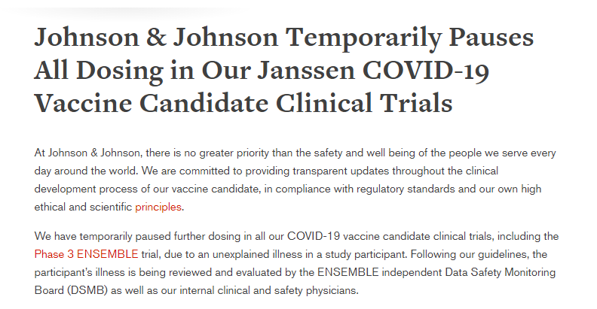
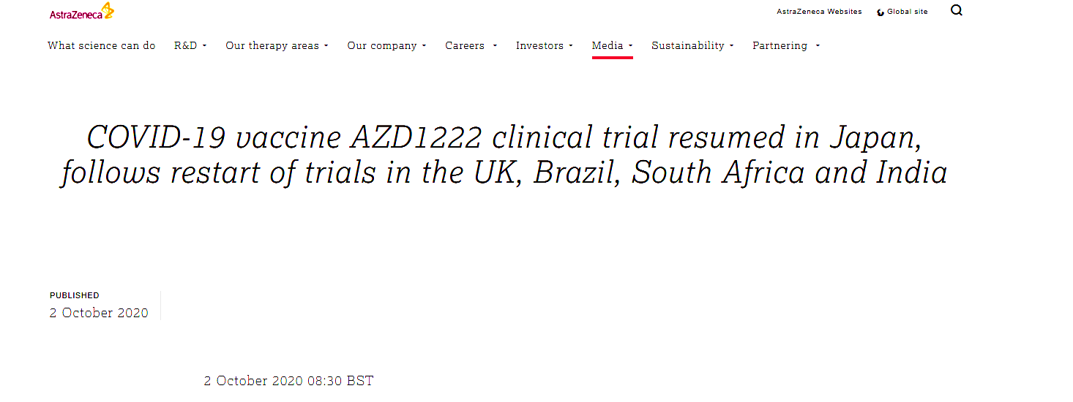
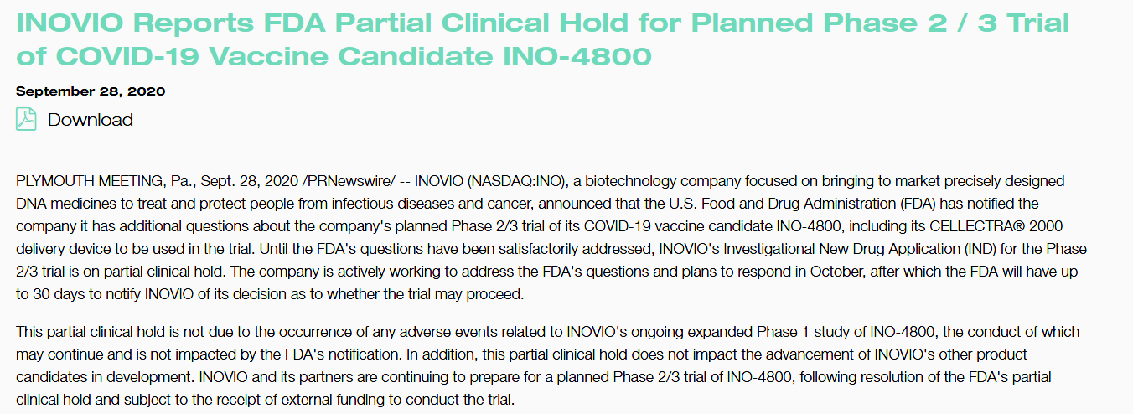
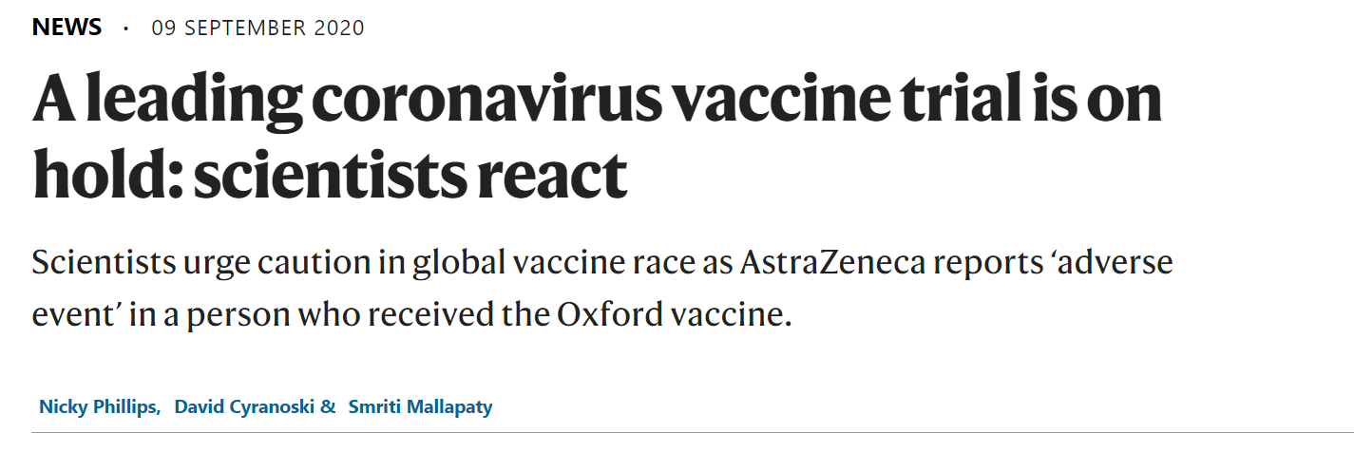
COVID 19 Vaccine Information for Consumers
News are confusing
Consumers need data or science-based information to make well-informed decision

Slide 4
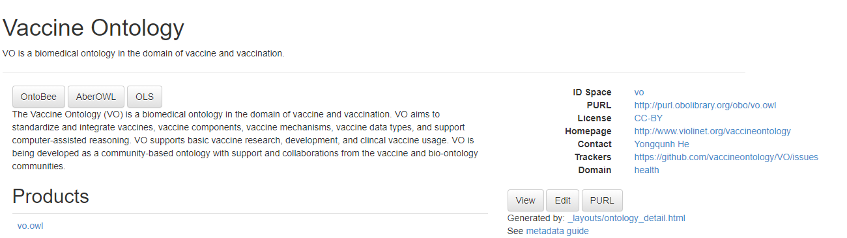
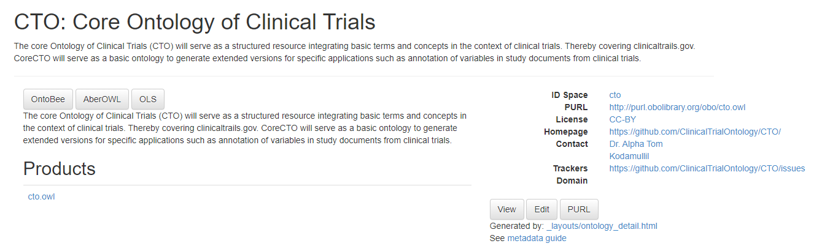
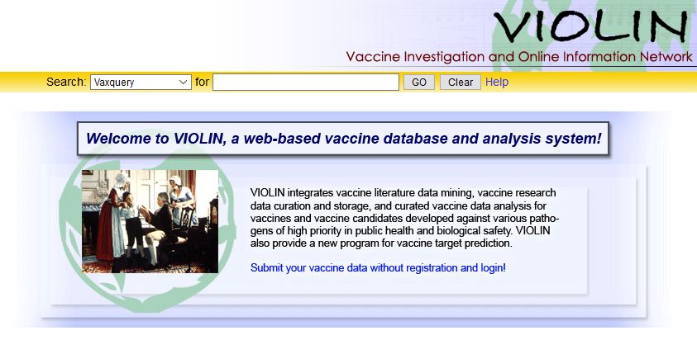
Vaccine Ontology (VO), Clinical Trial Ontology (CTO) & VIOLIN

Slide 5
COVID 19 Vaccines in VO
22 Vaccines included.
Vaccines included if listed by clinical trial or peer-reviewed journal for source.
Almost all vaccines use a variant of S protein or whole virus as an antigen (ZyCoV-D has envelope protein).
Vaccines for human clinical trial
Macaques and mice common research test model
Vaccine Role | Amount
DNA Vaccine | 4
Recombinant Vector | 5
RNA Vaccine | 6
Subunit Vaccine | 2
Virus-Like Particle Vaccine | 1
Whole Organism Vaccine | 4

Slide 6
COVID 19 Clinical Trials (Phase III)

Slide 7
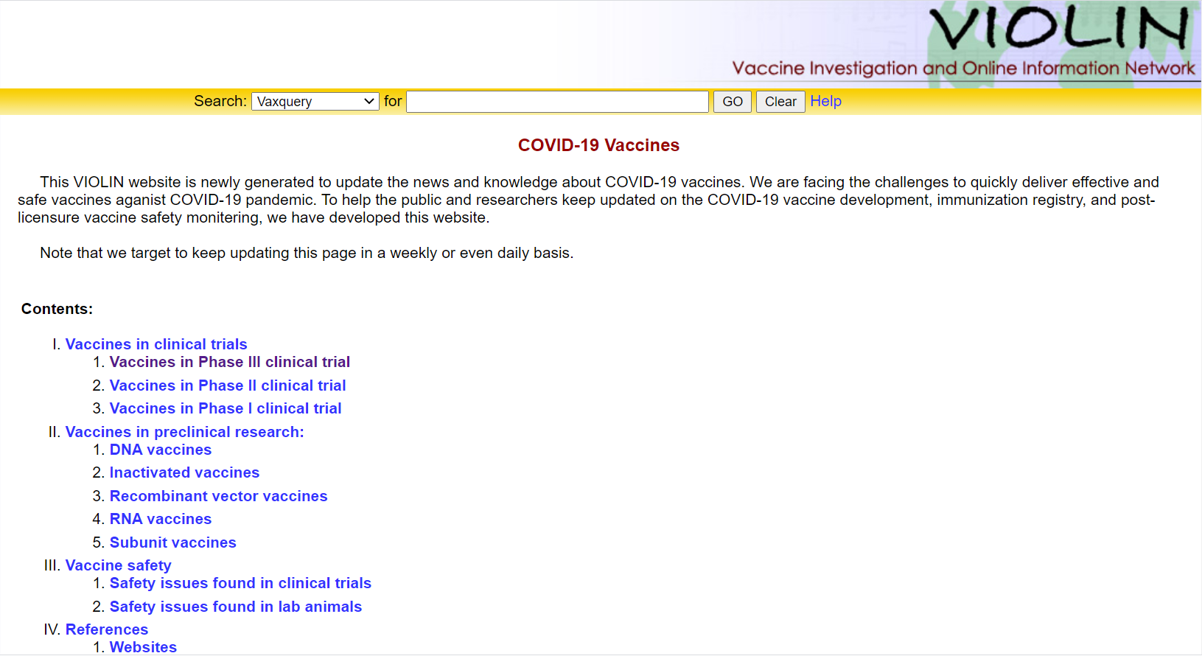
VIOLIN COVID 19 Vaccines

Slide 8
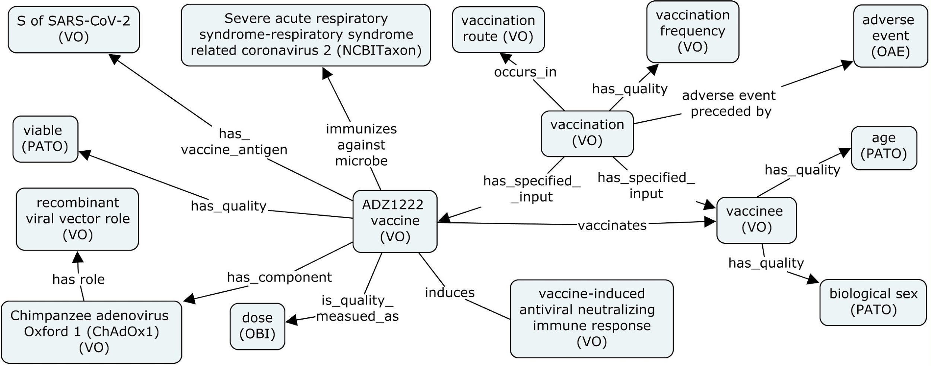
ADZ1222 (ChAdOx1 nCoV19)

Slide 10
Future Directions

