Slide 1
CIE ACTIVITY – 2
TOPIC: IR PERIPHERAL ON DE-10 BOARD

Slide 2
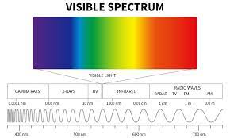
INFRARED RADIATION

Slide 3
INFRARED RADIATION
WHY IR OVER OTHER RADIATIONS IN THE SPECTRUM?
IR has higher wavelength than visible light and hence can travel longer distances giving it the ability to pass through dense regions without significant scattering→ RAYLEIGH’S LAW
WHEN NOT TO USE IR?
The main limitation of IR would be its dependency on LOS(line of sight) and also large exposure to IR can harm the human eye

Slide 4
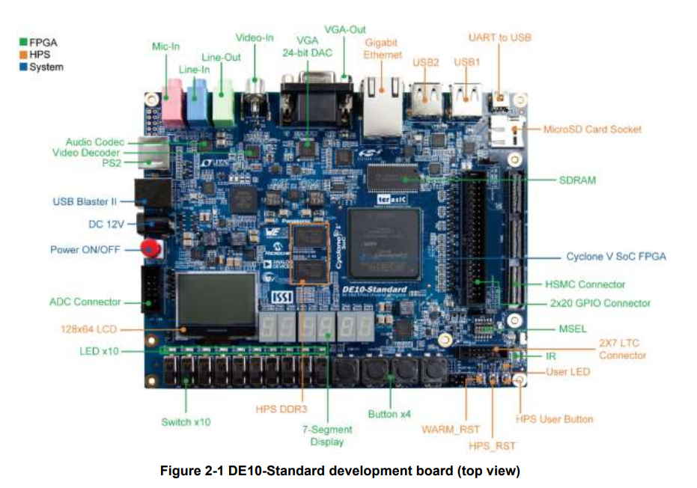
INFRARED RADIATION

Slide 5
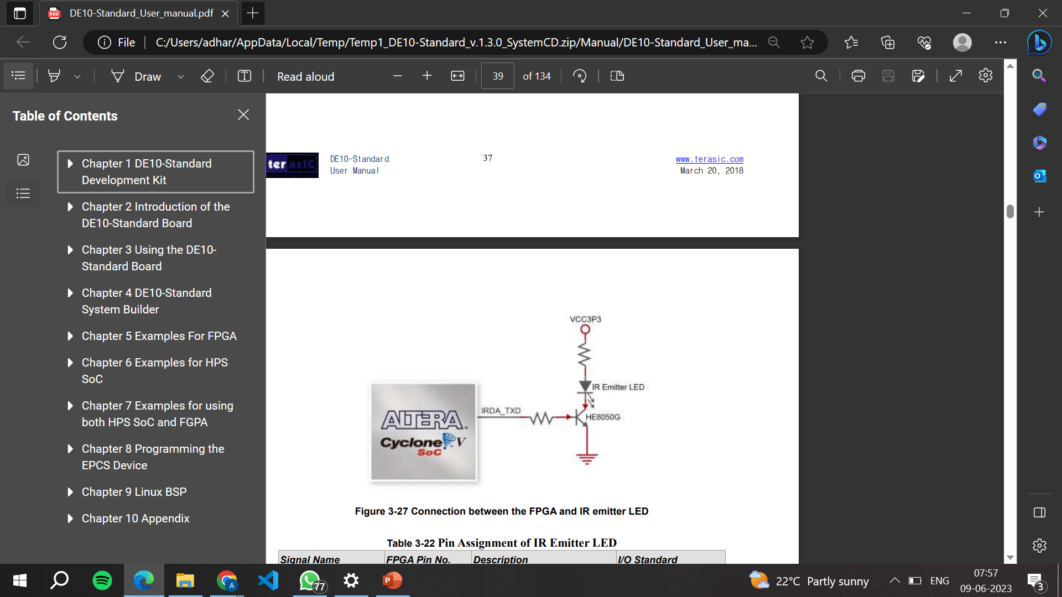
INFRARED RADIATION
Construction of IR emitter in DE-10 board:

Slide 6
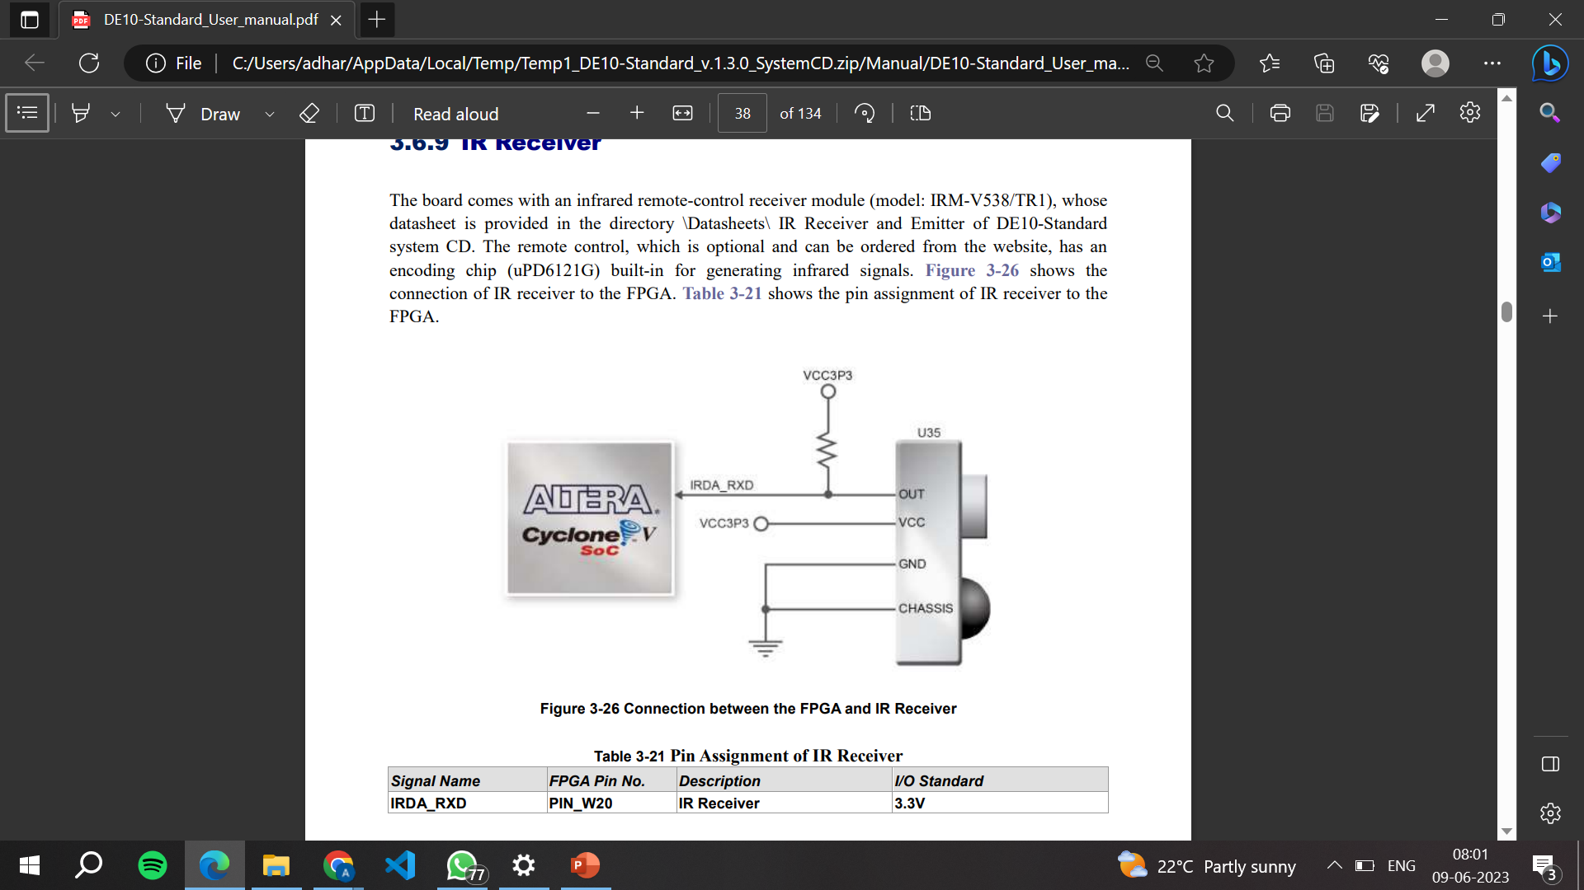
INFRARED RADIATION
Construction of IR receiver in DE-10 board:

Slide 7
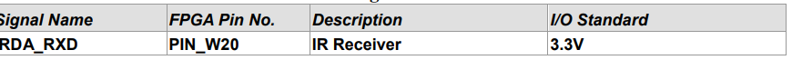
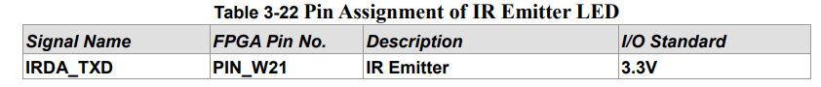
INFRARED RADIATION
WORKING:
The IR emitter and receiver are both part of the IR sensor in the DE-10 board.
The users are also given an option to order a remote controller for generating IR signals from the emitter.
PIN ASSIGNMENT:

Slide 8
INFRARED RADIATION
APPLICATIONS:
Contactless temperature measurement
Wearable gas detection devise
Motion sensors and other security applications
DISADVANTAGES:
The most prominent disadvantage of using IR would be that it’s working is limited to the LOS- Line Of Sight
The other disadvantages are prolonged exposure being harmful, not being able to pass through dense solids and so on.

Slide 9
INFRARED RADIATION
The next step/improvement of an IR sensor would be an ultraviolet sensor. UV sensors work on the principle of echolocation. If accurate and reliable proximity detection is required then UV sensors woi=uld be the better option.

Slide 10
THANK YOU

