Slide 1
Living Data Project: Range Shifts of the Black-capped Chickadee
Rory Macklin
Jankowski Lab
UBC

Slide 2
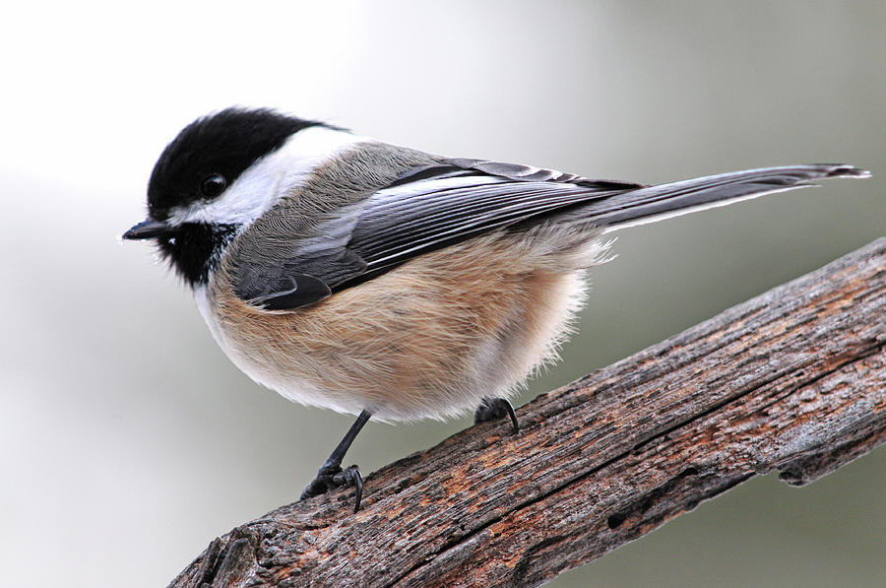
Black-Capped Chickadee: https://images.fineartamerica.com/images/artworkimages/mediumlarge/2/poecile-atricapillus-mike-martin.jpg

Slide 3
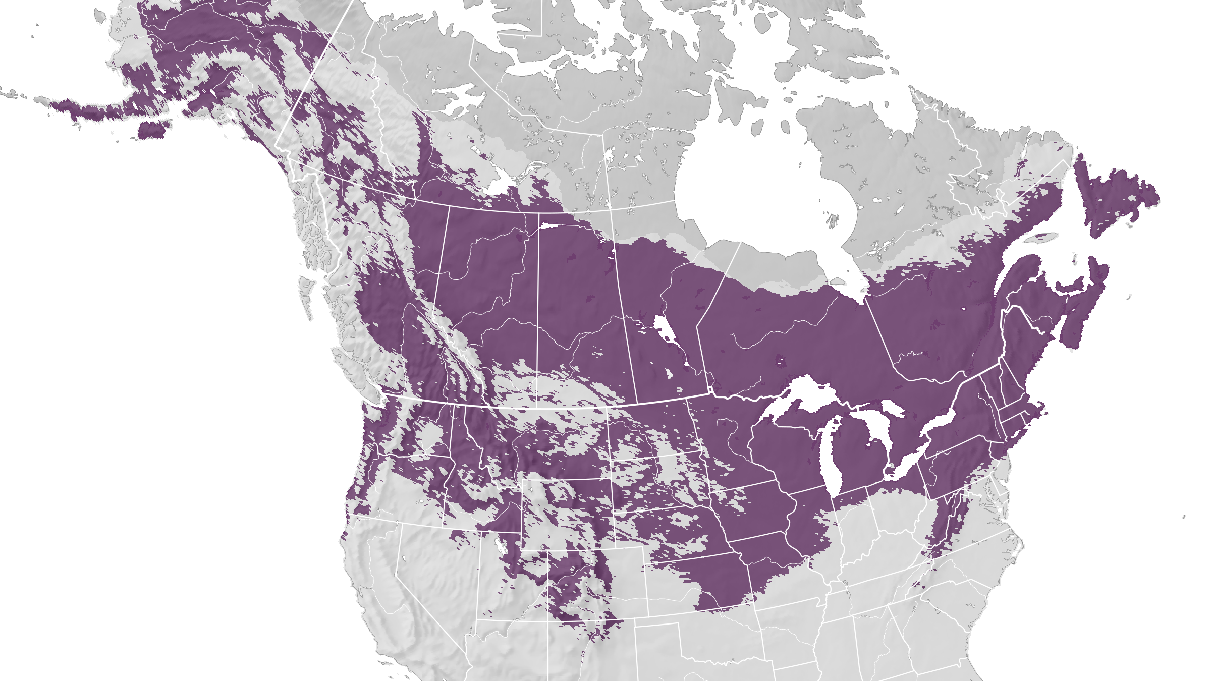
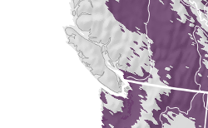
Fink, D., T. Auer, A. Johnston, M. Strimas-Mackey, O. Robinson, S. Ligocki, W. Hochachka, L. Jaromczyk, C. Wood, I. Davies, M. Iliff, L. Seitz. 2021. eBird Status and Trends, Data Version: 2020; Released: 2021. Cornell Lab of Ornithology, Ithaca, New York. https://doi.org/10.2173/ebirdst.2020

Slide 4
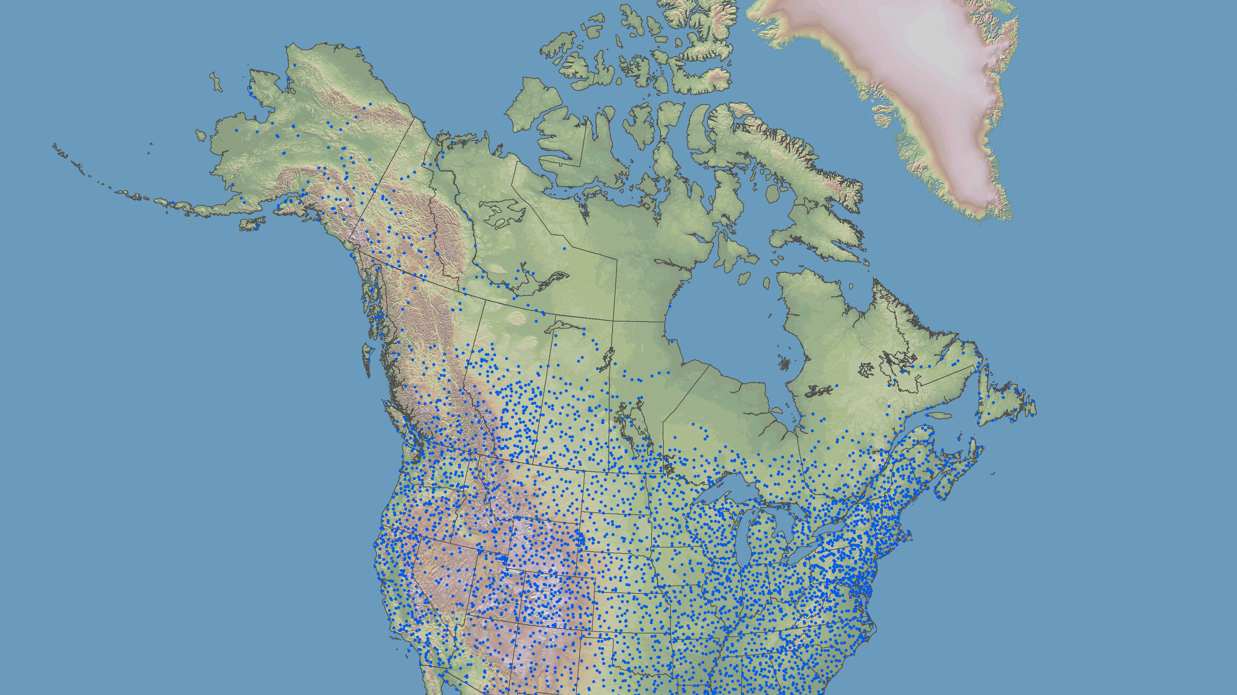
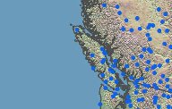
Breeding Bird Survey Route Map:
https://www.usgs.gov/media/images/map-breeding-bird-survey-routes

Slide 5
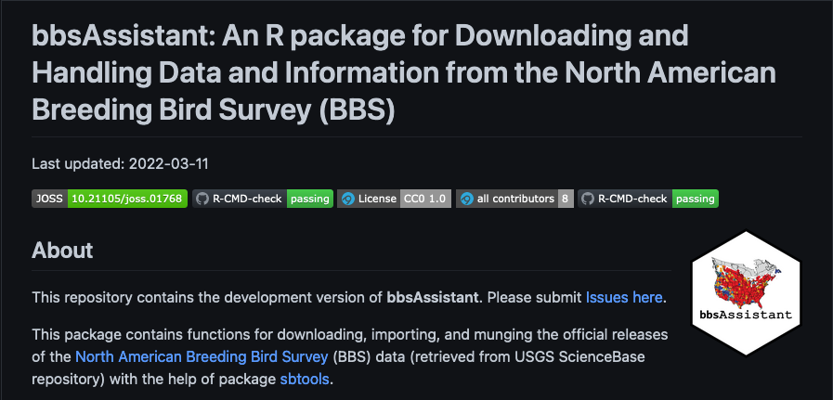
https://github.com/trashbirdecology/bbsAssistant

