Slide 1
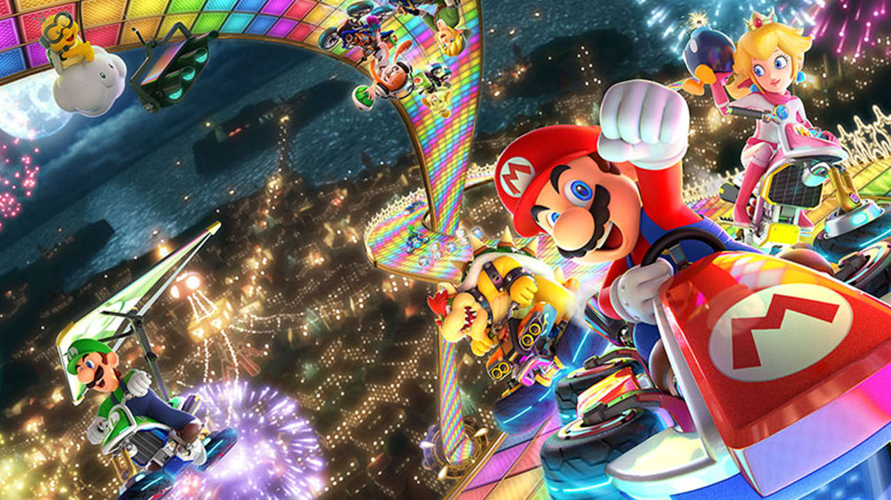
Off to the Races: Optimizing kart builds for each character in Mario Kart 8 Deluxe
Emily Black
Department of Zoology
University of British Columbia
Emily@zoology.ubc.ca
https://www.ign.com/games/mario-kart-8-deluxe

Slide 2
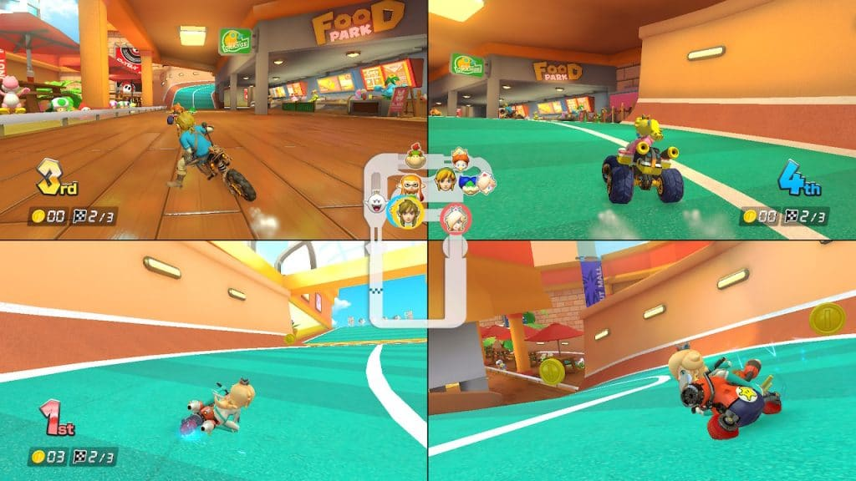
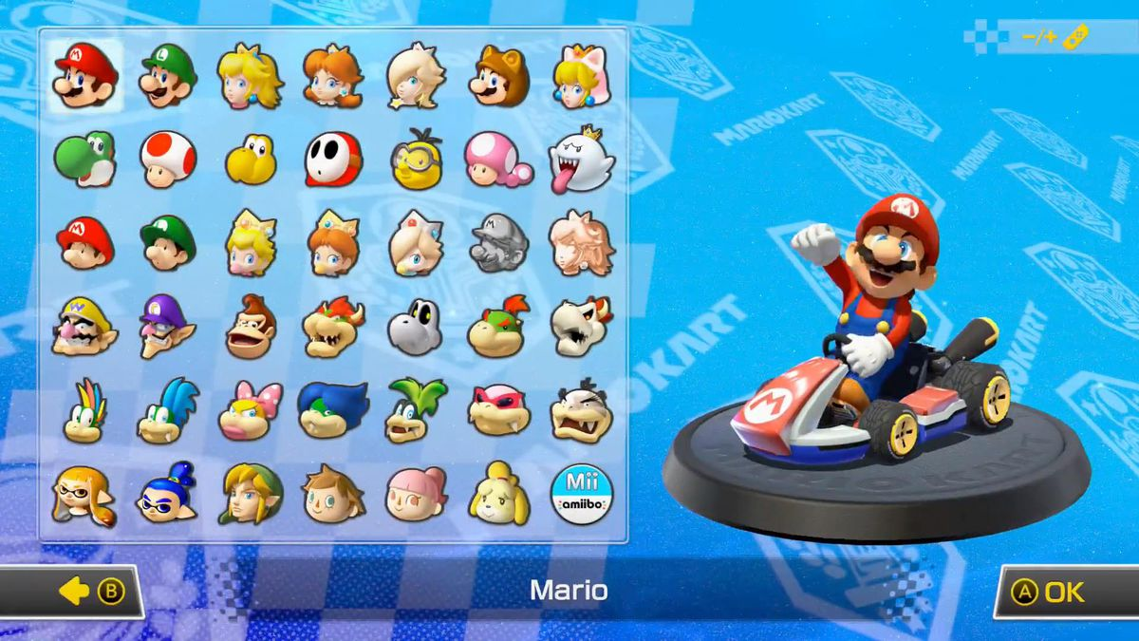
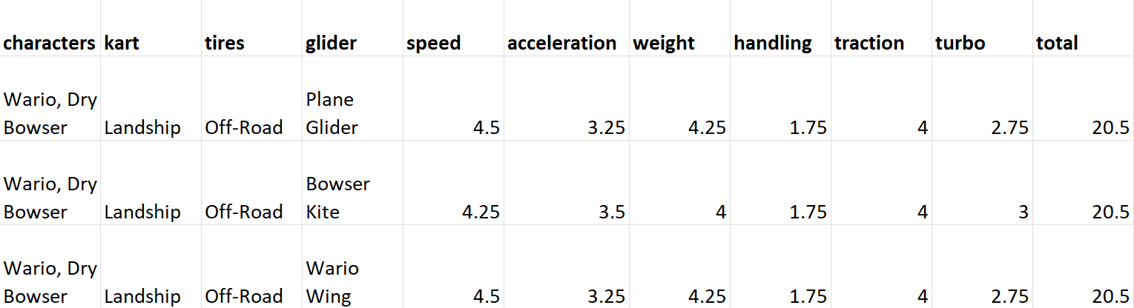
What is Mario Kart 8 Deluxe?
Build
Stats
Characters
https://data.world/databeats/mario-kart-8-deluxe-kart-stats
https://www.youtube.com/watch?v=xhZuu0AmWzY
https://noisypixel.net/mario-kart-8-booster-impressions/

Slide 3
Problem: how do you win races while also choosing a character you like?
Select builds with maximum speed, accel., turbo based on weighted averaging
Output dataset with optimal builds for each character
Use Pareto Optimization to select builds with maximum performance and least loss of traction, handling
Group by character

Slide 4
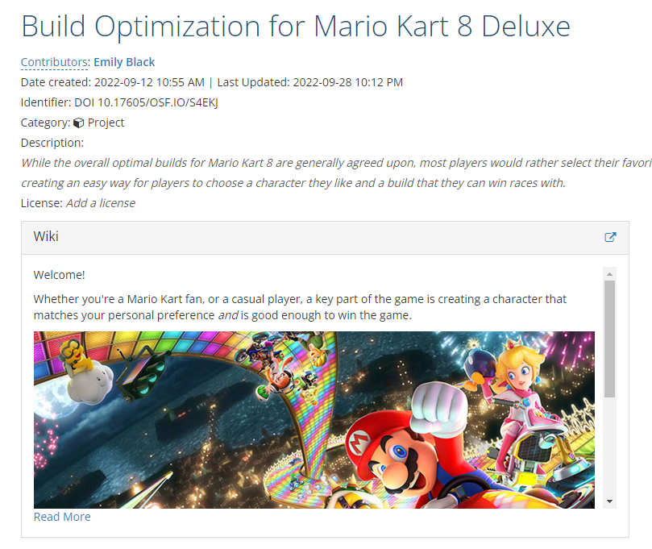
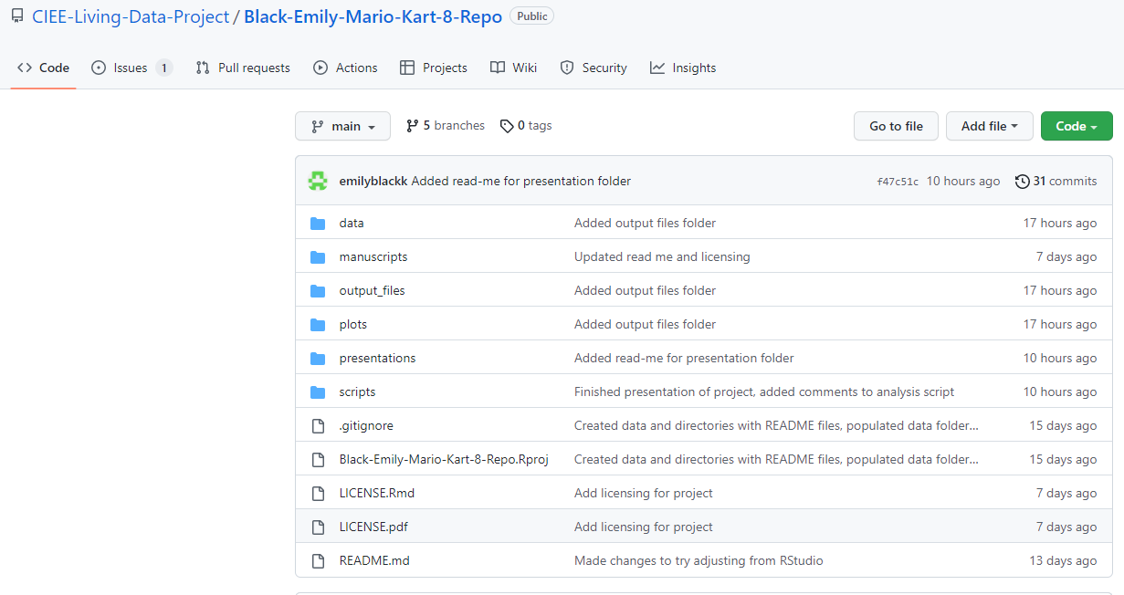
Problem: how do you win races while also choosing a character you like?

Slide 5
Solution:
characters | build | speed | acceleration | weight | handling | traction | turbo | total | avg_performance_score
Baby Daisy | Streetle,Azure Roller,Paper Glider | 1 | 5.25 | 0.75 | 4.75 | 3.75 | 5.75 | 21.25 | 3.75
Baby Rosalina | Tanooki Kart,Roller,Parachute | 1.25 | 4.5 | 1.5 | 5.25 | 3.5 | 6 | 22 | 3.8
Lemmy Koopa | Tanooki Kart,Roller,Parachute | 1.25 | 4.5 | 1.5 | 5.25 | 3.5 | 6 | 22 | 3.8

Slide 6
