Slide 1
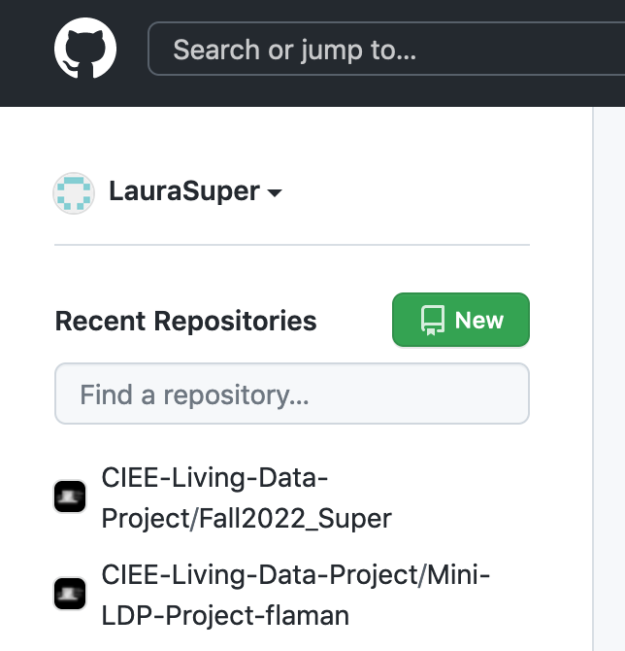
LDP for PREE
Laura Super
September 29, 2022

Slide 2
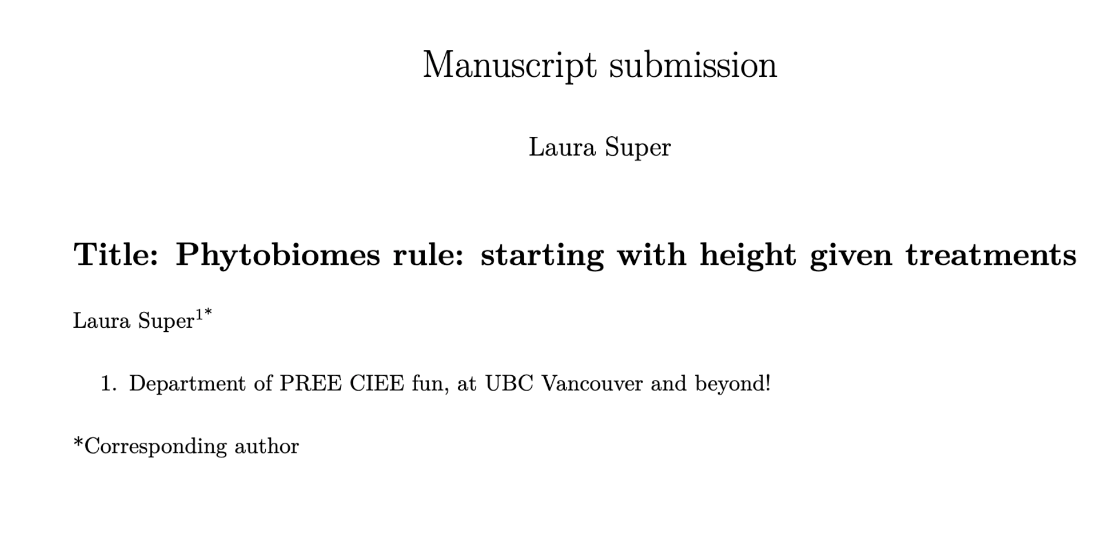
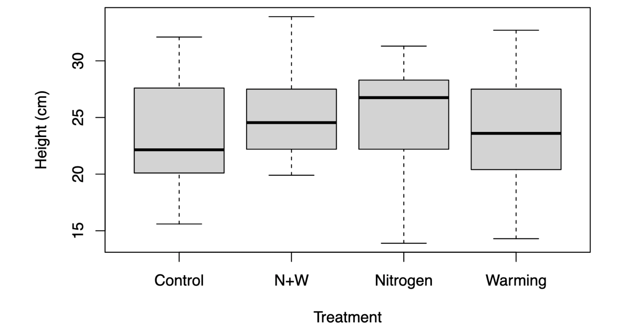
- What did
Parts:
What I did
How organized it (OSF, GitHub, etc.)
How and why it is reproducible
Steps take to archive data (FRDR)
…Hurdles (next steps)

Slide 3
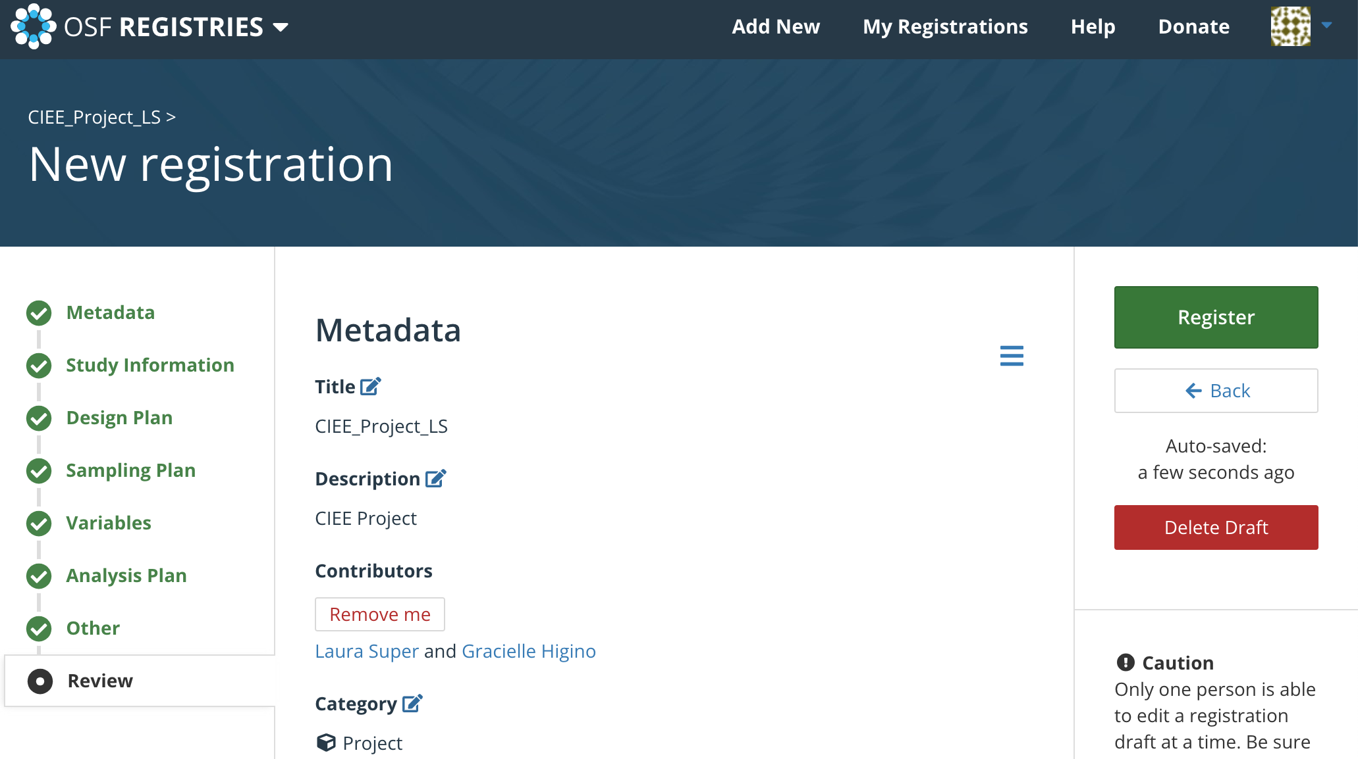
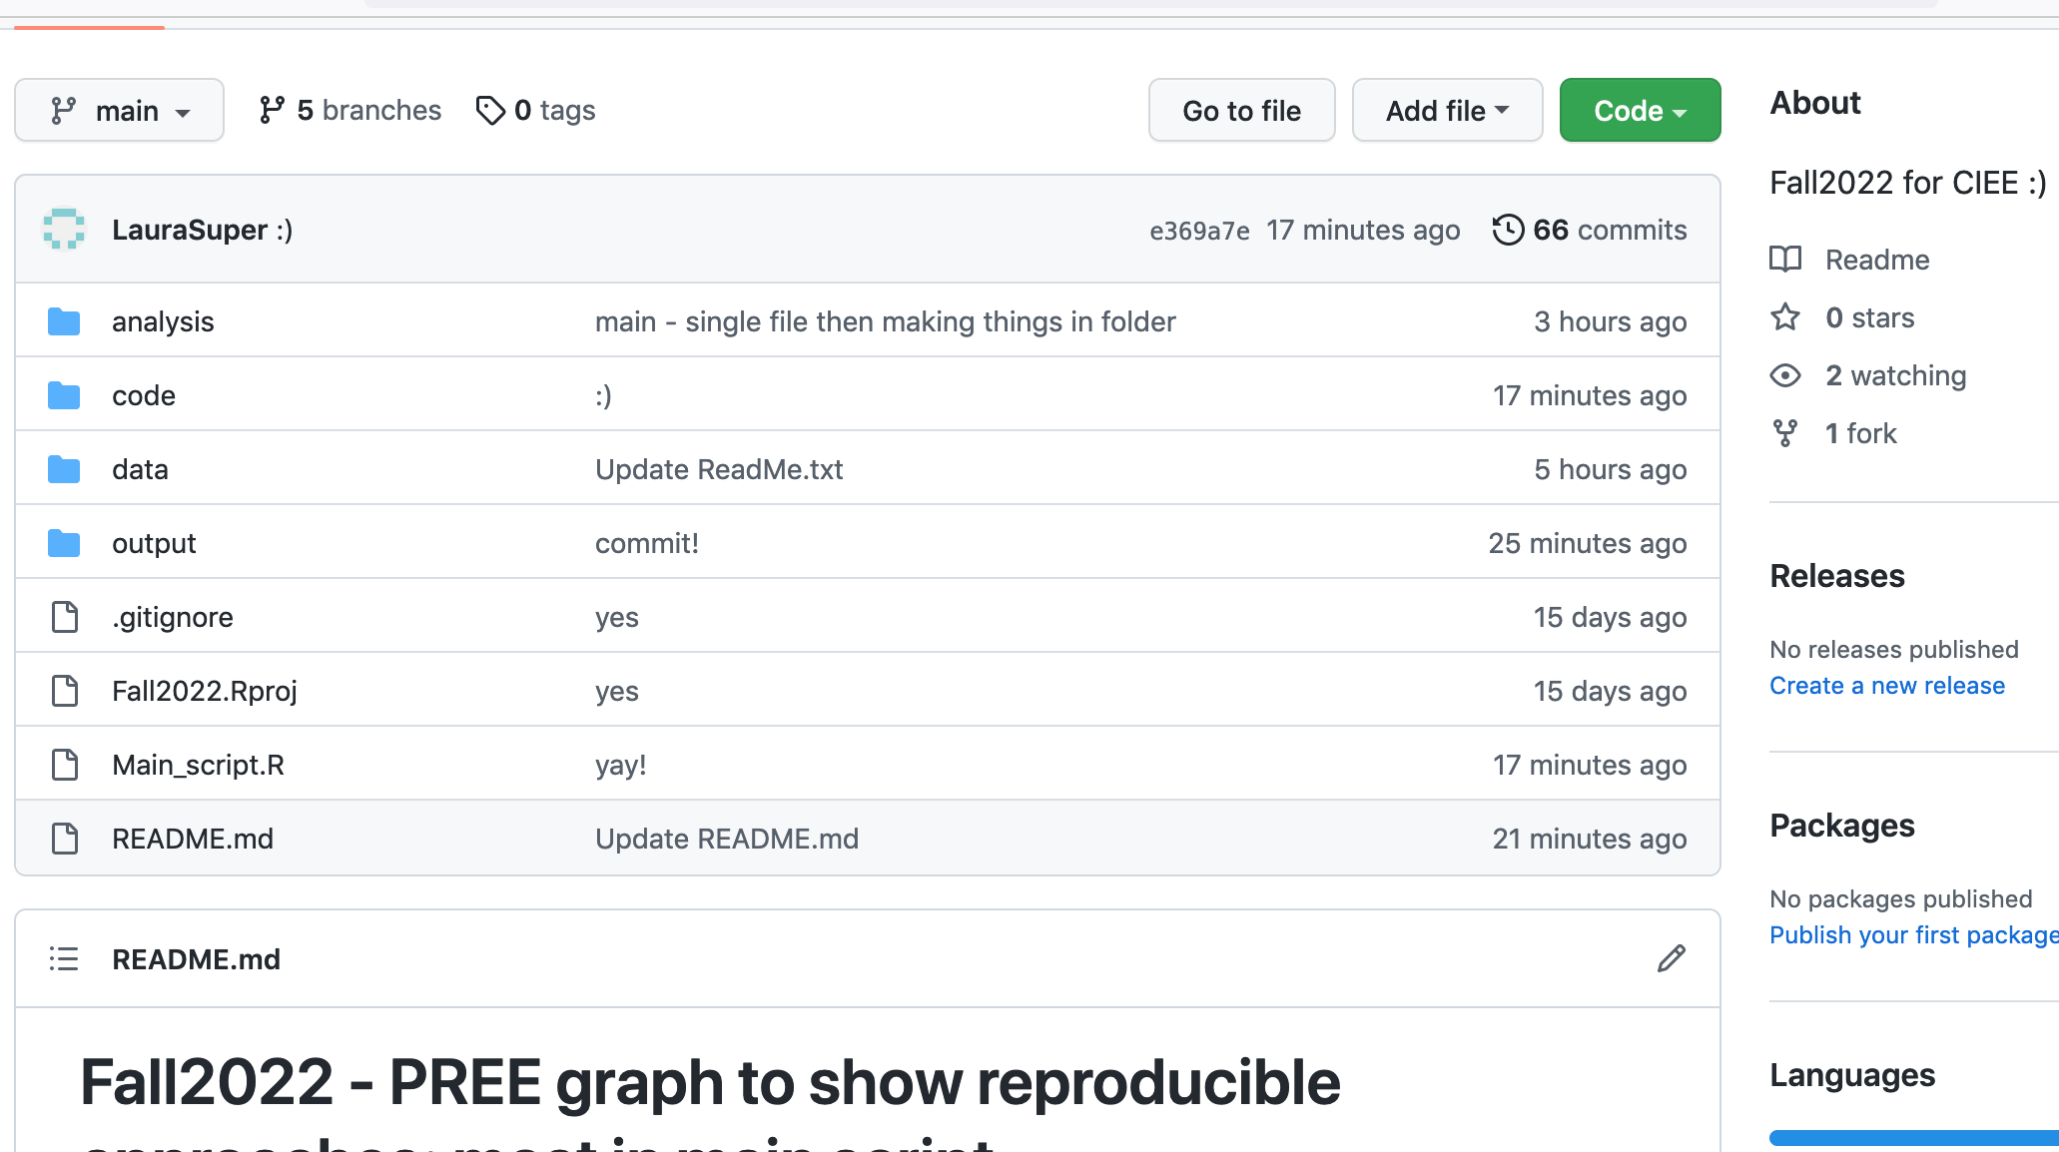
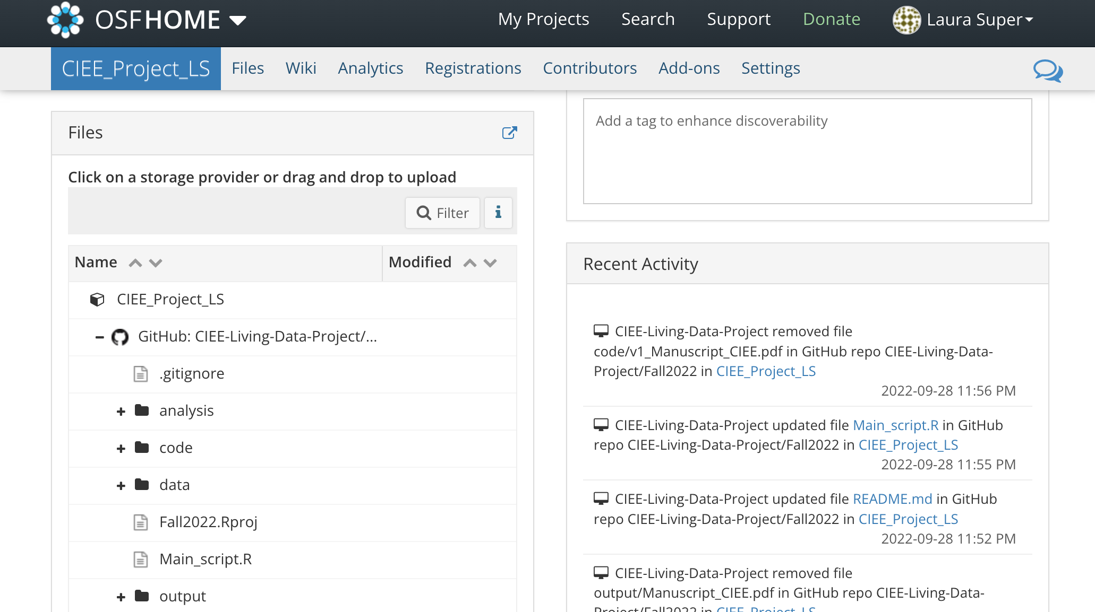
Hurdles
Parts:
Making sure everything all reorganized
Code issues (groundhog)
Finding things (GitHub)
Elegance versus speed
- Time such as depositing (OSF see image)

