Slide 1
Brief Overview of my Reproducibility Project
Stephanie Flaman

Slide 2
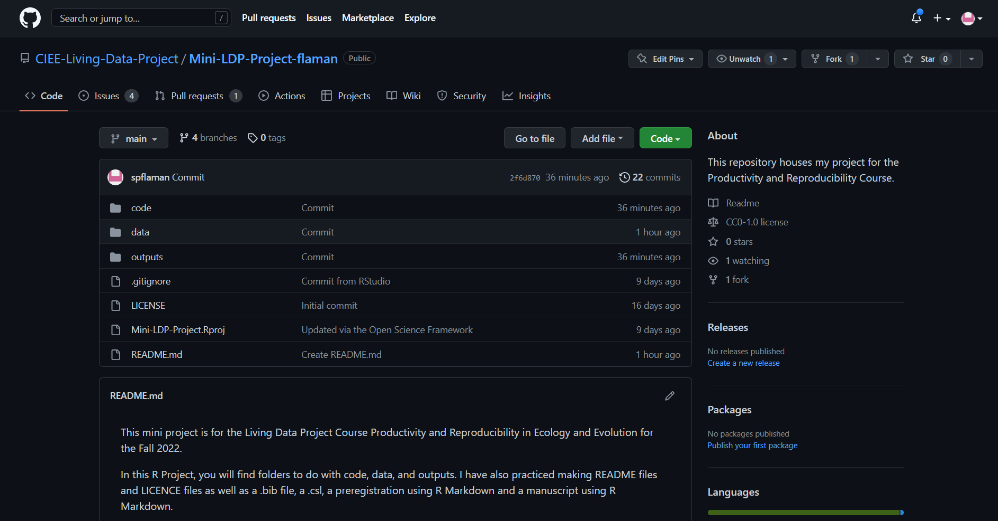

Slide 3
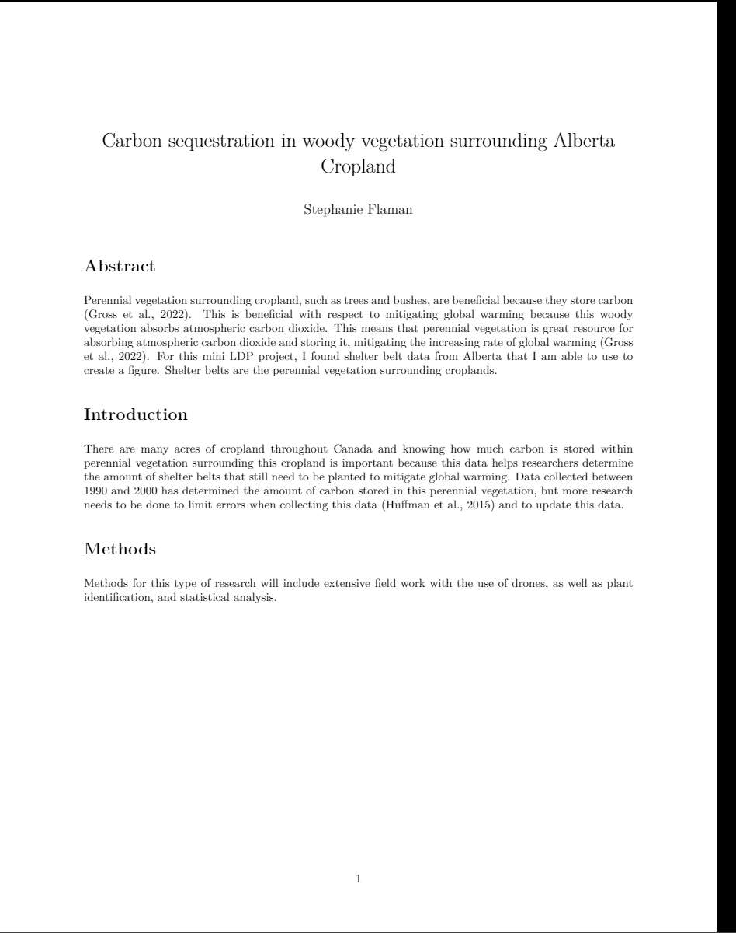
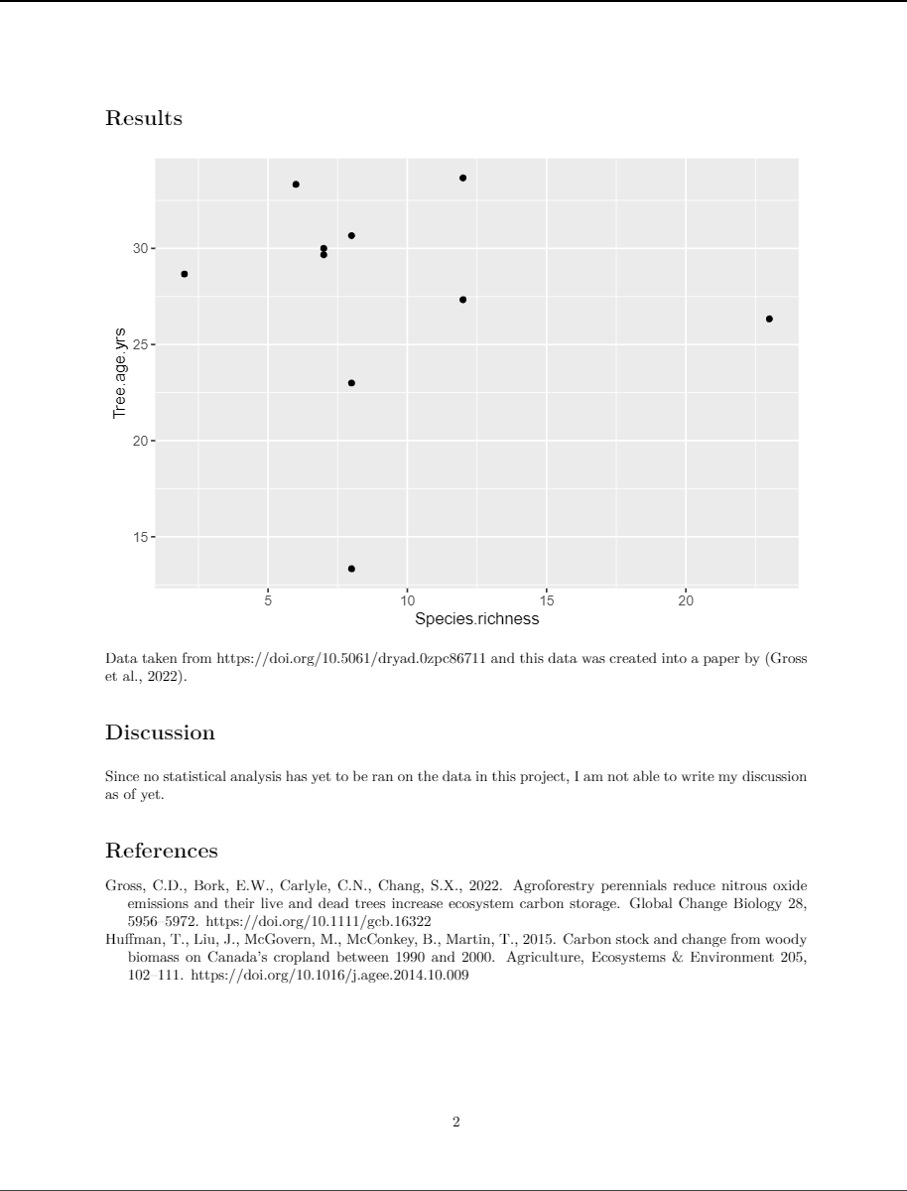

Slide 4
