Slide 1
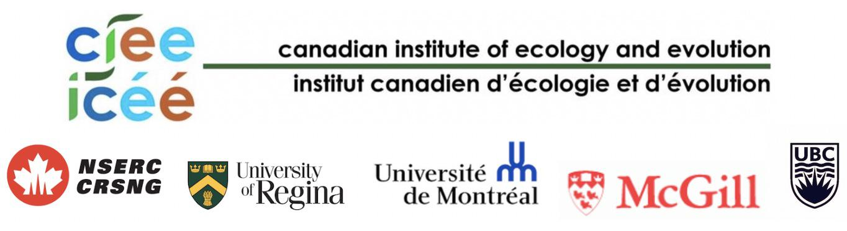
A Quick Introduction to Rmarkdown
Notes:
basic tools to have a basis to explore more advanced stuff

Slide 2
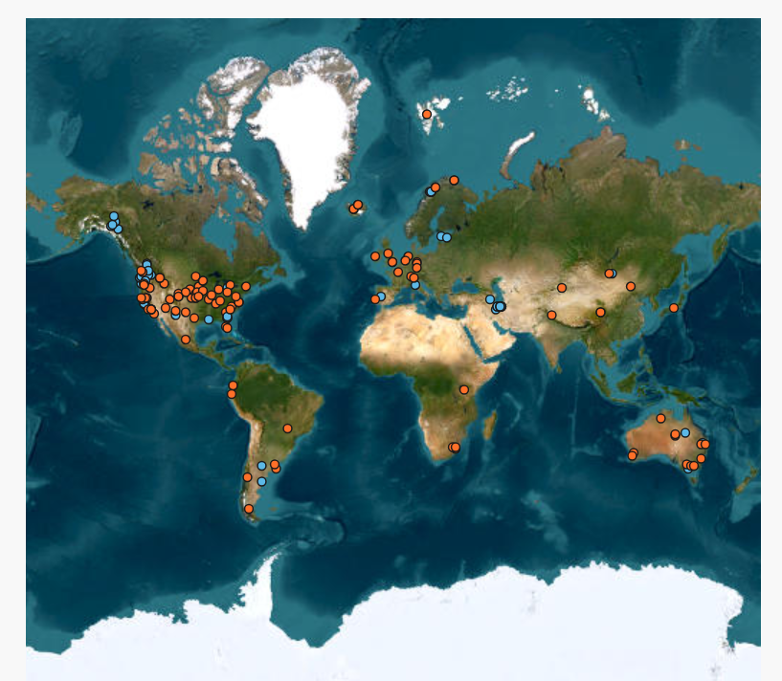
https://nutnet.org/
Notes:
experiment replicated across 170 sites

Slide 3
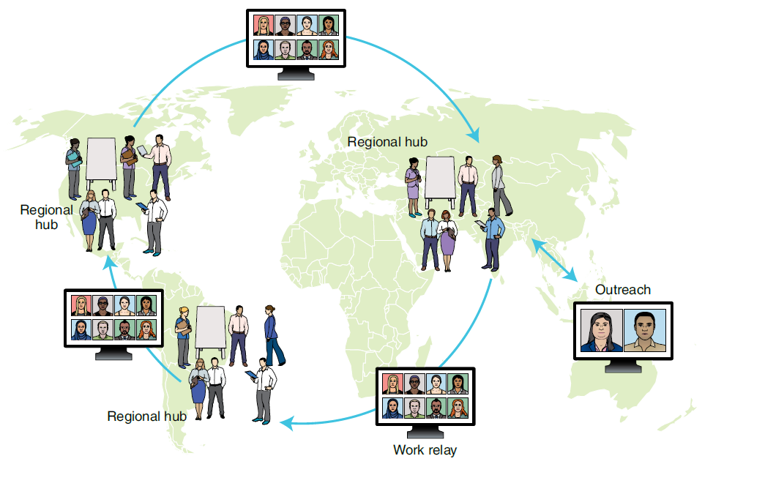
Collaborative science
Srivastava et al. (2021)

Slide 4
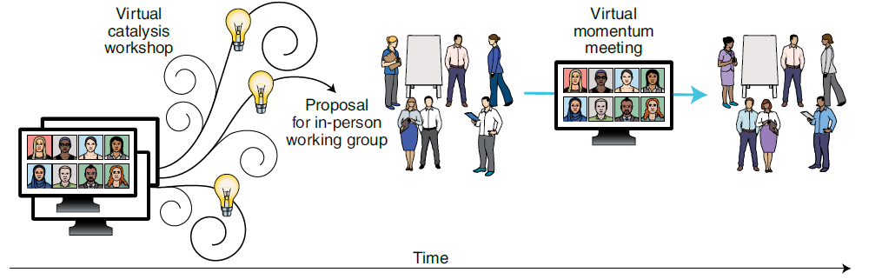
Collaborative science
Srivastava et al. (2021)

Slide 5
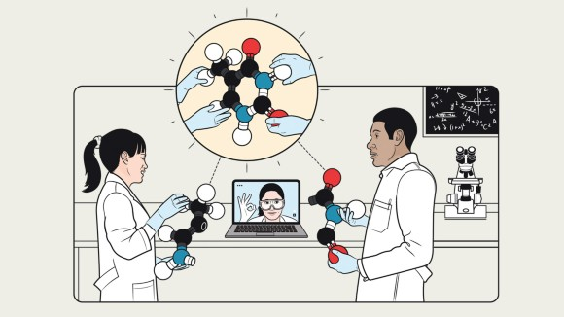
Collaborative science
Collaborative coding:
→ git
Sharing files,
integrating platforms:
→ OSF
Jameson Simpson

Slide 6
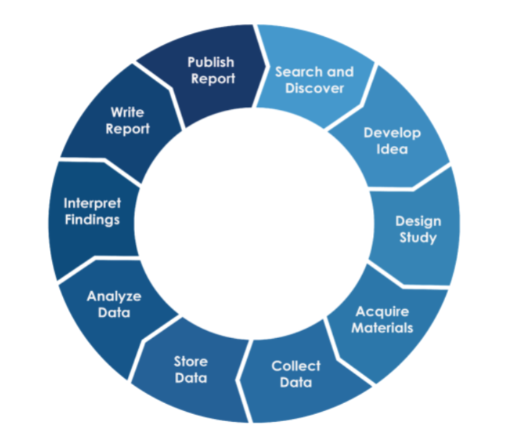
Collaborative science
Collaborative coding:
→ git
Sharing files,
integrating platforms:
→ OSF
But how do you share writing?
How do you collaborate on a single document?
Can you integrate writing and coding?

Slide 7
Collaborative writing
OSF
→ one at a time editing check in/out
→ does not solve the format problem
Microsoft Word
→ great interface, track changes, easy to use
→ proprietary
→ disconnected from code
Notes:
format: integrate writing and code

Slide 8
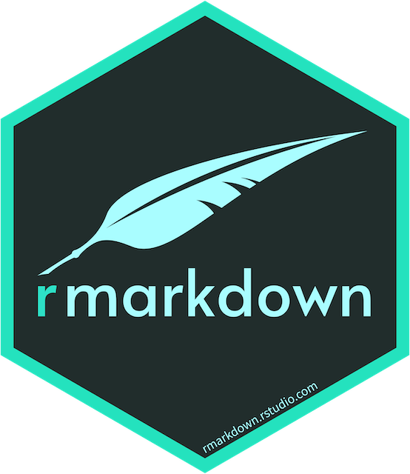
Rmarkdown
Fully reproducible documents
Easy customisation
Can integrate different (programming) languages
Variety of output formats

Slide 9
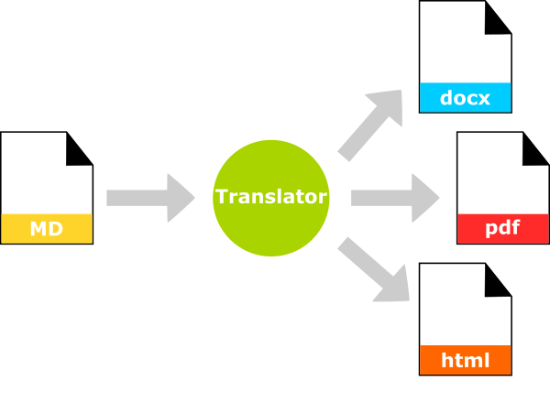

Slide 10
more machine readable → more human readable

Slide 11


Slide 12
Rmarkdown
Fully reproducible documents
Easy customisation
Can integrate different (programming) languages
Variety of output formats
But what about collaboration?

Slide 13
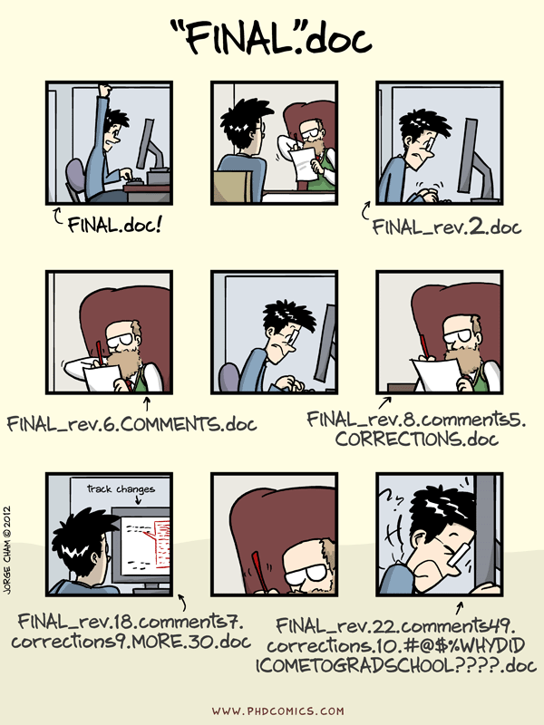
Collaborative writing through email

Slide 14
Collaborative writing through email
Imagine the mess with 30 co-authors…

Slide 15

Collaborative writing through email
Same advantages than Word
Google Drive but same disconnect from code
Notes:
great interface, track changes, easy to use

Slide 16
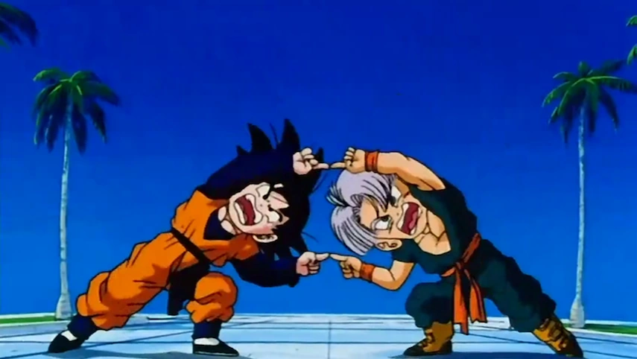
The solution: Rmarkdown + Google Drive
Notes:
trackdown: only the primary author needs a google account

Slide 17

The solution: trackdown
Notes:
trackdown: only the primary author needs a google account

