Slide 1
MCMC Fitting
Joe Michail
Data Science for Public Good Conference
CIERA, Northwestern University

Slide 2
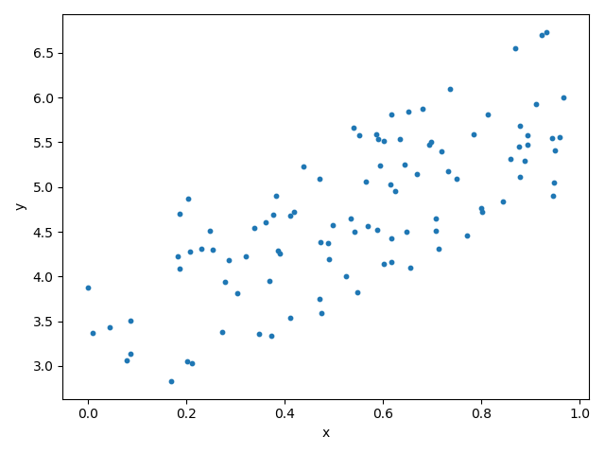
Say we have a simple data set like this:
Notes:
Ask what kind of model could be used to fit it: pls say line/linear model

Slide 3
Say we have a simple data set like this:
y=mx+b

Slide 4
Say we have a simple data set like this:
“parameters”
y=mx+b
Notes:
Linear fit, the form of which is very well known. m is slope, b is y intercept
We don’t know what the value of the parameters are a priori

Slide 5
Which line more accurately represents the data?
Notes:
Which fit is better
Why is it better? → residuals

Slide 6
Residuals and least squares regression
Residual = data - model prediction
Notes:
Some residuals large, some are small, some are positive, some are negative

Slide 7
Residuals and least squares regression
Regression: A process where you fit a model to data by minimizing the value of a function
Residual = data - model prediction
Notes:
Can you think of a regression technique that you might have used before? Linear

Slide 8
Residuals and least squares regression
(Probably) the best known example of a regression is a “linear regression” where a line is fit to data.
Residual = data - model prediction
Notes:
Some residuals large, some are small, some are positive, some are negative

Slide 9
Residuals and least squares regression
Least-squares regression: The function to minimize is the summed, squared residuals
Residual = data - model prediction
Notes:
Some residuals large, some are small, some are positive, some are negative

Slide 10
Residuals and least squares regression
Brute force method: Play with combinations of ‘m’ and ‘b’ to minimize the summed, squared residual
Residual = data - model prediction
Notes:
Least squares fitting

Slide 11
Residuals and least squares regression
Or, better yet, use built-in regression methods!
Residual = data - model prediction
Notes:
Least squares fitting

Slide 12
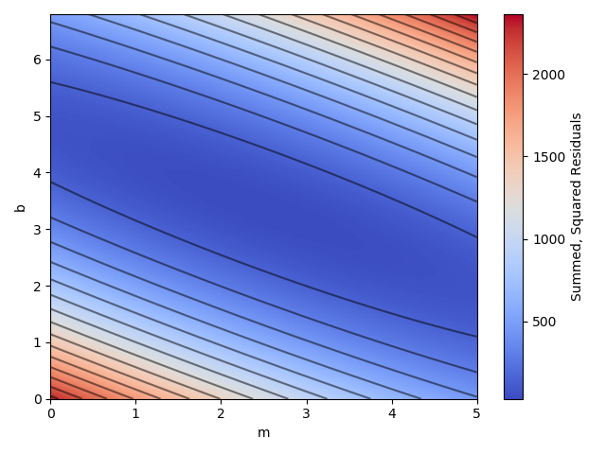
How least squares works:
“Parameter space”:
Summed, squared residuals as a function of m and b (or parameters in general)

Slide 13
How least squares works:
Choose starting position

Slide 14
How least squares works:
Choose starting position
(Different fitting routines will have different methods of choosing next point; most common is gradient descent)

Slide 15
How least squares works:
Choose starting position
(Different fitting routines will have different methods of choosing next point; most common is gradient descent)
Reach best fit parameters (where summed, squared residuals are minimized)

Slide 16
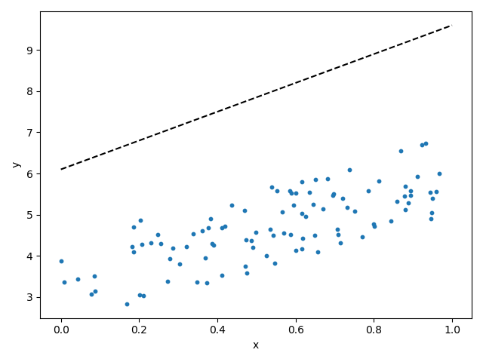
How least squares works:

Slide 17
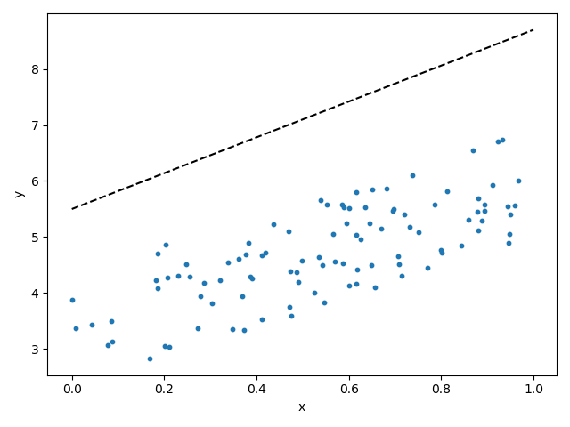
How least squares works:

Slide 18
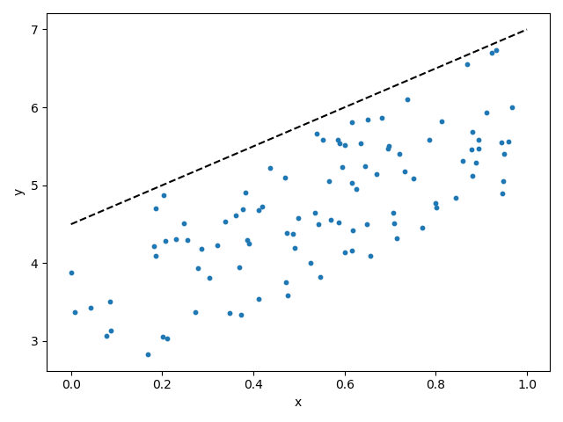
How least squares works:

Slide 19
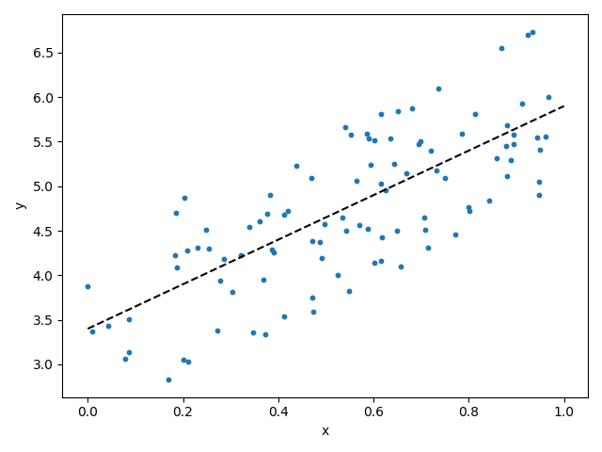
How least squares works:

Slide 20
How least squares works:
Choose starting position
(Different fitting routines will have different methods of choosing next point; most common is gradient descent)
Reach best fit parameters (where summed, squared residuals are minimized)
Can you think of an issue or problem with one of these steps?
Notes:
Step 1: CHOOSE a starting position → what if we don’t know?
Step 2: What if the parameter space is complex?

Slide 21
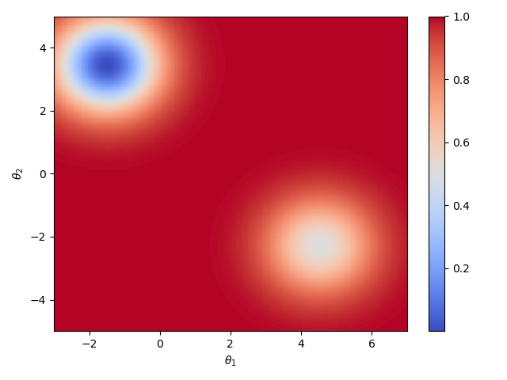
Least Squares Regression has its issues...
This primarily occurs when the parameter space is complicated or “hilly”
The true (or global) minimum in parameter space, which gives the lowest summed, squared residual
A local minimum in parameter space, which doesn’t give the lowest summed, squared residual
Notes:
Talk about it in terms of valleys, some are lower than others and you don’t know if you’ve hit the lowest one without sampling the entire space

Slide 22
Least Squares Regression has its issues...
Notes:
Different initial guess positions could give different (or incorrect!) parameters...this is where MCMC comes in

Slide 23
Markov Chain Monte Carlo (MCMC) to the rescue!
There are two major changes between MCMC and least squares fitting:
MCMC uses “walkers,” which are a number of points that traverse the parameter space
Choose the number of walkers
Give them random initial starting points
Let them walk around the parameter space
MCMC implements a random walk
This allows for a walker to “leave” a local minimum and keep moving about the parameter space
Since this is a random process, there’s a (very small) chance this will happen

Slide 24
Markov Chain Monte Carlo (MCMC) to the rescue!
Least Squares Regression
MCMC Regression (Random Walk)

Slide 25
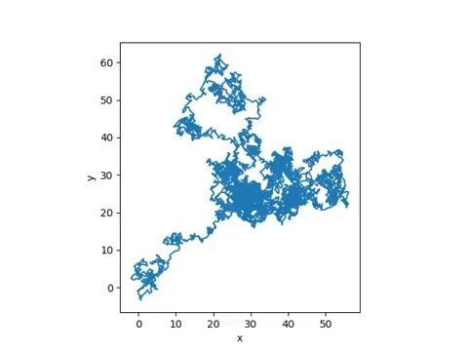
A much better example of Random Walks...

Slide 26
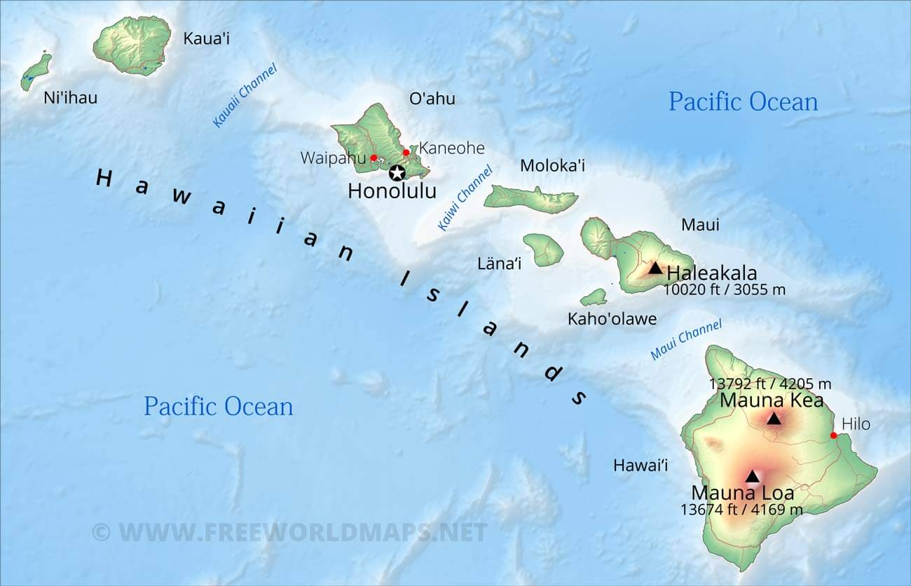

Random Walk - Mauna Loa CO2 data
Image credit: Free World Maps
Image credit: Viator

Slide 27
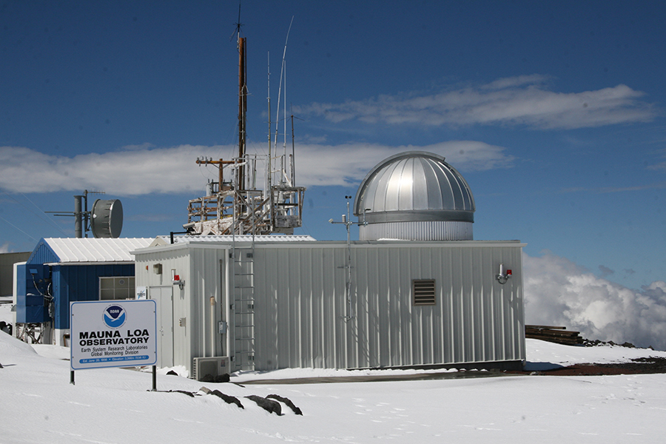
Random Walk - Mauna Loa CO2 data
Image credit: NOAA

Slide 28
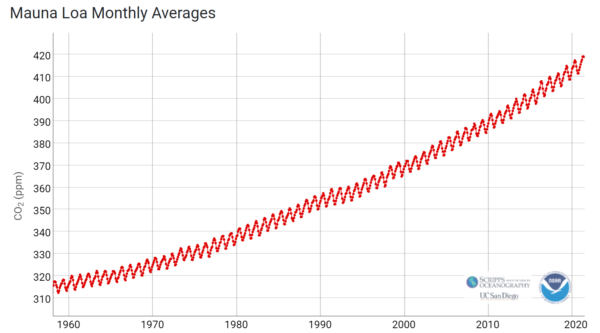
Random Walk - Mauna Loa CO2 data
As of July 20, 2021: https://gml.noaa.gov/ccgg/trends/graph.html

