Slide 1



Regret from cognition to code
Alan Dix
Computational Foundry, Swansea University, Wales, UK
Genovefa Kefalidou
School of Computing and Mathematical Sciences, University of Leicester, Leicester, UK
https://alandix.com/academic/papers/regret-2021/

Slide 2
REGRET

Slide 3
WHY ?
REGRET

Slide 4
WHY REGRET ?
negative
painful
debilitating

Slide 5
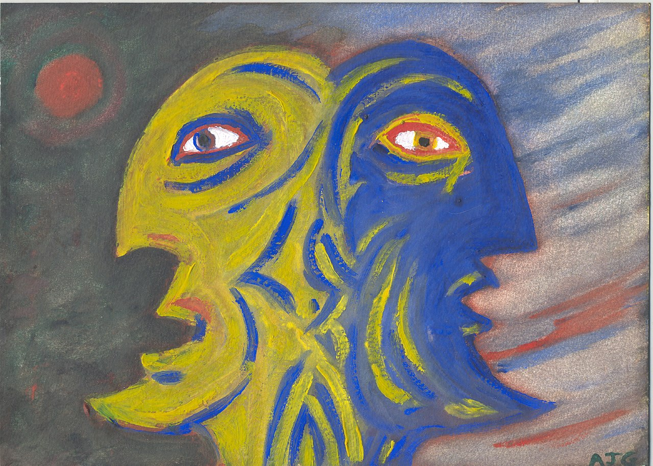
should be looking to the future
dwelling on the past
Tony Grist, CC0, via Wikimedia Commons
Notes:
https://commons.wikimedia.org/wiki/File:Janus_.jpg

Slide 6
WHY ?
REGRET

Slide 7
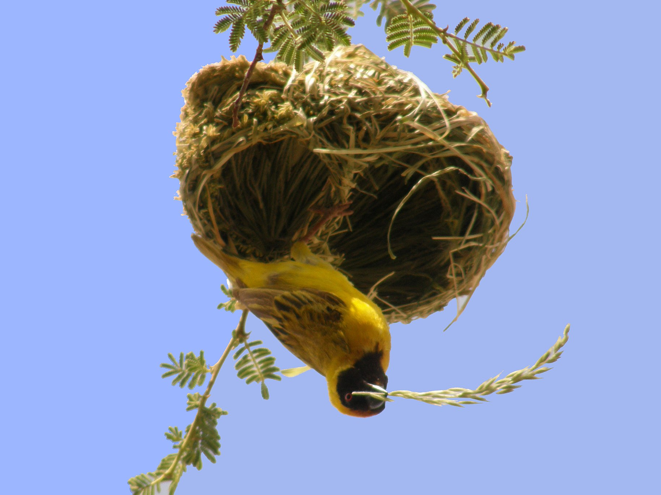
adaptive?
Gossipguy, CC BY-SA 3.0 via Wikimedia Commons
Notes:
https://commons.wikimedia.org/wiki/File:Tisserin_Etosha.jpg

Slide 8
adaptive?
not necessarily for the
21st century
§
§
§
Gossipguy, CC BY-SA 3.0 via Wikimedia Commons
Notes:
https://commons.wikimedia.org/wiki/File:Tisserin_Etosha.jpg

Slide 9
features of regret
past (bad) decisions brought to mind
counter-factual “what if” reasoning
feel bad if could have done better
feel worse if “just missed”
most egregious recapitulated

Slide 10
tuning learning to where it makes the most difference

Slide 12
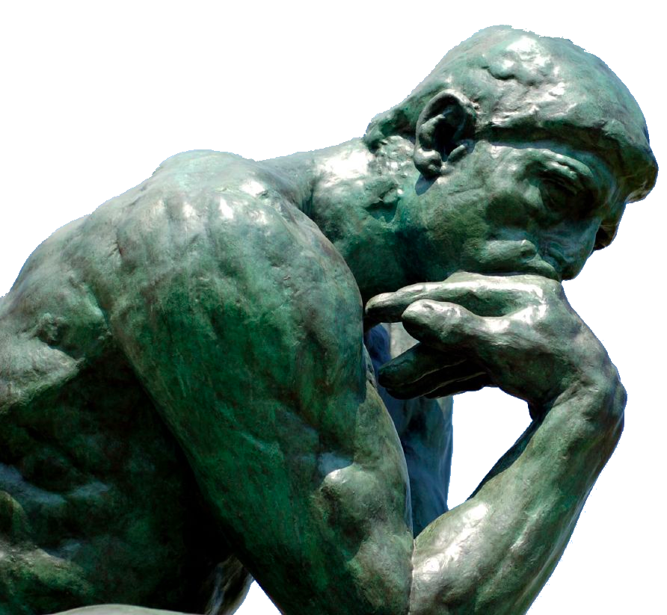
a cognitive model of regret

Slide 13
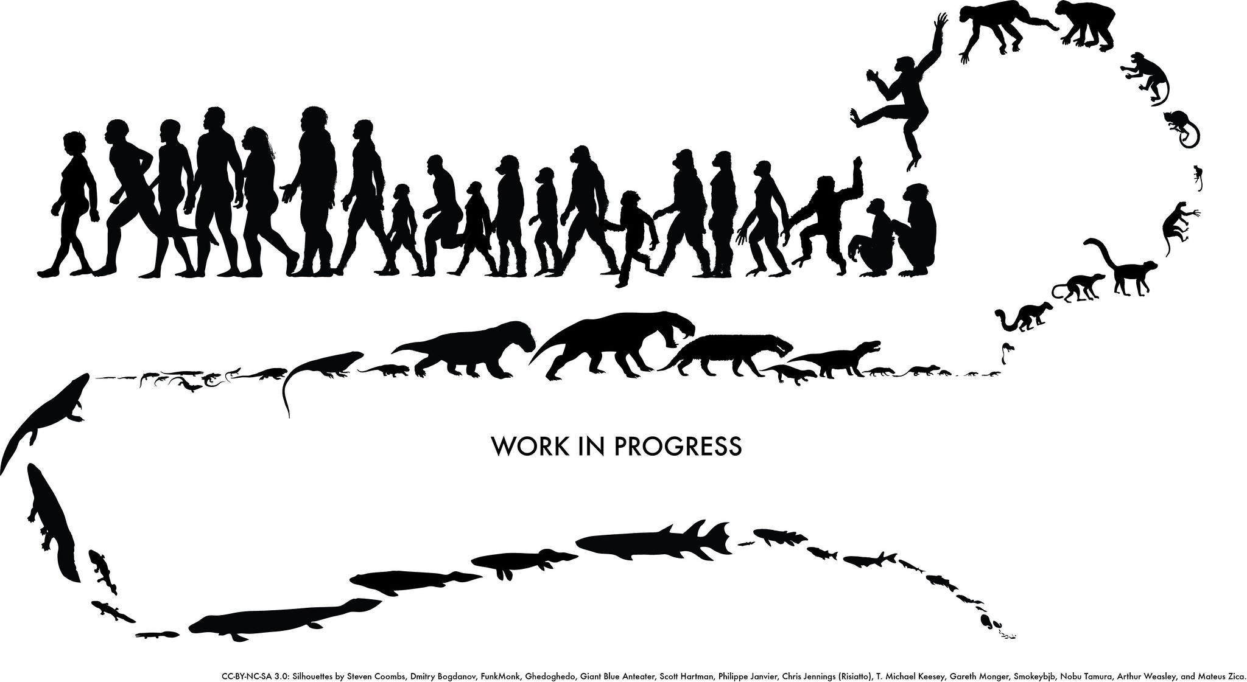
cognitive model of adaptive learning
build complex emotion
from simple mechanisms
plausible development path
T. Michael Keesey (CC BY-NC-SA 2.0) Flickr
Notes:
https://www.flickr.com/photos/keesey/9915333023

Slide 14
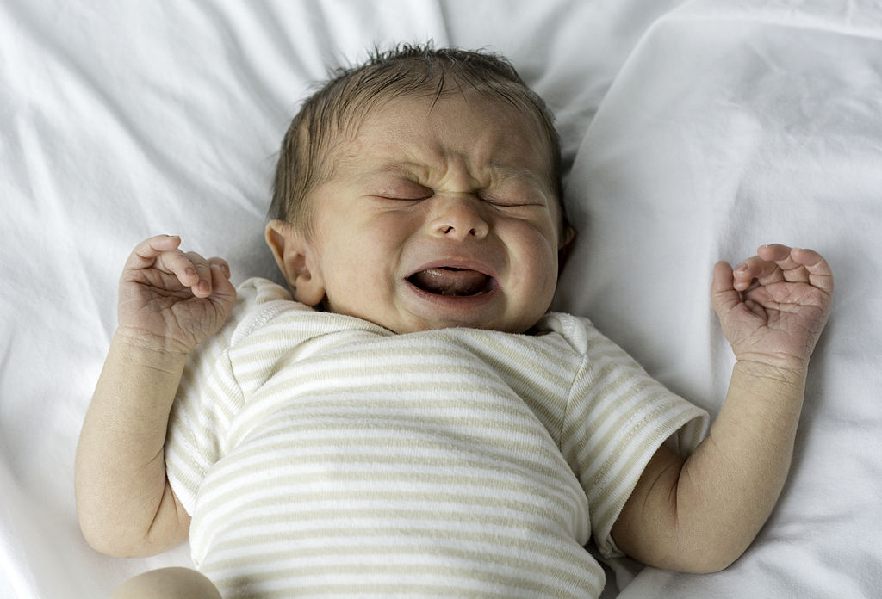
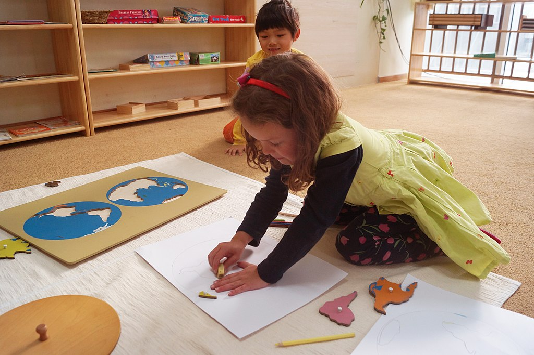
cognitive model of adaptive learning
build complex emotion
from simple mechanisms
plausible development path
Evan-Amos, Public domain, via Wikimedia Commons
Natalie Choi, CC BY-SA 4.0, via Wikimedia Commons
Notes:
https://commons.wikimedia.org/wiki/File:Human-Male-White-Newborn-Baby-Crying.jpg
https://commons.wikimedia.org/wiki/File:Geography_in_Montessori_Early_Childhood_at_QAIS.jpg

Slide 15
step by step

Slide 16
basic reactions - learning
(4) learnt association touching thorn is bad
(3) evaluation ow! it hurts!
emotion
action
senses
(1) touch thorn
(2) thorn pricks finger

Slide 17
basic reactions – moderating action
(2) learnt association ‘fires’
(3) bad feeling
emotion
(1) about to touch thorn
action
senses
(4) veto
No action!

Slide 18
next step – moderating intention
(1) imagination of planned action
(4) veto
emotion
(2) causes similar brain activity to actually doing it!
(3) learnt association fires
action
senses

Slide 19
dealing with delays ...
simple association only works for instant effects (a few seconds)
so what about delayed effects? (e.g. poisonous plant)
… need imagination!

Slide 20
delayed effect – the gap
why?
(4) desire to make sense
emotion
(3) evaluation “that hurts”
action
senses
(1) touch plant
(2) some time later your finger is sore

Slide 21
delayed effect – bringing to mind
(5) recent salient events brought to mind
why?
(6) causes simultaneous activation in relevant areas
(4) desire to make sense
emotion
(7) learnt association don’t touch that plant
(3) evaluation “that hurts”
action
senses
(1) touch plant
(2) some time later your finger is sore

Slide 22
and now regret ...
similar but also: causal connections moderating emotions

Slide 23
regret – the gap
why?
(4) desire to make sense
emotion
(3) evaluation “that hurts”
action
senses
(1) touch plant
(2) some time later your finger is sore

Slide 24

regret – causal thinking
(4) logical deduction of what mattered determines what is brought to mind
(5) imagination causes simultaneous activation in relevant areas
emotion
(7) learnt association even though action not obviously linked or most salient
(6) causes negative emotion “if only I hadn’t” … regret
action
senses
(7b) learnt association stronger or weaker depending on strength of emotion
(6b) counter-factual deduction of how much it matters influences strength of emotion

Slide 25
but is it true?
... build a computer model

Slide 27

a computational model of regret
learn( stimulus, response, afterwards, effect) {
double best = findBestResponse( stimulus, afterwards);
double regret = best - effect;
double emotion; // ***** where regret modifies effect
if ( effect >= 0 ) {
emotion = params.POS_NO_REGRET_FACTOR * effect
- params.POS_REGRET_FACTOR * regret;
} else {
emotion = params.NEG_NO_REGRET_FACTOR * effect
- params.NEG_REGRET_FACTOR * regret;
}
learner.condition(stimulus,response,emotion);
}
Gemmaribasmaspoch, CC BY-SA 4.0 via Wikimedia Commons
Notes:
https://commons.wikimedia.org/wiki/File:MareNostrum_4_supercomputer_at_Barcelona_Supercomputing_Center_2_br.jpg

Slide 28



model architecture
basic ML module
environment
stimulus
cards dealt
SRE assoc
lookup and choose
simplified Pontoon
response
stick/twist
update
plug-in regret module
emotion
effect
win/lose
modify
post-hoc info.
further cards dealt

Slide 29
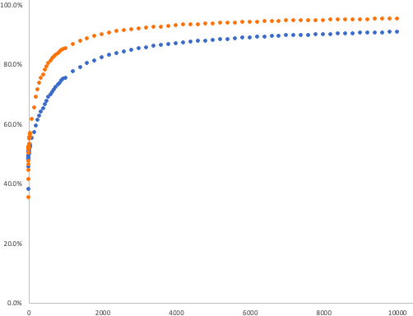
100%
scaled score
better asymptote
80%
60%
40%
faster learning
20%
key
with regret
0%
basic leaner
1
2000
4000
6000
8000
10000
learning iterations

Slide 30
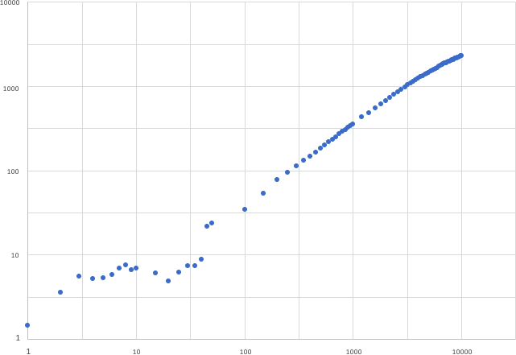
faster learning – fewer exposures
10000
1000
with regret
100
10
1
1
10
100
1000
10000
simple learner

Slide 31
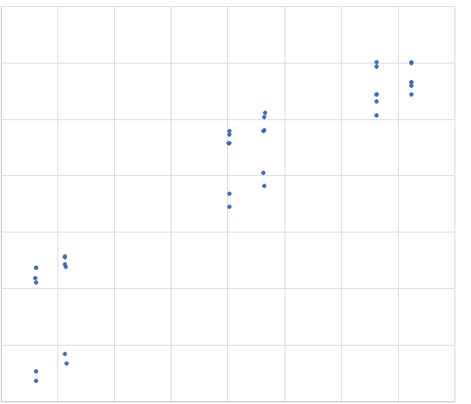
better learning – higher scores
100%
with regret
95%
90%
95%
simple learner

Slide 33
lessons …
computational model improves learning evidence for plausibility of cognitive model potential use in machine learning
positive regret also good for learning the “grass is greener” effect helps avoid local maxima
rigour and reliability explore parameter space thoroughly needs loads of replications!

Slide 34
what next …
computational model
include recapitulation and prediction
other games and problem domains
other underlying ML algorithms
cognitive model
understand therapeutic implications explore related areas: attention, creativity, serendipity
practical applications
embody lessons in cognitive aid apps

Slide 35
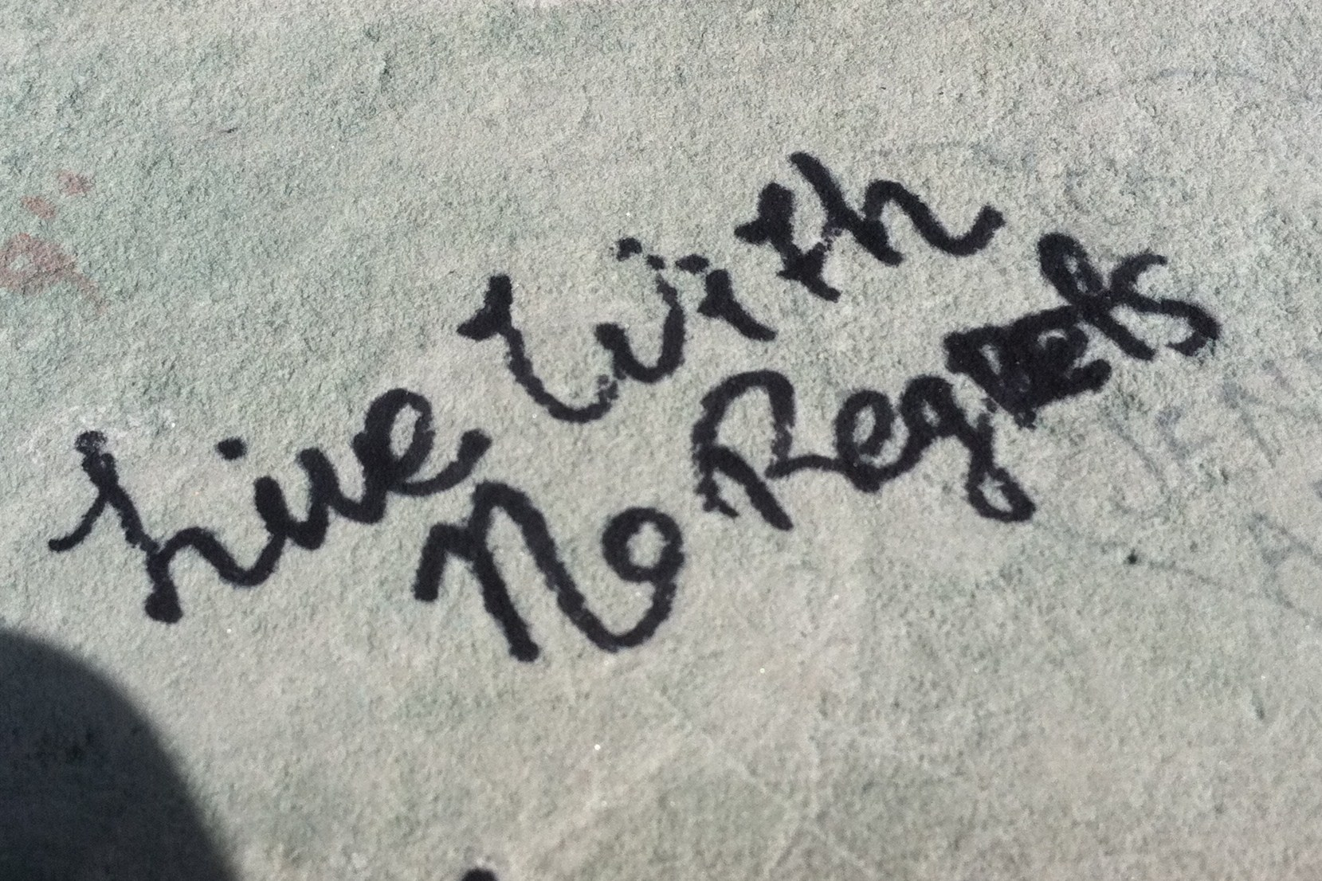
Jason Howie (CC BY 2.0) Flickr
Notes:
https://www.flickr.com/photos/jasonahowie/6489623615

