Slide 1
Robot as embodied agent? A phenomenological critique Laura Corti University Campus Bio-Medico of Roma 4th International Workshop on Cognition: Interdisciplinary Foundations, Models and Applications Tuesday 27 September 2022

Slide 2
Outline
Robots as embodied systems
The embodied turn in robotics
Embodiment: an interdisciplinary idea
Phenomenological embodiment: why is useful for robotics?

Slide 3
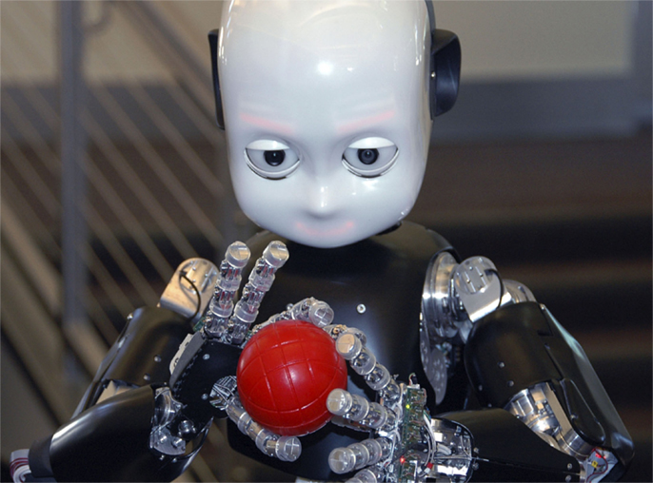
“Cognitive scientists have much to learn from Merleau-Ponty”. (Dreyfus, H. & Dreyfus, S., 1999)
“Also roboticics have much to learn from phenomenology”

Slide 4
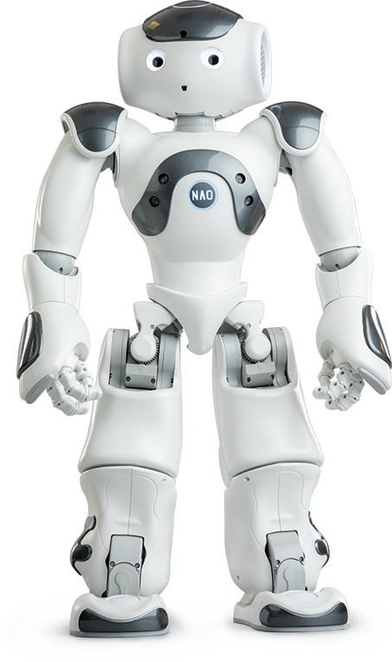
A definition
Robot is “a smart machine that does routine, repetitive, hazardous mechanical tasks, or performs other operations either under direct human command and control or on its own, using a computer with embedded software (which contains 12 previously loaded commands and instructions) or with an advanced level of machine (artificial) intelligence (which bases decisions and actions on data gathered by the robot about its current environment)”. (Angelo, 2007)

Slide 5
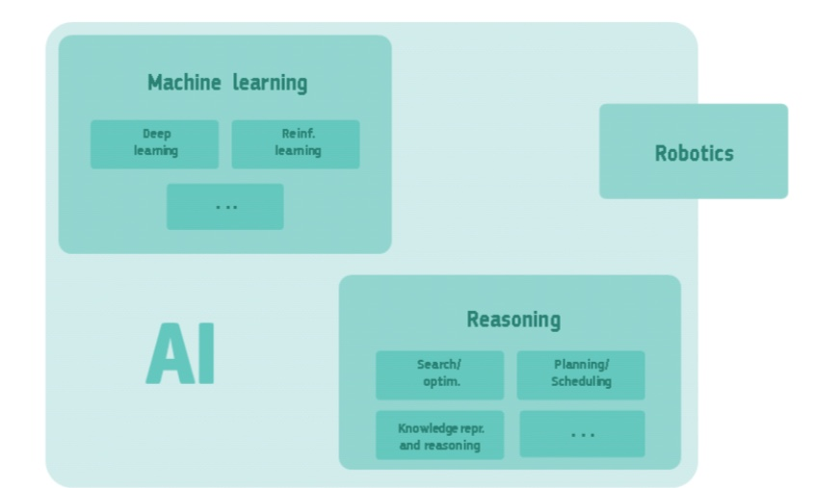
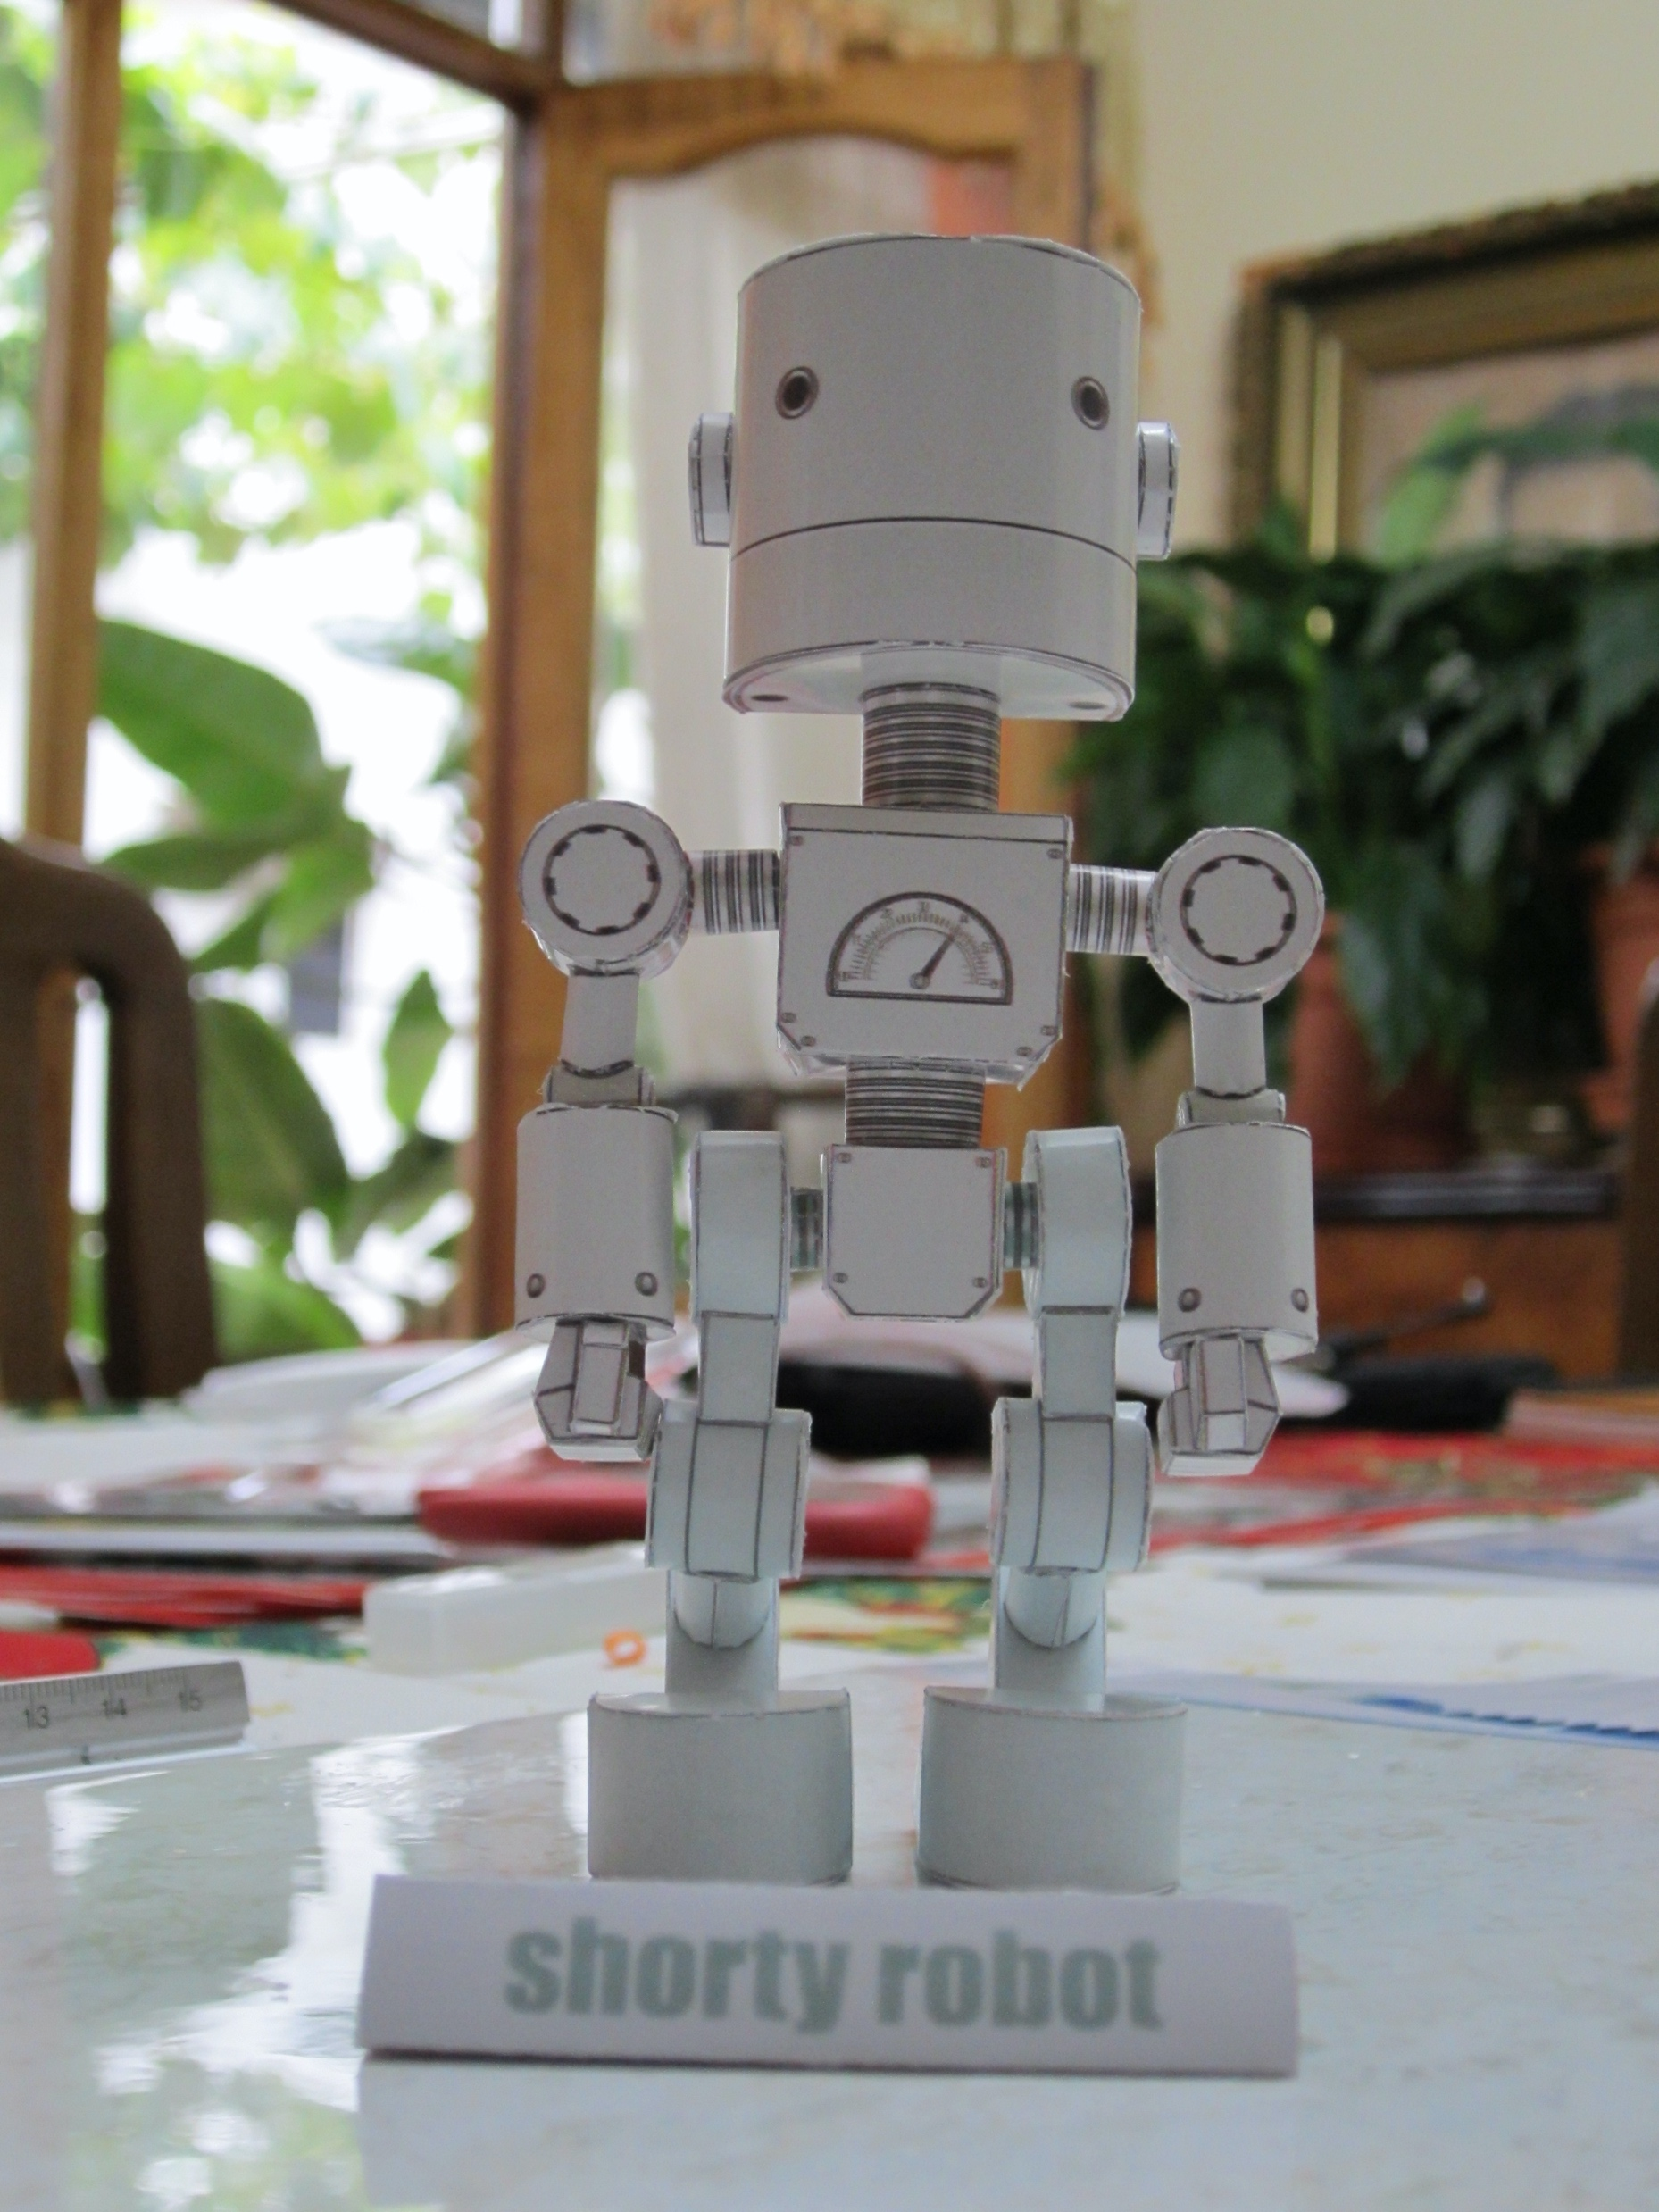
High-Level Expert Group on Artificial Intelligence , A definition of AI: Main capabilities and scientific disciplines
In robotics, embodiment means human activities in the body tending towards the need to discuss the boundary between mind and body again. It does so by ”incorporating” the mind into a body that becomes the engine of action and cognition.
Questa foto di Autore sconosciuto è concesso in licenza da CC BY-SA

Slide 6
The embodied turn in robotics
"Life and intelligence only develop inside a body". Kerstin Dautenhahn
The feature of possessing/ having a body is the simplest way to interact with the world.

Slide 7
The phenomenological embodiment
Why Phenomenology?
phenomenology is useful to talk about robotic systems since…
1. phenomenology does not deny the physical dimension of the body (relevant for robotics), which has its own peculiar aim;
2. phenomenology highlights a human-world systemic approach that characterizes cognition, showing a clear break with the cognitive models of current robots

Slide 8
Leib
Körper
the physical dimension of the body

Slide 9
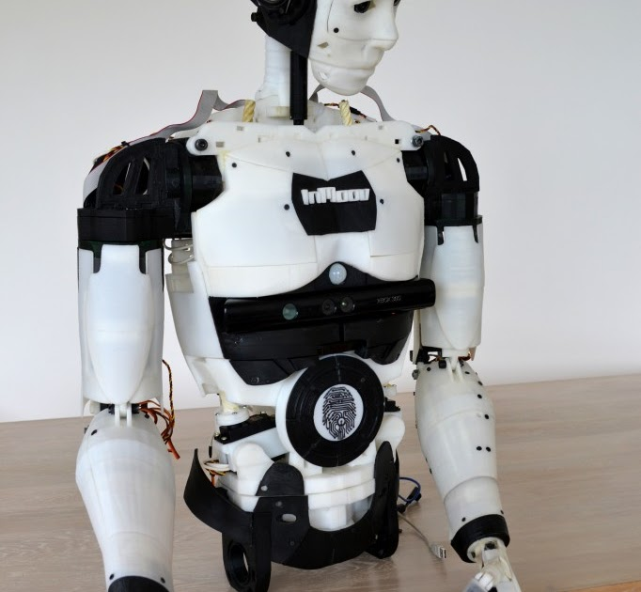
human-world systemic approach
Body Schema
” global awareness of my posture in the inter-sensory world” (Merleau-Ponty, 2013)

Slide 10

In conclusion….
It is possible to describe robots as embodied AI
Nevertheless, in this context, the term embodiment refers to a “weak version”, which focus on the functional role of body.
The phenomenological perspective on living body, on the other hand, helps us to distinguish between humans and artificial systems.
Questa foto di Autore sconosciuto è concesso in licenza da CC BY-NC

Slide 11
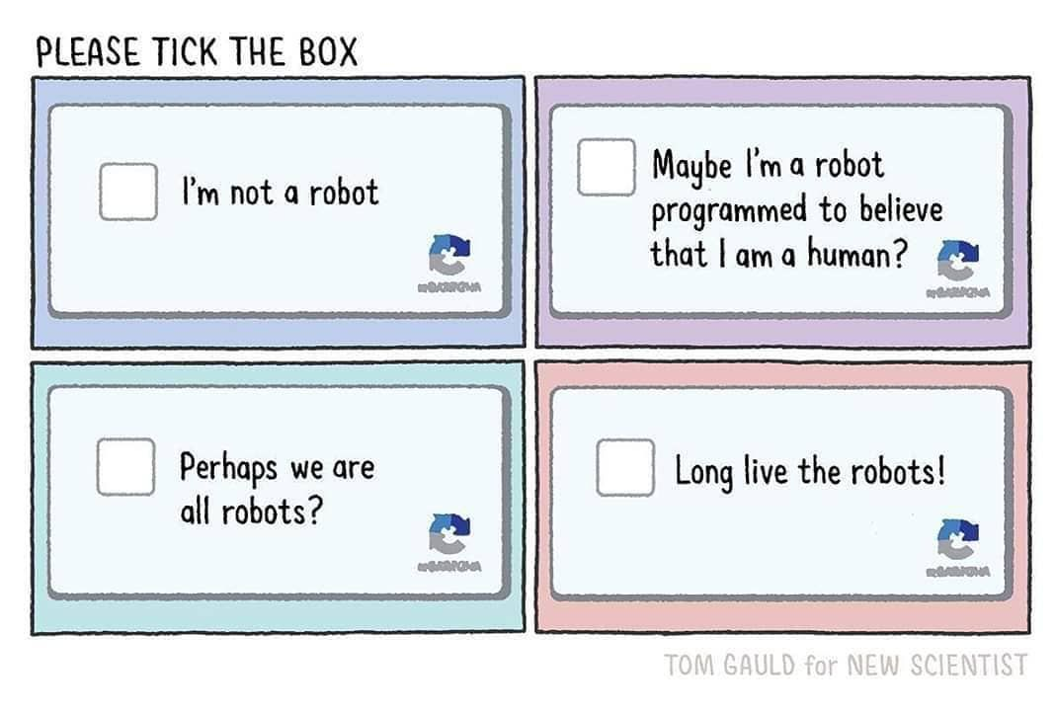
Thank you for the attention!

