Slide 1
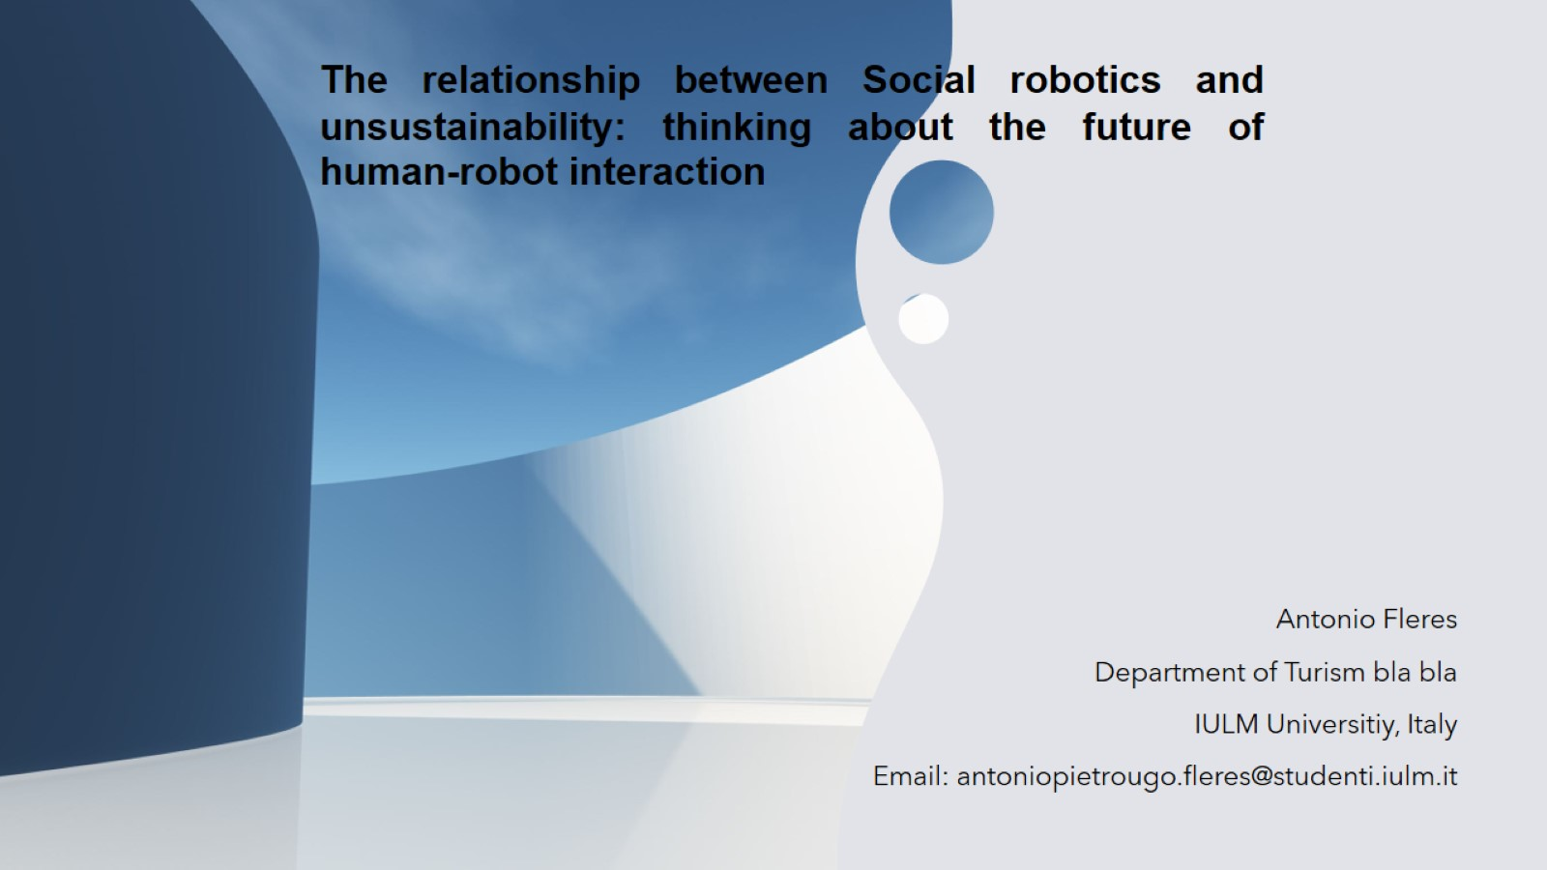

The relationship between Social robotics and unsustainability: thinking about the future of human-robot interaction
CIFMA 2022
4th International Workshop on
Cognition: Interdisciplinary Foundation, Models and Applications
Berlin
Antonio Fleres
Ph.D. Student
IULM University, Italy
Email: antoniopietrougo.fleres@studenti.iulm.it

Slide 2
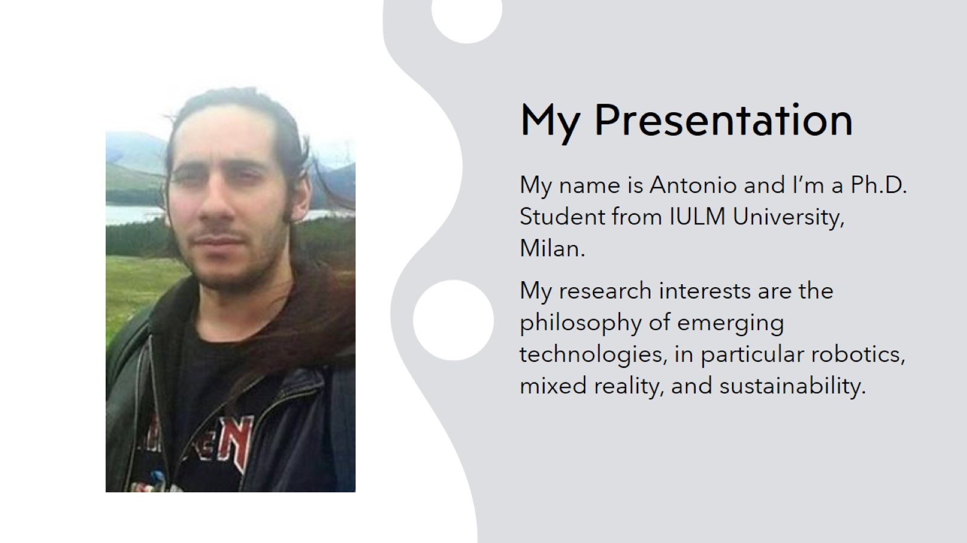
My Presentation

Slide 3
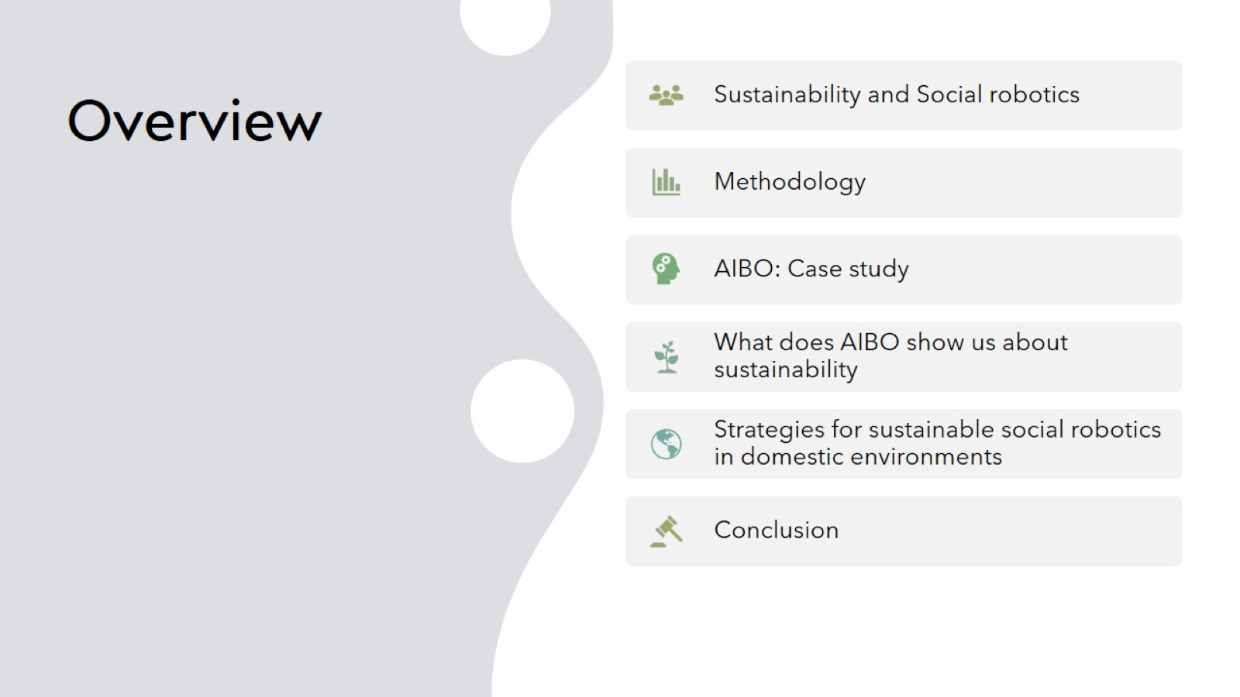
Overview

Slide 4
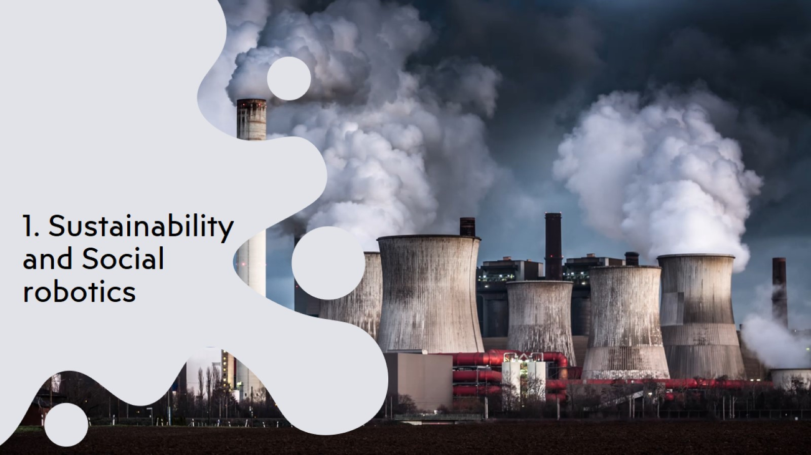
1. Sustainability and Social robotics

Slide 5
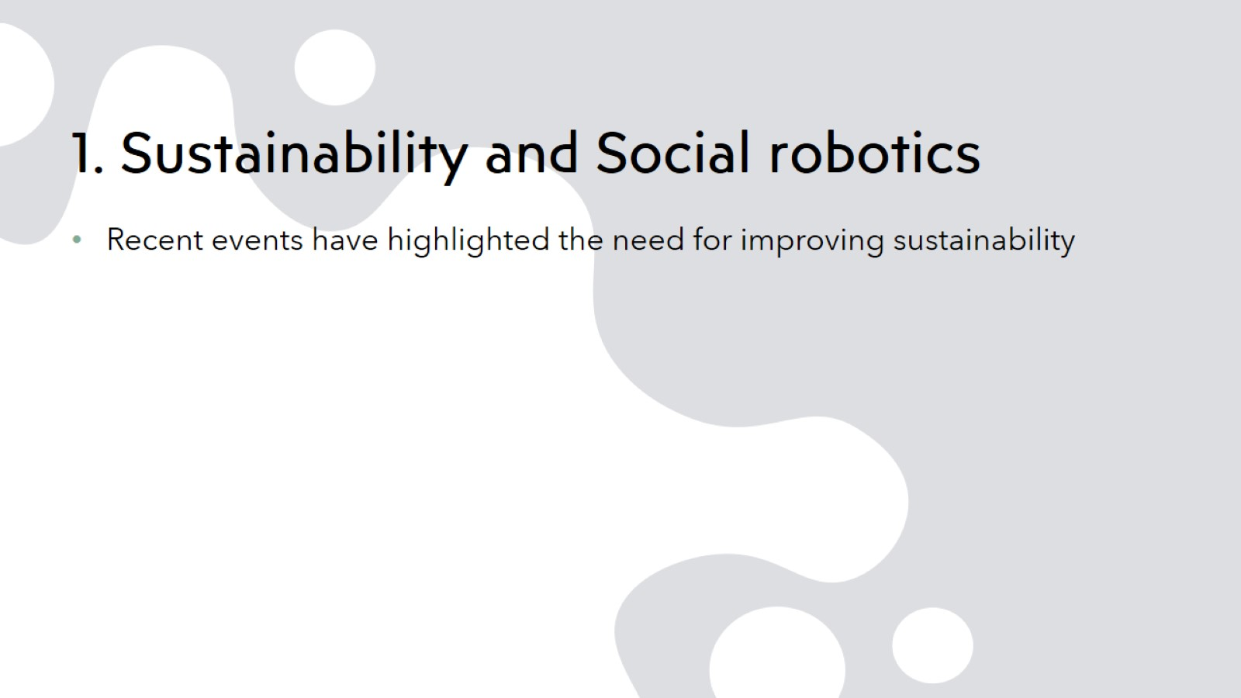
1. Sustainability and Social robotics
of

Slide 6
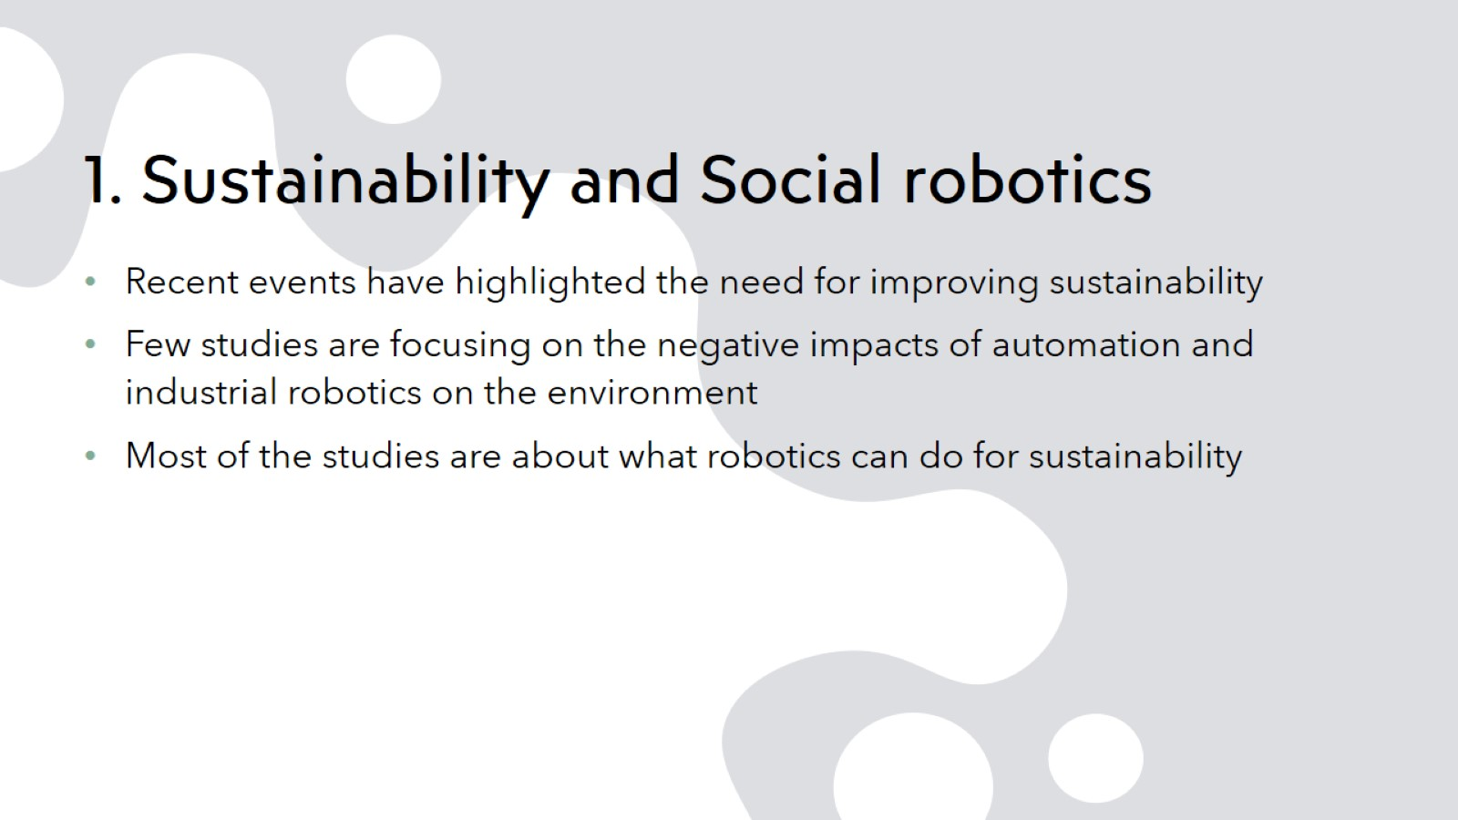
1. Sustainability and Social robotics
of
(N. Joshi, 2018; J. Dusik, B. Sadler, 2019)

Slide 7
1. Sustainability and Social robotics
of
(N. Joshi, 2018; J. Dusik, B. Sadler, 2019)

Slide 8
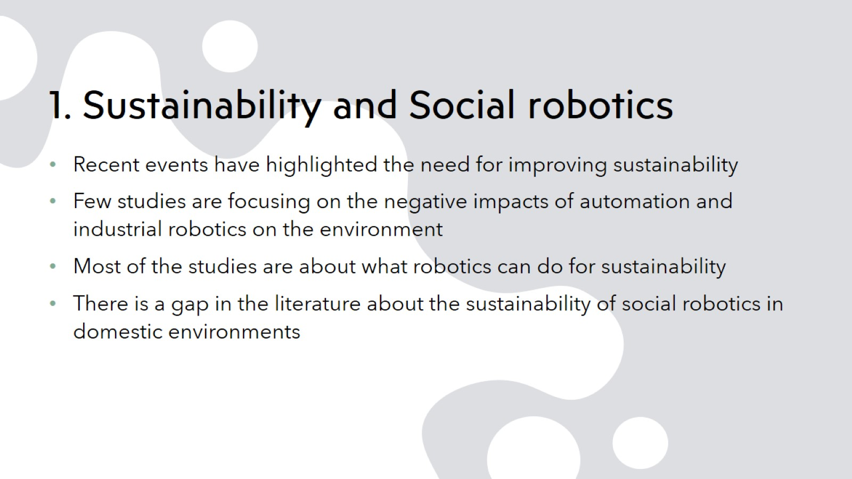
1. Sustainability and Social robotics
of
(N. Joshi, 2018; J. Dusik, B. Sadler, 2019)

Slide 9
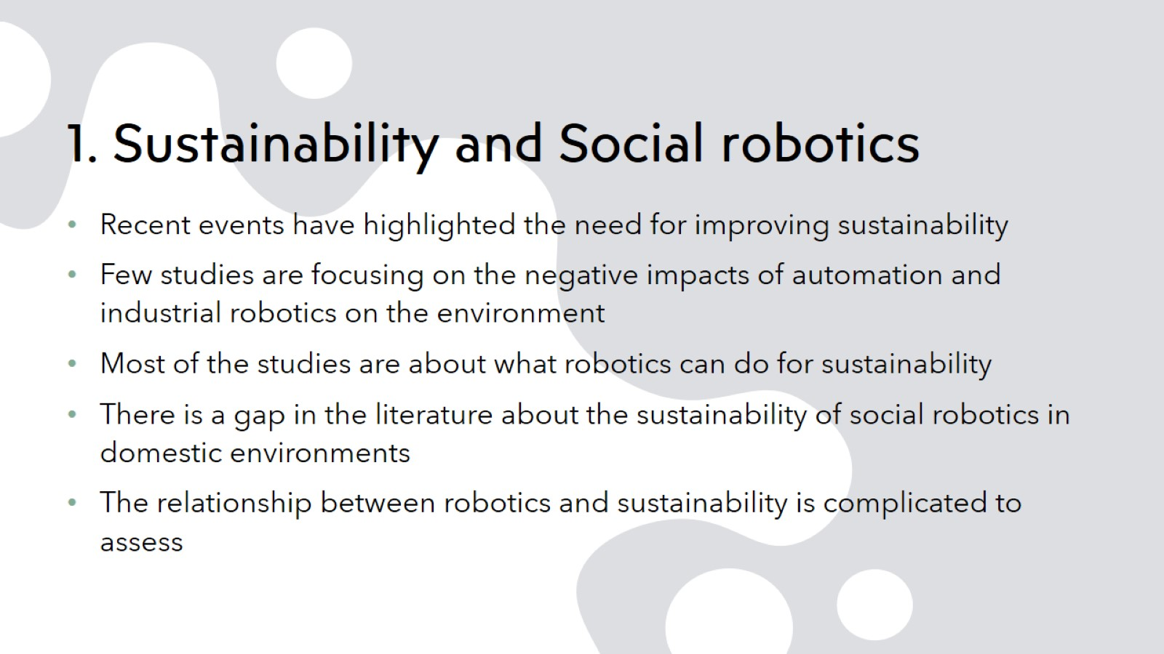
1. Sustainability and Social robotics
of
(N. Joshi, 2018; J. Dusik, B. Sadler, 2019)

Slide 10
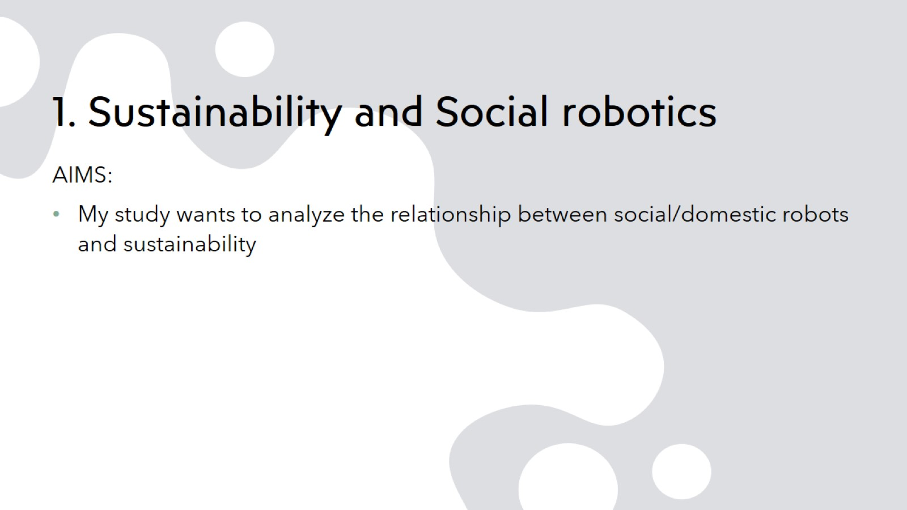
1. Sustainability and Social robotics

Slide 11
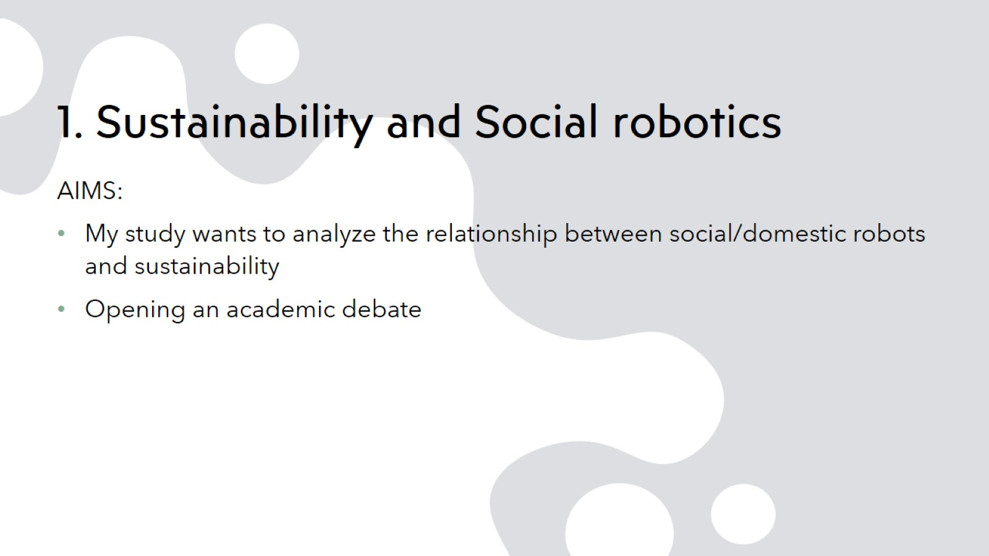
1. Sustainability and Social robotics

Slide 12
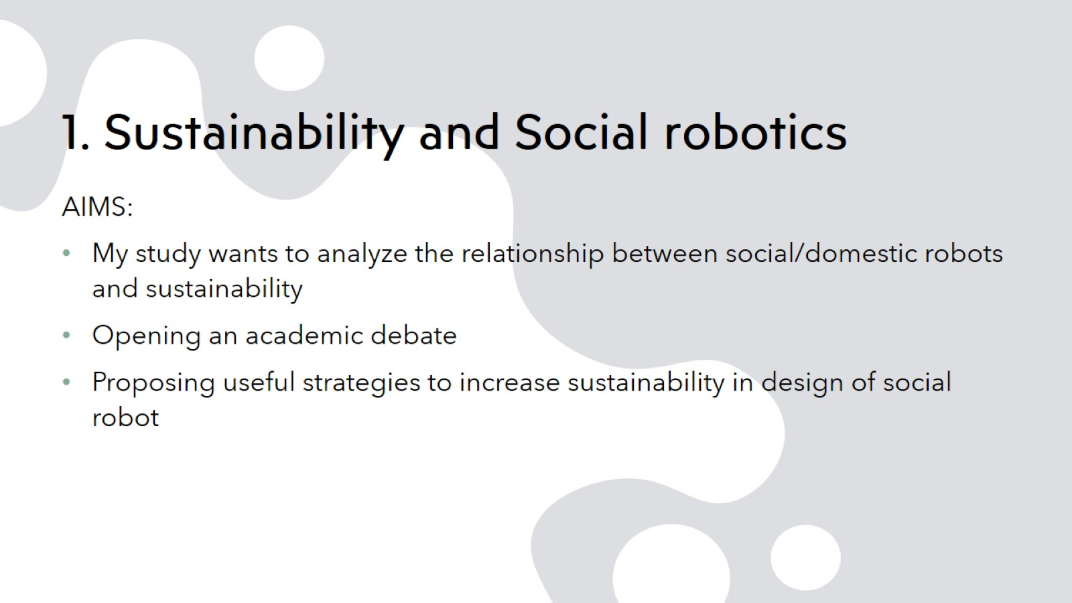
1. Sustainability and Social robotics

Slide 13

2.Methodology

Slide 14

2.Methodology

Slide 15
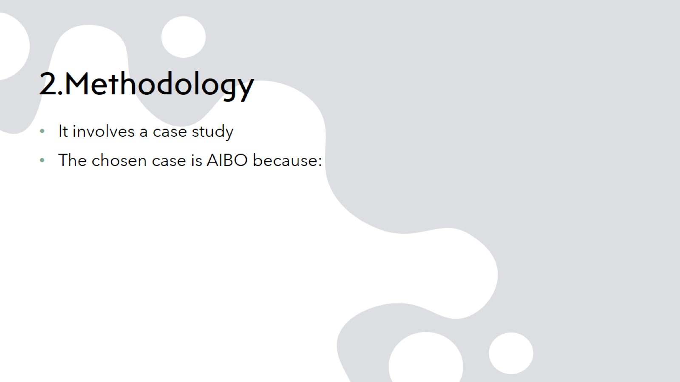
2.Methodology

Slide 16
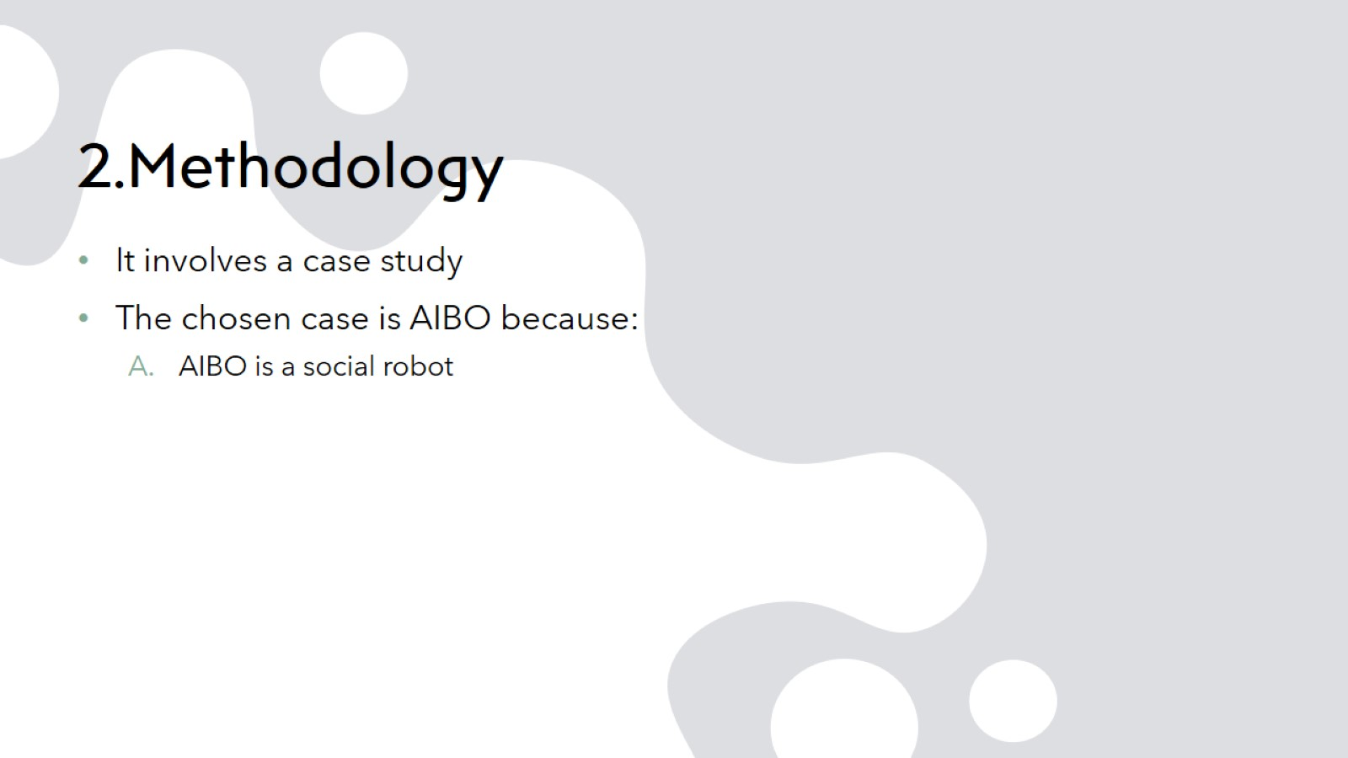
2.Methodology

Slide 17
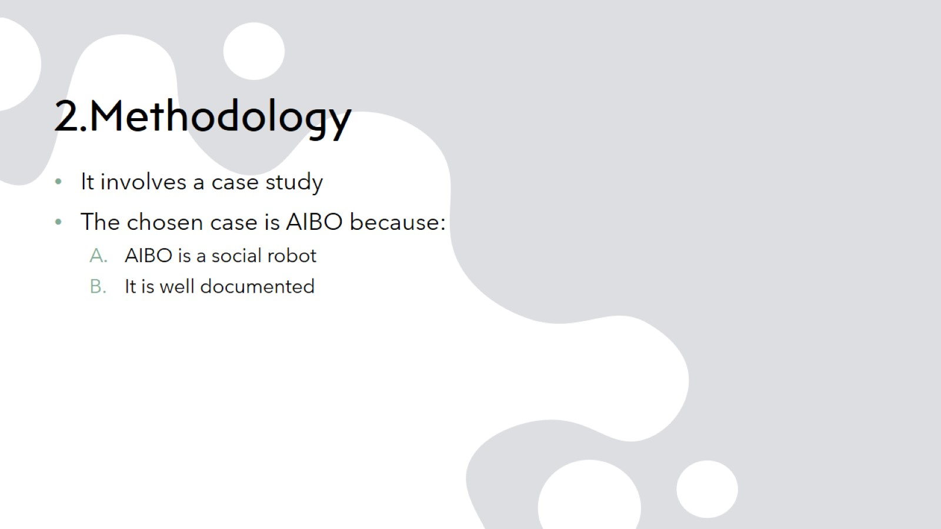
2.Methodology

Slide 18
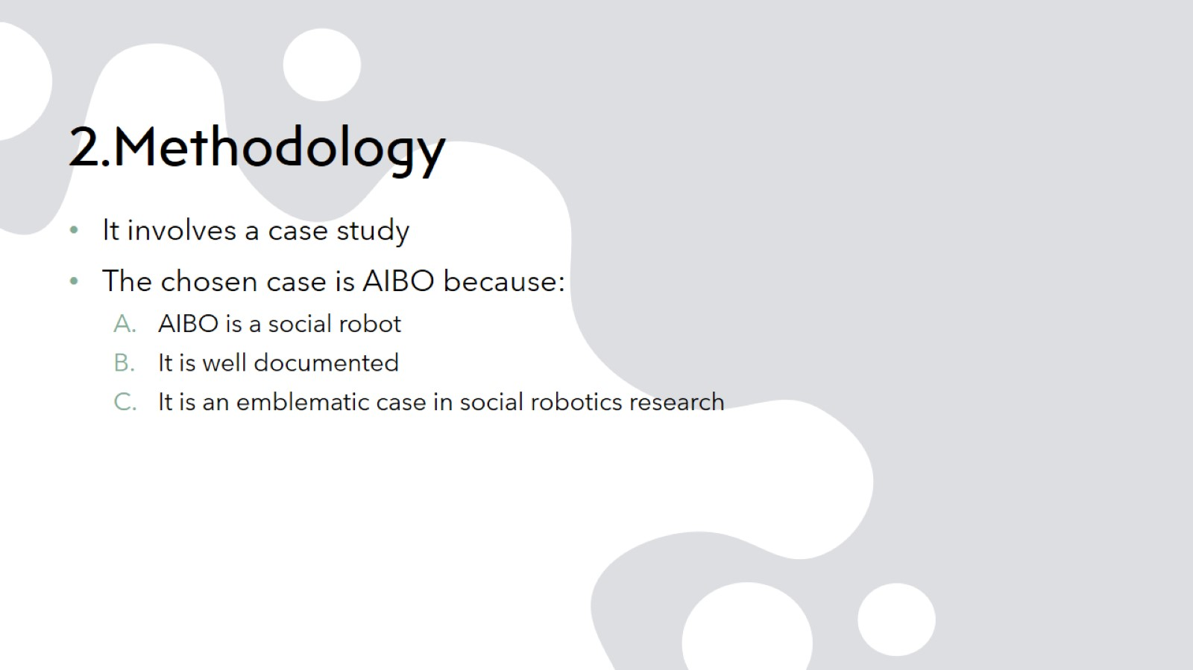
2.Methodology

Slide 19
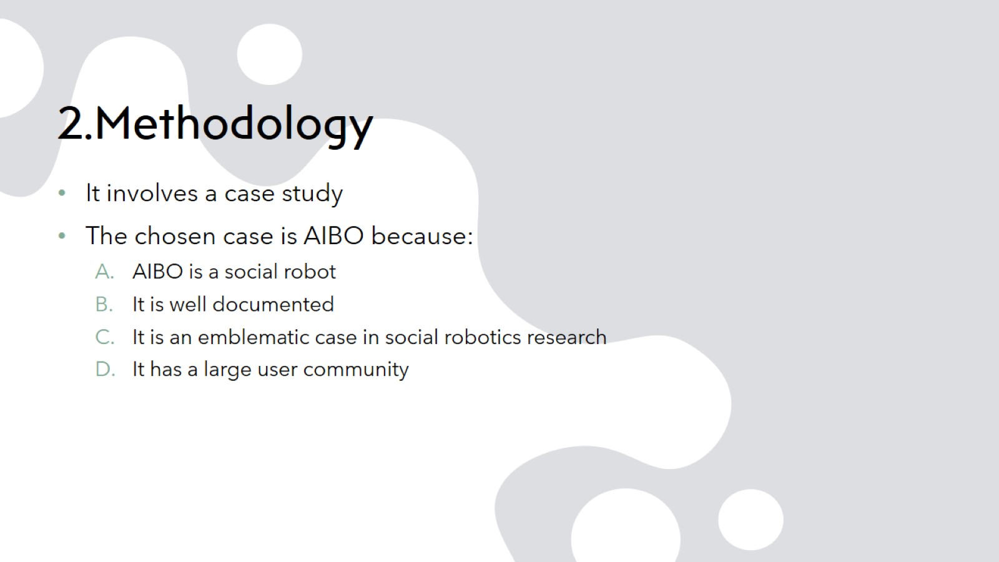
2.Methodology

Slide 20
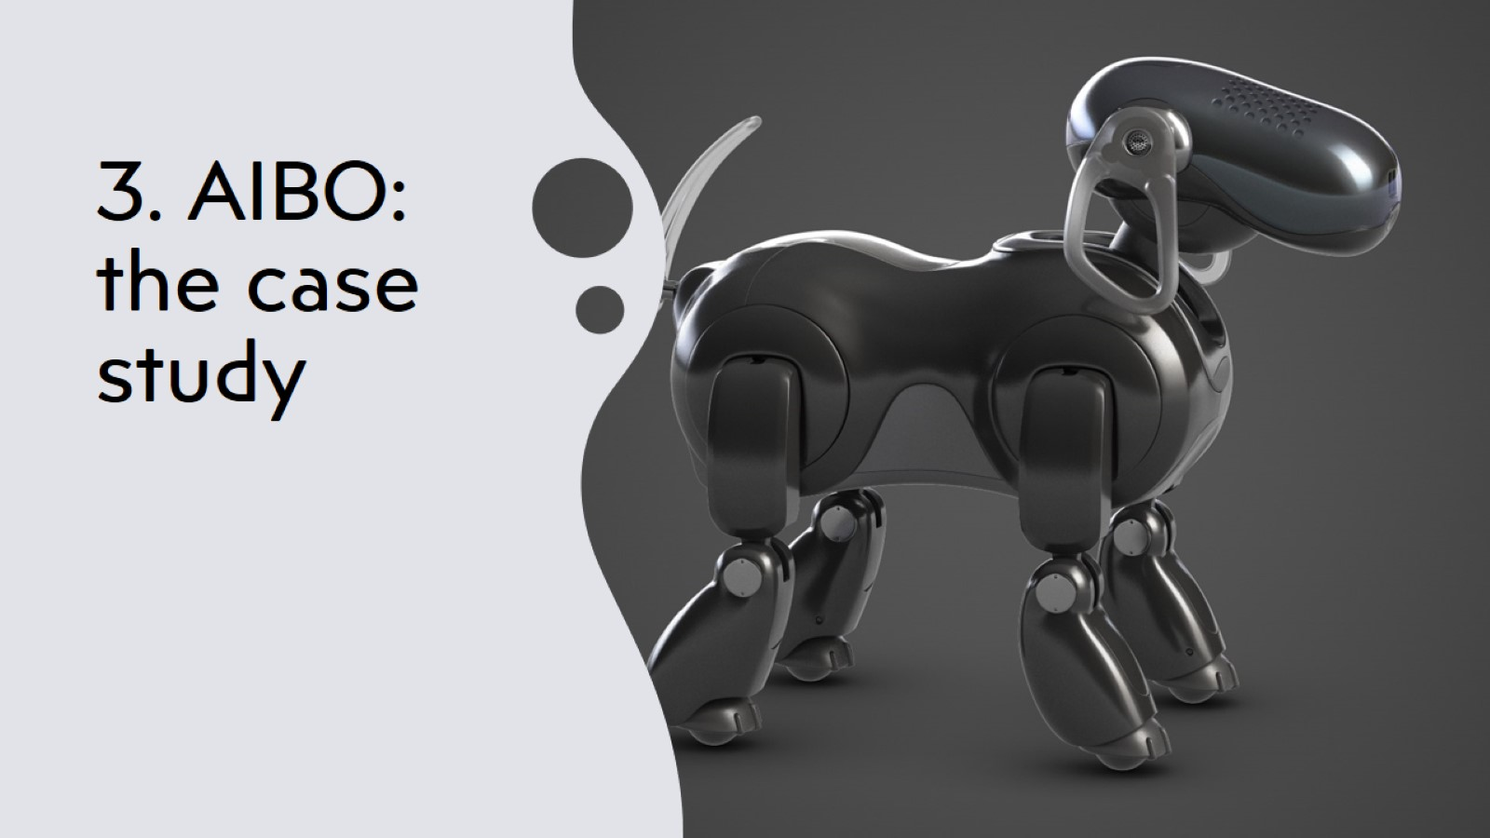
3. AIBO: the case study

Slide 21
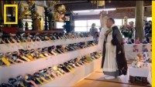
3. AIBO: the case study

Slide 22
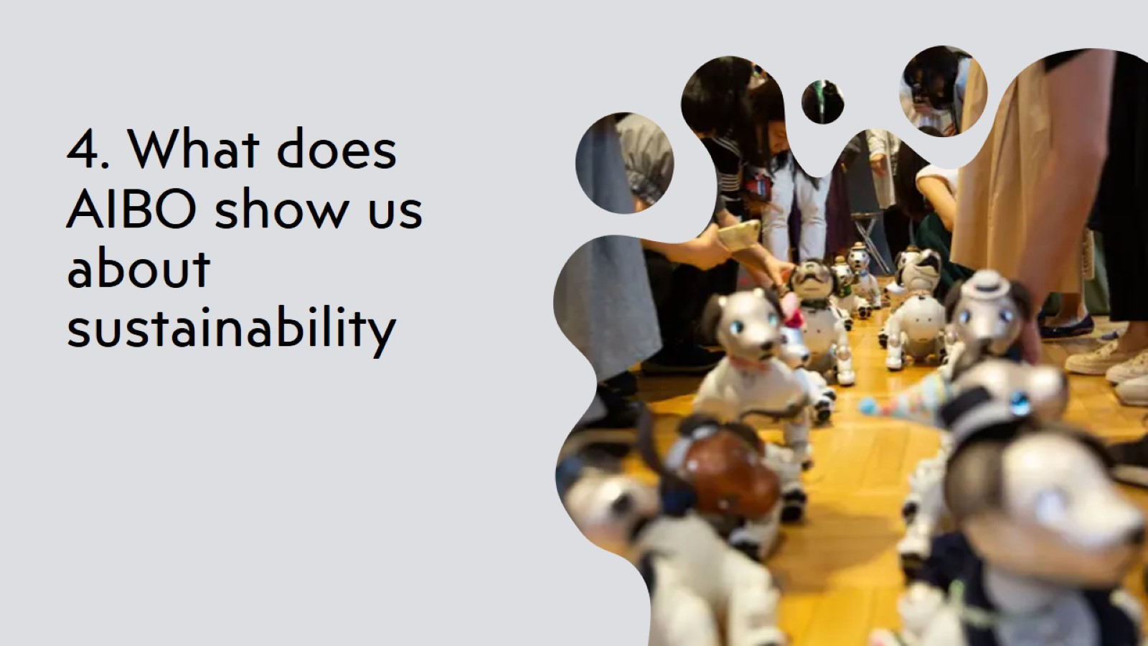
4. What does AIBO show us about sustainability

Slide 23
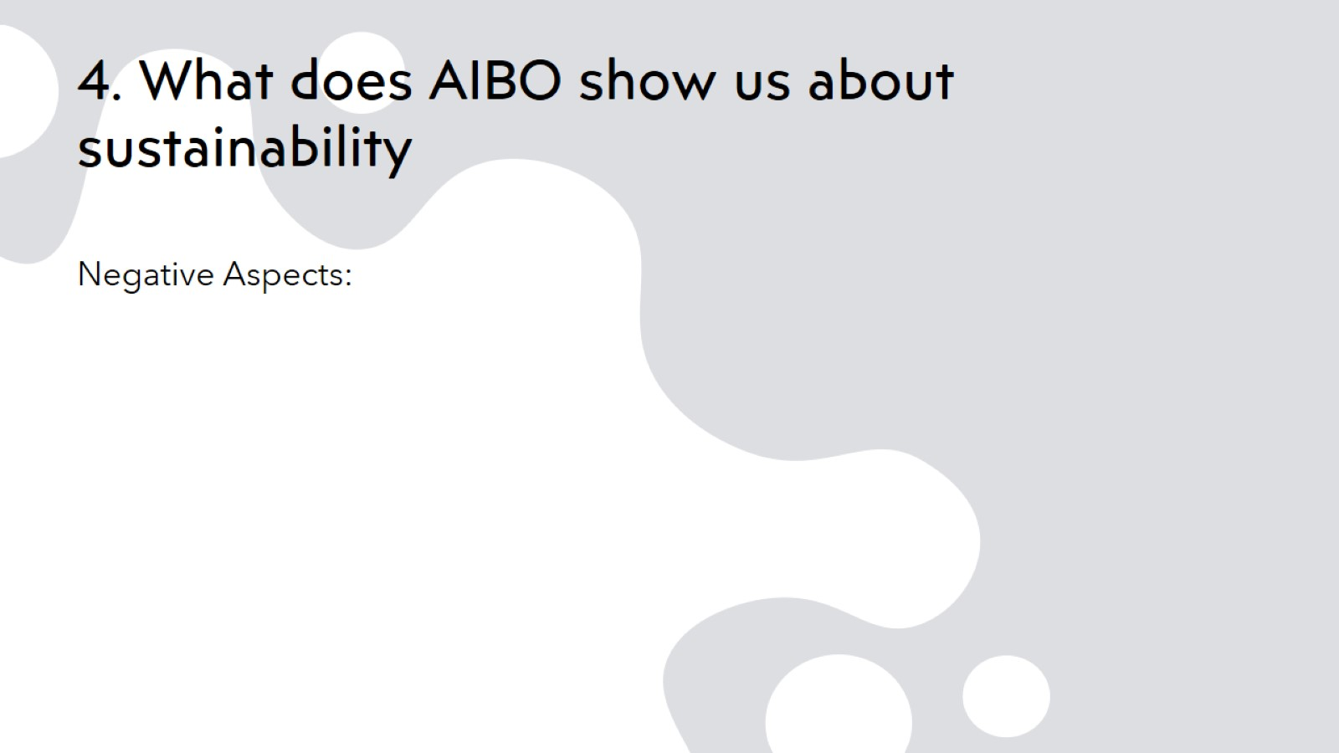
4. What does AIBO show us about sustainability

Slide 24
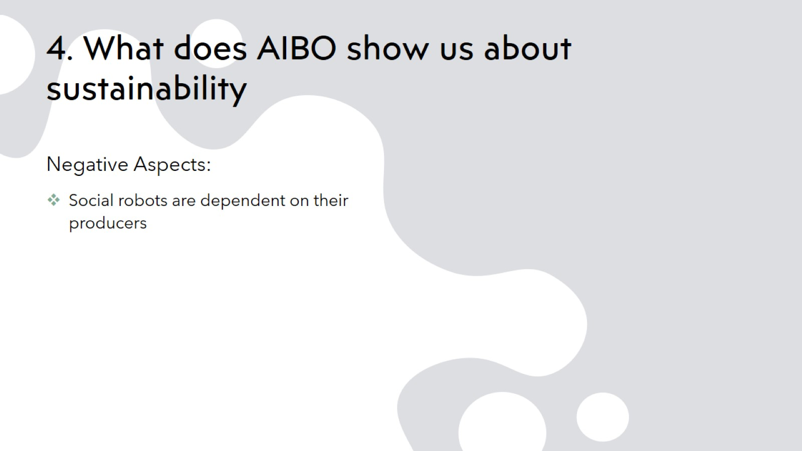
4. What does AIBO show us about sustainability

Slide 25
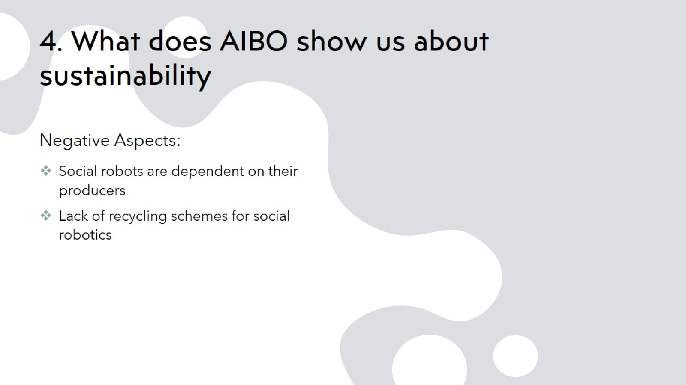
4. What does AIBO show us about sustainability

Slide 26
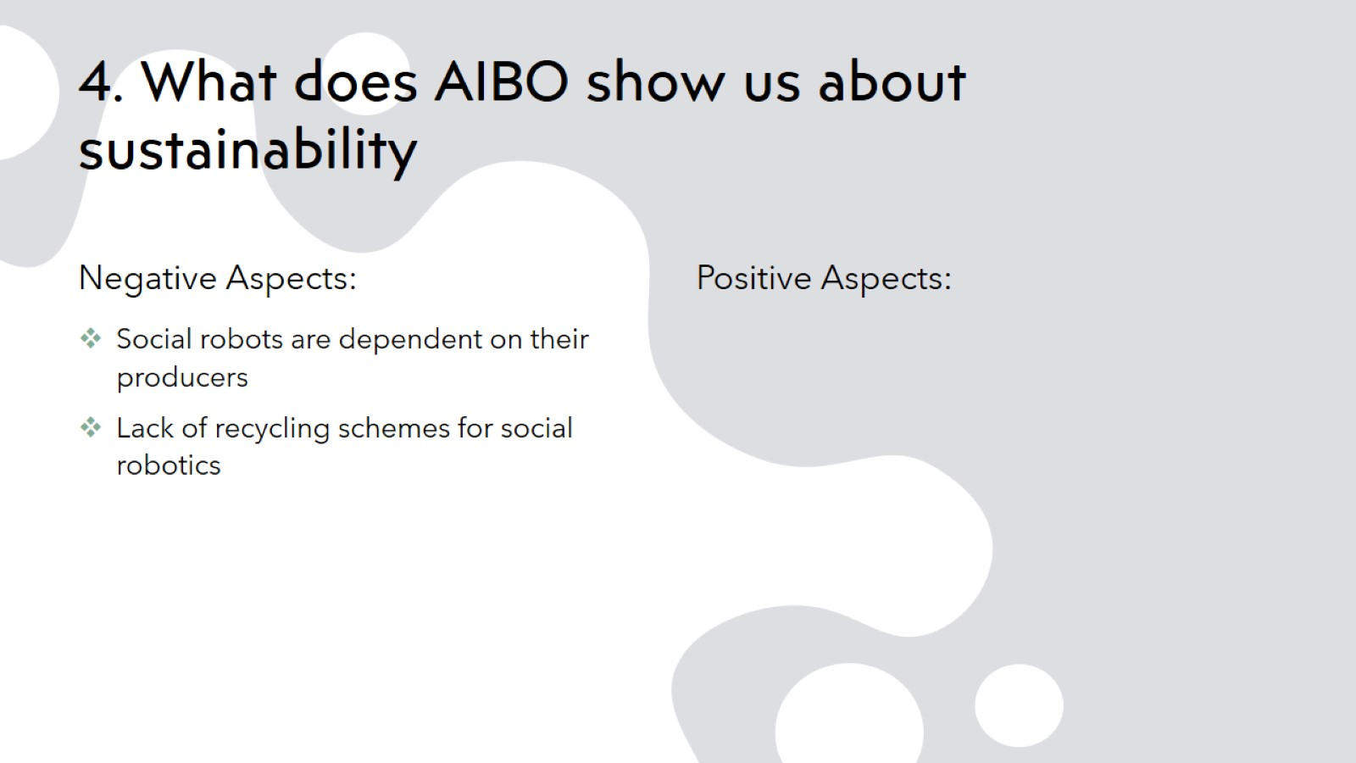
4. What does AIBO show us about sustainability

Slide 27
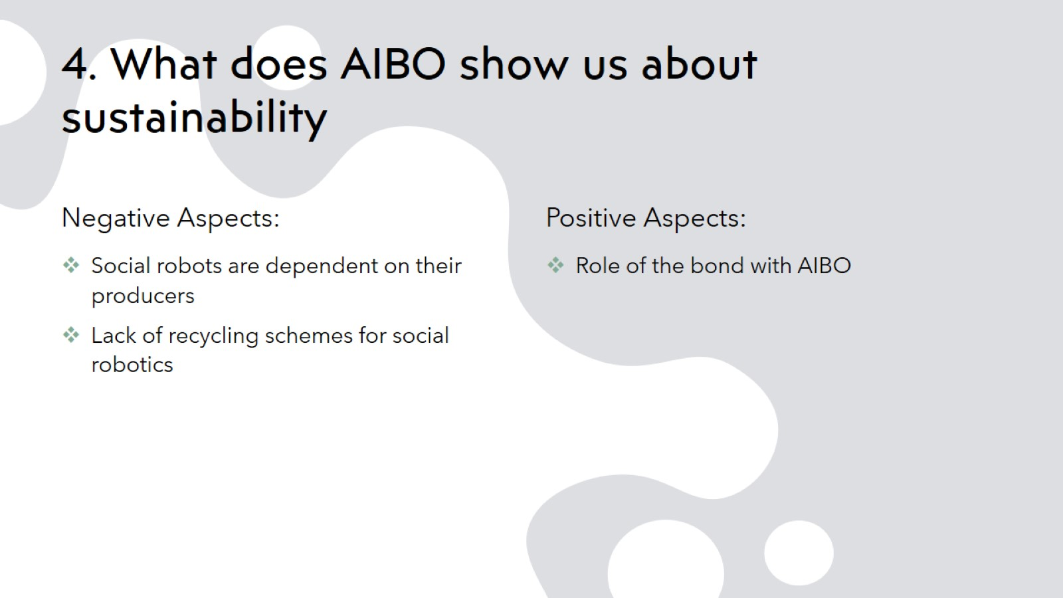
4. What does AIBO show us about sustainability

Slide 28
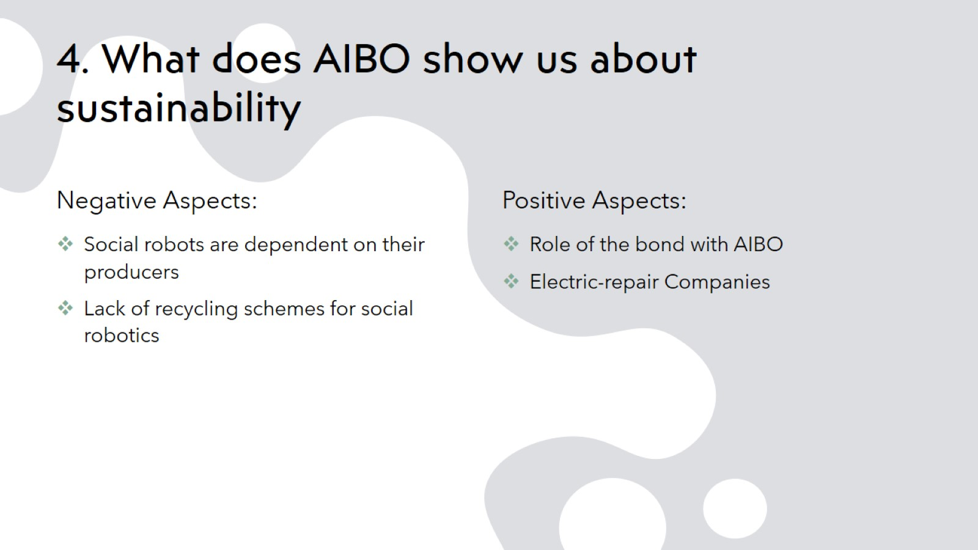
4. What does AIBO show us about sustainability

Slide 29
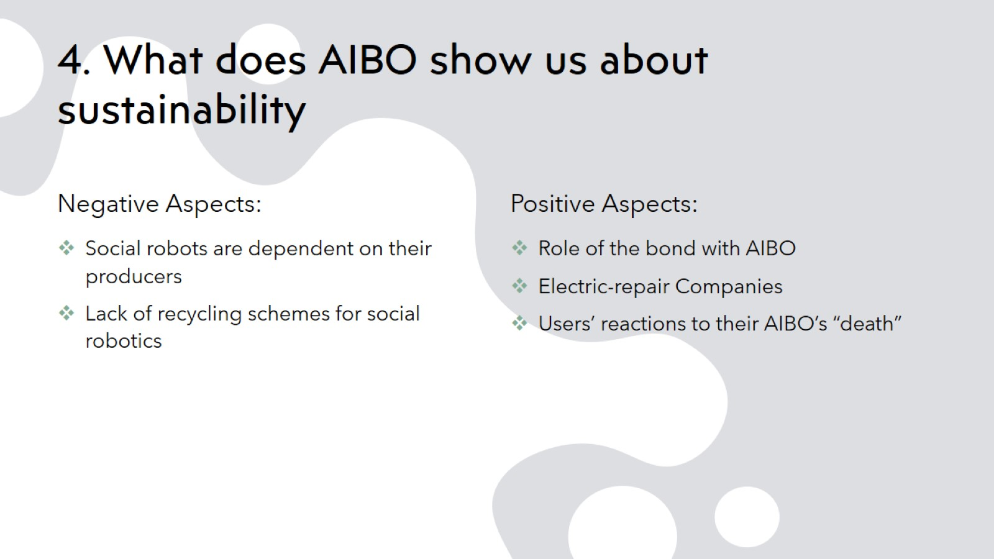
4. What does AIBO show us about sustainability

Slide 30
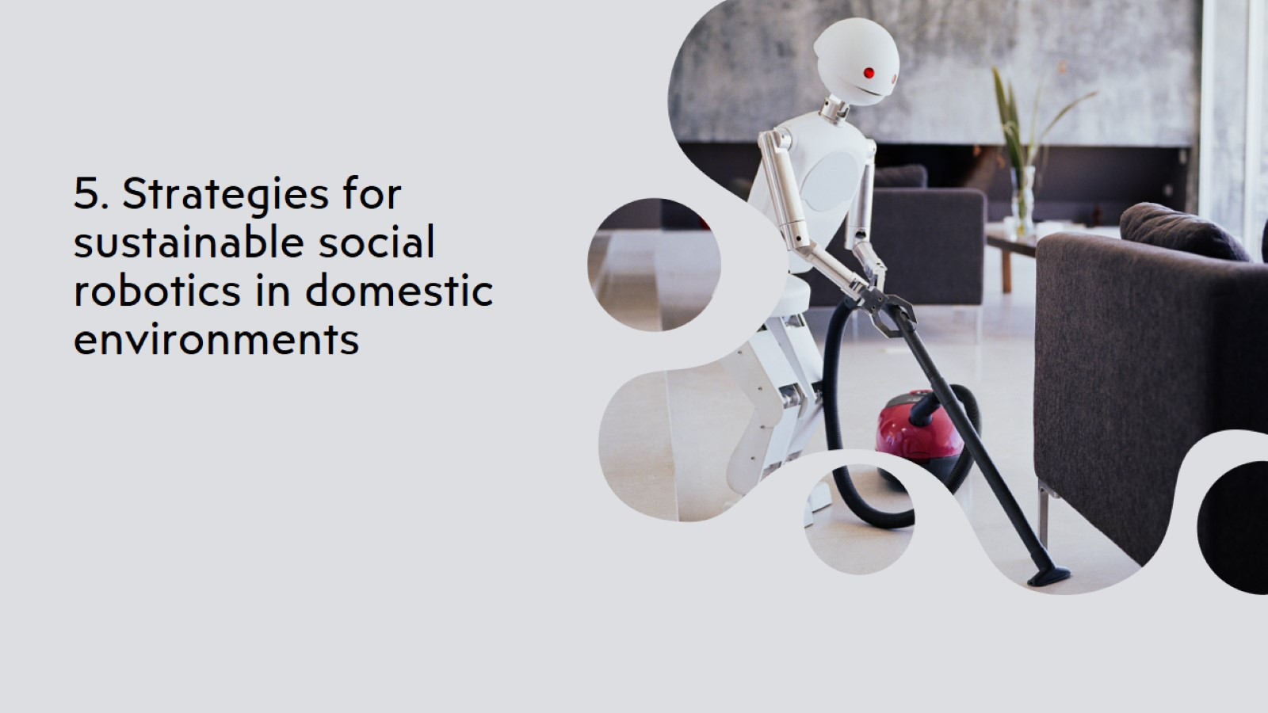
5. Strategies for sustainable social robotics in domestic environments

Slide 31
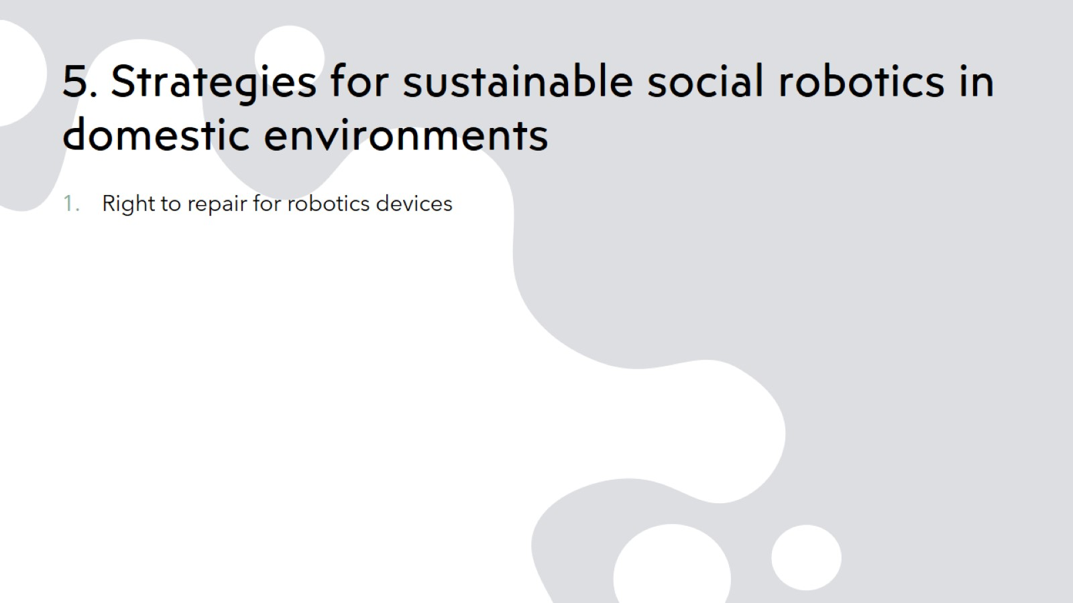
5. Strategies for sustainable social robotics in domestic environments

Slide 32
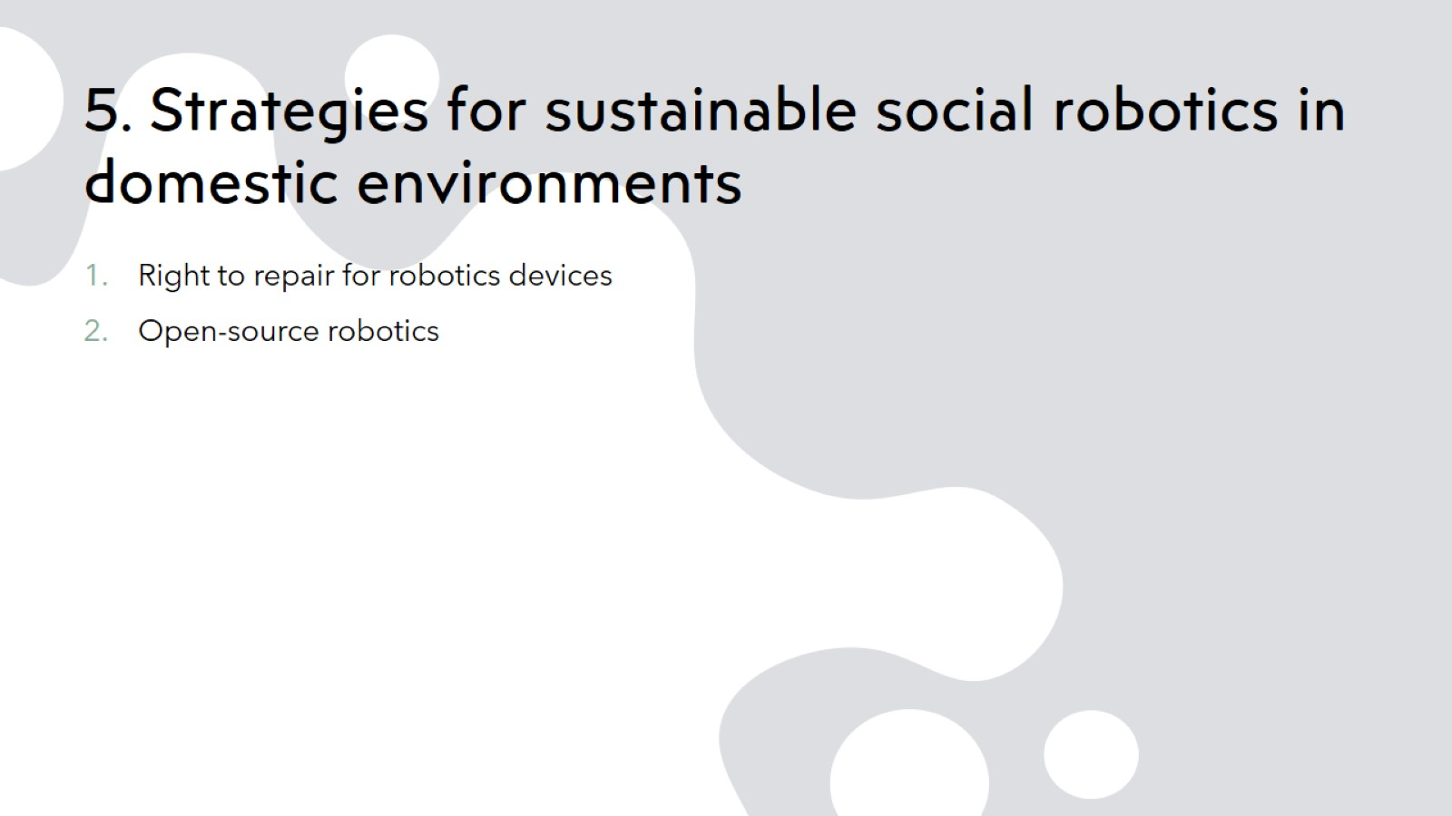
5. Strategies for sustainable social robotics in domestic environments

Slide 33
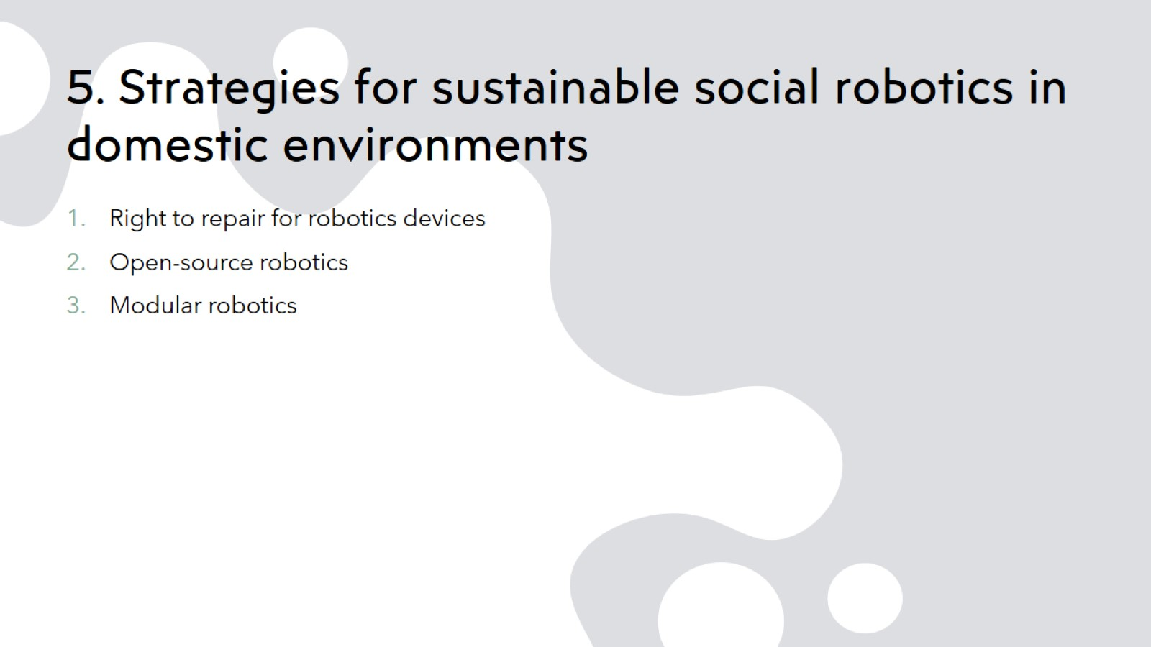
5. Strategies for sustainable social robotics in domestic environments

Slide 34
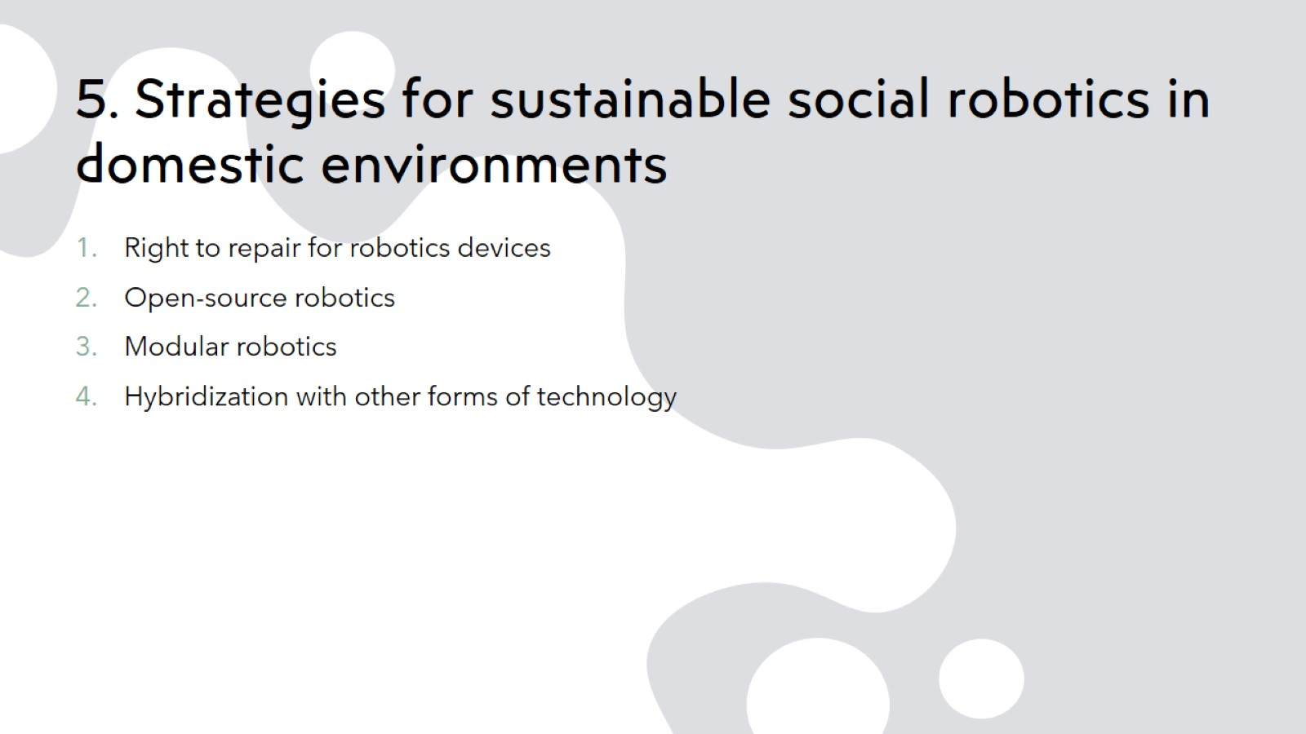
5. Strategies for sustainable social robotics in domestic environments

Slide 35

6. Conclusion

Slide 36
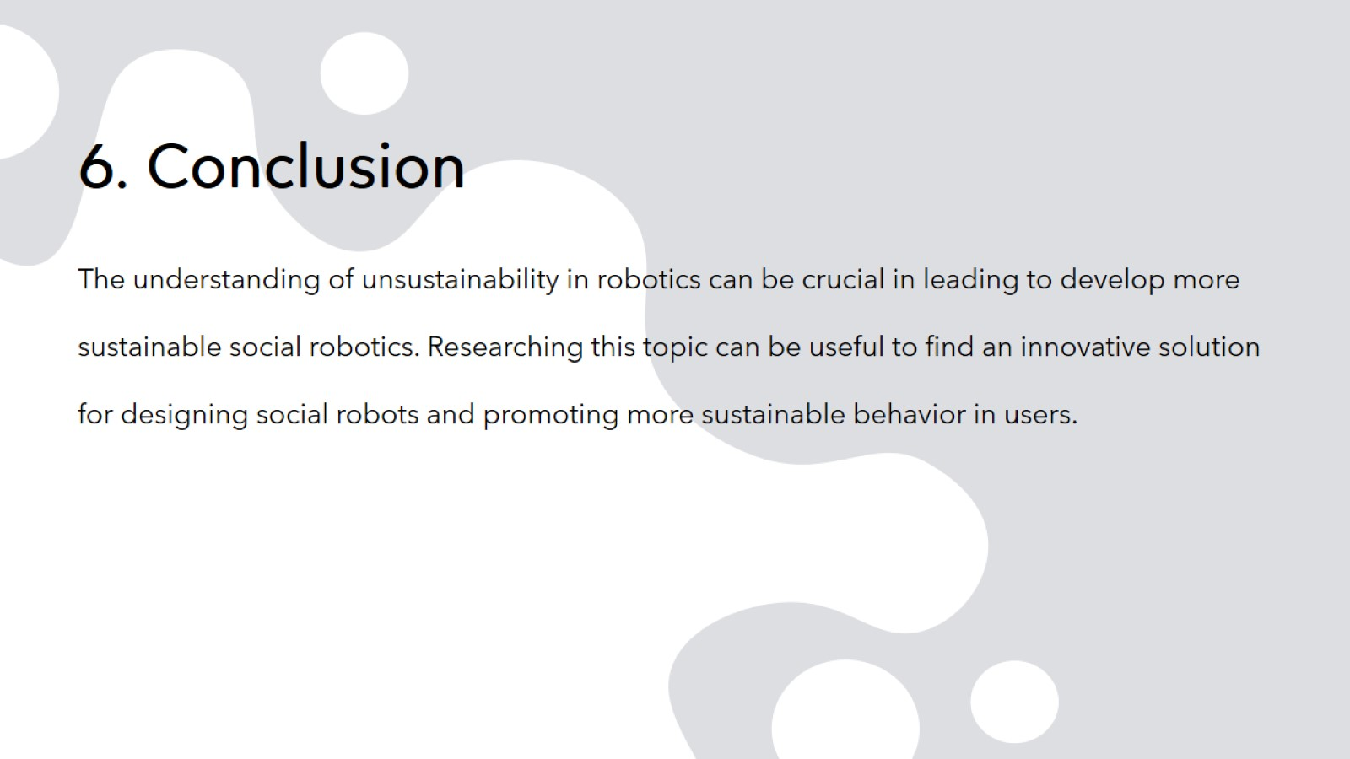
6. Conclusion

Slide 37

Thank you for your attention
antoniopietrougo.fleres@studenti.iulm.it

Slide 38

Questions?

