Slide 1

Somewhere in-between: inner speech and the proto-mental content
Dr. Mariela Destéfano
UBA-CONICET

Slide 2
Introduction
MENTAL CONTENT
Cognitivism: HARD PROBLE OF CONTENT
Enactivism: THE GAP PROBLEM

Slide 3
Introduction
Inner speech and reading acquisition:
PROTO-CONTENTS
“internal aboutness”
Hybrid explanation
Constructivism
Cognitivism
Enactivism

Slide 4
Assumptions
Human linguistic content
Ontogenetic account
Sociologized
Naturalized picture of the mind
Internalized
Gradualized

Slide 5
Early literacy
Pictorial stage
Phonological stage
Orthographic stage
MODELS OF READING:
LEXICAL ROUTE
SUB-LEXICAL ROUTE

Slide 6
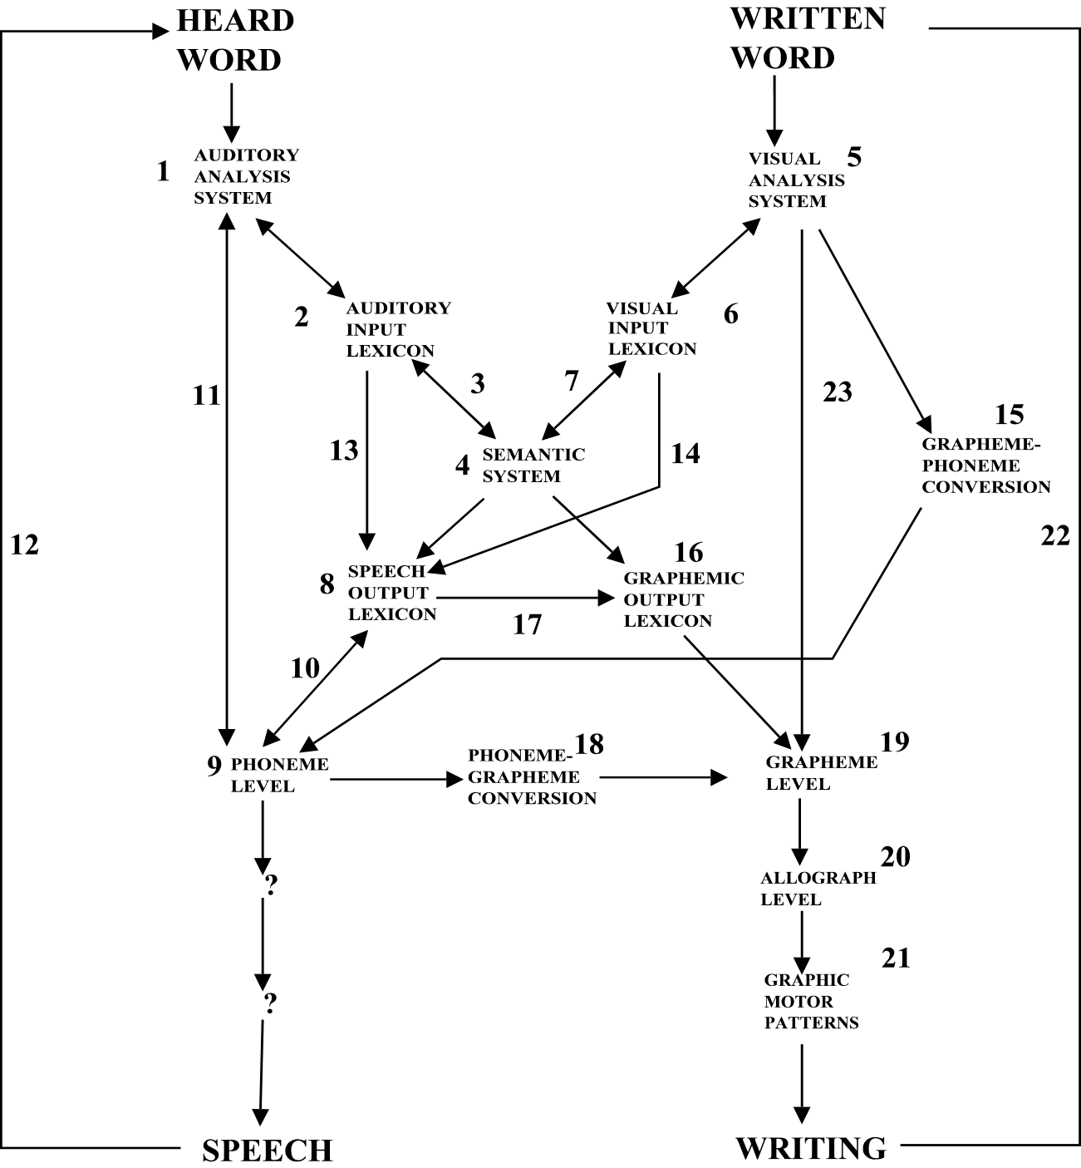
Redrawn from Ellis and Young (1988:222)

Slide 7
Inner speech
Cognitive functions:
Thought broadcasting, behaviour control, working memory, verbal self-regulation, reasoning, planning, memory, or attribution of mental states (Spelke 2003, Baddeley 1986, Law et al. 2013, Gilhooly 2005, Hardy 2006).
Vygotsky
PROBLEM SOLVING DEVICE
OVERT
SPEECH
PRIVATE
SPEECH
INNER
SPEECH

Slide 8
Inner speech
Liva et al.(1994)
“inner speech can be considered as a mediator between a text and a child, as mother reading a story to her child is a mediator between the book and the child” (p. 322).
Sokolov (1975)
Empirical evidence that during reading, inner speech becomes abbreviated when familiar text is encountered and that, conversely, when more complex text is encountered, inner speech becomes more expanded. If this is the case for children, then they must use expanded inner speech during reading acquisition.
Fernyhough (2004)
CONDENSED Inner speech
EXPANDED Inner speech

Slide 9
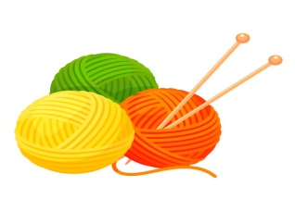



Inner speech
Gathercole (1998)
Phonological similarity effect around age 7
This effect shows that infant´s inner speech includes phonological information which could be useful for the grapheme-phoneme conversion involved in reading processes

Slide 10
Inner speech
THE PHONOLOGICAL RERHEARSAL CONCEPTION
Conversion rules
SUB-
LEXI
CAL
ROUTE
Phonemes
Gra
phemes
Expanded Inner
Speech

Slide 11
Proto-contents
“standing for” is characterized a mapping relation where phonological information (/cat/) serve as representations of the written words (“cat”).
The mapping displays an asymmetrical relation between phonemes and graphemes.

Slide 12
Proto-contents
Inner speech works as a consumer mechanism that exploits an observer-dependent mapping.
Mis-representation/Mis-application: In reading process, the system can fail to behave appropriately when it designates the wrong phoneme (/b/) to a target grapheme (“p”). Inner speech indicates these errors by performing the phonological rehearsal.

Slide 13
Proto-contents
Internal aboutness
Precursors required for adult contentful minds.

Slide 14
Firstly, proto-contents elude the gap between non-contentful and contentful minds simply because they are built on a cognitive architecture where there is no distinction between basic and non-basic capacities of the mind. Reading acquisition is taken into account and it should be considered as an hybrid capacity where cognitive and cultural aspects run together.
Secondly, proto-contents evade the hard problem of content since they depart from the assumptions owned by informational theories. In fact, proto-contents have conditions of satisfaction and the subpersonal operations underlaying reading capacity are affected by mis-applications identified by inner speech.

Slide 15
Conclusion
I proposed some features of a reading model where inner speech works together with graphemes-to-phonemes conversion rules. Proto-contents supervene on these operations and this evidences some kind of internal aboutness.

