Slide 1


C I F M A - 2 0 2 1
Monday, 6 December 2021
Fostering Safe Behaviours
via Metaphor-based Nudging Technologies
Georgi Stojanov
Dept. of Computer Science, Mathematics, and Environmental Science
The American University of Paris, France
Francesca Ervas
Dept. of Education, Psychology, Philosophy
University of Cagliari, Italy
Giuseppe Lorini
Dept. of Law
University of Cagliari, Italy
Artur Gunia
Dept. of Cognitive Science
Jagellonian University, Poland
Bipin Indurkhya
Institute of Philosophy
Jagellonian University, Poland

Slide 2
The aim of the research project
New technologies
New behaviours
New norms
In the Covid-19 context
New behaviours
Nudging people via metaphor

Slide 3
Research questions
Can we design artificial agents to recognize inappropriate and unsafe behaviors?
How to design a metaphor-based interface of artificial agents that relevantly and effectively influence human decisions and choices in the event of improper behavior?
In this talk, we will explore the challenge of social distance to answering these questions and designing nudging technology based on the fire metaphor.

Slide 4
Social distance
WHO recommendation: at least 1m people away from each other to be safe and reduce the transmission.
The human distance perception (Yamamoto 2017): difficult to accurately estimate for an artificial agent.
The spatial distance: easy to measure and maintain by an artificial agent, difficult for humans:
They need to be explicitly instructed (with explicit reminders as written and visual normative rules).
Despite the reminders, this restriction was (and still is) most often not properly respected.

Slide 5
Spatial distance and social closeness
Social distancing “pushes against human beings’ fundamental need for connection with one another” (Zaki 2020).
The lack of social closeness can be at the roots of serious mental health problems: while affective and social support can help people during the pandemic in this respect (Abel & McQueen 2020).
Previous research:
computer games can trigger (moral) emotions, especially in case of immoral behaviour (Tangney, Stuewig & Mashek 2007).
certain social behaviors in the virtual world can be translated into behaviors in subsequent social interactions by cognitive technologies influencing emotions (Gunia 2019).
The “quantified self”
or
self-tracking

Slide 6
Nudging technologies
Self-tracking tools can be regarded as an element of motivational cognitive enhancement, to provide a better perception of needs, to stimulate and supplement cognitive processes and emotional feelings (Gunia 2019):
apps for mobile phones (MapMyFitness or Runkeeper), based on the optimization of basic physiological processes.
apps for self-improvement, based on scheduling and self-control, and finally self-awareness.
Persuasive technology can also positively influence social agency and connection to the environment via indirect reinforcement and suggestions (Berger 2020; Matsumura et al. 2015).
The Nudge theory (Thaler & Sunstein 2009) focused on “pushing” someone in some direction, by exploiting his/her cognitive biases.

Slide 7
Nudging: some limitations
Defining “nudging” (as manipulation of choices) independently from “regulation” implies accepting as nudging any attempt to influence someone else’s behaviour, even by merely granting information (Lorini & Moroni 2020).
Nudging effects are short-lived (Kelly et al. 2013) and their effectiveness depends on the correct identification of:
1) the mechanisms through which information influences behaviour; 2) the motivations for specific (in)appropriate behaviour; 3) the specific context in which the target behaviour occurs (Bicchieri & Dimant 2019).
Language and visual format of the conveyed messages matters for nudging (Schultz et al. 2007), thus different framings of the messages can bring to the failure of the nudging itself.

Slide 8
A metaphor-based interface
A metaphorical representation can provide people with a conceptual model of the (social) world, but can also be the basis to build conceptual models of how persuasive artificial agents can influence human behaviour.
Metaphor is a cognitive process through which a (generally more abstract and less known) target conceptual domain is seen in light of a (generally more concrete and better known) source conceptual domain (Lakoff & Johnson 1980; Bowdle & Gentner 2005).
Metaphor is thus a useful conceptual tool not only to design interfaces in human-computer interaction (Colburn & Shute 2008), but also to represent messages from artificial agents that can be easily understood by laypeople (Klingen 2018).

Slide 9
Metaphor as a reasoning device
Metaphor implicitly accompanies the audience along a path of inferences from the source to the target conceptual domain.
Metaphor is never “neutral”: it provides a figurative frame that makes the audience ignore some properties of the source and select other properties, which become prominent (Entman 1993; Semino 2008; Burgers et al. 2016).
Thus, metaphor as a reasoning device has an “ignorance-preserving trait” (Arfini et al. 2018; Ervas 2019): it gently “pushes” the audience to select the relevant properties of the source to understand the target, while other properties of the source remain ignored.

Slide 10
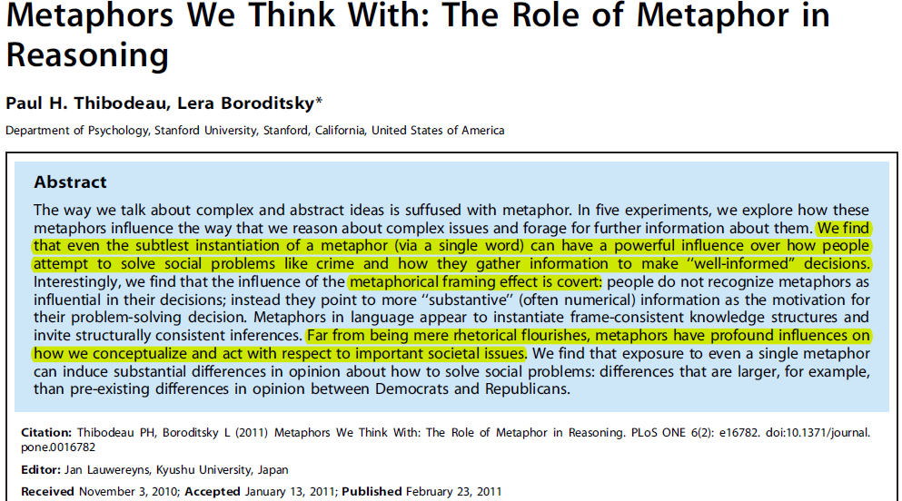
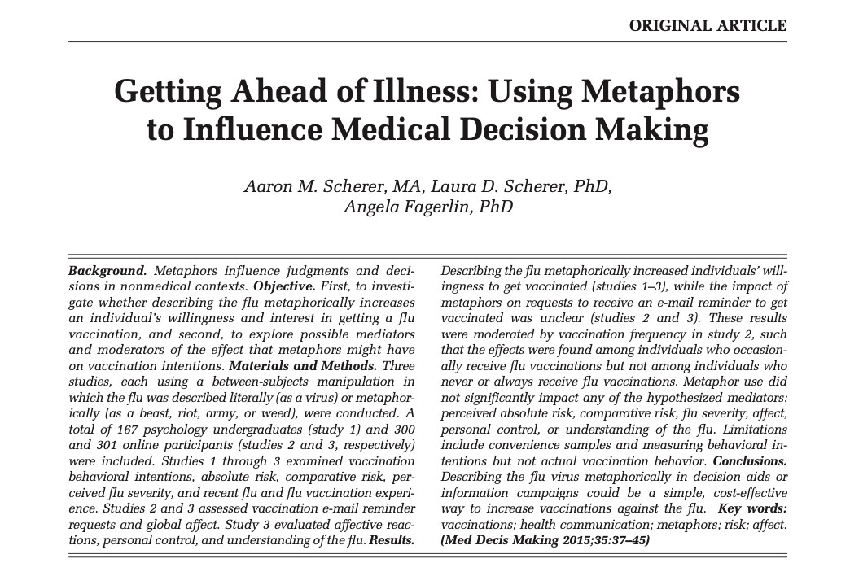
Metaphor and decision making
MEDICAL DECISION MAKING/JANUARY 2015

Slide 11
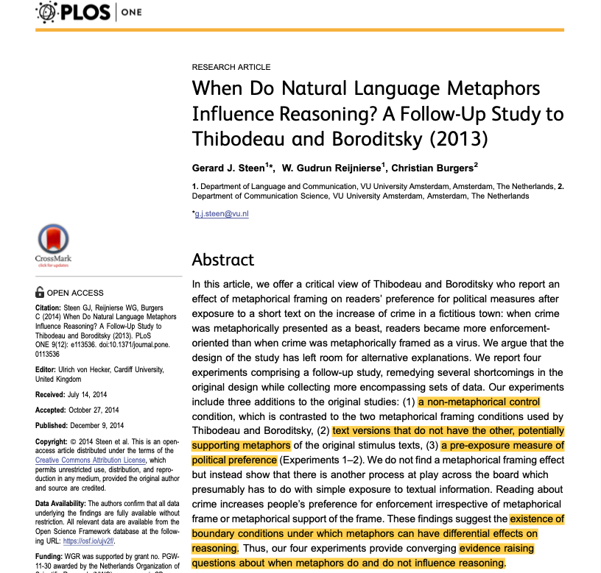
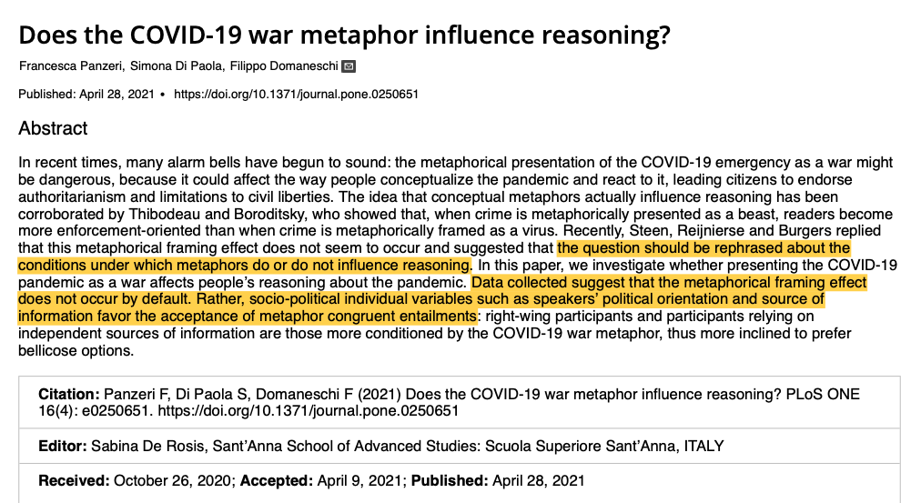
Framing effect: some limitations

Slide 12
The war metaphor for Covid-19
The war metaphor has been largely applied in discourse to describe illness and therapy management, especially in oncology to conceptualize a phenomenon that is difficult to express in literal terms (Sontag 1978, Semino et al. 2018).
As the war metaphor is highly conventional and frequent in health communication, it is easier to understand when compared to new and creative metaphors.
However, scholars highlighted the negative entailments: feelings of anger or sadness in perceiving them as losers in a war that was not in their control.
More recently, the war metaphor has been applied to the Covid-19 pandemic, moving it to a collective health context, with both negative and positive entailments (Marron et al. 2020). Thus, other metaphors have been proposed: #ReframeCovid Initiative.

Slide 13
Reasoning conditions
An experimental study (Robyns & Mayer 2000) on the use of metaphor for the solution of everyday dilemmas showed that the framing effect also depends on reasoning conditions (Cf. Ervas, Salis, Fanari, WPRN-439252).
The authors proposed the metaphor processing termination hypothesis: when a metaphor is unnecessary, not consistent with the reasoner’s understanding process, or increases ambiguity, the metaphorical framing effect decreases.
Other empirical studies (Ervas et al. 2018, 2021) have shown that conventional metaphors can lead people to revise the premises of the reasoning processes to hold their (already believed) conclusions while creative metaphors can help them in finding alternative solutions, but this might crucially depend on the affective coherence of the source with the target of the metaphor.

Slide 14
The fire metaphor for Covid-19
As pointed out (Semino 2020, 2021), the fire metaphor for Covid-19 could be more effective in communication and reasoning about health emergencies:
Beyond evoking vivid and rich images, it can:
convey danger and urgency,
help in explaining the different phases of the pandemic,
how transmission happens, and the role of individuals within that,
how the pandemic connects with health inequalities.
Most importantly for our research, while the war metaphor cannot explain measures for reducing contagion, in the fire metaphors people are “trees” and “fuel”, thus exploiting “the forest fire scenario” to communicate the effectiveness of social distancing.
These might be the basic elements to build a metaphor-based interface suggesting how to avoid the spreading of the fire: via “spatial” distancing.

Slide 15

A fire is also enlightening and warming…
What is missing in Semino’s analysis is that fire is also used as a metaphorical frame to entail affective “warmth” and “enlightenment”.
Other studies (Frankfort 2021; Schnell & Ervas 2021) suggested that Covid-19 as enlightenment entails a call to change and find a new direction in life: quarantine and spatial distance were also times and places where to think about our (pre-pandemic) life, making sense of the new situation and finding creative ways to socially connect to others.
These might rather be the basic elements of a metaphor-based interface to promote “social closeness”, besides “spatial distancing”.

Slide 16

The fire visual metaphor
An example of fire visual metaphor in a short video is provided by the graphic designer Juan Delcan, who depicted Covid-19 as a fire spreading via matches, alias people, who need the “right” distance to stop Covid-19 spreading.

Slide 17
A disruption in familiar conceptualization
As previously argued (Indurkhya & Ojha 2013; Ervas 2019), a visual metaphor is inconsistent with our familiar conceptualization of the (social) world.
Nudging technologies could therefore exploit the unfamiliar or changed “architecture of the world” presented via visual metaphor.
The visual version of the fire metaphor can thus be realized in different ways in the interface:
1) homospatiality (i.e., the physical co-impossibility of the two discrete entities occupying the same space);
2) suspension of functionality (regarding objects or spaces);
3) unexpected affordances.
In the example provided by Delcan, it is realized via suspension of functionality (of the match), alias the suspension of functionality of a person as a vehicle for Covid-19 contagion.

Slide 18
Conclusions
In this paper we explore the idea of a metaphor-based interface for technologies designed to nudge social distance.
Especially when novel and creative, metaphors can help us in focusing on the target from a completely new perspective, questioning previous beliefs held as true or reframing them, thus providing a new conceptualization that can change our view of the social world.
In the development of the research, it will also be important to consider legal and surveillance issues, and from an ethical point of view, if the metaphor’s effect depends on different cultural contexts.

Slide 19
Questions and suggestions welcome
C I F M A - 2 0 2 1
3rd International Workshop on
Cognition: Interdisciplinary Foundations, Models and Applications
Monday, 6 December 2021 VIRTUAL EVENT organised by Nazarbayev University, Nur-Sultan, Kazakhstan, and the University of York, York, UK

