Slide 1
Estimation of brain tissue microstructure with dMRI
MediCSS 2022
Michele Guerreri
m.guerreri@ucl.ac.uk

Slide 2
Aim of the project
To explore different approaches of estimating brain tissue microstructure parameters from diffusion MRI data.

Slide 3
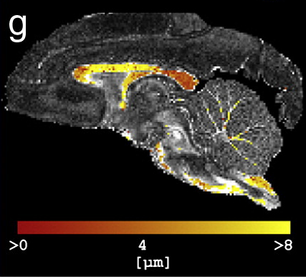
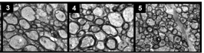
Why is this relevant?
The central vision in microstructure imaging is of virtual histology.
Barazany, Daniel, Peter J. Basser, and Yaniv Assaf. "In vivo measurement of axon diameter distribution in the corpus callosum of rat brain." Brain 132.5 (2009): 1210-1220.
Alexander, Daniel C., et al. "Orientationally invariant indices of axon diameter and density from diffusion MRI." Neuroimage 52.4 (2010): 1374-1389.

Slide 4
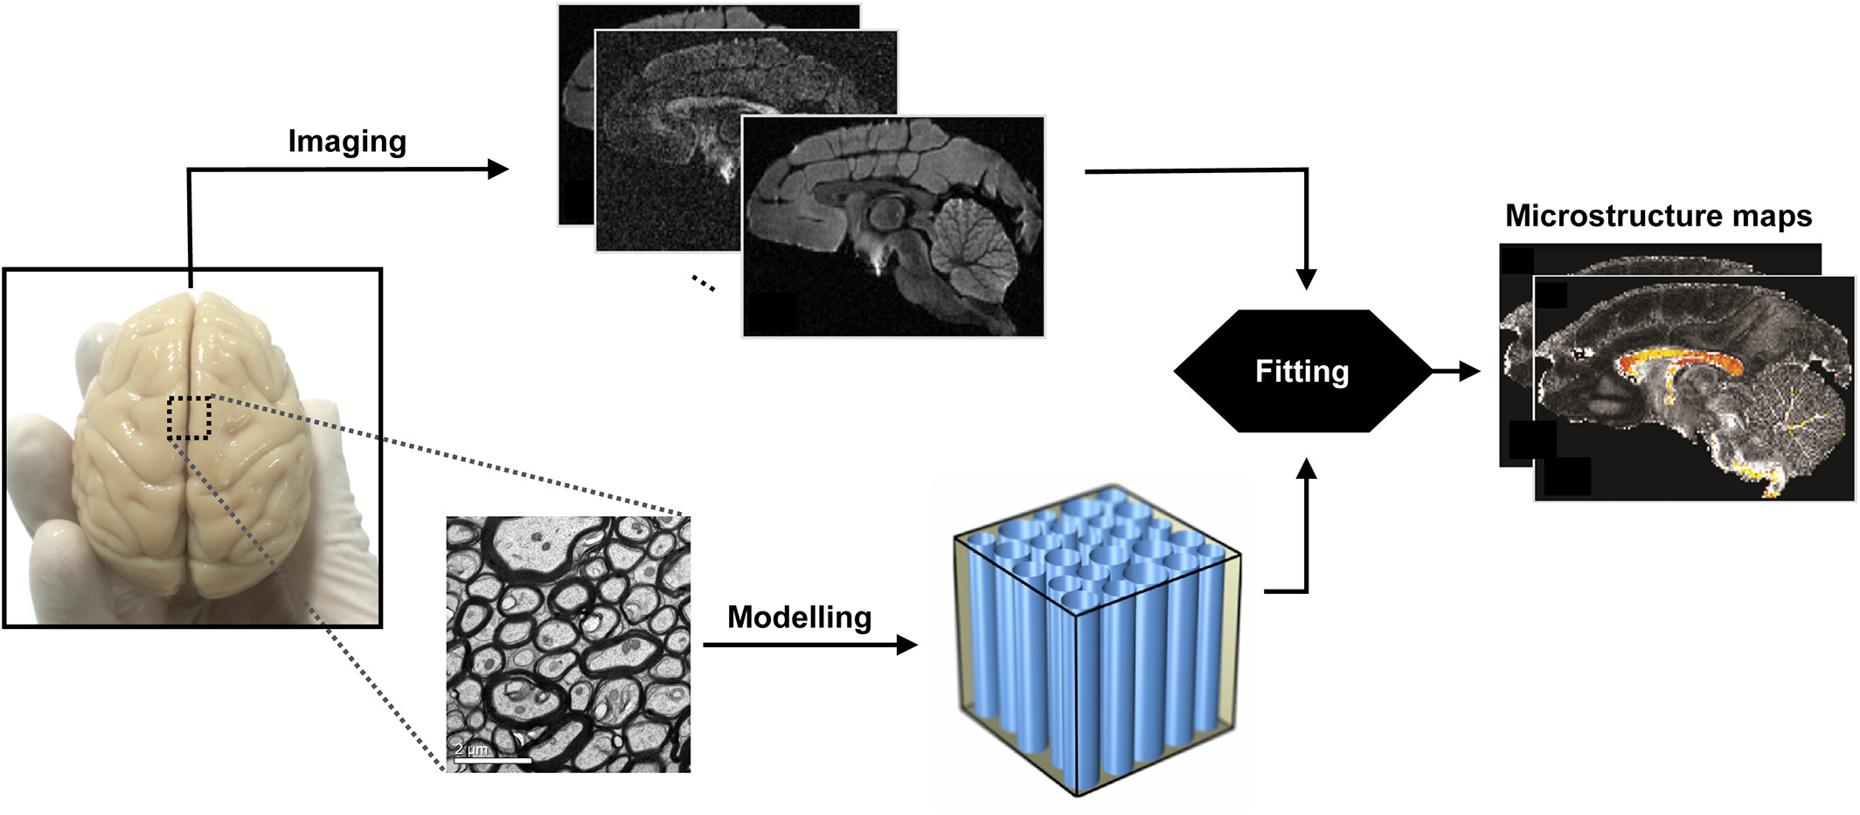
How can we do it?
We rely on a model that relates microscopic features of tissue architecture to MR signals.
Alexander, Daniel C., et al. "Imaging brain microstructure with diffusion MRI: practicality and applications." NMR in Biomedicine 32.4 (2019): e3841.

Slide 5
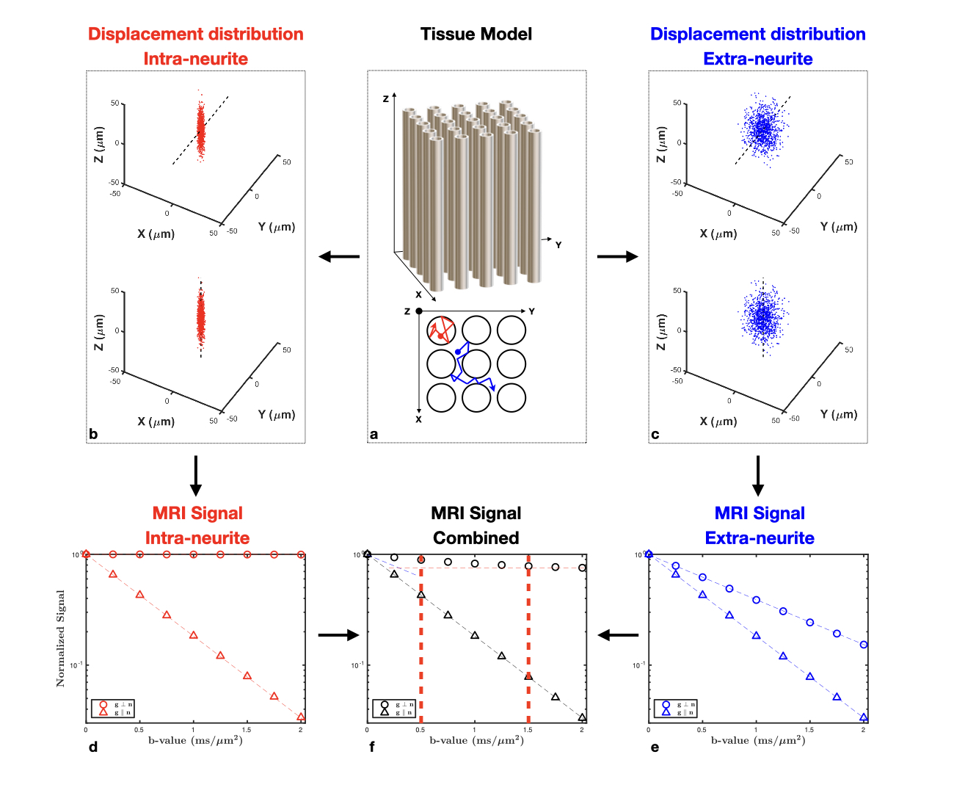
Why diffusion MRI?
Diffusion MRI (dMRI) has a unique sensitivity to cellular architecture.

Slide 6
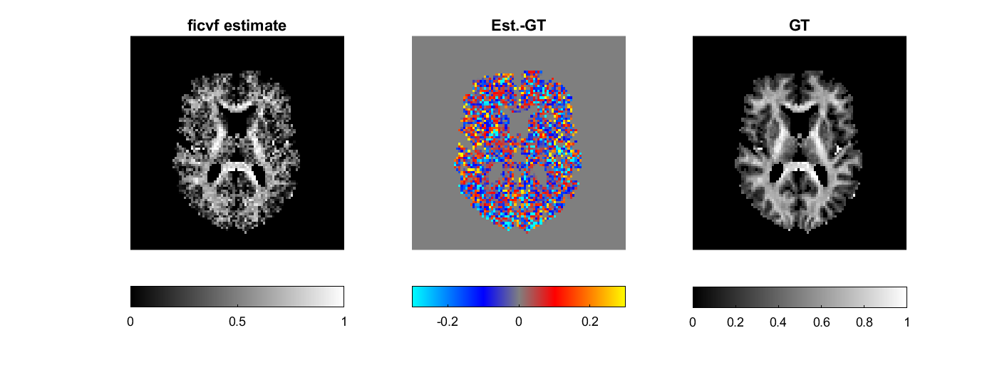
Parameter estimation - a key step.
Parameter estimation can be challenging.
There exist many different ways of tackling the problem.

Slide 7
Conventional parameter estimation
Problem statement:
We need to find the parameters (1) that make the data the model predicts (2) as close (3) as possible (4) to the data we observe.
Let’s break it down…

Slide 8
Conventional parameter estimation – key ingredients
We have some data
We identify a model
We need a systematic way to improve the parameter estimation
We need to measure closeness

Slide 9
Conventional parameter estimation - cons
Sub-optimal solutions are often found corresponding to local mininima.
The procedure can be extremely slow and computationally very expensive.

Slide 10
Machine learning as alternative
Machine learning (ML) and more specifically deep learning (DL) proposed as an alternative to overcome some conventional parameter estimation limitations.
Can be trained off-line and then deployed almost instantaneously.
Offer more stable solutions when trained accurately.

Slide 11
ML-based parameter estimation
Problem statement (supervised learning):
We need to learn a function (1) that can predict the parameters of interest (2) from the data observed (3), given a set of observed data and parameters of interest pairs (4) exampling the relation between the two.
Let’s break it down…

Slide 12
ML-based parameter estimation – key ingredients
We have some data and connected parameters
We need a function which connect the two
We need to measure closeness between estimated and true parameters
We need a systematic way to vary the function to improve the estimation

Slide 13
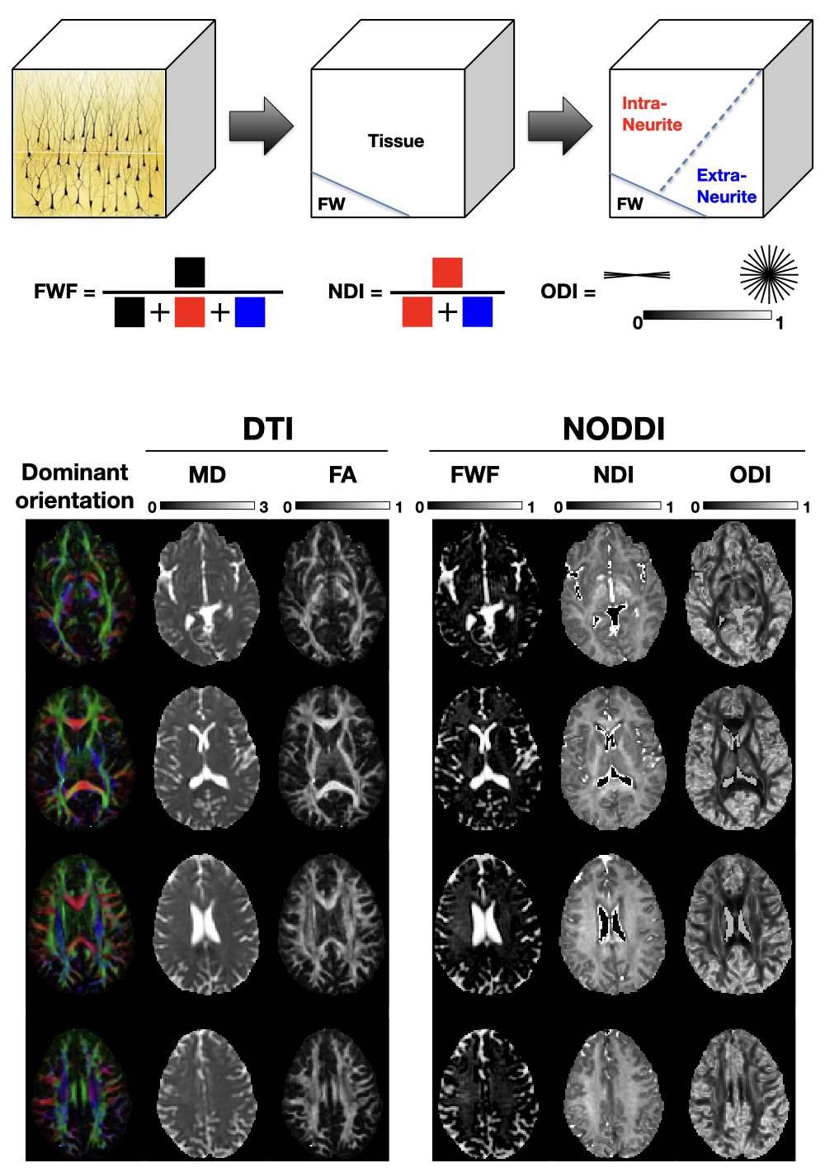
NODDI as example
Neurite orientation dispersion and density imaging (NODDI): a popular microstructure imaging model in neuroimaging.
Input
Output

Slide 14
What are you going to learn?
How to access and manipulate DWI data in Matlab.
How to explore diffusion data.
NODDI input and output, how to generate DW signal from the forward model.
How to run the parameter estimation via the conventional approach.
How to assess the parameter estimation performance.
How to run the parameter estimation via DL.

