Slide 1
Paper1
CVPR2017
Densely Connected Convolutional Networks

Slide 2
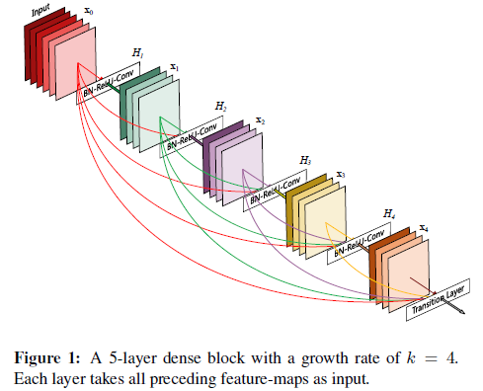
一. 简介
（1）强大之处：
1、 alleviate vanishing-gradient ： 2、 strengthen feature propagation 3、 encourage feature reuse 4、 substantially reduce the number of parameters
5、 state-of-the-art improvement
（2）对ResNet的拓展：
比起ResNet , 特征图传入下一层之前，绝不逐像素相加，而是
concat起来；因此，第l层有l个输入，包含前面所有卷积block
的特征图，而l层的输出特征图，将传递给所有的后继层.
（3）反直觉：fewer parameters
as there is no need to relearn redundant feature-maps. ResNet用恒等映射保持信息，很多层贡献很少，可以随机dropout, 使得
Resnet很像RNN，但Resnet每层都有权重，参数更多，
DenseNet layers are very narrow (e.g., 12 filters per layer),
adding only a small set of feature-maps to the “collective
knowledge” of the network and keep the remaining feature maps
unchanged—and the final classifier makes a decision based on all feature-maps in the network.
思路：比较DenseNet与ResNet，通道数设置多少才最合适？
（4）梯度流通更有效
每一层能直接获取损失函数ude梯度，以及最初的输入信号，有利于训练更深的网络；同时， dense connections具有正则化效果，可以防止过拟合

Slide 3
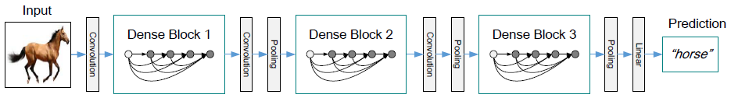
一. 细节
1. ResNets ： add a skip-connection that bypasses the non-linear transformations with an identity function：
3. Pooling layers:
将网络划分为多个 dense blocks，blocks之间添加
transition layers （ BN + 1*1_Conv + 2*2_average_pooling）
H() ：a non-linear transformation
BN + ReLU + Pooling or Convolution
X ： output or input
优点：梯度有恒等映射直接流向前一层
缺点：逐像素相加丢失特征，抑制梯度流通
4. Growth rate
若每个函数产生k个特征图，第l层 channel = k0+k(l-1)；
K一般设置较小, e.g. k=12
5. Bottleneck layers
当k0+k(l-1)较大时，卷积计算量较大;因此，在3*3_Conv前，
进行1*1_Conv以降低特征图的数目。
实验发现，最有效的设置:
H() : BN-ReLU-Conv(1*1)-BN-ReLU-Conv(3*3)
DenseNet-B : 1*1 convolution produce 4k feature-maps
2. Dense connectivity.
[x1,x2,…,xl]先concat再进行非线性映射
H() ： BN + ReLU + a 3 * 3 convolution
思路：每层作为concat的特征图，是否应该有权重？

Slide 4
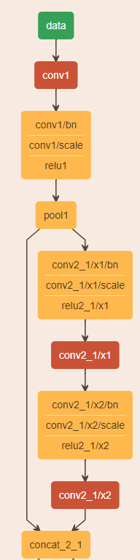
6. Compression:
reduce the number of feature-maps at transition
layers as for 0<a<1 scale size (a =0.5)
7. Implementation Details
1）Except ImageNet, DenseNet has three dense blocks that each has an equal number of layers.
2）Input : a convolution with 16 (or twice the growth rate for DenseNet-BC) output channels is performed on the input images.
3） conv layer : 3*3_conv-input is zero-padded to keep the feature-map size fixed.
4） transition layers : 11 convolution followed by 22 average pooling
5）the last dense block: a global average pooling is performed and then a softmax classifier is attached. The feature-map sizes in the three dense blocks are 32*32, 16*16, and 8*8, respectively.
6）Basic DenseNet : { L = 40; k = 12 }, { L = 100; k = 12 } and { L = 100; k = 24 }.
7）DenseNet-BC : { L = 100; k = 12 },{ L=250; k=24 }， and { L=190; k=40 }
8）ImageNet DenseNet-BC : 4 dense blocks on 224*224 input images. The initial convolution layer comprises 2k convolutions of size 7*7 with stride 2; the number of feature-maps in all other layers also follow from setting k.

Slide 5
Paper2
The One Hundred Layers Tiramisu:
Fully Convolutional DenseNets for Semantic Segmentation

Slide 6
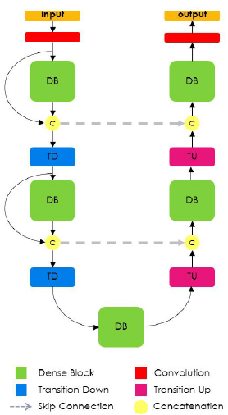
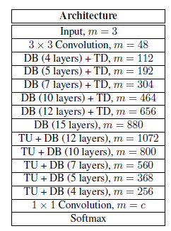
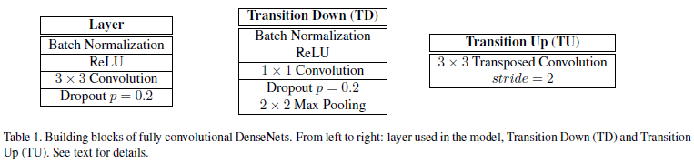
FC-DenseNet
DB : k = 16
1）引入类似FCN的反卷积和上采样，替换其反卷积操作为 DB + TU
2）DB的输出没有concat输入, 以降低 反卷积过程通道数，降低内存且加深网络
3）仅仅在dense模块后增加升采样通道，使每种分辨率的dense模块提取的特征不受池化层的影响
FC-DB103: 103 Conv
U-Net or FCN-like fashion
Pixel-wise cross-entropy loss

Slide 7
Paper3
ICCV DSOD
Learning Deeply Supervised Object Detectors from Scratch

