Slide 1
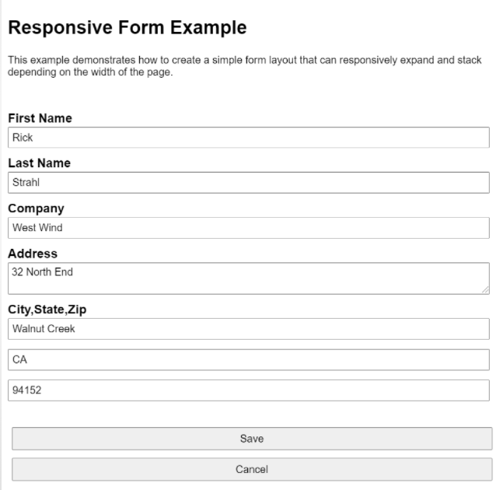
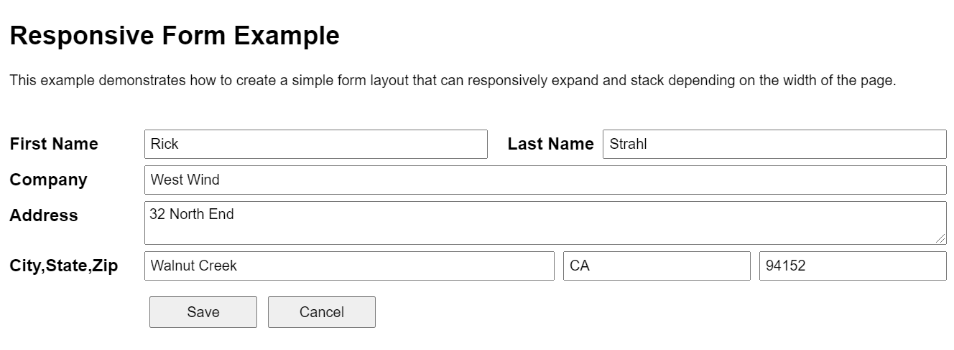
ASM
Notes:
https://codepen.io/rstrahl/full/rxmjgL

Slide 2

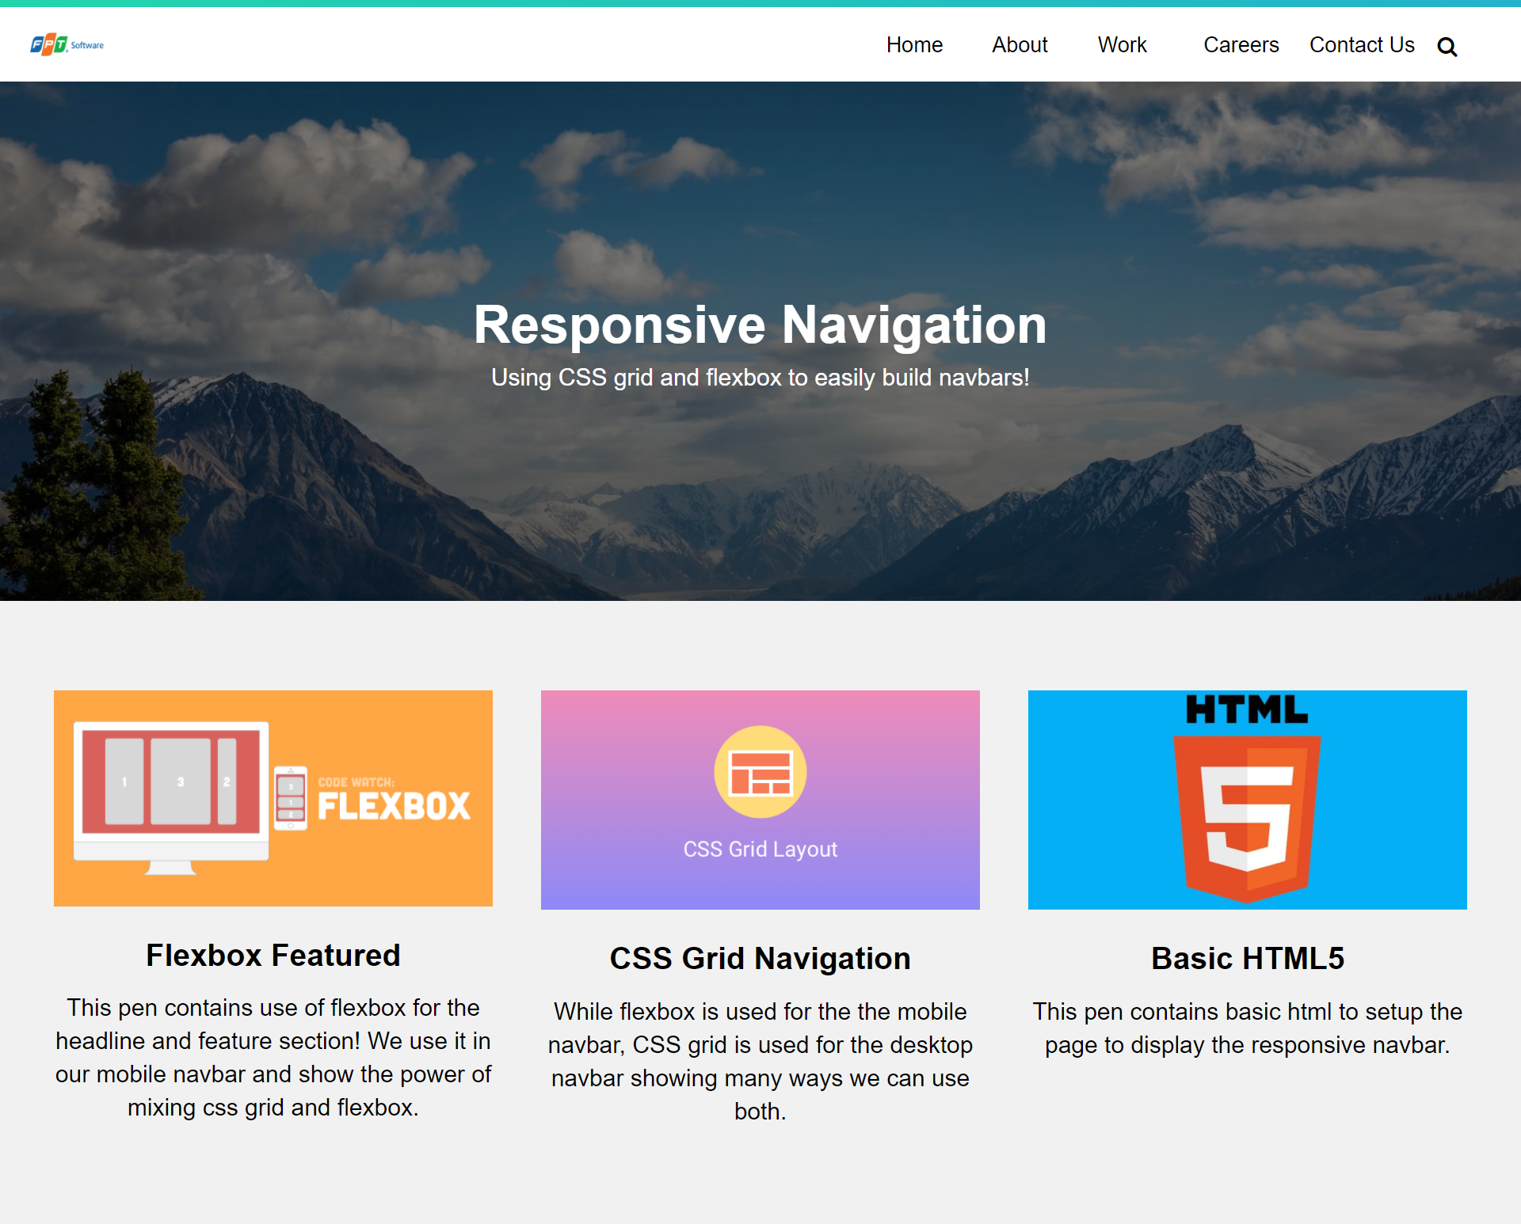
ASM

