Slide 1
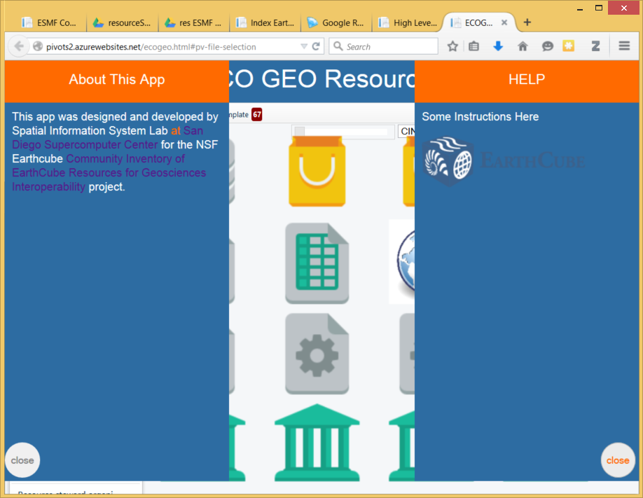
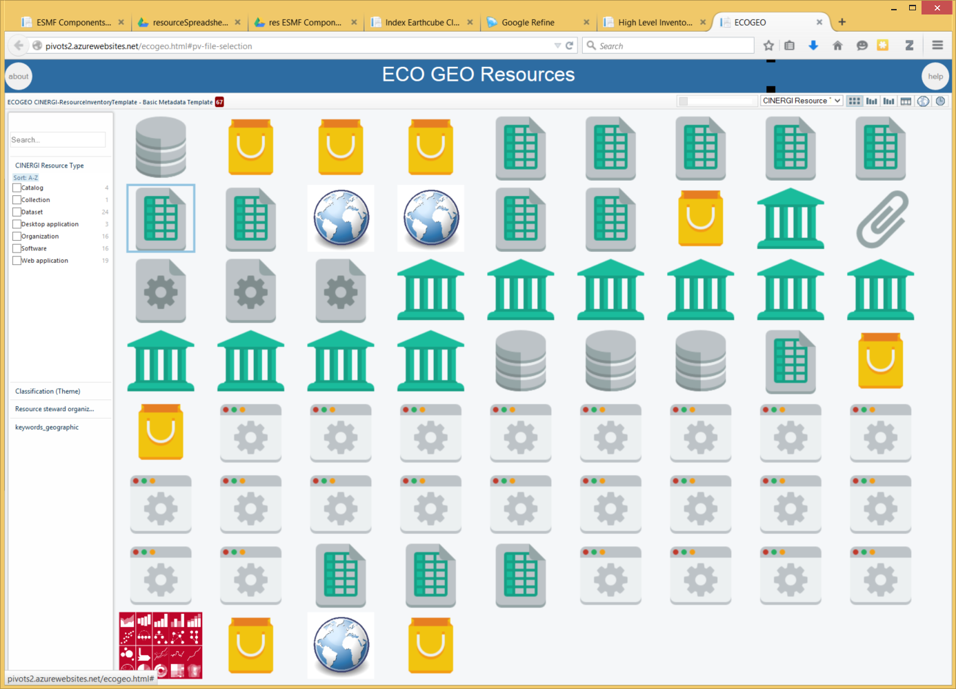
5
1
6
3
7
2
9
8
The ECOGEO Resource Catalog is a collaboration between the ECOGEO Research Coordination Network project and the CINERGI (Community Inventory of EarthCube Resources for Geoscience Interoperability) projects.
It is a community-curated registry of information resources used in geo-microbiology, genomics and related fields
4
10
1: select categories to show the items you want
2: expand other variables and make additional selections
3: this is how many items are displayed
4: click an item to see its description on the right
5: zoom in to items
6: select a variable to organize items in a bar graph
7: grid view of items
8: bar graph view of items (use this together with 1 and 2 to explore distribution of items in different subsets)
9: bivariate graph view (also try other icons)
10: setting: specify which variables to display
Questions about the content of the catalog: <email>
Instructions for updating the catalog: <link>
Funding under the NSF EarthCube program is gratefully acknowledged:
ECOGEO:
CINERGI: NSF ICER-1343816
Questions about the app: ec_apps@sdsc.edu
http://spatial.sdsc.edu

