Slide 1

SECURE HOME GATEWAY PROJECT
CIRA Labs
Secure Home Gateway
One Page Project Page
Jacques Latour
March 2019
Notes:
Consider starting with a story of your vision – how did this come to be?

Slide 2

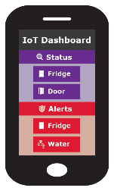
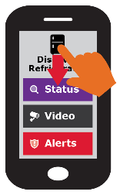
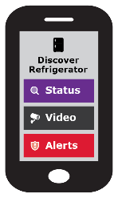









Swipe UP, DOWN, LEFT and RIGHT
SHG
ACME.CORP
MUD
Repository
(1)
CIRA SHG
MUD Repository
MUD Supervisor
(2)
Send to
CIRA
(2)
Get vendor
MUD file
SHG App
Standardized API
MUD Controller
(IP Tables)
(1)
(4)
(1)
Scan MUD
QR code &
send to MUD
Controller
(DHCP in future)
Visit the CIRA Labs page and as well as GitHub
https://cira.ca/cira-secure-home-gateway
https://github.com/CIRALabs
MUD QR Code
RFC8520
ACME.CORP
IoT Water Sensor
Notes:
High Level MUD & IoT Device Provisioning Workflow

