Slide 1
Device Quarantine definition for Manufacturer Usage Descriptions (RFC8520)
draft-richardson-shg-mud-quarantined-access
Michael Richardson (Sandleman Software Works)
Mudumbai Ranganathan (NIST)

Slide 2
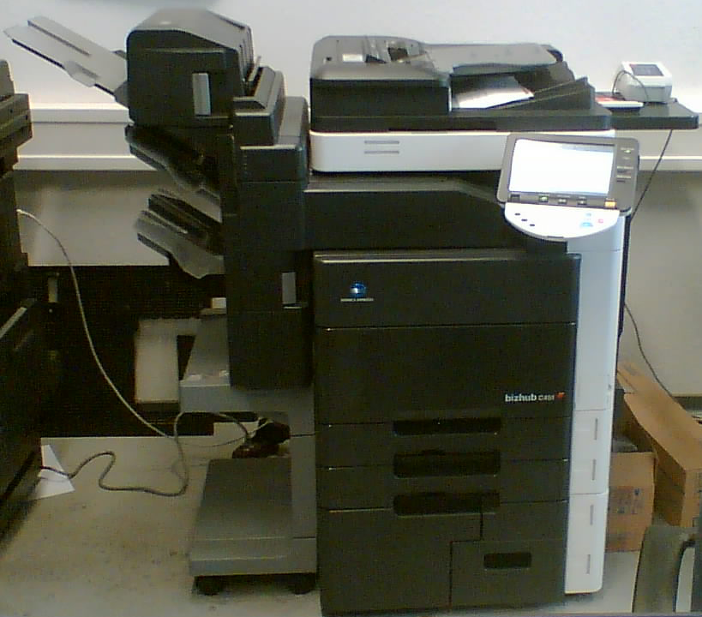

What puts a device into Quarantine?
Device violates its MUD specification
External vulnerability report identifying a vulnerability in the device firmware
Network administrator decides to place device into quarantine (e.g. runs an automated vulnerability scan on the device and discovers vulnerability)
Device emits
a URL
Access
Switch
forwards
MUD controller
queries
manufacturer
https://example.com/mud/…
Device
Access Switch
MUD Manager
DHCP,
LLDP,
or 802.1X
Radius
Enterprise Network

Slide 3
Critical ACEs
Complete isolation from network may not be advisable.
  Device can’t update itself.
  May be connected to critical equipment.
Critical Access Control Entries
  ACEs that should not be blocked when device goes into quarantine

Slide 4
MUD Extension for Quaranitne ACEs
augment "/m:mud" {
description
"Adds leaf nodes appropriate MUD usage in the
Secure Home Gateway";
container quaranteed-device-policy {
list enabled-ace-names {
key ace-name;
leaf ace-name {
type leafref {
Path "/acl:acls/acl:acl/acl:aces/acl:ace/acl:name";
}
}
The policies that should be enforced on traffic
coming from the device when it is under quarantine. These policies are usually a subset of operational policies and are intended to permit firmware updates only.
They are intended to keep the device safe (and the network safe from the device) when the device is suspected of being out-of-date, but still considered sufficiently intact to be able to do a firmware update.

