Slide 1
The CIRA Labs
Secure Home Gateway
An RFC8520 (MUD) IoT firewall
Looking at IoT Unquarantine
Playbook options
Michael Richardson (Sandelman, CIRA)
with media from Eliot Lear (CISCO)
October 2019
RIPE79, Rotterdam, Netherlands
Notes:
Consider starting with a story of your vision – how did this come to be?

Slide 2
Today’s Agenda for Talk
brief update on project
brief introduction to RFC8520: Manufacturer Usage Description (published March 2019 http://rfc-editor.org/info/rfc8520 )
the quarantine process
the remediation process
recidivism
discussion – get here

Slide 3
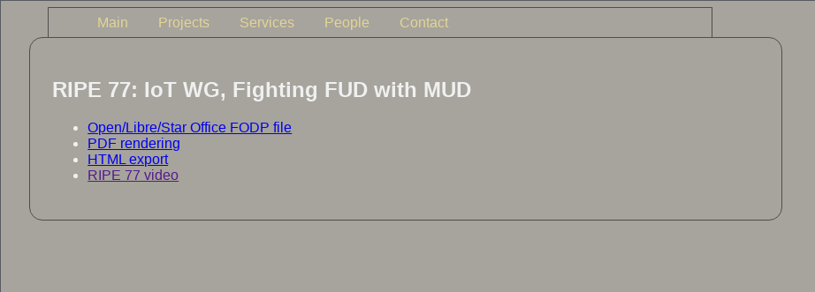
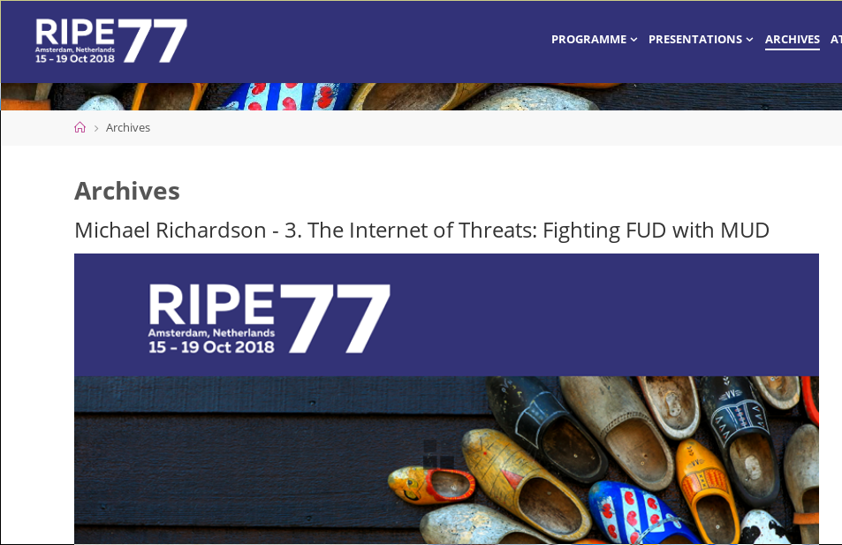

The CIRA Labs Secure Home Gateway (SHG) Project update
RIPE77 talk on this
phase 2 (2018Q4,2019Q1) was norming
phase 3 (2019Q2/3) tries to get to performing, but not GA yet.
https://cira.ca/labs/projects/cira-secure-home-gateway

Slide 4
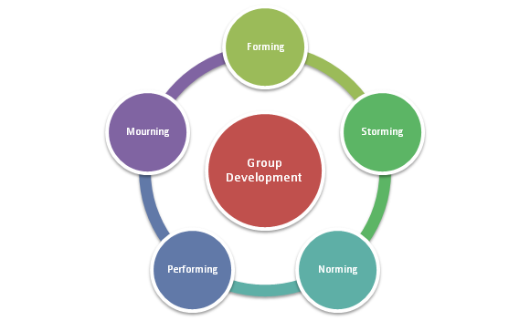

Phase 1
PoC
Phase 2
Product?
Phase 3
Agile focus

Slide 5






Secure Home Gateway (SHG) Goals
x
Protect the internet from IoT devices attacks
x
Protect IoT devices from the internet attacks
Notes:
The primary goal of this project is to develop a secure home gateway that;
protects the internet from IoT devices attacks and
protects home IoT devices from the internet attacks

Slide 6
What Sort of Access Do These Printers/IoT devices require?
From | To | Protocol | Source Port | Destination Port(s)
Printer | xmpp009.hpeprint.com | TCP |  | 80, 443, 5222,5223
Printer | DNS Server | UDP |  | 53
Printer | chat.hpeprint.com | TCP |  | 80,443
Printer | 224.0.0.251/32 | UDP |  | 5353
Printer | 220.0.0.252/32 | UDP |  | 5355
Printer | h10141.www1.hp.com | TCP |  | 80
Printer | Local Networks | UDP | 5353
Printer | Local Networks | TCP | 80
Source: University of New South Wales, using mudgee
(not shown: L2 packets)

Slide 7
Questions that need answering
What is the device’s identity? Does this particular thing belong on the network?
What type of thing is it?
What is the device’s identity? Does this particular thing belong on the network?
What type of thing is it?
What is this thing?
Who is responsible for it?
If something breaks, who should be called?
What access does it need?
With which devices should it communicate?
Is it doing what it should be doing?
With which devices is it actually communicating?
Is it behaving as designed?
Notes:
Eliot – Added AVC to the last bullet point

Slide 8
Assumptions and Assertions
Assumptions
Assertions
A Thing has a single use or a small number of uses.
Because a Thing has a single or a small number of intended uses, all other uses must be unintended.
Things are tightly constrained. Very little CPU, memory, and battery.
Any intended use can be clearly identified.
But, what
about home
users?
Network administrators are the ultimate arbiters of how their networks will be used
Manufacturers are in a generally good position to provide guidance to administrators.
Even those Things that can protect themselves today may not be able to do so tomorrow
A mechanism is needed to protect devices that may have vulnerabilities.

Slide 9
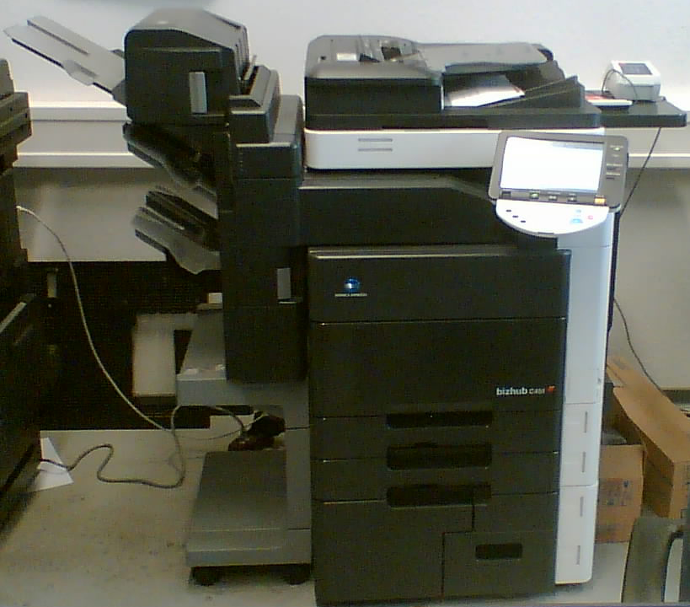

Expressing Manufacturer Usage Descriptions
Device emits
a URL
Access
Switch
forwards
ISE/DNA-C
queries
manufacturer
https://example.com/mud/…
Internet
Device
Access Switch
MUD Manager
MUD File Server
https
DHCP,
LLDP,
or 802.1X
Radius
Enterprise Network
Notes:
Fix this

Slide 10









SHG
ACME.CORP
MUD
Repository
(1)
CIRA SHG
MUD Repository
MUD Supervisor
(3)
User accepts
provisioning
instructions
(2)
Send to
CIRA
(2)
Get vendor
MUD file
SHG
App
MUD Controller
(IP Tables)
(4)
IoT device added to network with specific network access controls
Network Access control:
Allow access to ACME.CORP
Allow to send alerts internally
Allow to be configured by app
Deny all other internet access
(1)
(4)
(1)
Scan MUD
QR code &
send to MUD
Controller
(DHCP in future)
MUD QR Code
ACME.CORP
IoT Water Sensor
Notes:
High Level MUD & IoT Device Provisioning Workflow

Slide 11
Getting from the MUD file to deployment config
Whatever is appropriate in the local deployment.
... "acl": [
{
"name": "mud-76228-v4to",
"type": "ipv4-acl-type",
"aces": {
"ace": [
{
"name": "myctl0-todev",
"matches": {
"ietf-mud:mud": {
"my-controller": [
null
]
}
},
"actions": {
"forwarding": "accept"
} …
10.1.2.3
10.4.5.6
https://mudmaker.org
Notes:
Same stuff we already have except what’s in red
NETCONF is already there (for most of our devices)
May not be abstract enough for some
Open question

Slide 12





Quarantine of compromised devices
-> Behavioural analysis
A standard process (a playbook) to quarantine and restore IoT Devices
https://datatracker.ietf.org/doc/draft-richardson-shg-un-quarantine
Manufacturer Usage Description for quarantined access to firmware
https://datatracker.ietf.org/doc/draft-richardson-shg-mud-quarantined-access/
x
Appliances
Management
Application
The refrigerator is quarantined
- Bad lettuce ☺

Slide 13

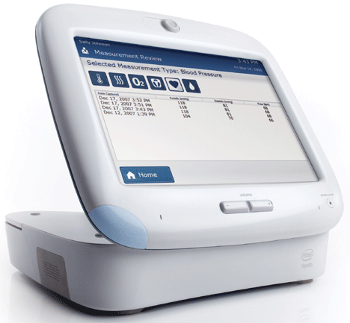
Who ya gonna call?
Refridgerator
Manufacturer?
Home Router
Vendor?
Phone
“police”?
ISP
Helpdesk?
x
DOTS?
MILE?
STIX?
MISP-project.org
National
CERT
ISP
https://www.internetsociety.org/events/caris2
Application
Developer?
attackee
Call doctor?
Make sure
Other devices
Are good?
The refrigerator is quarantined
- Bad lettuce ☺

Slide 14
States of a device
New device is blank,
has no user settings,
no valuable content
Device is in use,
Has end user content
Device performs
unexpected
communications
nominal
Device has new
firmware, quarantine
lifted.
suspicious
New
device
Device traffic/firmware
/etc is being examined
by experts.
returning
to service
p0wned
Device-of
interest
Serious concern that
device has a
vulnerability.
New firmware
issued,
device loading
upgrading
suspect
quarantine
Device is destroyed
Recycle?
Reject?
disabled
Device unfixable,
Unreliable, power
removed
Device is quarantined,
Still operational

Slide 15
States of a device: with protocols
IPFIX?!
nominal
RATS
suspicious
MILE?
ROLIE!
New
device
MUD update
???
returning
to service
p0wned
Device-of
interest
RATS
IOC.pdf
MILE!
NIST:
SCAPv2
(rolie)
upgrading
suspect
quarantine
MISP-project
SUIT
MILE
rolie/iodef
dumpster?
disabled
DHS likes
TAXI (rolie)
STIIX
Notes:
ROLIE is RESTful version of RID (which is SOAPy)

Slide 16
Playbooks
IETF COCAO - Collaborative Automated Course of Action Operations for Cyber Security
This is an attempt to create a standard playbook for IoT breaches that occur in residential installations, where an ISP might otherwise be blamed, or need to take action
Looking for Operator Feedback

Slide 17
Questions?

Slide 18
Auxiliary Slides

Slide 19









Best practices – Apply enterprise security framework to home networks
Home Security
PDAP
Appliances
PDAP
IoT Cloud
Services
Sensors
PDAP
Management
Application
PDAP: Per Device Access Policy
Scale Enterprise solutions to fit the home network
Notes:
-> best practices and new standards (note to Jacques – please explain Per Device Access Policy (PDAP) for those who may not understand what it means)
Rule #1: Identify IoT devices on your home network
Rule #2: Place a policy around the IoT device that restricts it to a specific function (default is no access)
Rule #3: Monitor for behavioural changes in the device and quarantine at the first sign of change.

Slide 20
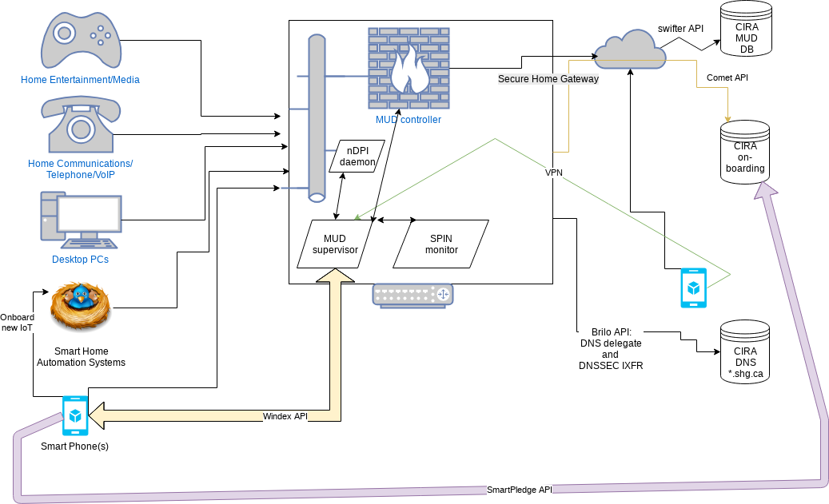
Work in progress architecture

Slide 21
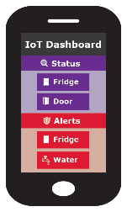
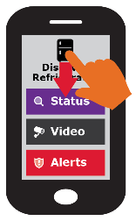
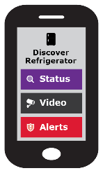

Simple user interface is key to this project
Swipe UP, DOWN, LEFT and RIGHT
Notes:
Gateway provisioning, device discovery, device provisioning must be as simple as possible, intuitive for non experienced users, available as framework for default open source app.

Slide 22
Want more info?
Visit the CIRA Labs page and as well as GitHub
https://cira.ca/cira-secure-home-gateway
https://github.com/CIRALabs
Don’t forget to share your feedback and input!
Notes:
For an informational version of this deck that includes:
High level architecture graphic
More details on the proof of concept and prototype
Specifications we are currently leveraging

