Slide 1

CIRA Labs
Secure Home Gateway
A Residential
IoT Unquarantine Playbook
Michael Richardson
(Jacques Latour, Marc Blanchet)
May 2019
RIPE78, Reykjavík, Iceland
Notes:
Consider starting with a story of your vision – how did this come to be?
<number><number><number><number><number>

Slide 2




Project Evolution – From Idea in late 2016
In the home
Gateway
Need security access controls
Has to be easy to use
MIRAI Dyn Attack
October 2016
x
x
?
Need a new framework to prevent lightbulbs from killing the internet!

Slide 3





Secure Home Gateway (SHG) Goals
x
Protect the internet from IoT devices attacks
x
Protect IoT devices from the internet attacks
Notes:
The primary goal of this project is to develop a secure home gateway that;
protects the internet from IoT devices attacks and
protects home IoT devices from the internet attacks
<number><number><number><number><number>

Slide 4
Project Evolution – To a Secure Home Gateway (SHG) Prototype
openWRT
Turris Omnia
CZNIC
MUD Server Repository / Curation
SHG MUD Controller
Supervisor
SHG App “Ease of Use”
SIDN (.NL) SPIN
SHG Security Access Controls
Running
Code
Proposed
Standards
prpl Foundation
(prplWrt)
Secure
Home
Gateway
CIRA
DNS & SHG Provisioning
Mozilla IoT -
Web Thing API
Secure Home Gateway Framework
Standards Development
IETF, CSA/UL, ISO/IEC
Enhanced WIFI security
In progress:
DOTS, DNSSEC, Domain aware NFtable

Slide 5
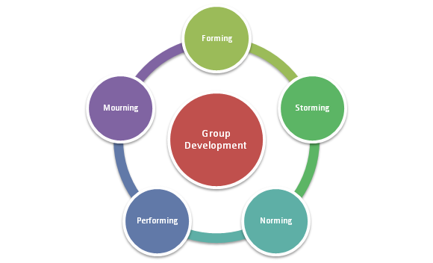
Phase 1
PoC
Phase 2
Product?
Phase 3
Agile focus
Notes:
<number><number><number><number><number>

Slide 6





Quarantine of compromised devices -> Behavioural analysis
A standard process (a playbook) to quarantine and restore IoT Devices
https://datatracker.ietf.org/doc/draft-richardson-shg-un-quarantine
Manufacturer Usage Description for quarantined access to firmware
https://datatracker.ietf.org/doc/draft-richardson-shg-mud-quarantined-access/
x
Appliances
Management
Application
The refrigerator is quarantined
- Bad lettuce ☺

Slide 7

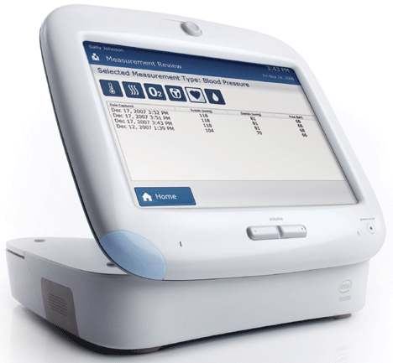
Who ya gonna call?
Refridgerator
Manufacturer?
Home Router
Vendor?
Phone
“police”?
ISP
Helpdesk?
x
DOTS?
MILE?
National
CERT
ISP
Application
Developer?
attackee
Call doctor?
Make sure
Other devices
Are good?
The refrigerator is quarantined
- Bad lettuce ☺

Slide 8
States of a device
New device is blank,
has no user settings,
no valuable content
Device is in use,
Has end user content
Device performs
unexpected
communications
nominal
Device has new
firmware, quarantine
lifted.
suspicious
New
device
Serious concern that
device has a
vulnerability.
returning
to service
p0wned
suspect
Device traffic/firmware
/etc is being examined
by experts.
New firmware
issued,
device loading
upgrading
device-of
interest
quarantine
External
information
Device is destroyed
dumpster?
disabled
Device unfixable,
Unreliable, power
removed
Device is quarantined,
Still operational

Slide 9
States of a device
DOTS?
nominal
???
suspicious
New
device
???
returning
to service
p0wned
suspect
???
MILE?
upgrading
device-of
interest
quarantine
TAXI?
STIIX?
dumpster?
disabled

Slide 10
Playbooks
IETF COCAO - Collaborative Automated Course of Action Operations for Cyber Security
https://www.iacdautomate.org/playbook-and-workflow-examples
This is an attempt to create a standard playbook for IoT breaches that occur in residential installations, where an ISP might otherwise be blamed, or need to take action.
Seeking feedback and contributions from ISPs on what they do now.

Slide 11
Questions?
Notes:
<number><number><number><number><number>

Slide 12
Auxiliary Slides

Slide 13








Best practices – Apply enterprise security framework to home networks
Home Security
PDAP
Appliances
PDAP
IoT Cloud
Services
Sensors
PDAP
Management
Application
PDAP: Per Device Access Policy
Scale Enterprise solutions to fit the home network
Notes:
-> best practices and new standards (note to Jacques – please explain Per Device Access Policy (PDAP) for those who may not understand what it means)
Rule #1: Identify IoT devices on your home network
Rule #2: Place a policy around the IoT device that restricts it to a specific function (default is no access)
Rule #3: Monitor for behavioural changes in the device and quarantine at the first sign of change.
<number><number><number><number><number>

Slide 14








SHG
ACME.CORP
MUD
Repository
(1)
CIRA SHG
MUD Repository
MUD Supervisor
(3)
User accepts
provisioning
instructions
(2)
Send to
CIRA
(2)
Get vendor
MUD file
SHG
App
MUD Controller
(IP Tables)
(4)
IoT device added to network with specific network access controls
Network Access control:
Allow access to ACME.CORP
Allow to send alerts internally
Allow to be configured by app
Deny all other internet access
(1)
(4)
(1)
Scan MUD
QR code &
send to MUD
Controller
(DHCP in future)
MUD QR Code
ACME.CORP
IoT Water Sensor
Notes:
High Level MUD & IoT Device Provisioning Workflow
<number><number><number><number><number>

Slide 15
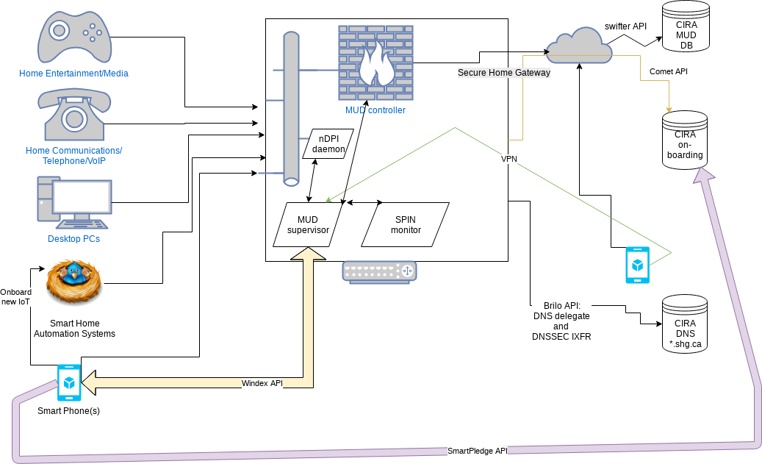
Work in progress architecture

Slide 16
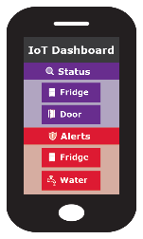
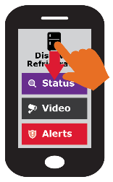
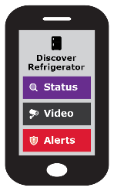

Simple user interface is key to this project
Swipe UP, DOWN, LEFT and RIGHT
Notes:
Gateway provisioning, device discovery, device provisioning must be as simple as possible, intuitive for non experienced users, available as framework for default open source app.
<number><number><number><number><number>

Slide 17
Want more info?
Visit the CIRA Labs page and as well as GitHub
https://cira.ca/cira-secure-home-gateway
https://github.com/CIRALabs
Don’t forget to share your feedback and input!
Notes:
For an informational version of this deck that includes:
High level architecture graphic
More details on the proof of concept and prototype
Specifications we are currently leveraging
<number><number><number><number><number>

