Slide 1
GLOBAL CYBERSECURITY PLATFORM
Jacques Kellner May 7th 2025

Slide 2
Agenda
Service NISS
01. SERIMA as a Global Cybersecurity-Platform
3
02. Incident Notification Module
7
02.01. Module Features
9
03. Risk assessment Module
12
04. Security Objectives Module
15
05. Interplay of the Modules
17
06. Questions
19

Slide 3
01. SERIMA as a Global Cybersecurity-Platform
Service NISS

Slide 4
01. SERIMA as a Global Cybersecurity-Platform
SERIMA – Main goals
ILR Support for the community
Tool to facilitate the activities regarding cybersecurity
Centralisation of information to facilitate informed governance

Slide 5
01. SERIMA as a Global Cybersecurity-Platform
Free
Global Cybersecurity Platform
Open source

Slide 6
01. SERIMA as a Global Cybersecurity-Platform
Service NISS
Incident notification
Security objectives
Dependencies
Fill the questionnaire with the security objectives to self-assess your security level
Fill the questionnaire with the security objectives to self-assess your security level
Notify your incidents to ILR
Available
Development
Development
Risk assessment
Report Generation
Self-Learning
Perform a risk assessment to protect your most valuable assets
Generate your yearly reports
Improve your security level
Available
Development
Planned

Slide 7
02. Incident Notification Module
Service NISS

Slide 8
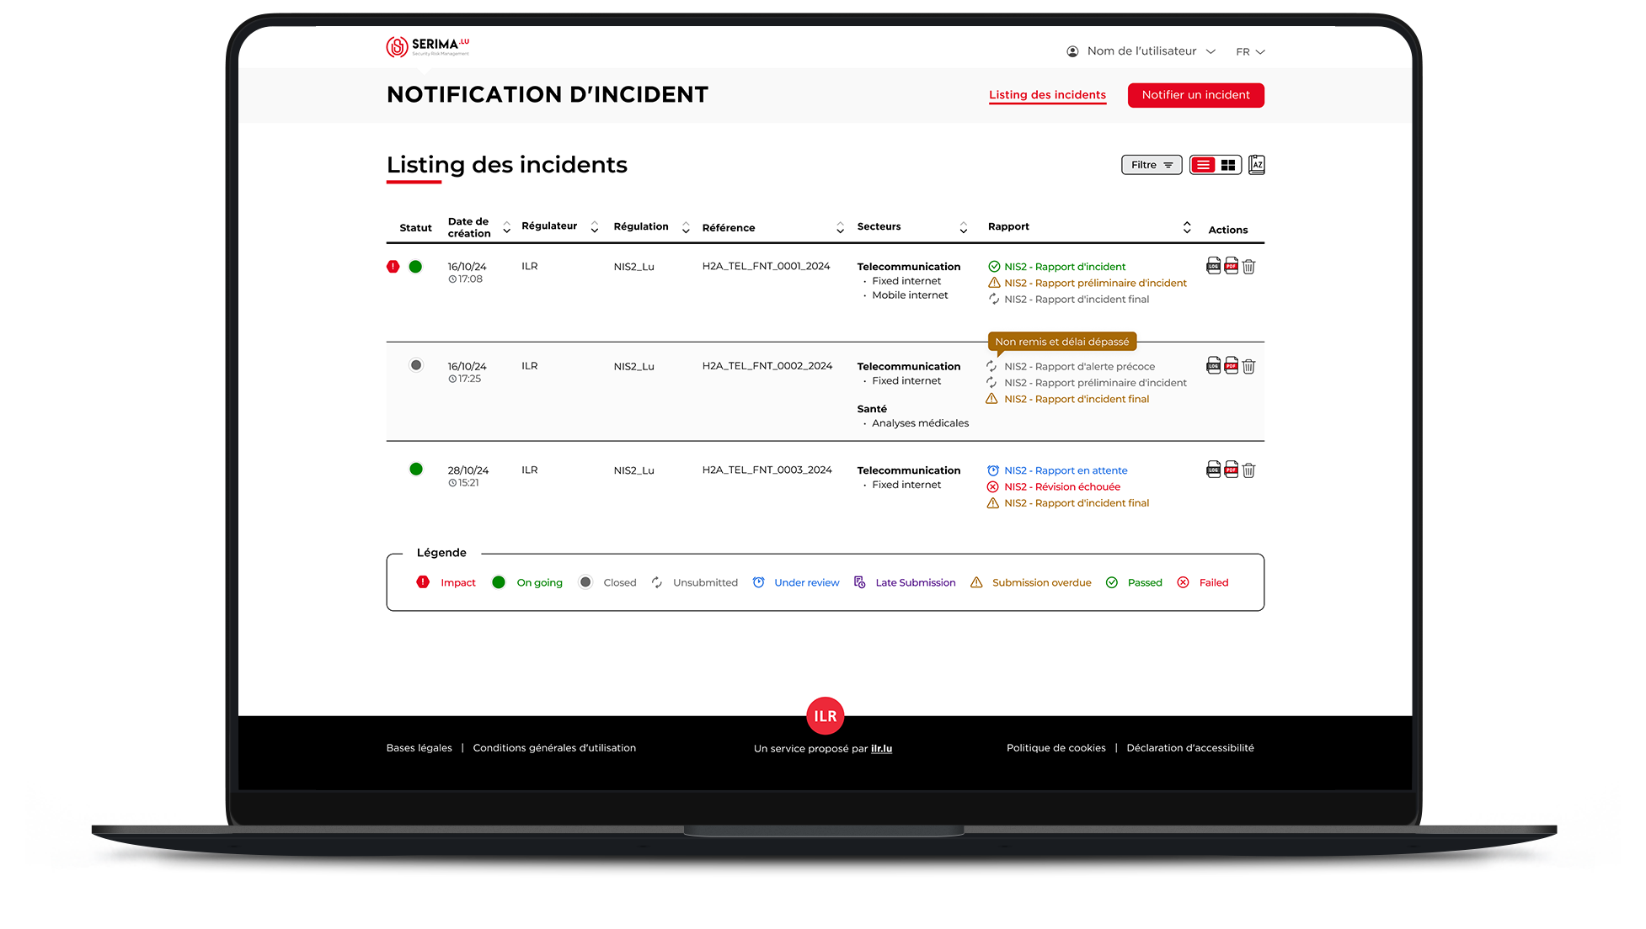
02. Incident Notification Module
Service NISS

Slide 9
02.01. Module Features
Service NISS
Incident Notification - 6 pillars
1
Multi-regulation
(NIS, EECC…)
2
Multi-regulator
3
National platform
4
Multi-sector
5
Interactive
6
Multi-language
(En, Fr, De, Nl, …)

Slide 10
02.01. Module Features
Service NISS
Multi-regulation
Platform completely configurable
Platform completely configurable
Platform completely configurable
EARLY WARNING
24h
Regulation = workflow
OFFICIAL INCIDENT
NOTIFICATION
72h
Workflow step = report
OFFICIAL INCIDENT
NOTIFICATION
Upon request
Report = collection of questions
FINAL REPORT
¹ Month

Slide 11
02.01. Module Features
Service NISS
Multi-regulator
Entities
Incident Notification Platform
Authorities
E1
E2
ILR
HCPN
CNPD
…
INCIDENT 01
E3
Observers
E4
E5
INCIDENT 02
GovCERT
CIRCL
Notes:
Incident 01: private entity
Incident 02: Public entity under NIS2 (HCPN SPOC)

Slide 12
03. Risk assessment Module
Service NISS

Slide 13





03. Risk assessment module
Service NISS
Risk assessment
Based on the MONARC Technology
Sectoral librairies under NIS1 and EECC
NIS2: Generic library + specific sectoral libraries
13
Notes:
Net einfach Risikoanalyse ze maachen dofir huet den ILR librairies sectoriellen entweckelt
Consultanten kënnen di generesch librairie kréien mee de Recht hechstens duerch hir Clienten

Slide 14
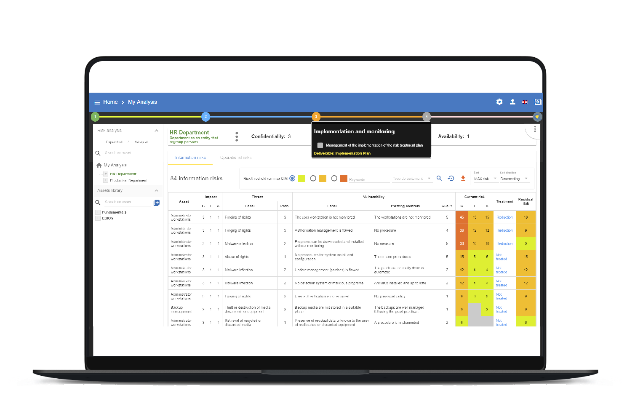
03. Risk assessment module

Slide 15
04. Security Objectives Module
Service NISS

Slide 16
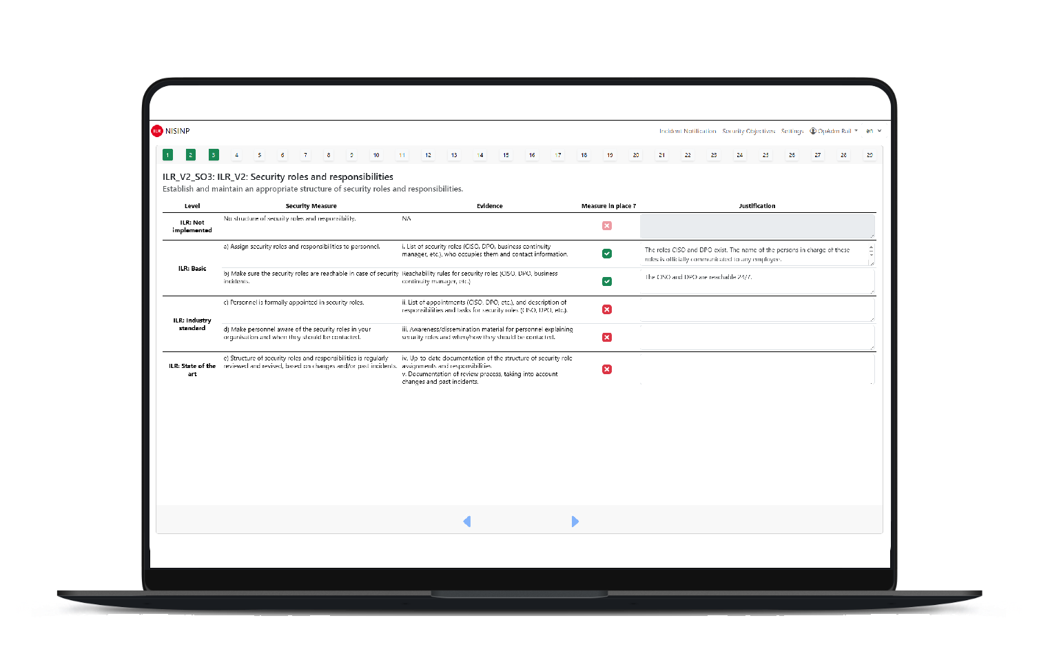
04. Security Objectives Module
In development
Facilitates keeping track of the security measures that are implemented and those that still need to be implemented
Feedback can be given by ILR through platform
Notes:
All Measure get eenzel ausgewielt

Slide 17
05. Interplay of the Modules
Service NISS

Slide 18
05. Interplay of the modules
Service NISS
Insights through combination of information from different modules
Security Objectives
Risks
Risk reduction through Security Measures
Yearly reports taking into account infos from different modules
Incident
Security objectives
Risk assessment
Dependencies
Incident as a trigger to improve Security Measures
Security Objectives
Risk Assessment
Dependencies
Yearly Report

Slide 19
Service NISS
Questions?
Join the SERIMA community! serima@ilr.lu

Slide 20
17, rue du Fossé Adresse postale
L-2922 Luxembourg
T. : +352 28 228 228
F. : +352 28 228 229
info@ilr.lu

