Slide 1
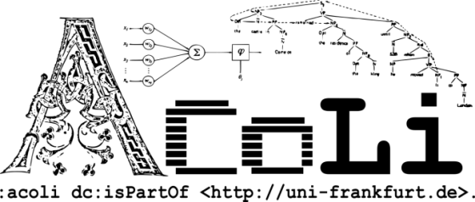

Towards an Ontolex-Lemon module for Frequency, Attestations and Corpus Information (FrAC)
2nd Ontolex-Lemon 2f2 meeting, held in conjunction with LDK-2019, Leipzzig, May 20, 2019
Christian Chiarcos & Maxim Ionov
Applied Computational Linguistics / LiODi
Goethe-Universität Frankfurt, Germany

Slide 2
Towards an Ontolex-Lemon module for Frequency, Attestations and Corpus Information
Motivation
FrAC
Frequency
Attestations
Corpus(-derived) Information
Collocations
(distributional) Similarity
Embeddings

Slide 3
Towards an Ontolex-Lemon module for Frequency, Attestations and Corpus Information
here and today
concept draft developed at
the ACoLi Lab, GU Frankfurt
not a proposal, but a basis for discussion
https://acoli-repo.github.io/ontolex-frac/ (page)
https://github.com/acoli-repo/ontolex-frac (dev)
todo: decide and specify scope,
next steps and relevant use cases
Motivation
FrAC
Frequency
Attestations
Corpus(-derived) Information
Collocations
(distributional) Similarity
Embeddings

Slide 4

Next steps
biweekly telcos, starting mid-July 2019
who would commit to participate?
we need 5 participants from different institutions
after/alternating with morphology telcos? different slot?
until then
creating and populating a wiki with requirements, use cases and data sets
cf. morphology module

Slide 5
Corpus Frequency
Side note: „Corpus“ here is used in the original, broader sense as „structured data collection“. This can, but does not have to be a corpus in the language resource sense. It could also be, e.g., a(nother) dictionary

Slide 6
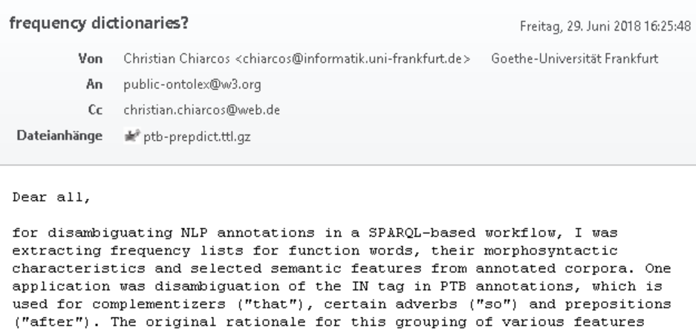
FrAC – Motivation: Frequency
There‘s no easy way
not in(to) lexicography module
frequency is lexicographically relevant, but not only there
can only be defined relative to a corpus, i.e., reification
not a plain lexinfo property

Slide 7
FrAC – Motivation: Frequency
BTW: We still don‘t have a solution for that
original use case annotation engineering
(Chiarcos & Fäth@LDK-2019)
so far without frequency-based disambiguation
There‘s no easy way
not in(to) lexicography module
frequency is lexicographically relevant, but not only there
can only be defined relative to a corpus, i.e., reification
not a plain lexinfo property

Slide 8
FrAC – Beyond Frequency
frequency can only be defined relative to a corpus
if we need to provide novel vocabulary anyway, other, corpus-related information can be included here, too
Leiden f2f meeting
attestations (originally suggested for lexicog module)
corpus-derived information for digital lexicography
collocations (and NLP)
distributional similarity (clusters) [as produced by common tools]
SOTA NLP resources (beyond lexicography)
embeddings? (esp., sense embeddings, cf. Rothe & Schütze 2017)

Slide 9
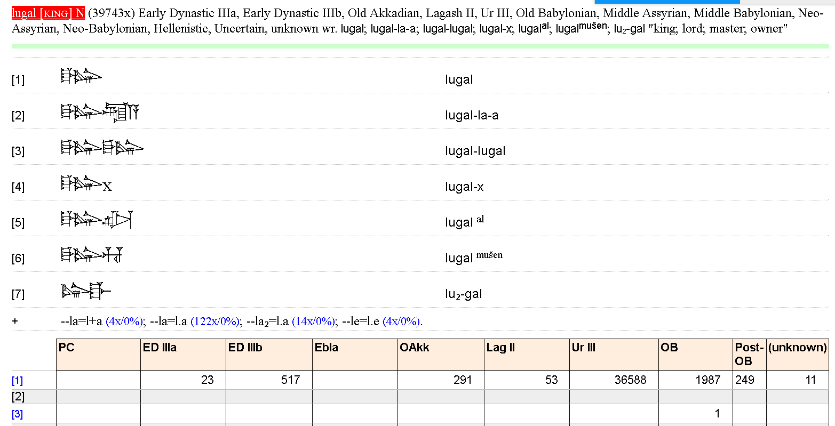
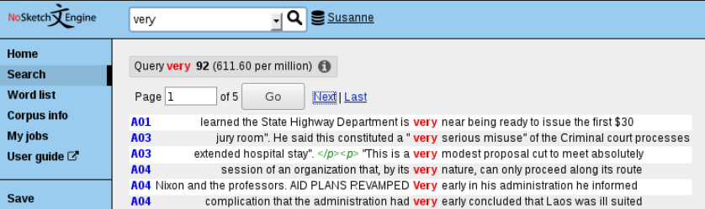
Corpus Frequency in EPSD2
http://oracc.museum.upenn.edu/epsd2/sux
frequency
corpus-based lexicography
taking corpus frequencies into account
(at least, displaying them)
Corpus Frequency in NoSketchEngine
https://www.sketchengine.eu/nosketch-engine/
basically for everything
that you could find in
a corpus
informs lexicographers
about commonness, etc.

Slide 10
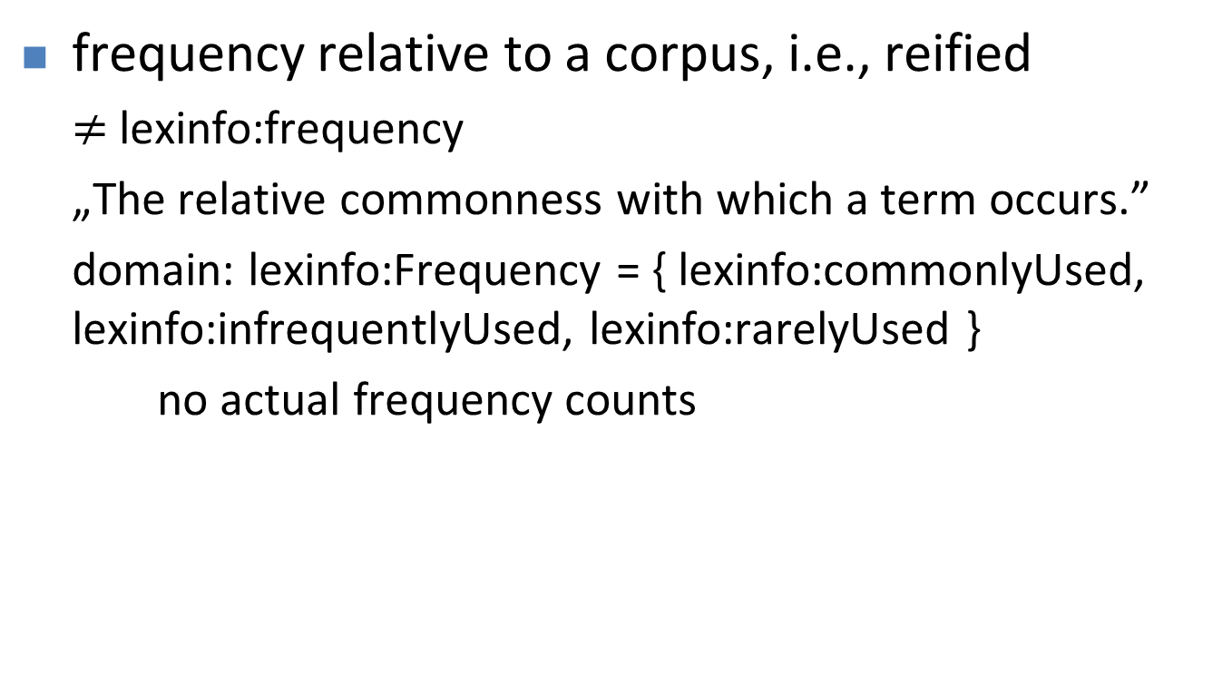
Corpus Frequency
frequency relative to a corpus, i.e., reified
$≠$lexinfo:frequency
„The relative commonness with which a term occurs.”
domain: lexinfo:Frequency = { lexinfo:commonlyUsed, lexinfo:infrequentlyUsed, lexinfo:rarelyUsed }
no actual frequency counts

Slide 11
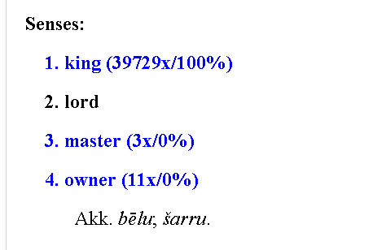
Corpus Frequency in EPSD2
http://oracc.museum.upenn.edu/epsd2/sux
frequency of lexical entry
frequency of lexical form
(in different periods/
subcorpora)
frequency of
lexical senses

Slide 12
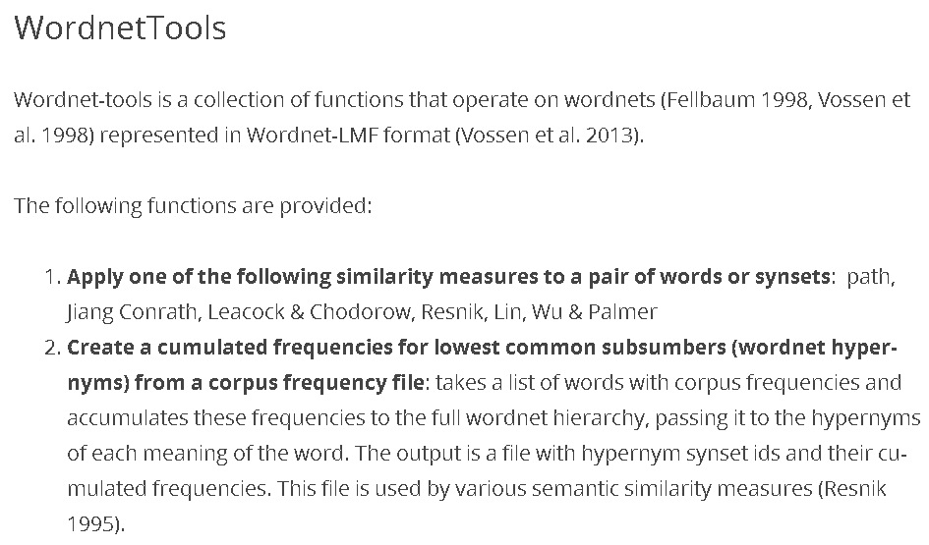
Corpus Frequency beyond lexical entries
http://www.cltl.nl/results/software/wordnettools/
=> corpus frequency for lexical concepts !

Slide 13
Corpus Frequency
everything in ontolex can be counted against a corpus
minimum information: absolute frequency & provenance, i.e. reference to source corpus (any URI)
ontolex:Form
ontolex:LexicalEntry
CorpusFrequency
rdf:value: int
corpus/locus URI
frequency
dc:source
ontolex:LexicalSense
ontolex:LexicalConcept

Slide 14
Corpus Frequency
everything in ontolex can be counted against a corpus
similarly for every subsequent piece of corpus information => generalization
ontolex:Element
CorpusFrequency
rdf:value: int
corpus/locus URI
frequency
dc:source
ontolex:Form
ontolex:LexicalSense
ontolex:LexicalConcept
ontolex:LexicalEntry

Slide 15
Corpus Frequency
everything in ontolex can be counted against a corpus
similarly for every subsequent piece of corpus information => generalization
if not in the ontolex module, then introduce it here
ontolex:Element
CorpusFrequency
rdf:value: int
corpus/locus URI
frequency
dc:source
ontolex:Form
ontolex:LexicalSense
ontolex:LexicalConcept
ontolex:LexicalEntry

Slide 16
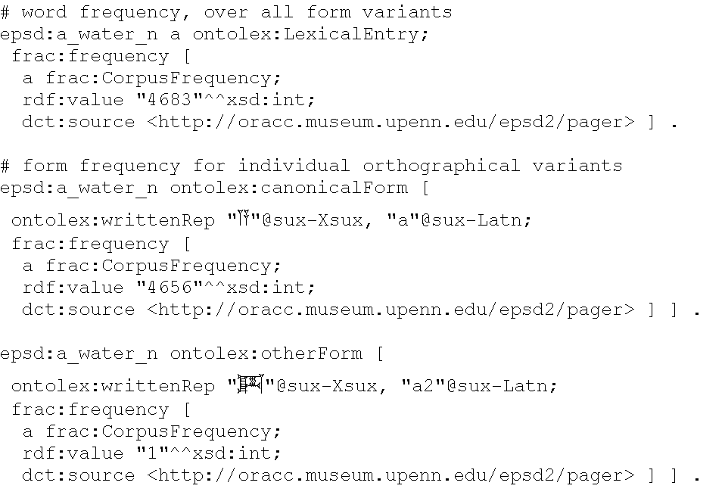
Corpus Frequency

Slide 17
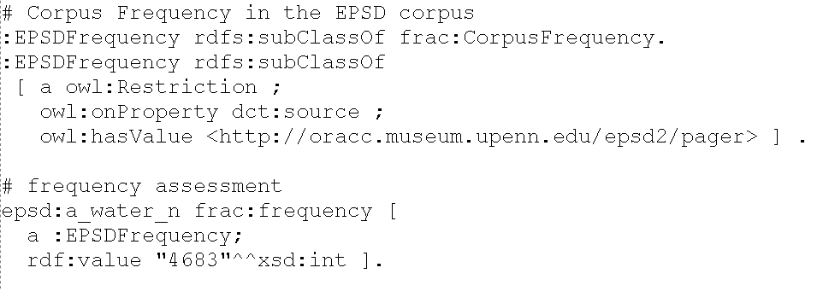
Simplifications
introduce corpus-specific frequency classes

Slide 18
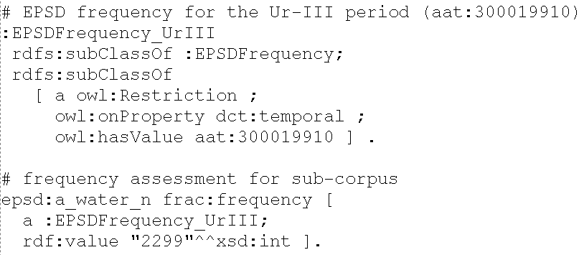
Simplifications
additional restrictions => frequency classes for specific sub-corpora

Slide 19
Frequency: Discussion
ontolex:Element
CorpusFrequency
rdf:value: int
corpus/locus URI
frequency
dc:source
ontolex:Form
ontolex:LexicalSense
ontolex:LexicalConcept
ontolex:LexicalEntry

Slide 20
Attestations

Slide 21
Attestations
long and vivid discussion in the lexicog model
Leiden f2f meeting: merge with module on corpus-related issues
based on two existing proposals
Khan and Boschetti (2018) and Depuydt and de Does (2018)
approach:
focus on linking with an edition/corpus
move “simple” lexicographic properties to lexinfo
support citations, but stay agnostic wrt. vocabulary for bibliography

Slide 22
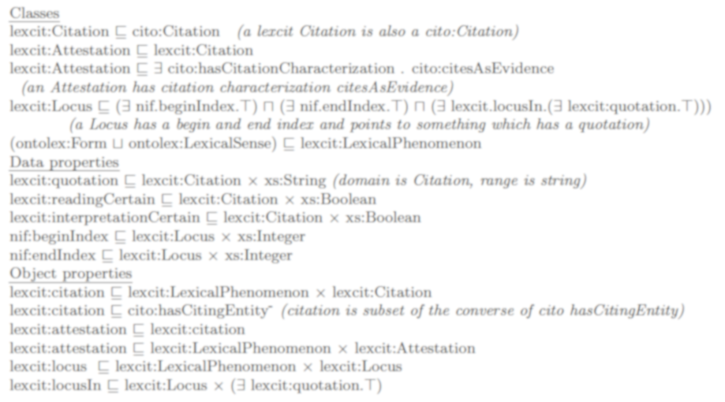
attestations after Depuydt & de Does 2018
Locus
nif:beginIndex***
nif:endIndex***
locusIn**
locus
Citation
quotation: string
readingCertain: boolean****
interpretationCertain: boolean****
citation
ontolex:Element*
attestation
Attestation
* i.e., D&dD: lexcit:LexicalPhenomenon
** simplified: pointing to an anonymous superclass of
something that contains a quotation
*** I would prefer not to prescribe nif properties in order to permit other means of cross-referencing, e.g., nif URIs, WebAnnotation selectors, etc.
**** I would prefer to leave certainly etc. to lexinfo

Slide 23
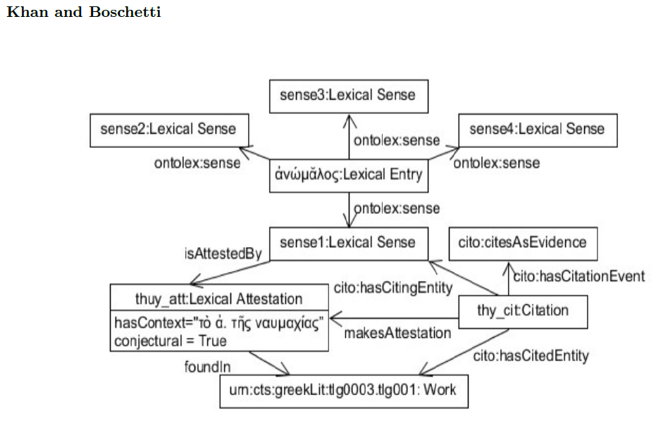
attestations after Khan & Boschetti (2018)
attestation**
Attestation***
hasContext: str(6*)
conjectural: boolean****
makesAttestation
ontolex:Element*
Citation
foundIn(7*)
work URI*****
* originally restricted to LexicalSense
** originally „isAttestedBy“
*** originally „LexicalAttestation“
**** I would prefer to leave certainty etc. to lexinfo
***** originally „Work“
(6*) maybe rename such that that also context-free examples fit
(7*) I had dc:source at other occasions
as in the other proposal, cito properties and
concepts are skipped, these are beyond the module

Slide 24
attestations: proposal for a minimal consensus (Nov 2018)
we do not cover:
scientific citations (should refine Citation, using external vocabularies)
corpus pointers (can be NIF objects, NIF URIs, WebAnnotation selectors, CTS URNs, URLs, etc.)
dc:source (6*)
attestation***
Attestation*
quotation: string**
ontolex:Element
locus URI
makes
Attestation
(5*)
Citation
citation****
* D&dD: Citation
** K&B: hasContext
*** D&dD: attestation
**** K&B: inv of hasCitingEntity
5* D&dD: implicit
6* D&dD: inv of locusIn, K&B: foundIn

Slide 25
attestation
Attestation
quotation: string
dc:source
ontolex:Element
locus URI
makes
Attestation
Citation
citation
proposed minimal consensus | D&dD | K&B
ontolex:Element | LexicalPhenomenon | (LexicalSense)
attestation | attestation | isAttestedBy
Attestation | Attestation | Attestation
Citation | ~ Citation | Citation
citation | ~ citation | (indirectly via makesAttestation)
makesAttestation | [identity/subClassOf] | makesAttestation
dc:source | ^locusIn | foundIn
quotation | quotation | hasContext
(locus URI) | Locus | Work
(indirectly via attestations) | locus | (hasCitingEntity/hasCitedEntity)

Slide 26
Attestations: initial discussion
Fahad (May 15, 2019)
I see an attestation as evidence of the use of some linguistic element or convention and therefore attestations relate together entries, senses, etc, with any source that might manifest evidence of that use, e.g., a book, an inscription, a corpus; it is not simply a quotation as in Christian's model, although there should be datatype properties which link an attestation with its textual context;
currently covered by dc:source and quotation
the source is the dc:source element, the textual content is quotation
do we need a frac-specific source identifier?

Slide 27
Attestations: initial discussion
Fahad (May 15, 2019)
I see an attestation as evidence of the use of some linguistic element or convention and therefore attestations relate together entries, senses, etc, with any source that might manifest evidence of that use, e.g., a book, an inscription, a corpus; it is not simply a quotation as in Christian's model, although there should be datatype properties which link an attestation with its textual context;
attestation
Attestation
quotation: string
dc:source
ontolex:Element
locus URI
link to textual
content (rename?)
well, we
have that
makes
Attestation
Citation
textual
content
citation

Slide 28
Attestations: initial discussion
Fahad (May 15, 2019)
uncertainty levels to attestations and in certain cases might actually be referring to a conjectural, reconstructed text; in other cases a legacy resource might actually be incorrect in regarding a certain source as attest and it would be useful to be able to annotate; we should make provision for this;
not specific to attestations => lexinfo (& provo)
eluku ‘offered (?)‘ (uncertain sense)
lemais ‘Lemai‘, THEO (?) (uncertain POS)
ti[– – –] ‘?‘ (defective form)
got. raíhts, aisl. réttr, ags. riht, as. ahd. reht ... (= kelt. *rektu- ...) (reconstructed lexeme)
(examples 1-3 from Wallace 2008. Zikh Rasna. A Manual of the Etruscan Language and Inscriptions, Beech Stave Press,
example 4 from Pokorny, J. (1969). Indogermanisches etymologisches Wörterbuch (Vol. 2). Francke, entry 1589)

Slide 29
Attestations: initial discussion
Fahad (May 15, 2019)
citations are (speech) acts which can't be correct or incorrect, they're either successful or unsuccessful, they should be related to attestations, because a lexical entry will often *cite* a book in order to specify an attestation (but this is far from the only way citations can be used in a lexical entry)
attestation
Attestation
quotation: string
dc:source
ontolex:Element
locus URI
makes
Attestation
Citation
citation

Slide 30
Attestation: Discussion
attestation
Attestation
quotation: string
dc:source
ontolex:Element
locus URI
makes
Attestation
Citation
citation
ontolex:Form
ontolex:LexicalSense
ontolex:LexicalConcept
ontolex:LexicalEntry

Slide 31
Embeddings
and related distributional resources

Slide 32
Embeddings
in a broader sense: incl. bags of words, etc.
if representable as a vector
why?
most important data structure in distributional semantics, often laborsome to replicate
reuse encouraged
applicable to form, lexeme, sense,* concept*
but detached from their definition
often distributed as CSV files => vocabulary for CSV2RDF rendering
nobody expects embeddings to be distributed in Turtle ;)
* cf. Rothe & Schütze (2017), AutoExtend, for embedding induction over WordNet senses and synsets

Slide 33
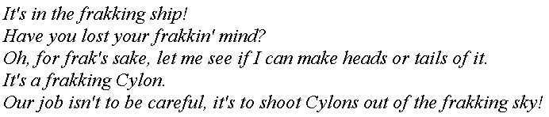
Embeddings: Co-occurrence
simple, uncompressed form of embedding
based on a reference list of vocabulary items, where every reference word is associated with a fixed position, e.g., ship with position 1, ocean with 2, sky with 3, etc.
Sample corpus for frak (from Wikiquote)

Slide 34
Word Embeddings
Word vectors are always defined relative to a base corpus*
for co-occurrence statistics
source needs to be explicated
Word vectors can be compressed
using different statistical or neural methods
needs to be explicated
dimensions are usually no longer interpretable
* “corpus“ in a broader sense, could be knowledge base, etc.

Slide 35
Sense Embeddings
Normally extrapolated from word embeddings plus a lexical resource
e.g., WordNet word senses (= ontolex:Sense) and synsets (= ontolex:LexicalConcept)
(Rothe & Schütze 2017)
Sense definition/underlying KB version should be explicated, e.g., by an URI

Slide 36
Embeddings in OntoLex
typical CSV format
first column contains string/lemma/sense id
followed by ,-separated float numbers
suggestion: shallow model / „BLOB“
first column => a ontolex:Element (LexEnt/Form/Sense/Concept)
following columns => rdf:value (single string) + dct:extent (dimensionality)
dct:description: method, e.g., „CBOW“, „co-occurrence counts“
dc:source: underlying corpus (URI)

Slide 37
Embedding
50-dimensional GloVe 6B (Wikipedia 2014+Gigaword 5)
embedding
Embedding
dc:description: String
dc:extent: int
rdf:value: Literal
dc:source
ontolex:Element
corpus URI
used to exist
in Monnet/lemon
ontolex:Form
ontolex:LexicalSense
ontolex:LexicalConcept
ontolex:LexicalEntry

Slide 38
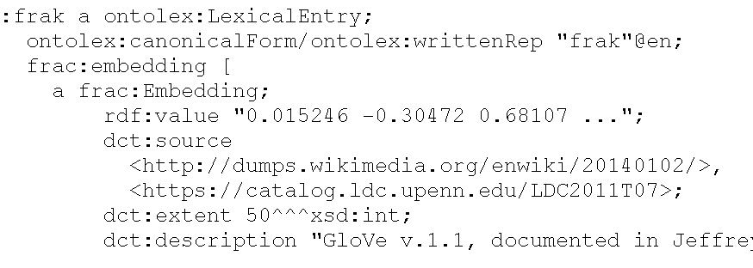
embedding
Embedding
dc:description: String
dc:extent: int
rdf:value: Literal
dc:source
ontolex:Element
corpus URI
used to exist
in Monnet/lemon
ontolex:Form
ontolex:LexicalSense
ontolex:LexicalConcept
ontolex:LexicalEntry

Slide 39
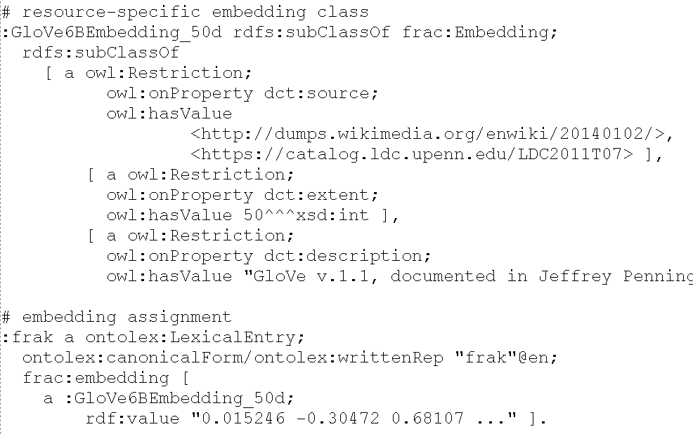
Simplifications: Resource-specific embedding class

Slide 40
Afterthoughts on embeddings
wrt. embeddings and RDF, we most not confuse the following two aspects:
vector processing / machine learning
requires encoding structured data in embeddings
embedding publication and sharing
requires interoperable representation of embeddings
current research on RDF embeddings solely focuses on processing (1)
Here, we are interested in resource sharing and access (2), not in processing. Of course, subsequent processing of embeddings requires a machine learning component, but here, we are ignorant on how this is handled.

Slide 41
Discussing embeddings
Not yet ...
let‘s look into collocations and synonyms, first
with a generalized notion of embeddings, corpus-based synonyms can be defined relative to embeddings

Slide 42
Corpus-based Associations
Collocation & Synonymity

Slide 43
Corpus-based associations
collocation
two (or more) words that regularly co-occur with each other, can be lexicalized multi-word expressions
corpus-based approximation of idiomatic expressions
syntagmatic relation between words: likelihood to occur simultaneously in the same context
similarity
two (or more) words that are characterized by their occurrence in similar contexts
corpus-based approximation of synonymity
paradigmatic relation between words: likelihood to stand in for each other in the same context

Slide 44
Corpus-based associations
There's a chemical cocktail that makes fracking possible

Slide 45
Corpus-based associations (Wortschatz)
collocation
(co-occurrence score
0.51)
(frequency: 915)
fracturing
There's a chemical cocktail that makes fracking possible
drilling
(0.35)
similarity
...

Slide 46
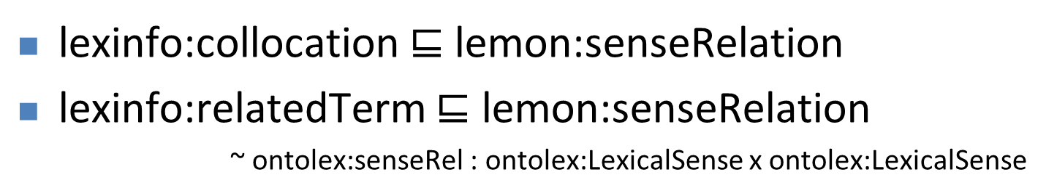
Corpus-based associations (Wortschatz)
collocation
(co-occurrence score
0.51)
(frequency: 915)
fracturing
There's a chemical cocktail that makes fracking possible
drilling
(0.35)
similarity
...
lexinfo:collocation $⊑$ lemon:senseRelation
lexinfo:relatedTerm $⊑$ lemon:senseRelation
~ ontolex:senseRel : ontolex:LexicalSense x ontolex:LexicalSense

Slide 47
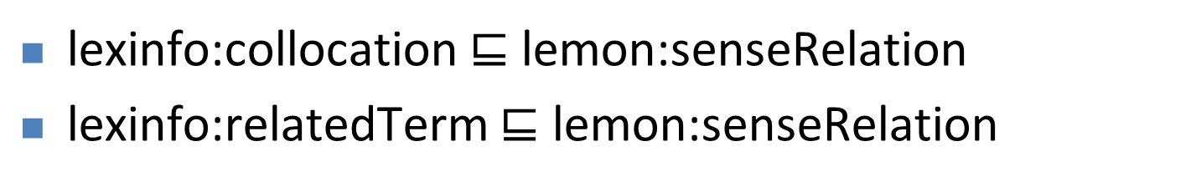
Corpus-based associations (Wortschatz)
collocation
(co-occurrence score
0.51)
(frequency: 915)
fracturing
There's a chemical cocktail that makes fracking possible
drilling
(0.35)
similarity
...
lexinfo:collocation $⊑$ lemon:senseRelation
lexinfo:relatedTerm $⊑$ lemon:senseRelation
but we‘re normally not dealing with senses, here, more often with forms or lemmas => new vocabulary elements

Slide 48
Corpus-based associations (Wortschatz)
collocation
(co-occurrence score
0.51)
(frequency: 915)
fracturing
There's a chemical cocktail that makes fracking possible
drilling
(0.35)
similarity
...
lexinfo:collocation $⊑$ lemon:senseRelation
lexinfo:relatedTerm $⊑$ lemon:senseRelation
but we‘re normally not dealing with senses, here, more often with forms or lemmas => new vocabulary elements
similarity assessments are the primary purpose of (word) embeddings

Slide 49
ContextualRelation
Container modelling inspired by lexicog draft (rdf:Seq)
rdfs:Container
dc:source
ContextualRelation
dc:description: String
rdf:value: double
corpus URI
~ rdf:Seq or rdf:Bag
(ordered/unordered)
~ rdf:Alt or rdf:Bag
(ordered/unordered)
Collocation
Similarity
rdfs:member
rdf:_1, ...
rdfs:member
ontolex:Element
Embedding
Collocation between ontolex:Elements
(distributional) similarity between embeddings
where none are given, these can be blanks attached to ontolex:Elements via frac:embedding
classical bags of words are infinite-dimensional vectors ;)

Slide 50
Summary: Embeddings & Contextual Relations
rdfs:Container
dc:source
dc:source
ContextualRelation
dc:description: String
rdf:value: double
corpus URI
Collocation
Similarity
rdfs:member
rdf:_1, ...
rdfs:member
Embedding
dc:description: String
dc:extent: int
rdf:value: Literal
embedding
ontolex:Element

Slide 51
get all collocates for a given lexical entry
SELECT ?x (MAX(?strength) as ?s)
WHERE {
?le canonicalForm/writtenRep „bucket“.
?le ^rdfs:member ?coll.
?coll a Collocation; rdf:value ?strength;
rdf:member ?sim.
FILTER(?sim!=?le)
?sim canonicalForm/writtenRep ?x.
} GROUP BY ?x
note that we have no way of telling whether how many elements the collocation contains

Slide 52
Discussion
frac:Embedding
more generalized than plain word embeddings, any better term?
relation to lexinfo properties ?
alternatives to the container modelling of contextual associations?
suggested use cases:
contextual relation: wrapper for corpus-based word associations (word sketches)
embedding: wrapper for any kind of distributional representation, bridge to SOTA NLP resources

Slide 53
ContextualRelation
dc:description: String
rdf:value: double
rdfs:Container
dc:source
Collocation
Similarity
rdfs:member,
rdf:_1, ...
rdfs:member
Embedding
dc:description: String
dc:extent: int
rdf:value: Literal
embedding
dc:source
attestation
Attestation
quotation: string
ontolex:Element
makes
Attestation
Citation
citation
dc:source
CorpusFrequency
rdf:value: int
corpus/locus
URI
frequency
dc:source
ontolex:Form
ontolex:LexicalEntry
ontolex:LexicalSense
ontolex:LexicalConcept

Slide 54
How to proceed ...
biweekly telcos, starting mid-July 2019
who would commit to participate?
we need 5 participants from different institutions
after/alternating with morphology telcos? different slot?
until then
create and populate a wiki with requirements and use cases
cf. morphology module

Slide 55
Some more details

Slide 56
Corpus Frequency

Slide 57
Simplifications
introduce corpus-specific frequency classes

Slide 58
Simplifications
additional restrictions => frequency classes for specific sub-corpora

Slide 59
Simplifications: Resource-specific embedding class

