Slide 1
Distributional Information in OntoLex
Christian Chiarcos and Maxim Ionov
ACoLi, Goethe-Universität Frankfurt

Slide 2
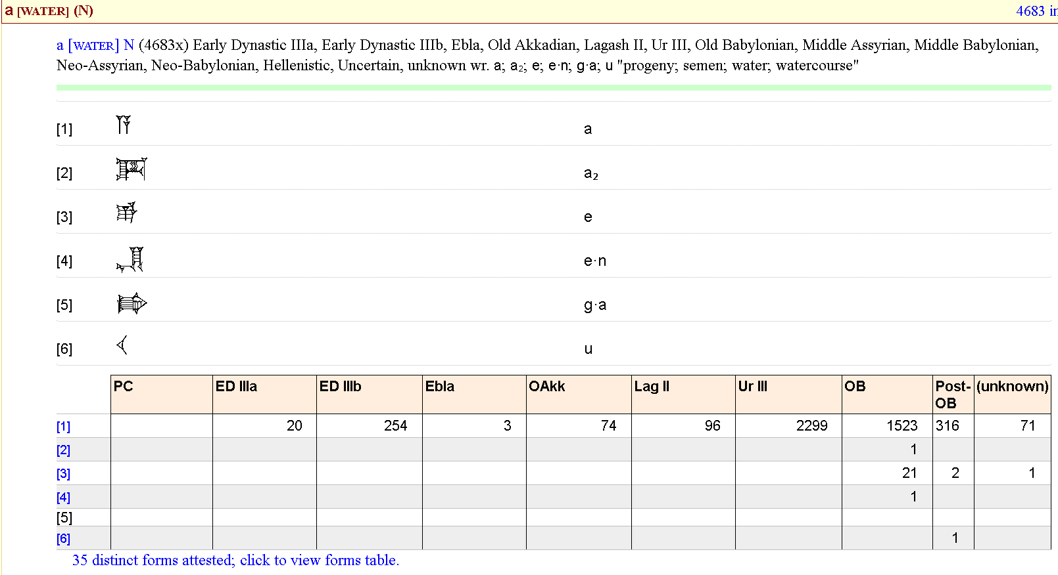
Motivation
representation of frequency information
corpus-based lexicography (ePSD)

Slide 3
Motivation
representation of frequency information
corpus-based lexicography (ePSD)
lexical entry a [WATER]
sense and language definition
total lexeme frequency
Form/written representations
(original and transcript)
corpus distribution over
time and region

Slide 4
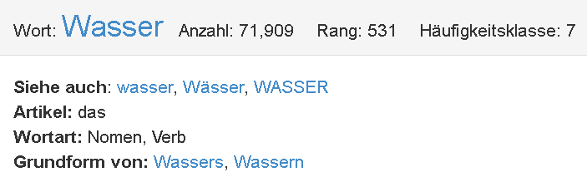
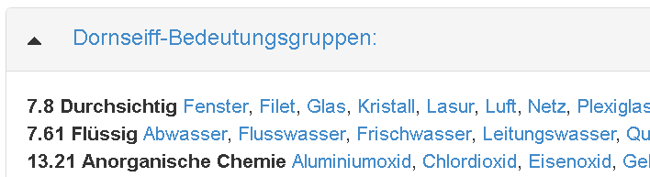
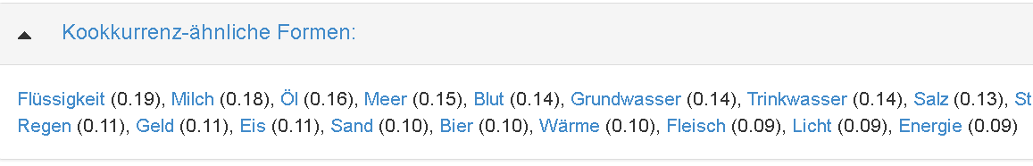
Motivation
representation of frequency information
corpus-based lexicography (Wortschatz Leipzig)

Slide 5
Motivation
representation of frequency information
corpus-based lexicography (Wortschatz Leipzig)
lexical entry Wasser
total lemma frequency, rank and derived scores
form and grammar
lexical concepts
relative frequency of collocates

Slide 6
Motivation
representation of frequency information
corpus-based lexicography
absolute frequencies
lemma and form frequencies
frequencies of annotations (e.g., sense, concept per lexical entry or form, etc.)
relative frequencies
collocations
frequency ranks
Wortschatz Rang (position in frequency list) and Häufigkeitsklasse (frequency relative to maximum frequency, in logarithmic steps)

Slide 7
Motivation
representation of frequency information
corpus-based lexicography
absolute frequencies
lemma and form frequencies
frequencies of annotations (e.g., sense, concept per lexical entry or form, etc.)
relative frequencies
collocations
frequency ranks
Wortschatz Rang (position in frequency list) and Häufigkeitsklasse (frequency relative to maximum frequency, in logarithmic steps)
But where to place frequency?

Slide 8
Use Case
representation of absolute frequency
frequency
dc:source
ontolex:Element
CorpusFrequency
rdf:value: int
corpus URI
used to exist
in Monnet/lemon
ontolex:Form
Side note: „Corpus“ here is used in
the original, broader sense as
„structured data collection“.
This can, but does not have to be
a corpus in the language resource
sense. It could also be, e.g., a(nother)
dictionary
ontolex:LexicalSense
ontolex:LexicalConcept
ontolex:LexicalEntry

Slide 9
Use Case
representation of absolute frequency
frequency
dc:source
ontolex:Element
CorpusFrequency
rdf:value: int
corpus URI
used to exist
in Monnet/lemon
ontolex:Form
This would be the minimally required
OntoLex extension to represent frequency-
related information (from which many other
scores may be derived).
Other aspects:
- links to actual attestations
(i.e., the elements counted over)?
- relative frequencies
- derived frequency scores
ontolex:LexicalSense
ontolex:LexicalConcept
ontolex:LexicalEntry

Slide 10
Use Cases
representation of corpus information
corpus-based lexicography
represent diagnostic corpus scores as often returned by lexicographic tools
WordSmith, SketchEngine
handling of attestations (as links with corpora)
representation of frequency lists or other forms of distributional semantics
Does this fit the lexicog model?
If not, we need to put into a separate model
apparent consensus at telco on Oct 30, 2018

Slide 11
Challenges for a new module
Defining scope
corpus-driven lexicography
which other use cases? (NLP, corpus linguistics, lexicography-related web services, word embeddings, attestations)
Finding contributors
wave your hand and get in touch with us
if we find 4 more people willing to contribute, we‘ll organize a telco in the next weeks

Slide 12
Thank you!
And of course, we need a name
? „DisLe“ (adding distribution data to lemon) ?

