Slide 1
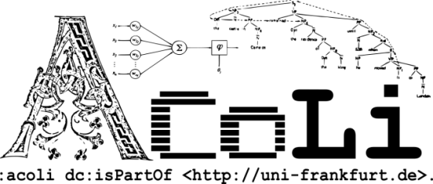

Towards an Ontolex-Lemon module for Frequency, Attestations and Corpus Information (FrAC)
2nd Ontolex-Lemon 2f2 meeting, held in conjunction with LDK-2019, Leipzzig, May 20, 2019
Christian Chiarcos & Maxim Ionov
Applied Computational Linguistics / LiODi
Goethe-Universität Frankfurt, Germany

Slide 2
TODO
add slides from Leiden freq and Leiden embeddings
create slides for attestations
check TTL inconsistencies

Slide 3
Towards an Ontolex-Lemon module for Frequency, Attestations and Corpus Information
Motivation
FrAC
Frequency
Attestations
Corpus(-derived) Information
Collocations
(distributional) Similarity
Embeddings

Slide 4
Corpus Frequency
Side note: „Corpus“ here is used in the original, broader sense as „structured data collection“. This can, but does not have to be a corpus in the language resource sense. It could also be, e.g., a(nother) dictionary

Slide 5
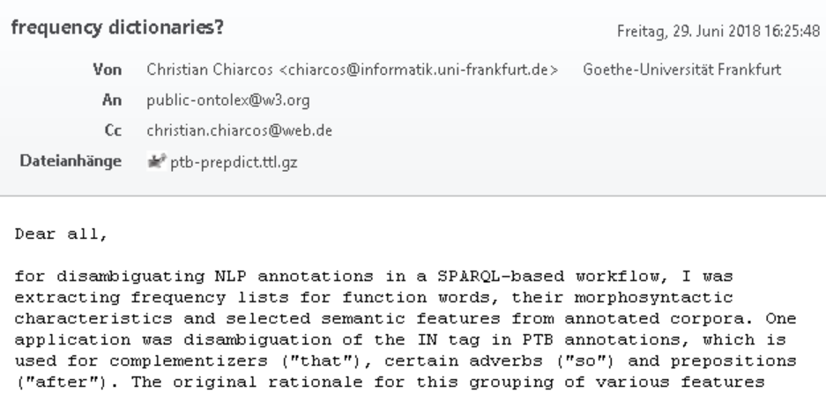
FrAC – Motivation: Frequency
There‘s no easy way
not in(to) lexicography module
frequency is lexicographically relevant, but not only there
can only be defined relative to a corpus, i.e., reification
not a plain lexinfo property

Slide 6
FrAC – Motivation: Frequency
BTW: We still don‘t have a solution for that
original use case annotation engineering
(Chiarcos & Fäth@LDK-2019)
so far without frequency-based disambiguation
There‘s no easy way
not in(to) lexicography module
frequency is lexicographically relevant, but not only there
can only be defined relative to a corpus, i.e., reification
not a plain lexinfo property

Slide 7
FrAC – Beyond Frequency
frequency can only be defined relative to a corpus
if we need to provide novel vocabulary anyway, other, corpus-related information can be included here, too
Leiden f2f meeting
attestations (originally suggested for lexicog module)
corpus-derived information for digital lexicography
collocations (and NLP)
distributional similarity (clusters) [as produced by common tools]
SOTA NLP resources (beyond lexicography)
embeddings? (esp., sense embeddings, cf. Rothe & Schütze 2015)

Slide 8
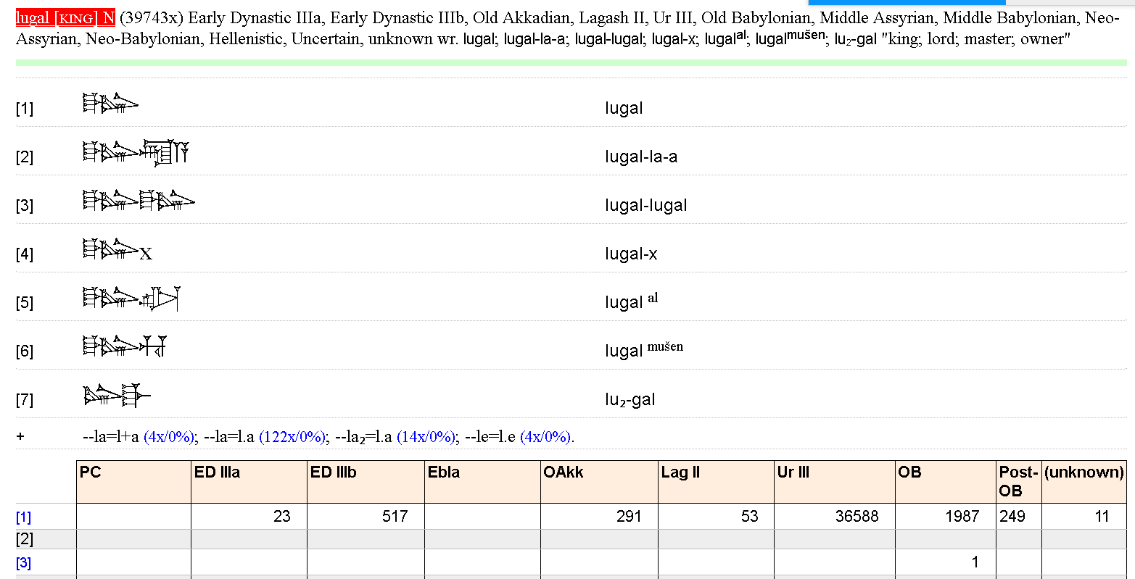
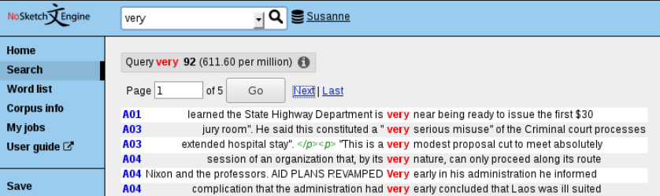
Corpus Frequency in EPSD2
http://oracc.museum.upenn.edu/epsd2/sux
frequency
corpus-based lexicography
taking corpus frequencies into account
(at least, displaying them)
Corpus Frequency in NoSketchEngine
https://www.sketchengine.eu/nosketch-engine/
basically for everything
that you could find in
a corpus
informs lexicographers
about commonness, etc.

Slide 9
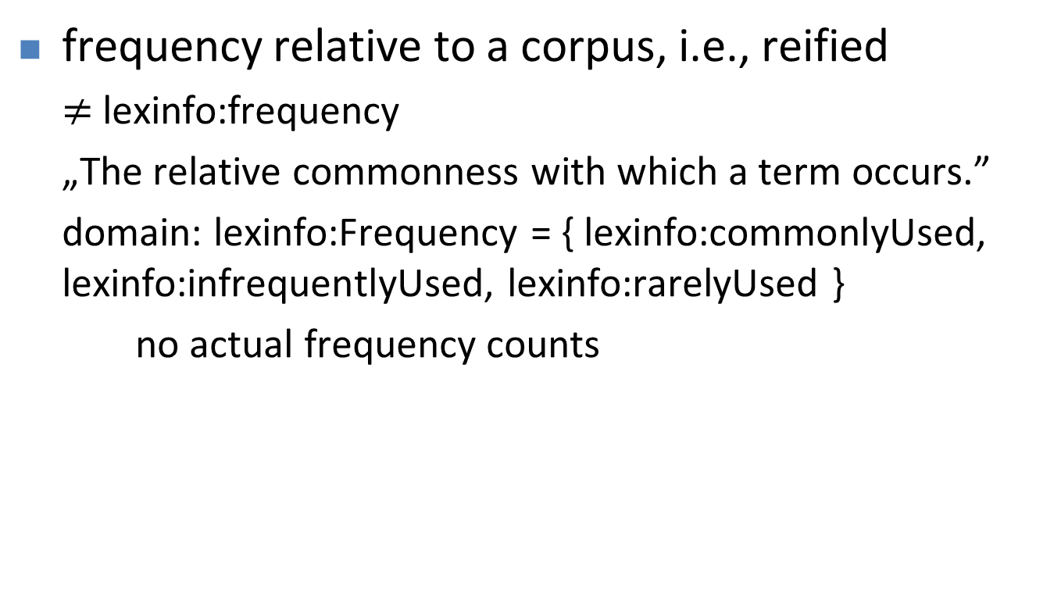
Corpus Frequency
frequency relative to a corpus, i.e., reified
$≠$lexinfo:frequency
„The relative commonness with which a term occurs.”
domain: lexinfo:Frequency = { lexinfo:commonlyUsed, lexinfo:infrequentlyUsed, lexinfo:rarelyUsed }
no actual frequency counts

Slide 10
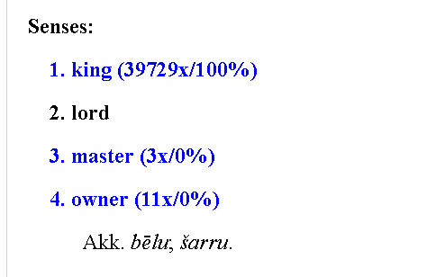
Corpus Frequency in EPSD2
http://oracc.museum.upenn.edu/epsd2/sux
frequency of lexical entry
frequency of lexical form
(in different periods/
subcorpora)
frequency of
lexical senses

Slide 11
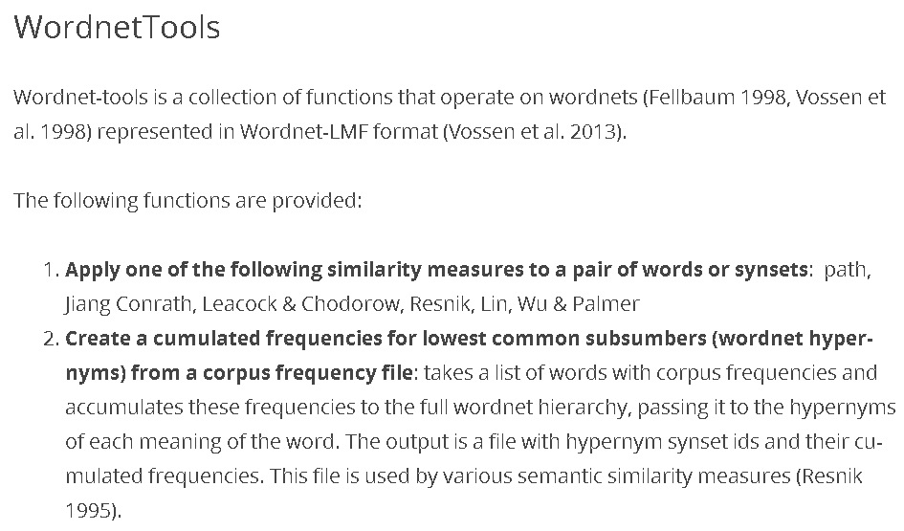
Corpus Frequency beyond lexical entries
http://www.cltl.nl/results/software/wordnettools/
=> corpus frequency for lexical concepts !

Slide 12
Corpus Frequency
everything in ontolex can be counted against a corpus
minimum information: absolute frequency & provenance, i.e. reference to source corpus (any URI)
ontolex:Form
ontolex:LexicalEntry
CorpusFrequency
rdf:value: int
corpus/locus URI
frequency
dc:source
ontolex:LexicalSense
ontolex:LexicalConcept

Slide 13
Corpus Frequency
everything in ontolex can be counted against a corpus
similarly for every subsequent piece of corpus information => generalization
ontolex:Element
CorpusFrequency
rdf:value: int
corpus/locus URI
frequency
dc:source
ontolex:Form
ontolex:LexicalSense
ontolex:LexicalConcept
ontolex:LexicalEntry

Slide 14
Corpus Frequency
everything in ontolex can be counted against a corpus
similarly for every subsequent piece of corpus information => generalization
if not in the ontolex module, then introduce it here
ontolex:Element
CorpusFrequency
rdf:value: int
corpus/locus URI
frequency
dc:source
ontolex:Form
ontolex:LexicalSense
ontolex:LexicalConcept
ontolex:LexicalEntry

Slide 15
Attestations

Slide 16
Attestations
long and vivid discussion in the lexicog model
Leiden f2f meeting: merge with module on corpus-related issues
based on two existing proposals
Khan and Boschetti (2018) and Depuydt and de Does (2018)
approach:
focus on linking with an edition/corpus
move “simple” lexicographic properties to lexinfo
support citations, but stay agnostic wrt. vocabulary for bibliography

Slide 17
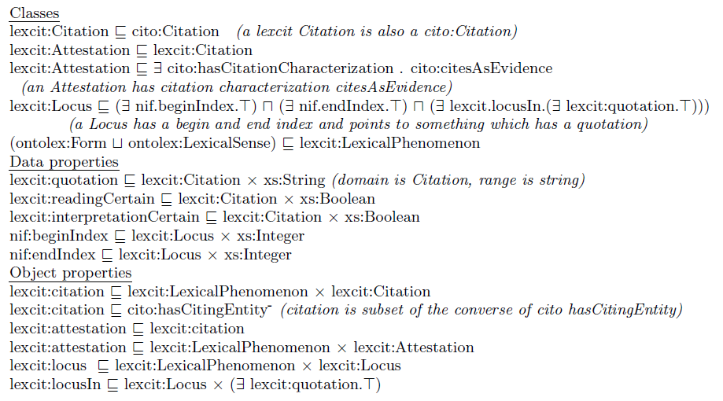
attestations after Depuydt & de Does 2018
Locus
nif:beginIndex***
nif:endIndex***
locusIn**
locus
Citation
quotation: string
readingCertain: boolean****
interpretationCertain: boolean****
citation
ontolex:Element*
attestation
Attestation
* i.e., D&dD: lexcit:LexicalPhenomenon
** simplified: pointing to an anonymous superclass of
something that contains a quotation
*** I would prefer not to prescribe nif properties in order to permit other means of cross-referencing, e.g., nif URIs, WebAnnotation selectors, etc.
**** I would prefer to leave certainly etc. to lexinfo

Slide 18
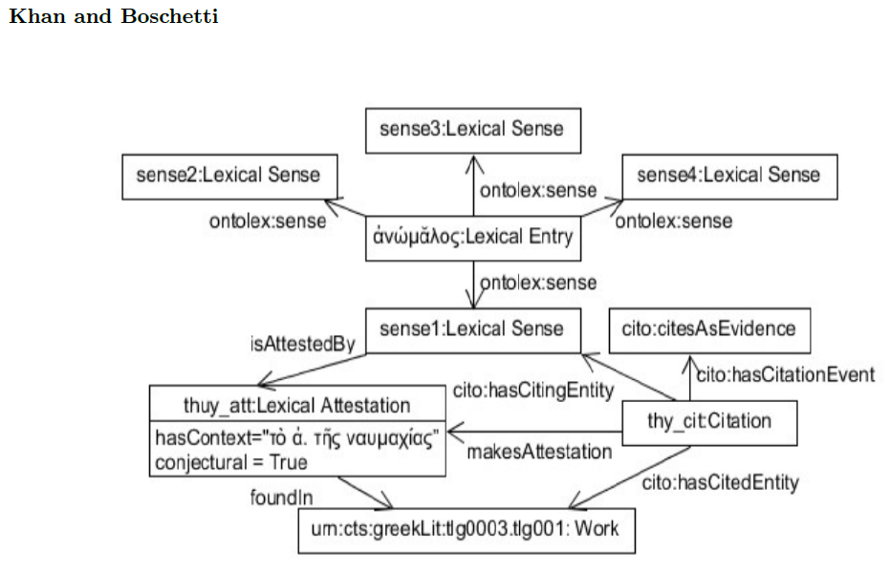
attestations after Khan & Boschetti (2018)
attestation**
Attestation***
hasContext: str(6*)
conjectural: boolean****
makesAttestation
ontolex:Element*
Citation
foundIn(7*)
work URI*****
* originally restricted to LexicalSense
** originally „isAttestedBy“
*** originally „LexicalAttestation“
**** I would prefer to leave certainty etc. to lexinfo
***** originally „Work“
(6*) maybe rename such that that also context-free examples fit
(7*) I had dc:source at other occasions
as in the other proposal, cito properties and
concepts are skipped, these are beyond the module

Slide 19
attestations: proposal for a minimal consensus (Nov 2018)
we do not cover:
scientific citations (should refine Citation, using external vocabularies)
corpus pointers (can be NIF objects, NIF URIs, WebAnnotation selectors, CTS URNs, URLs, etc.)
dc:source (6*)
attestation***
Attestation*
quotation: string**
ontolex:Element
locus URI
makes
Attestation
(5*)
Citation
citation****
* D&dD: Citation
** K&B: hasContext
*** D&dD: attestation
**** K&B: inv of hasCitingEntity
5* D&dD: implicit
6* D&dD: inv of locusIn, K&B: foundIn

Slide 20
attestation
Attestation
quotation: string
dc:source
ontolex:Element
locus URI
makes
Attestation
Citation
citation
proposed minimal consensus | D&dD | K&B
ontolex:Element | LexicalPhenomenon | (LexicalSense)
attestation | attestation | isAttestedBy
Attestation | Attestation | Attestation
Citation | ~ Citation | Citation
citation | ~ citation | (indirectly via makesAttestation)
makesAttestation | [identity/subClassOf] | makesAttestation
dc:source | ^locusIn | foundIn
quotation | quotation | hasContext
(locus URI) | Locus | Work
(indirectly via attestations) | locus | (hasCitingEntity/hasCitedEntity)

Slide 21
Attestations: initial discussion
Fahad (May 15, 2019)
I see an attestation as evidence of the use of some linguistic element or convention and therefore attestations relate together entries, senses, etc, with any source that might manifest evidence of that use, e.g., a book, an inscription, a corpus; it is not simply a quotation as in Christian's model, although there should be datatype properties which link an attestation with its textual context;
currently covered by dc:source and quotation
the source is the dc:source element, the textual content is quotation
do we need a frac-specific source identifier?

Slide 22
Attestations: initial discussion
Fahad (May 15, 2019)
I see an attestation as evidence of the use of some linguistic element or convention and therefore attestations relate together entries, senses, etc, with any source that might manifest evidence of that use, e.g., a book, an inscription, a corpus; it is not simply a quotation as in Christian's model, although there should be datatype properties which link an attestation with its textual context;
attestation
Attestation
quotation: string
dc:source
ontolex:Element
locus URI
link to textual
content (rename?)
well, we
have that
makes
Attestation
Citation
textual
content
citation

Slide 23
Attestations: initial discussion
Fahad (May 15, 2019)
uncertainty levels to attestations and in certain cases might actually be referring to a conjectural, reconstructed text; in other cases a legacy resource might actually be incorrect in regarding a certain source as attest and it would be useful to be able to annotate; we should make provision for this;
not specific to attestations => lexinfo (& provo)
eluku ‘offered (?)‘ (uncertain sense)
lemais ‘Lemai‘, THEO (?) (uncertain POS)
ti[– – –] ‘?‘ (defective form)
got. raíhts, aisl. réttr, ags. riht, as. ahd. reht ... (= kelt. *rektu- ...) (reconstructed lexeme)
(examples 1-3 from Wallace 2008. Zikh Rasna. A Manual of the Etruscan Language and Inscriptions, Beech Stave Press,
example 4 from Pokorny, J. (1969). Indogermanisches etymologisches Wörterbuch (Vol. 2). Francke, entry 1589)

Slide 24
Attestations: initial discussion
Fahad (May 15, 2019)
citations are (speech) acts which can't be correct or incorrect, they're either successful or unsuccessful, they should be related to attestations, because a lexical entry will often *cite* a book in order to specify an attestation (but this is far from the only way citations can be used in a lexical entry)
attestation
Attestation
quotation: string
dc:source
ontolex:Element
locus URI
makes
Attestation
Citation
citation

Slide 25
Embeddings
and related distributional resources

Slide 26
Embeddings
in a broader sense: incl. bags of words, etc.
if representable as a vector
why?
most important data structure in distributional semantics, often laborsome to replicate
reuse encouraged
applicable to form, lexeme, sense,* concept*
but detached from their definition
often distributed as CSV files => vocabulary for CSV2RDF rendering
nobody expects embeddings to be distributed in Turtle ;)
* cf. Rothe & Schütze (2015), AutoExtend, for embedding induction over WordNet senses and synsets

Slide 27
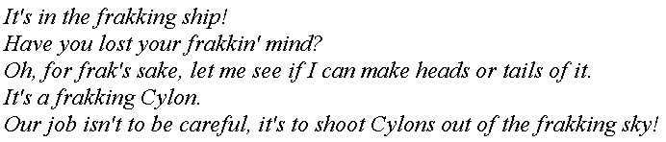
Embeddings: Word vectors
simple, uncompressed form of embedding
based on a reference list of vocabulary items, where every reference word is associated with a fixed position, e.g., ship with position 1, ocean with 2, sky with 3, etc.
Sample corpus for frak (from Wikiquote)

Slide 28
Embeddings
Word vectors can be compressed
using statistical (e.g., PCA) or neural methods (e.g., Autoencoder)
dimensions are usually no longer interpretable

Slide 29
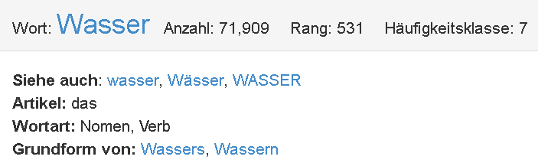
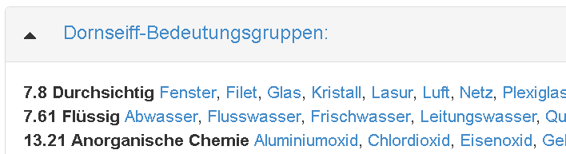
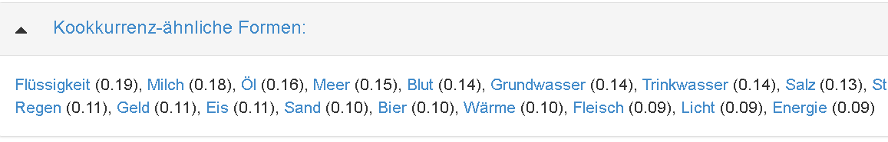
Distributional associations: Collocations
representation of frequency information
corpus-based lexicography (Wortschatz Leipzig)

Slide 30
Distributional associations: Collocations
representation of frequency information
corpus-based lexicography (Wortschatz Leipzig)
lexical entry Wasser
total lemma frequency, rank and derived scores
form and grammar
<= CorpusFrequency
lexical concepts
relative frequency of collocates
opaque aggregate score(s)

Slide 32
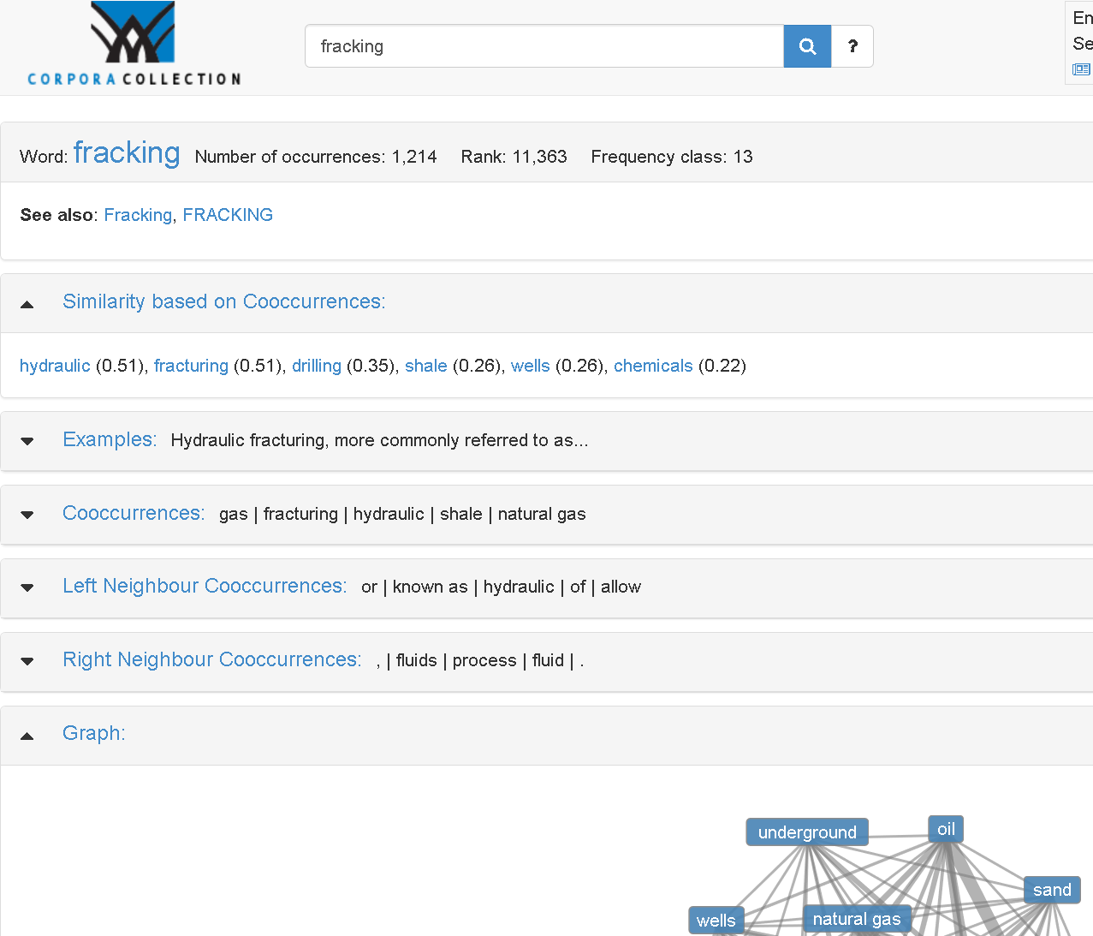
Collocations
co-occurrence information
e.g., programmatically, from SketchEngine
cf. automatically created collocation bases, e.g., Wortschatz (underlying corpus not available)

Slide 34
Web Annotation / Open Annotation
W3C Open Annotation Community Group
https://www.w3.org/community/openannotation/
2012-2014
mostly driven by bioinformatics, but generic formalism for annotating web content
Web Annotation (W3C recommendations, Feb 2017)
Data Model: https://www.w3.org/TR/annotation-model
general description
Vocabulary: https://www.w3.org/TR/annotation-vocab
ontology
Protocol: https://www.w3.org/TR/annotation-protocol
retrieving and manipulating annotations
serialization: must JSON-LD, should Turtle, may provide other RDF serializations

Slide 35
Web Annotation: Annotation
https://www.w3.org/TR/annotation-vocab/
rdf:type
hasTarget
motivatedBy
Motivation
Annotation
hasBody
dc:created
dc:creator
xsd:dateTime
recommended
required
TextualBody

Slide 36
Web Annotation: Annotation
https://www.w3.org/TR/annotation-vocab/
rdf:type
hasTarget
motivatedBy
Motivation
Annotation
hasBody
dc:created
dc:creator
rdf:type
xsd:dateTime
assessing
bookmarking
recommended
classifying
required
commenting
describing
editing
...
TextualBody

Slide 37
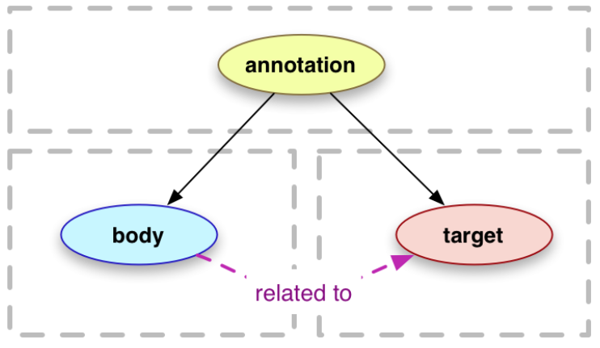
Web Annotation: Target and Body
https://www.w3.org/TR/annotation-model/
body
element containing the annotation
object property: oa:hasBody (any RDF object)
datatype property: oa:bodyValue (strings)
target
element being annotated
any RDF object, including
oa:Selector (more in a second)

Slide 38
oa:Selector – e.g. possible targets
Selector
FragmentSelector
XPathSelector
TextQuoteSelector
CssSelector
TextPositionSelector
SvgSelector
DataPositionSelector
RangeSelector
or: just any URI ;)

Slide 39
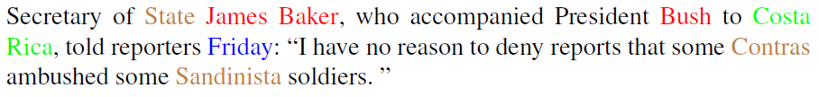
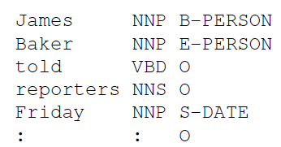
Named Entity Annotations
OntoNotes corpus, wsj-0655
https://catalog.ldc.upenn.edu/LDC2013T19

Slide 40
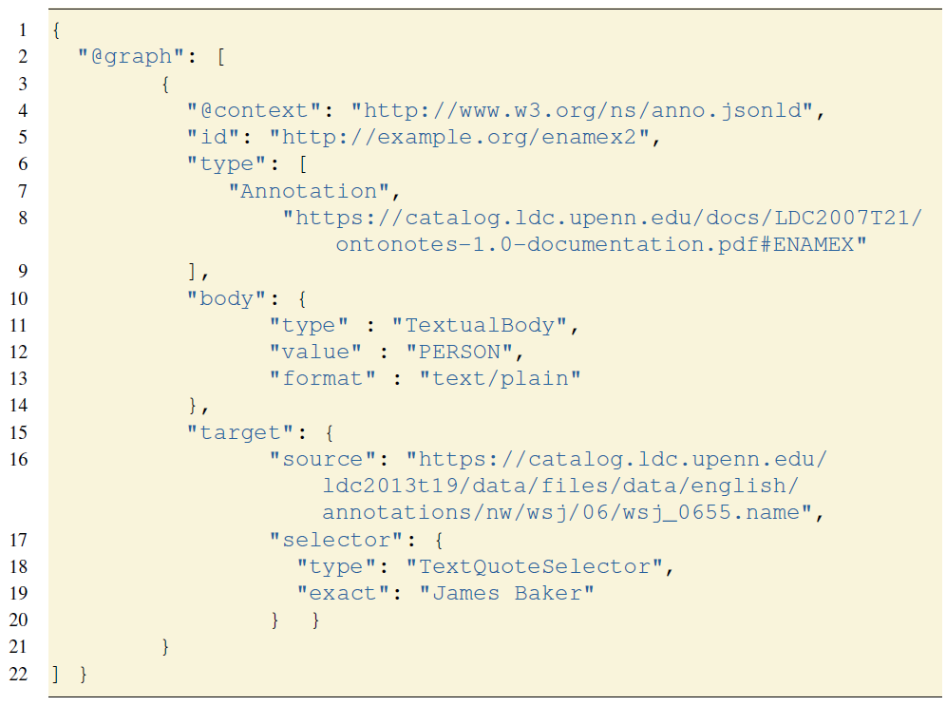
Named Entity Annotations (JSON-LD)

Slide 41
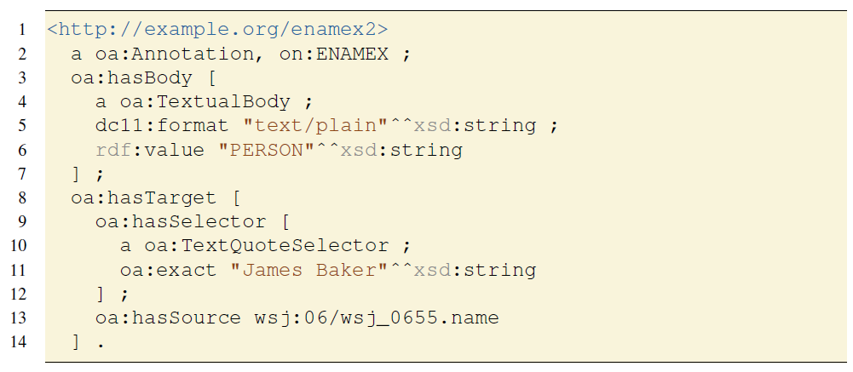
Named Entity Annotations (Turtle)

Slide 42
Named Entity Annotations
on:EMANEX
TextualBody
rdf:type
rdf:type
http://example.org/emanex2
hasBody
hasTarget
dc11:format
“text/plain“
rdf:value
“PERSON“
hasSource
TextQuote
Selector
hasSelector
wsj:06/wsj_0655.name
exact
“James Baker“

Slide 43
Web Annotation: Overview
relatively good uptake
esp. in bioinformatics
reification
annotation as n:m relation between bodies & targets
with metadata
powerful
annotate all instances of a string at once using a oa:TextQuoteSelector
very verbose
„X is a person according to EMANEX annotations“ takes 11 triples

Slide 44
Named Entity Annotations (Turtle)
notational shorthand: oa:bodyValue for string-value bodies
3-7 oa:bodyValue “PERSON“^^xsd:string ;
=> 4 triples replaced by 1

Slide 45
Web Annotation: Overview
relatively good uptake
esp. in bioinformatics
reification
annotation as n:m relation between bodies & targets
with metadata
powerful
annotate all instances of a string at once using a oa:TextQuoteSelector
rather verbose
„X is a person according to EMANEX annotations“ takes 11 7 triples

Slide 46
Web Annotation: Overview
relatively good uptake
esp. in bioinformatics
reification
annotation as n:m relation between bodies & targets
with metadata
powerful
annotate all instances of a string at once using a oa:TextQuoteSelector
rather verbose
no linguistic data structures

Slide 47
NIF - NLP Interchange Format
NIF URI schema
NIF ontologies

Slide 48
NIF - NLP Interchange Format
http://persistence.uni-leipzig.org/nlp2rdf/ontologies/nif-core/
String URIs
e.g., in a web document
can be directly used as object of oa:hasTarget
simple ontology of linguistic data structures
for selected, typical NLP annotations
not covering all you ever need for linguistic annotations ;)

Slide 49
NIF String URIs
RFC 5147 (for plain text documents)
URI fragments for text references, via
character position
https://catalog.ldc.upenn.edu/docs/LDC95T7/raw/06/wsj_0655.txt#char=19
character range
https://.../wsj_0655.txt#char=19,30

Slide 50
NIF String URIs
RFC 5147 (for plain text documents)
URI fragments for text references, via
character position
https://catalog.ldc.upenn.edu/docs/LDC95T7/raw/06/wsj_0655.txt#char=19
character range
https://.../wsj_0655.txt#char=19,30
line offsets
https://.../wsj_0655.txt#line=0 (first line)
https://.../wsj_0655.txt#line=0, (range until the end)

Slide 51
NIF String URIs
RFC 5147 (for plain text documents)
URI fragments for text references, via
position
https://catalog.ldc.upenn.edu/docs/LDC95T7/raw/06/wsj_0655.txt#char=19
range
https://.../wsj_0655.txt#char=19,30
optionally followed by integrity checks
https://.../wsj_0655.txt#char=19,30;length=12
https://...#char=19,30;md5=67f60186fe687bb898ab7faed17dd96a

Slide 52
NIF String URIs
RFC 5147 (for plain text documents)
URI fragments for text references, via
position
https://catalog.ldc.upenn.edu/docs/LDC95T7/raw/06/wsj_0655.txt#char=19
range
https://.../wsj_0655.txt#char=19,30
optionally followed by integrity checks
optionally followed by encoding specs
https://.../wsj_0655.txt#char=19,30;length=12,UTF-8
https://.../wsj_0655.txt#char=19,30;,UTF-8

Slide 53
NIF String URIs
RFC 5147 (for plain text documents)
URI fragments for text references, via
position
https://catalog.ldc.upenn.edu/docs/LDC95T7/raw/06/wsj_0655.txt#char=19
range
https://.../wsj_0655.txt#char=19,30
0 PREFIX wsj_0655 : <https://catalog.ldc.upenn.edu/docs/LDC95T7/raw/06/wsj_0655.txt#>
...
8-12 oa:hasTarget wsj_0655:char=19,30 .
13-14 wsj_0655:char=19,30 oa:hasSource wsj:06/wsj_0655.name .

Slide 54
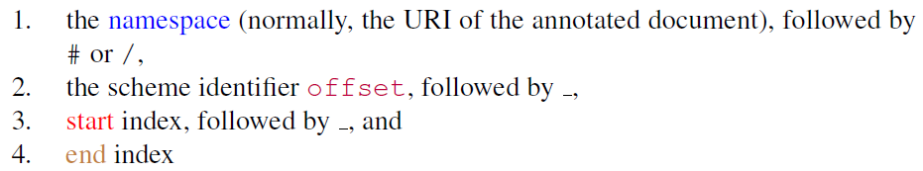
Native NIF String URIs: Offset-based
conceptually similar to RFC 5147
extends to other mime types by assuming text streams

Slide 55
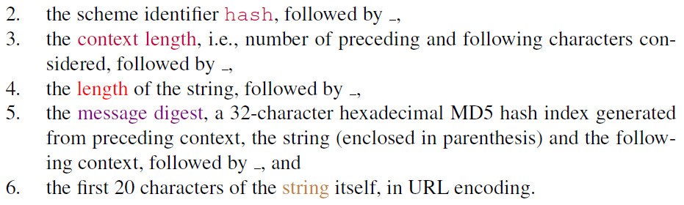
Native NIF String URIs: Match-based
a community convention, not a standard
resolve against all Strings matching the search term and its (MD5-encoded) context

Slide 56
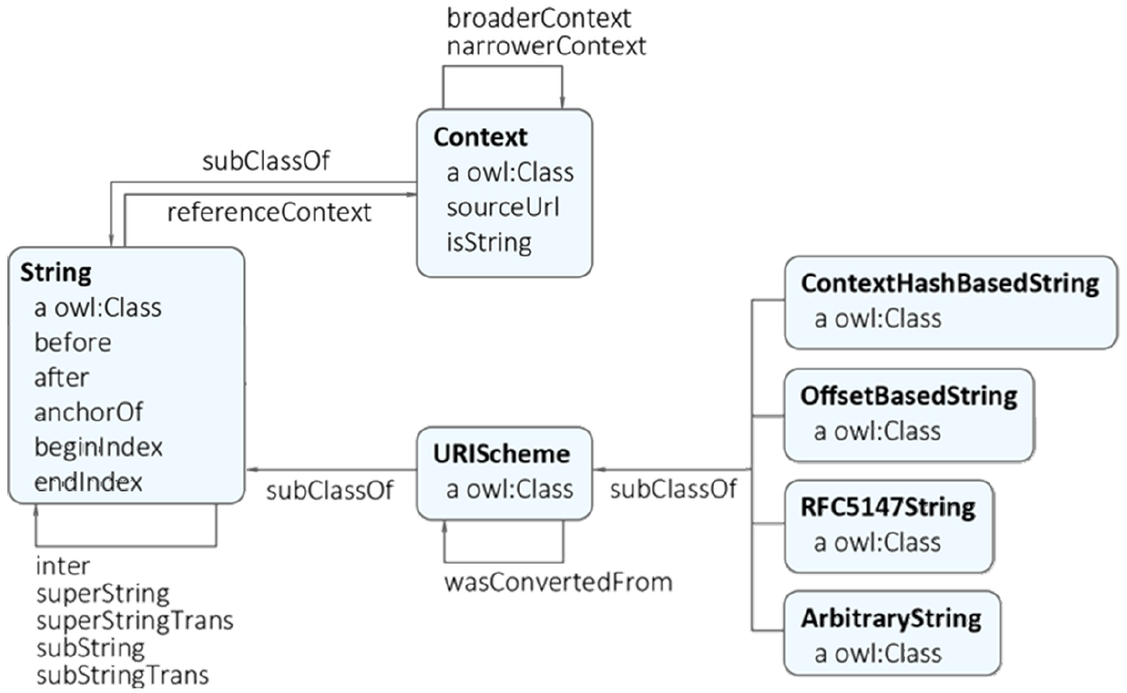
NIF 2.0 String (sub-)Ontology
String class
other classes explicating
URI information

Slide 57
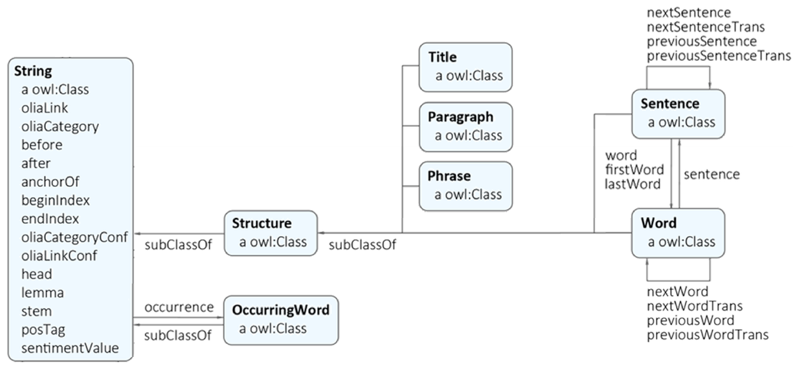
NIF 2.0 Annotation (sub-)Ontology
subclasses of String
annotation properties for selected properties

Slide 58
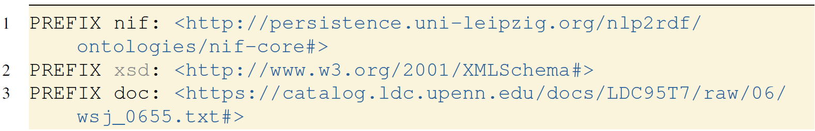
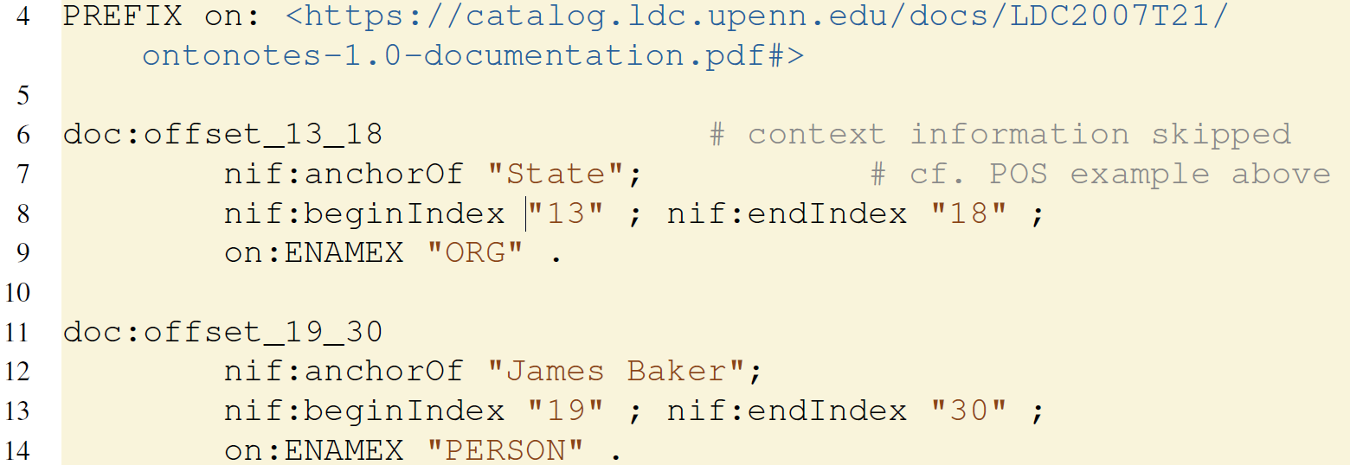
Named Entity annotation in NIF (Turtle)
...

Slide 59
Named Entity annotation in NIF
nif:String
rdf:type
doc:offset_19_30
nif:anchorOf
“James Baker“
nif:beginIndex
“19“
nif:endIndex
“30“
on:EMANEX
“PERSON“
optional
(i.e., implicitly encoded
in the URI scheme)
Notes:
forgot „a String“ in TTL

Slide 60
Named Entity annotation in NIF vs. WA
nif:String
rdf:type
doc:offset_19_30
cf. WebAnnotation
nif:anchorOf
“James Baker“
wsj:06/wsj_0655.name
oa:TextQuote
Selector
nif:beginIndex
oa:hasSource
“19“
on:EMANEX
nif:endIndex
“30“
rdf:type
oa:hasSelector
rdf:type
on:EMANEX
oa:hasTarget
“PERSON“
http://example.org/emanex2
oa:exact
“James Baker“
oa:bodyValue
“PERSON“

Slide 61
Named Entity annotation in NIF+WA
nif:String
rdf:type
doc:offset_19_30
oa:hasSource
nif:anchorOf
“James Baker“
wsj:06/wsj_0655.name
nif:beginIndex
“19“
on:EMANEX
nif:endIndex
“30“
rdf:type
oa:hasTarget
http://example.org/emanex2
oa:bodyValue
“PERSON“

Slide 62
NIF+WA minimalistic
doc:offset_19_30
oa:hasSource
wsj:06/wsj_0655.name
information encoded
in the NIF URI scheme
can be omitted
on:EMANEX
rdf:type
oa:hasTarget
http://example.org/emanex2
oa:bodyValue
“PERSON“

Slide 63
Using NIF
at the moment, one of the most widely known RDF-based annotation formalism for NLP
shallow, word-level annotations
implicit unification of annotations referring to the same string
useful in NLP
often unacceptable to linguists
implicit unification of annotations can be circumvented, e.g., using Web Annotation

Slide 64
NIF limitations
NIF data structures are no sufficient solution shallow for advanced linguistic annotations
morphology? (no sub-word strings)
non-phrasal/discontinuous segments ?
hard-wired annotation properties

Slide 65
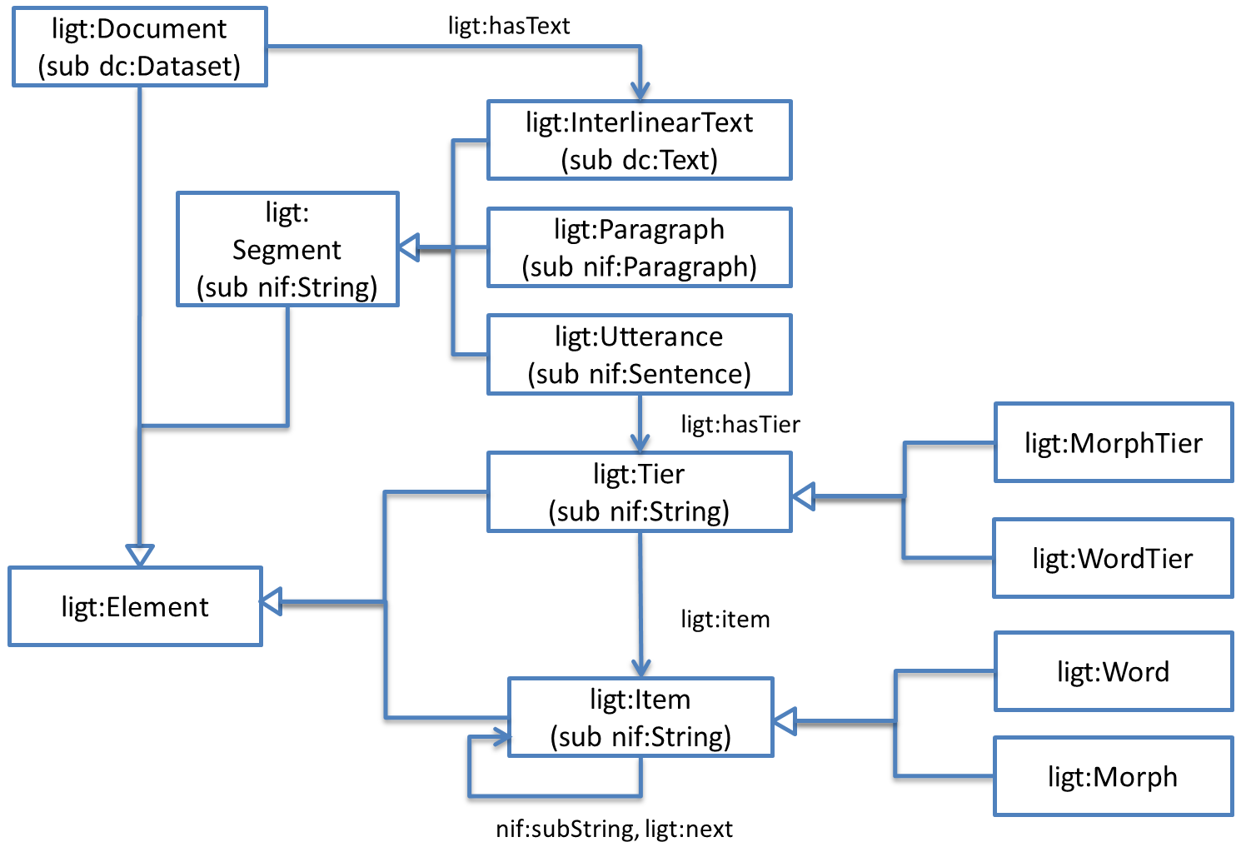
Beyond NIF I: domain-specific vocabularies
Interlinear Glossed Text (IGT)
FLEx-RDF (Chiarcos et al.@LDK-2017, https://github.com/acoli-repo/LLODifier)
Ligt
(Chiarcos & Ionov@LDK-2019)
morpheme-level
annotations

Slide 66
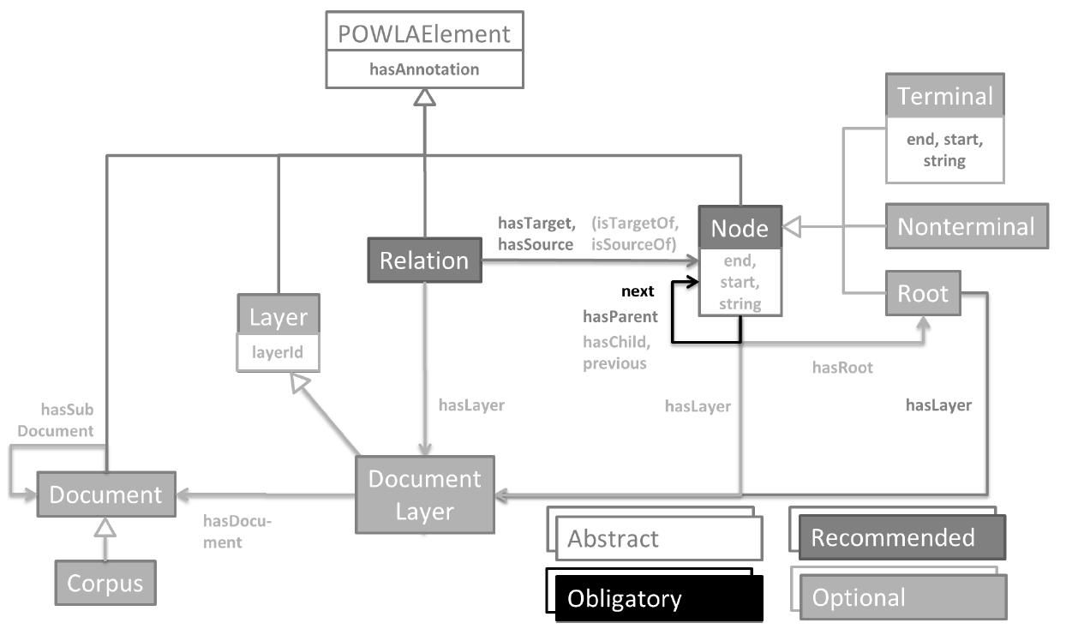
Beyond NIF II: Linguistic Data Structures
generic vocabulary for linguistic data structures
POWLA (Chiarcos@ESWC 2012, http://purl.org/powla)

Slide 67
Beyond NIF III: Linguistic Annotations
linguistic data categories
Ontologies of Linguistic Annotation (OLiA)
(Chiarcos & Sukhareva 2016,
http://purl.org/olia)
OLiA Reference Model
Terminology
Repositories
Terminology
Repositories
Terminology
Repositories
Terminology
Repositories
Terminology
Repositories
Terminology
Repositories
Morphosyntactic
Category
rdfs:subClassOf
Adjective
OLiA
Reference
Model
rdfs:subClassOf
rdfs:subClassOf
Attributive
Adjective
POS
rdf:type
rdfs:subClassOf
Terminology
Repositories
Adjective
Terminology
Repositories
Terminology
Repositories
Terminology
Repositories
Terminology
Repositories
rdf:type
rdf:type
Annotation
Models
ADJD
ADJA
STTS Annotation Model

Slide 68
RDF Annotations in NLP and Linguistics
great potential for resource interoperability and integration
still limited uptake
structural reasons
often project-based funding, limited capacity to care about esoteric formalisms to facilitate reusability
inherent reasons
some technical overhead
can be verbose/foreign in comparison to older formats
pragmatic reasons
limited tool support for linked data in NLP & linguistics
not integrated in existing workflows

Slide 69
RDF Annotations in NLP and Linguistics
great potential for resource interoperability and integration
still limited uptake
structural reasons
often project-based funding, limited capacity to care about data re-use
inherent reasons
some technical overhead
can be verbose in comparison to older formats
pragmatic reasons
limited tool support for linked data in NLP & linguistics
not supported by existing tools
we‘re working on that

Slide 70
RDF Annotations in NLP and Linguistics
great potential for resource interoperability and integration
still limited uptake
structural reasons
often project-based funding, limited capacity to care about data re-use
inherent reasons
some technical overhead
can be verbose in comparison to older formats
pragmatic reasons
limited tool support for linked data in NLP & linguistics
not supported by existing tools
we‘re working on that
Example: CoNLL-RDF

Slide 71
CoNLL-RDF
An NLP-friendly formalism for RDF corpora

Slide 72
CoNLL format family
CoNLL is a format family widely used in NLP
tab-separated values
one word per line
one column for annotation type
sentences separated by empty lines
conventions for most types of word-based linguistic annotation
SRL, dependency syntax, phrase structure syntax, span annotation, coreference
and beyond
cf. SketchEngine, NoSketchEngine, CorpusWorkbench
one-word-per-line TSV formats

Slide 73
CoNLL-RDF: idea
isomorphic rendering of CoNLL data structures in RDF
every line a nif:Word
every block a nif:Sentence
user provides labels for column names
column label => property in the conll: namespace
no underlying ontology
columns HEAD and SRL-ARGs become object properties
„foreign keys“, references to other words
other columns become datatype properties
annotation as literal value

Slide 74
CoNLL-RDF: motivation
Why?
create an RDF graph for every sentence
use SPARQL Update for manipulating or enriching annotations
serialize back into CoNLL, other formats or full-fledged Linked Data
seamless integration with existing TSV-based workflows/corpus tech and with Semantic Web technologies

Slide 75
CoNLL-RDF: motivation
Why?
create an RDF graph for every sentence
use SPARQL Update for manipulating or enriching annotations
serialize back into CoNLL, other formats or full-fledged Linked Data
decouples format from transformation logic
transformations applicable to different CoNLL dialects
we don‘t care whether column EDGE is 3rd or 42th column

Slide 76
CoNLL-RDF: implementation
https://github.com/acoli-repo/conll-rdf
command-line/JAVA tools for
parsing CoNLL (with user-provided column names)
applying SPARQL Update scripts or SELECT queries
streamable: sentence-by-sentence
scalable: parallelized
serializing and/or visualizing
CoNLL, TIGER-XML, RDF
dependency syntax
GraphViz/Dot visualization of results and intermediate steps
canonical CoNLL-RDF format
Turtle, one word per line, ;-separated annotations

Slide 77
CoNLL-RDF: applications
previously applied to
dependency parsing
for Sumerian (Chiarcos et al.@LDL-2018)
phrase structure parsing
for Middle High German (Chiarcos et al.@LREC-2018)
annotation engineering
PropBank + Universal Dependencies => Role and Reference Grammar (Chiarcos & Fäth@LDK-2019)
cross-corpus querying & resource integration
=> practical session by Christian Fäth & Maxim Ionov

