Slide 1
Observable
Observable
ontolex:Form
ontolex:LexicalEntry
ontolex:LexicalSense
ontolex:LexicalConcept
history:
- CC: originally „ontolex:Element“
- JM: no extension of lemon core admitted
- CC: „frac:Element“ (disambiguated by frac namespace)
- Dec 2019 consensus: too generic => „frac:Observable“

Slide 2

rdf:rest
ContextualRelation
dc:description: String
rdf:value: double
rdf:List
corpus
Collocation
Similarity
rdf:first,
rdf:_1, ...
rdf:first, rdf:_1, ...
embedding
Embedding
dc:description: String
dc:extent: int
rdf:value: Literal
corpus
Bag (of words)
rdf:value: JSON
TimeSeries
rdf:value rdf:JSON
FixedSizeVector
rdf:value rdf:Literal
frequency
CorpusFrequency
rdf:value: int
corpus
Corpus
total: int
Observable
attestation
$⊑$ citation
Attestation
quotation: string
attestationGloss:string
locus
locus
URI
ontolex:Form
ontolex:LexicalSense
ontolex:LexicalConcept
ontolex:LexicalEntry
... (user-defined)
Notes:
got embeddings in. note that we need
attestation embeddings, too

Slide 3
Frequency
frequency
CorpusFrequency
rdf:value: int
corpus
Corpus
total: int
Observable

Slide 4
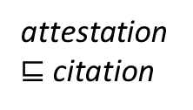
Attestations
attestation
$⊑$ citation
Attestation
quotation: string
attestationGloss:string
locus
locus
URI
Observable

Slide 5
embedding
embedding
Embedding
dc:description: String
dc:extent: int
rdf:value: Literal
corpus
Corpus
total: int
Observable

Slide 6
collocations / similarity
rdf:List
corpus
ContextualRelation
dc:description: String
rdf:value: double
Corpus
total: int
Collocation
Similarity
rdf:first,
rdf:_1, ...
rdf:first,
rdf:_1, ...
Observable
Embedding
not discussed yet

Slide 7
Sandbox
Area for drafting extensions

Slide 8
embedding (CC, 2020-06-25)
Embedding
dc:description: String
dc:extent
rdf:value: Literal
embedding
corpus
Observable
Corpus
TimeSeries
rdf:value !rdf:JSON
(JSON array)
Bag (of words)
rdf:value rdf:JSON
(JSON map)
FixedSizeVector
rdf:value ?xsd:string (orig)
(JSON array?)
e.g., recording of
movements
e.g., collocation vector,
weighted by frequency
or otherwise
e.g., word (or sense)
embeddings

Slide 9

draft without contextual relations
embedding
Embedding
dc:description: String
dc:extent: int
rdf:value: Literal
corpus
Bag (of words)
rdf:value: JSON
TimeSeries
rdf:value rdf:JSON
FixedSizeVector
rdf:value rdf:Literal
frequency
CorpusFrequency
rdf:value: int
corpus
Corpus
total: int
Observable
attestation
$⊑$ citation
Attestation
quotation: string
attestationGloss:string
locus
locus
URI
ontolex:Form
ontolex:LexicalSense
ontolex:LexicalConcept
ontolex:LexicalEntry
... (user-defined)

Slide 10

+ contextualized embedding (embedding per attestation)
attestation
$⊑$ citation
Attestation
quotation: string
attestationGloss:string
locus
locus
URI
instanceEmbedding
embedding
Embedding
dc:description: String
dc:extent: int
rdf:value: Literal
corpus
Observable
Corpus
total: int
Bag (of words)
rdf:value: JSON
TimeSeries
rdf:value rdf:JSON
FixedSizeVector
rdf:value rdf:Literal
frequency
CorpusFrequency
rdf:value: int
corpus
ontolex:Form
ontolex:LexicalSense
ontolex:LexicalConcept
ontolex:LexicalEntry
... (user-defined)

Slide 11
RELICS
older slides, may be important for understanding how the model evolved

Slide 12
full version as of GlobaLex-2020 (June 2020)
attestation and frequency agreed upon
embeddings and collocation/similarity not

Slide 13
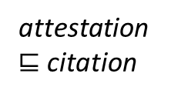
rdf:rest
ContextualRelation
dc:description: String
rdf:value: double
rdf:List
corpus
Collocation
Similarity
rdf:first,
rdf:_1, ...
rdf:first, rdf:_1, ...
Embedding
dc:description: String
dc:extent: int
rdf:value: Literal
embedding
corpus
frequency
CorpusFrequency
rdf:value: int
corpus
Corpus
total: int
Observable
attestation
$⊑$ citation
Attestation
quotation: string
attestationGloss:string
locus
locus
URI
ontolex:Form
ontolex:LexicalSense
ontolex:LexicalConcept
ontolex:LexicalEntry
... (user-defined)

Slide 14
first published version
Chiarcos et al. 2020@GlobaLex
(embeddings, collocations and similarity omitted)

Slide 15
Frequency and Attestation (Chiarcos et al. 2020@GlobaLex)
CorpusFrequency
rdf:value: int
corpus
Corpus
total: int
frequency
Attestation
quotation: string
attestationGloss: string
locus
locus
URI
attestation
subPropertyOf citation
Observable
ontolex:LexicalEntry
ontolex:LexicalConcept
ontolex:LexicalSense
ontolex:Form

Slide 16
initial draft (Nov 2018)

Slide 17
rdf:rest
ContextualRelation
dc:description: String
rdf:value: double
rdf:List
dc:source
Collocation
Similarity
rdf:first,
rdf:_1, ...
rdf:first, rdf:_1, ...
Embedding
dc:description: String
dc:extent: int
rdf:value: Literal
embedding
dc:source
attestation
Attestation
quotation: string
Observable
Citation
citation
makesAttestation
dc:source
CorpusFrequency
rdf:value: int
corpus/locus URI
frequency
dc:source
ontolex:Form
ontolex:LexicalSense
ontolex:LexicalConcept
ontolex:LexicalEntry

Slide 18
development of attestation model

Slide 19
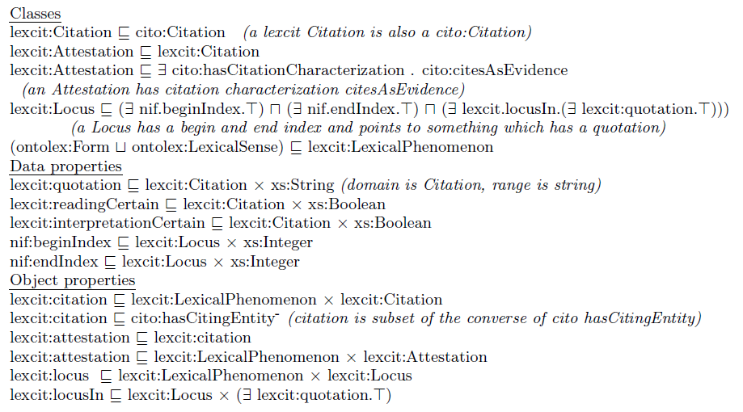
attestations after Depuydt & de Does 2018
Locus
nif:beginIndex***
nif:endIndex***
locusIn**
locus
Citation
quotation: string
readingCertain: boolean****
interpretationCertain: boolean****
citation
Element*
attestation
* i.e., D&dD: lexcit:LexicalPhenomenon
** simplified: pointing to an anonymous superclass of
something that contains a quotation
*** I would prefer not to prescribe nif properties in order to permit other means of cross-referencing, e.g., nif URIs, WebAnnotation selectors, etc.
**** I would prefer to leave certainly etc. to lexinfo
Attestation

Slide 20
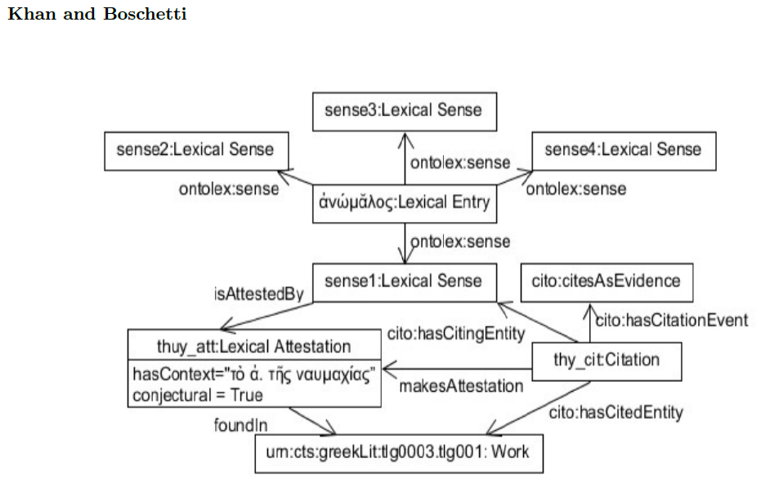
attestations after Khan & Boschetti (2018)
attestation**
Attestation***
hasContext: str(6*)
conjectural: boolean****
makesAttestation
Element*
Citation
foundIn(7*)
work URI*****
* originally restricted to LexicalSense
** originally „isAttestedBy“
*** originally „LexicalAttestation“
**** I would prefer to leave certainty etc. to lexinfo
***** originally „Work“
(6*) maybe rename such that that also context-free examples fit
(7*) I had dc:source at other occasions
as in the other proposal, cito properties and
concepts are skipped, these are beyond the module

Slide 21
attestations: proposal for a minimal consensus
we do not cover:
scientific citations (should refine Citation, using external vocabularies)
corpus pointers (can be NIF objects, NIF URIs, WebAnnotation selectors, CTS URNs, URLs, etc.)
dc:source (6*)
attestation***
Attestation*
quotation: string**
Element
locus URI
makes
Attestation
(5*)
Citation
citation****
* D&dD: Citation
** K&B: hasContext
*** D&dD: attestation
**** K&B: inv of hasCitingEntity
5* D&dD: implicit
6* D&dD: inv of locusIn, K&B: foundIn

Slide 22
attestation
Attestation
quotation: string
dc:source
Element
locus URI
makes
Attestation
Citation
citation
proposed minimal consensus | D&dD | K&B
ontolex:Element | LexicalPhenomenon | (LexicalSense)
attestation | attestation | isAttestedBy
Attestation | Attestation | Attestation
Citation | ~ Citation | Citation
citation | ~ citation | (indirectly via makesAttestation)
makesAttestation | [identity/subClassOf] | makesAttestation
dc:source | ^locusIn | foundIn
quotation | quotation | hasContext
(locus URI) | Locus | Work
(indirectly via attestations) | locus | (hasCitingEntity/hasCitedEntity)

