Slide 1
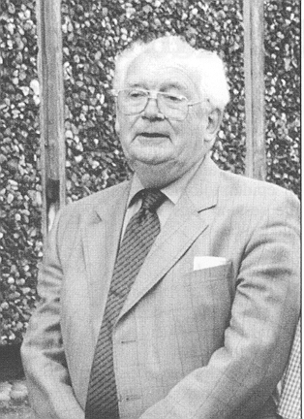

Compositional Data
John Aitchison

Slide 2
What is a domain?
Domain: the set of values for which a variable is defined

Slide 3
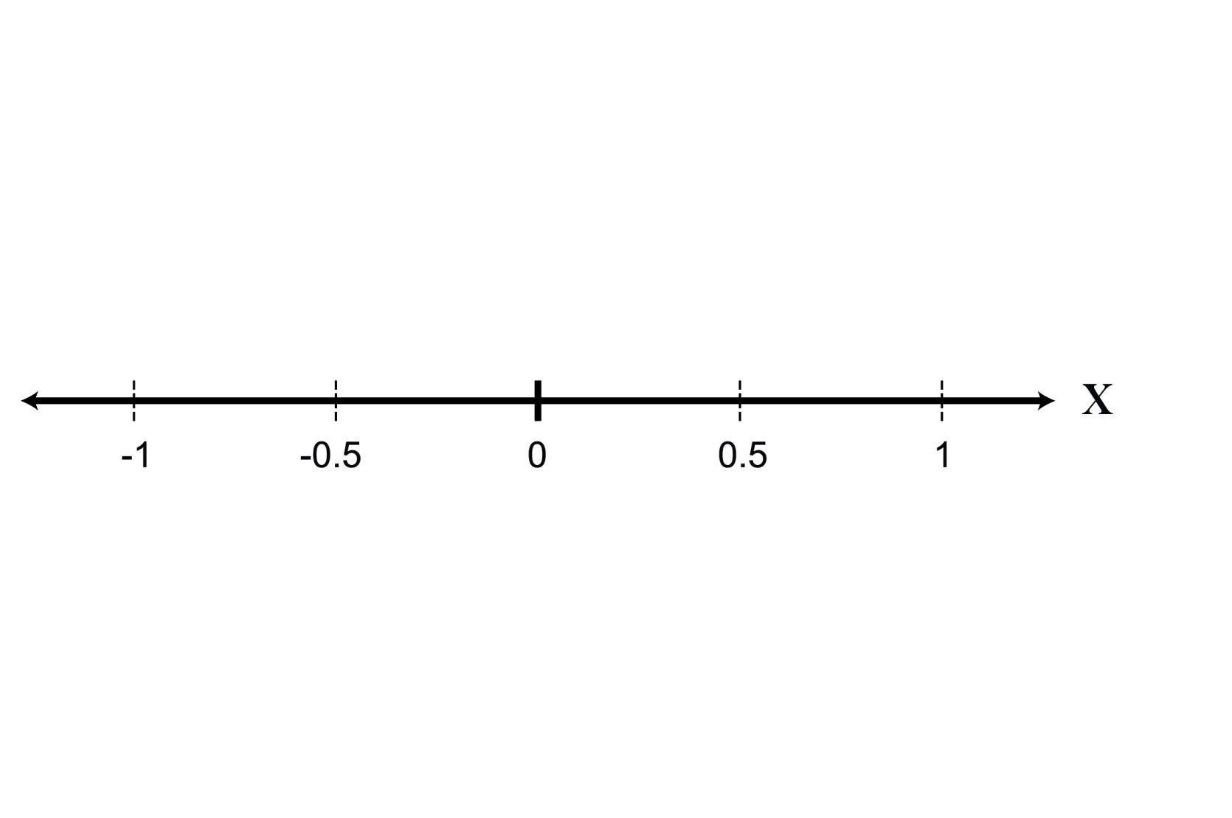
What is a domain?
Domain: the set of values for which a variable is defined
Real numbers:

Slide 4
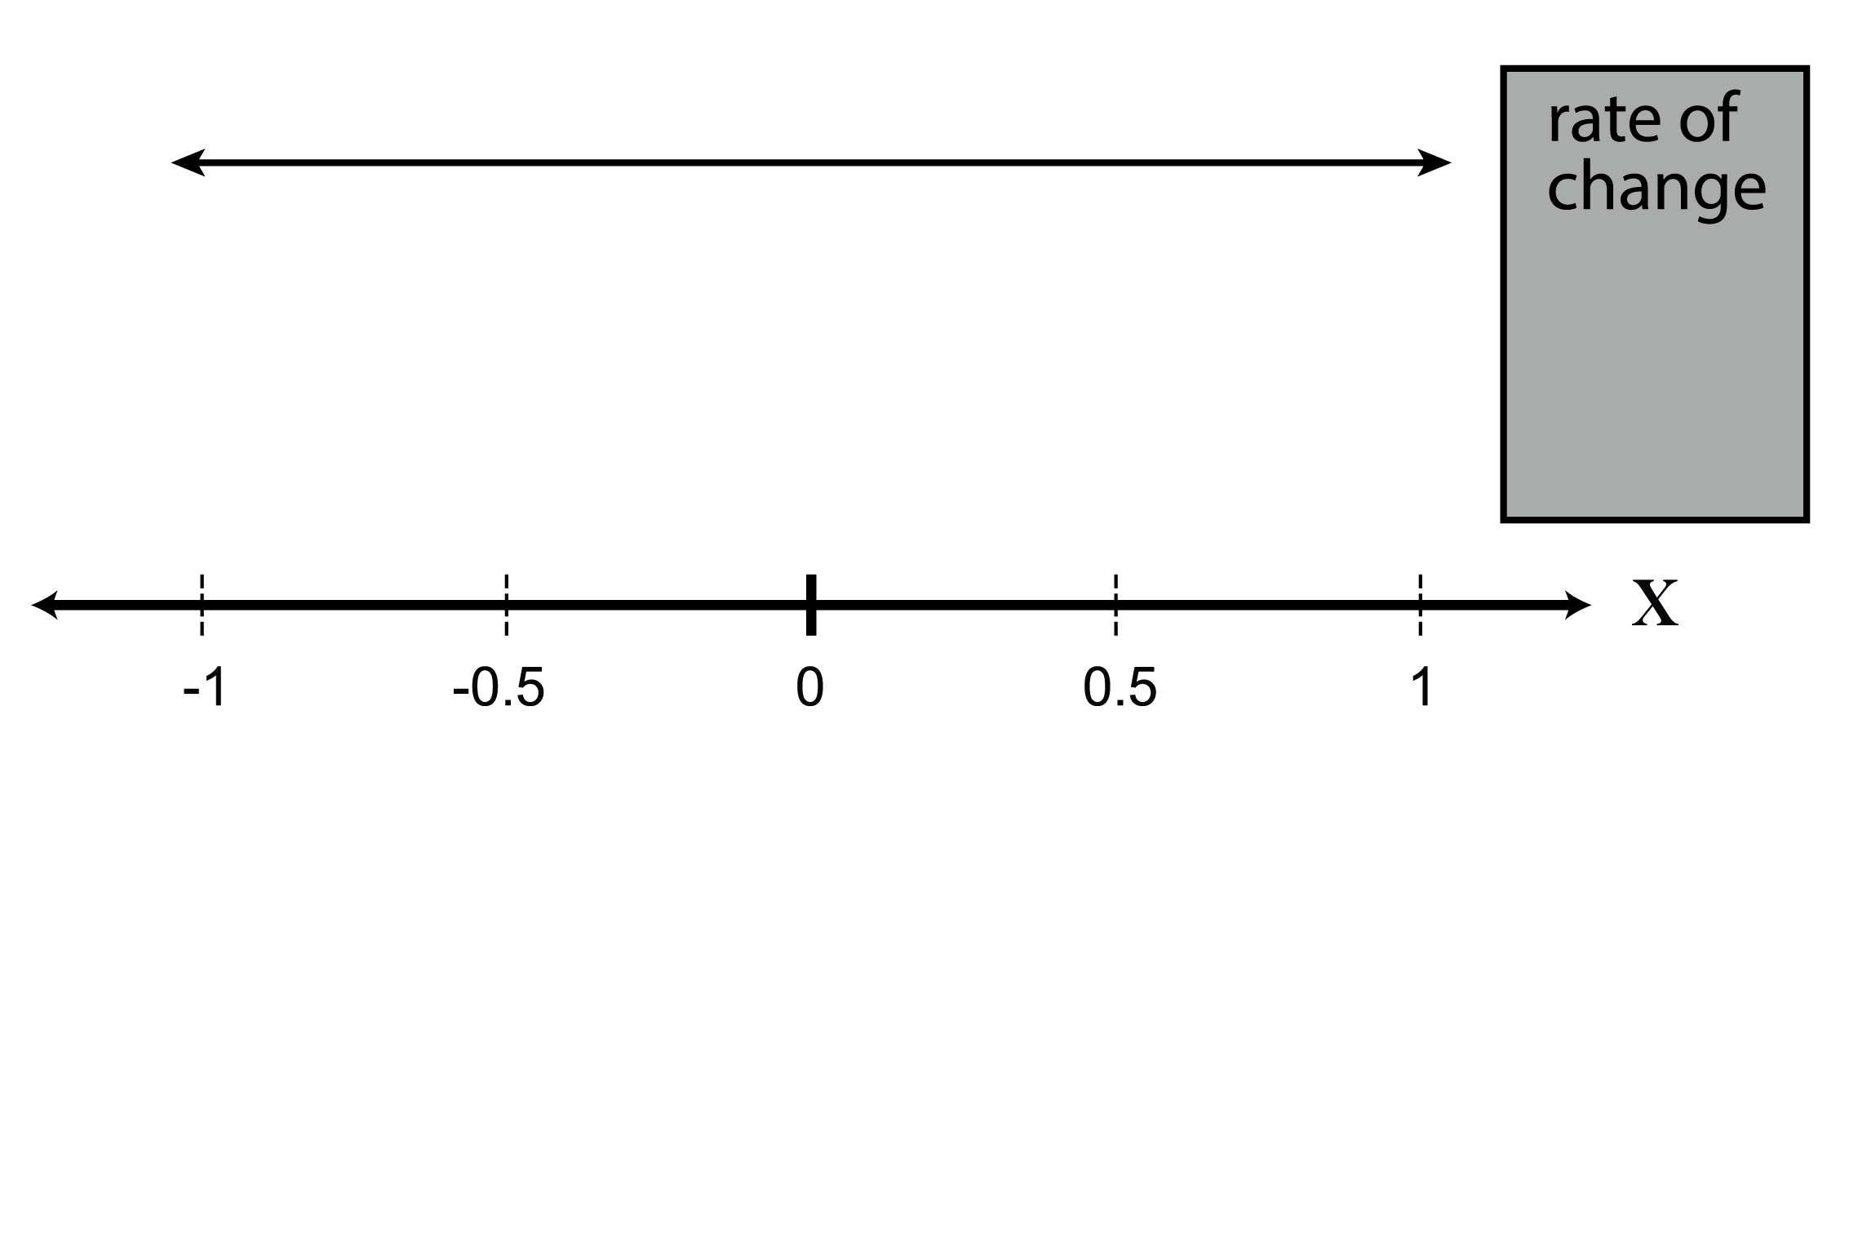
What is a domain?
Domain: the set of values for which a variable is defined

Slide 5

What is a domain?
Domain: the set of values for which a variable is defined

Slide 6

What is a domain?
Domain: the set of values for which a variable is defined

Slide 7
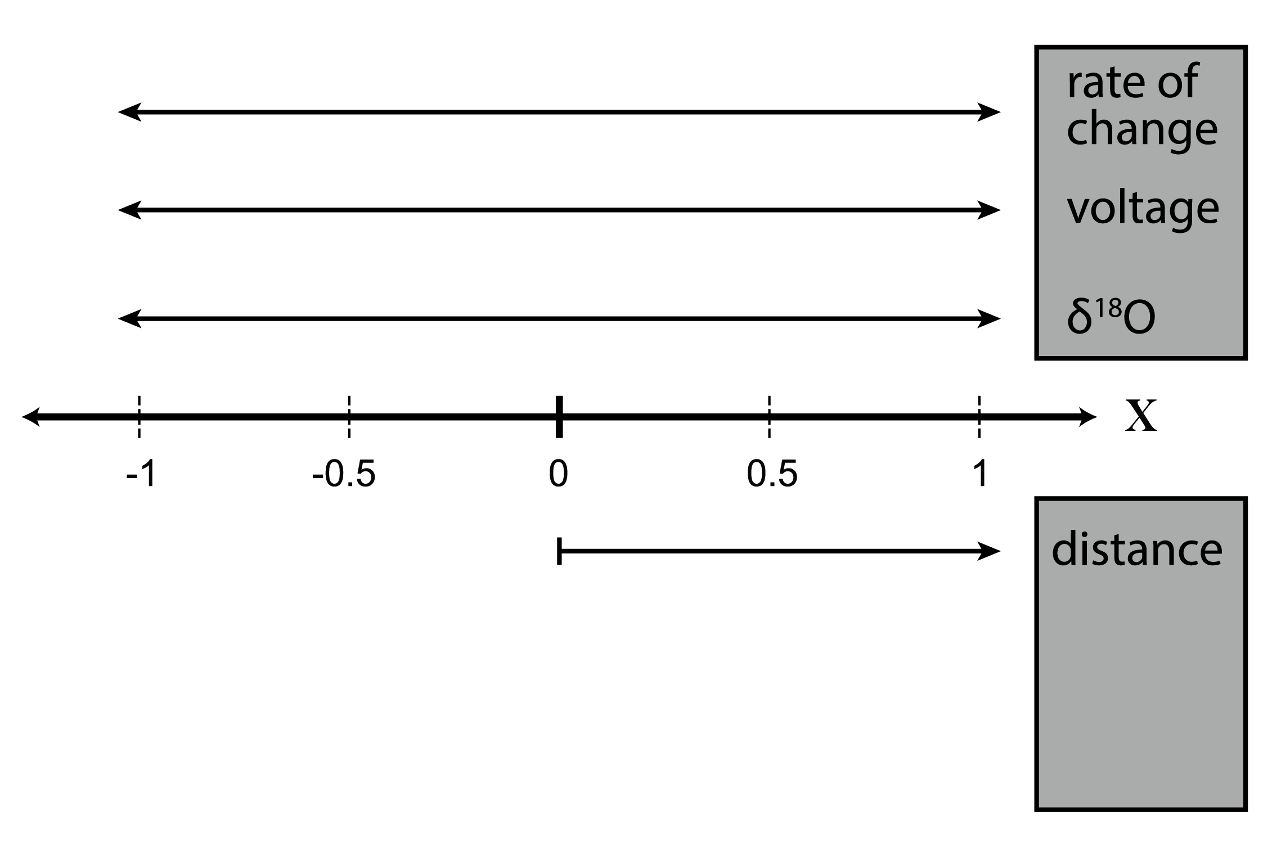
What is a domain?
Domain: the set of values for which a variable is defined

Slide 8
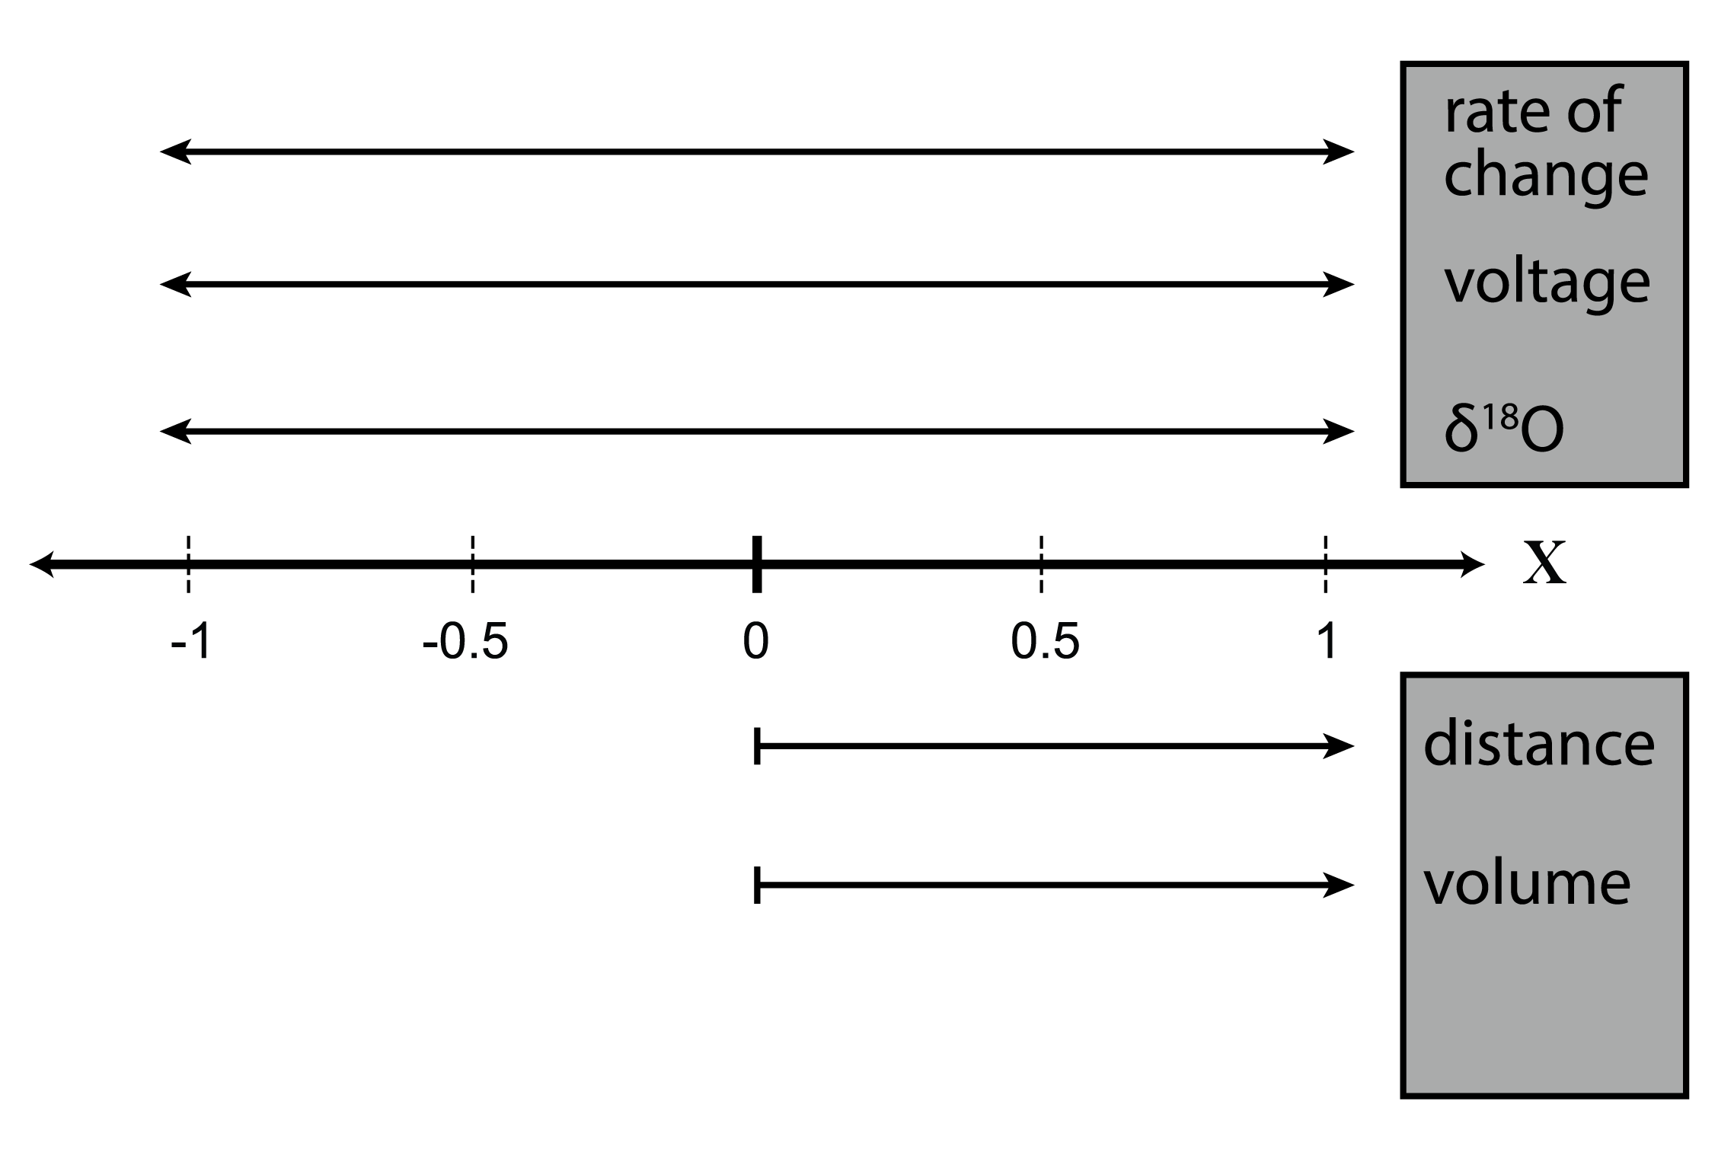
What is a domain?
Domain: the set of values for which a variable is defined

Slide 9
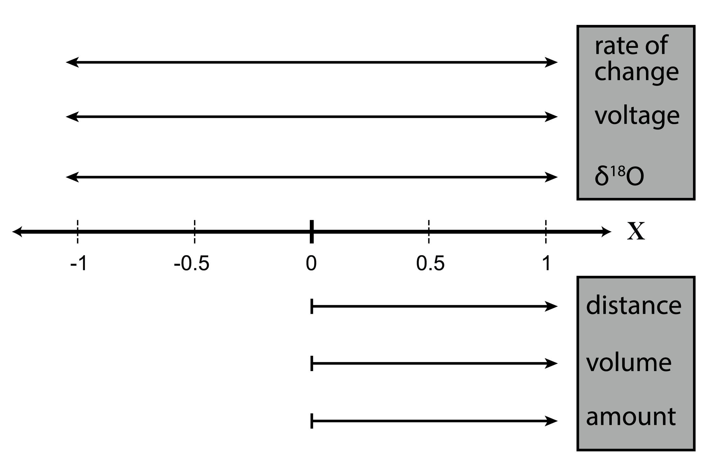
What is a domain?
Domain: the set of values for which a variable is defined

Slide 10
What is a domain?
Domain: the set of values for which a variable is defined

Slide 11
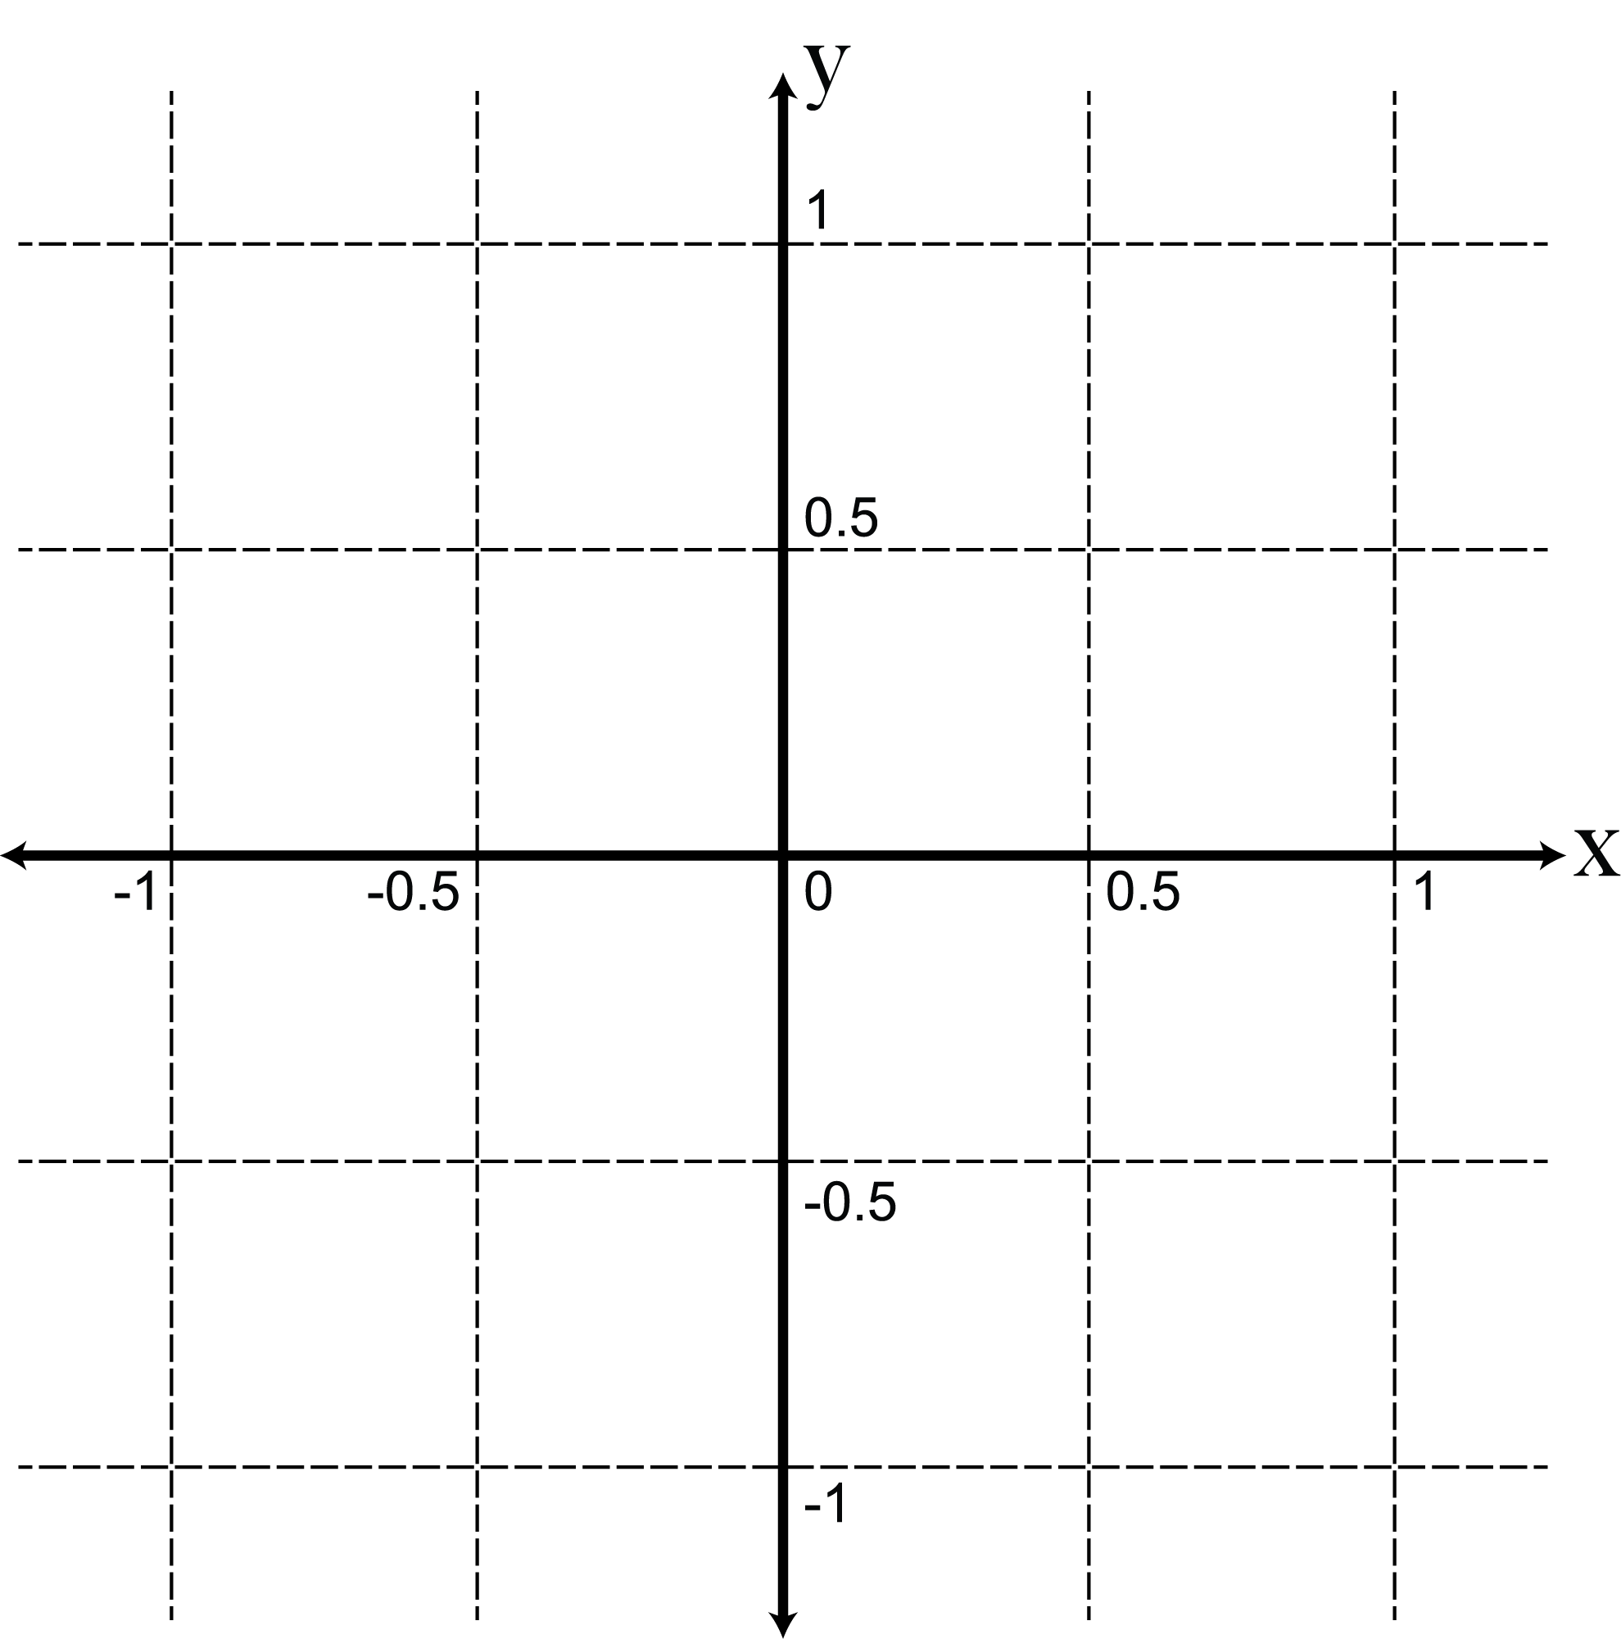
Now for two variables
If you are measuring two variables that are defined over the real numbers, then you get to use the whole 2D plane when plotting x vs. y

Slide 12
Now for two variables
If you are measuring two variables that are defined over the real numbers, then you get to use the whole 2D plane when plotting x vs. y

Slide 13
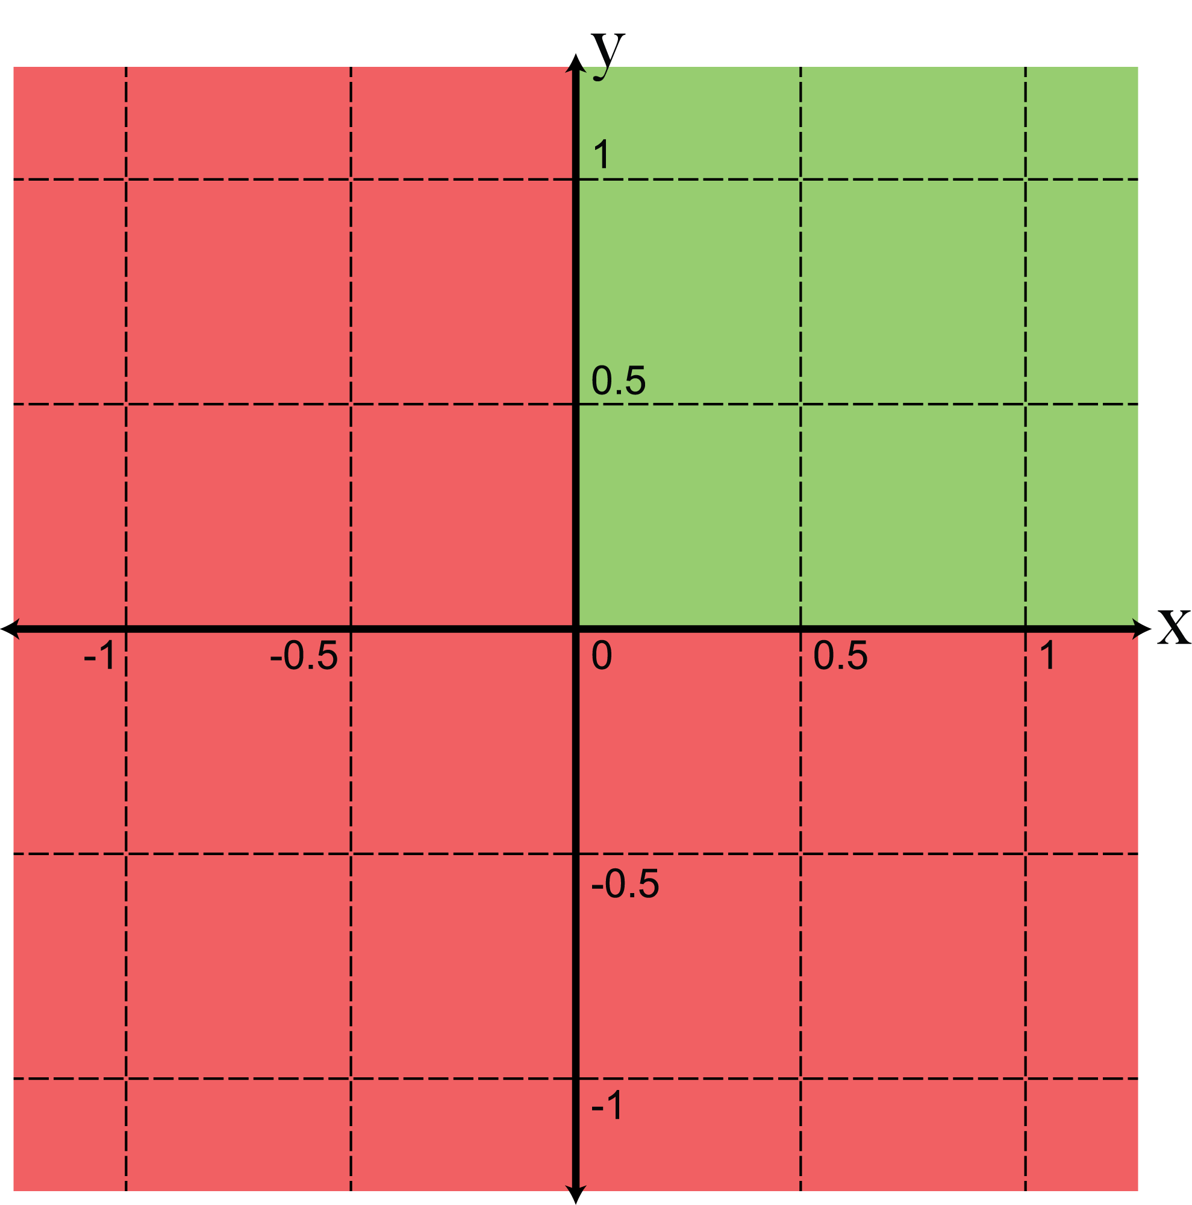
Now for two variables
If the two variables are constrained to be positive real numbers, then you only get to use a portion of the real plane:

Slide 14
Now for two variables
If the two variables are constrained to be positive real numbers, then you only get to use a portion of the real plane:

Slide 15
So, what is a composition?
The variables you’re measuring (components) all belong to and have the same units or on the same measurement scale
You’re not interested in the absolute abundance of any of the components—only the relative abundances, or proportions of a whole
All compositions sum to a constant
e.g. 100%, or 1

Slide 16
So, what is a composition?
The variables you’re measuring (components) all belong to and have the same units or on the same measurement scale
You’re not interested in the absolute abundance of any of the components—only the relative abundances, or proportions of a whole
All compositions sum to a constant
e.g. 100%, or 1

Slide 17
So, what is a composition?
The variables you’re measuring (components) all belong to and have the same units or on the same measurement scale
You’re not interested in the absolute abundance of any of the components—only the relative abundances, or proportions of a whole
All compositions sum to a constant
e.g. 100%, or 1

Slide 18
Examples of compositions
Geochemical compositions of rocks
e.g. wt. % oxides, but not ppm trace elements
Modal abundances: cpx/plag/amph/ol
Sediment grain sizes or compositions
e.g. sand/silt/clay, quartz/feldspar/lithics
Isotopic compositions
²⁰⁴Pb/²⁰⁶Pb/²⁰⁷Pb/²⁰⁸Pb, ²³⁴U/²³⁵U/²³⁸U

Slide 19
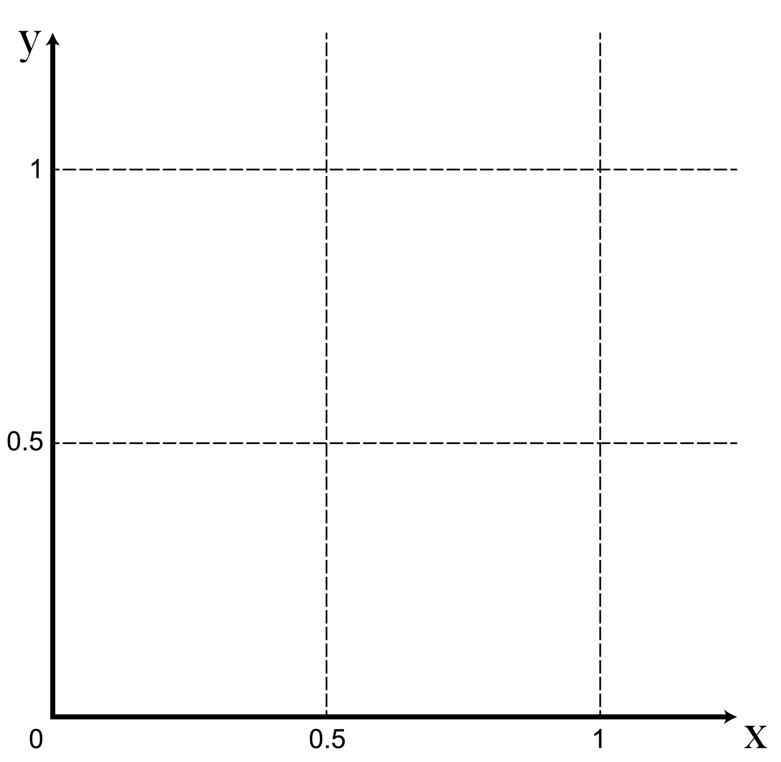
Zooming into
Note that the boundaries at x=0 and y=0 are absolute: nothing is allowed to be negative.
So, where do compositions fit in?

Slide 20
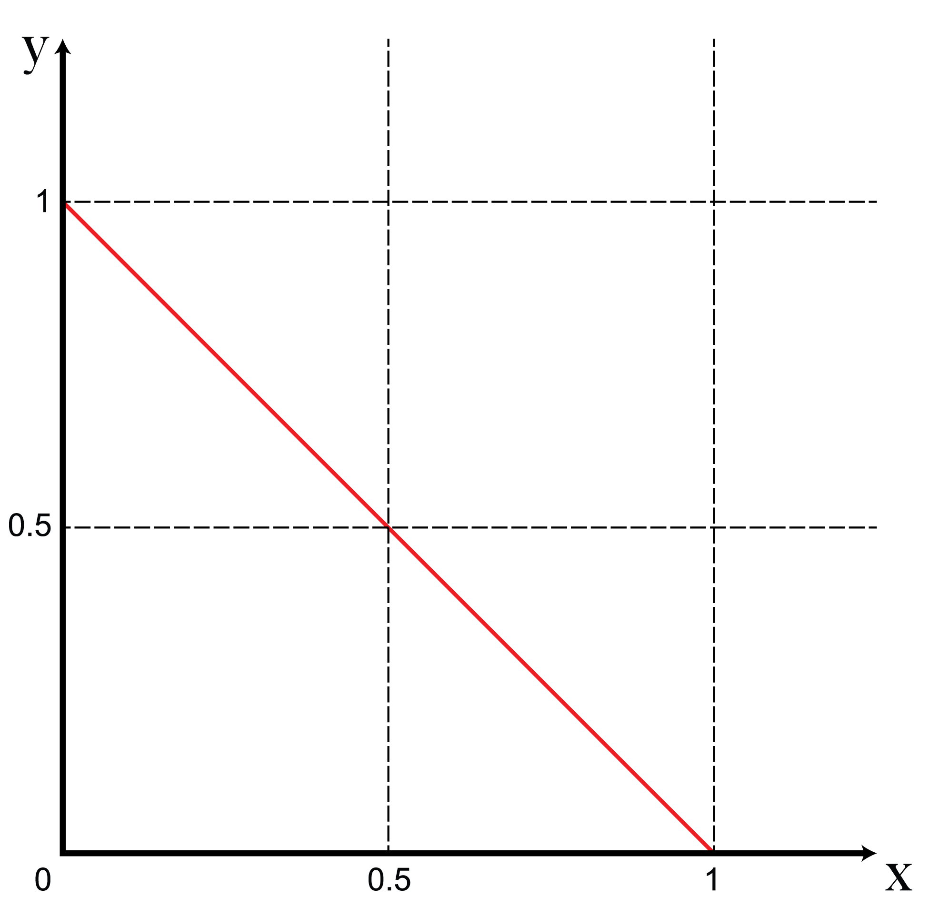
The simplex
The red line, known as the simplex, shows all the locations where x+y=1.
All two-component compositions (which must sum to a whole) can be represented on the line.

Slide 21
The simplex
The red line, known as the simplex, shows all the locations where x+y=1.
All two-component compositions (which must sum to a whole) can be represented on the line.

Slide 22
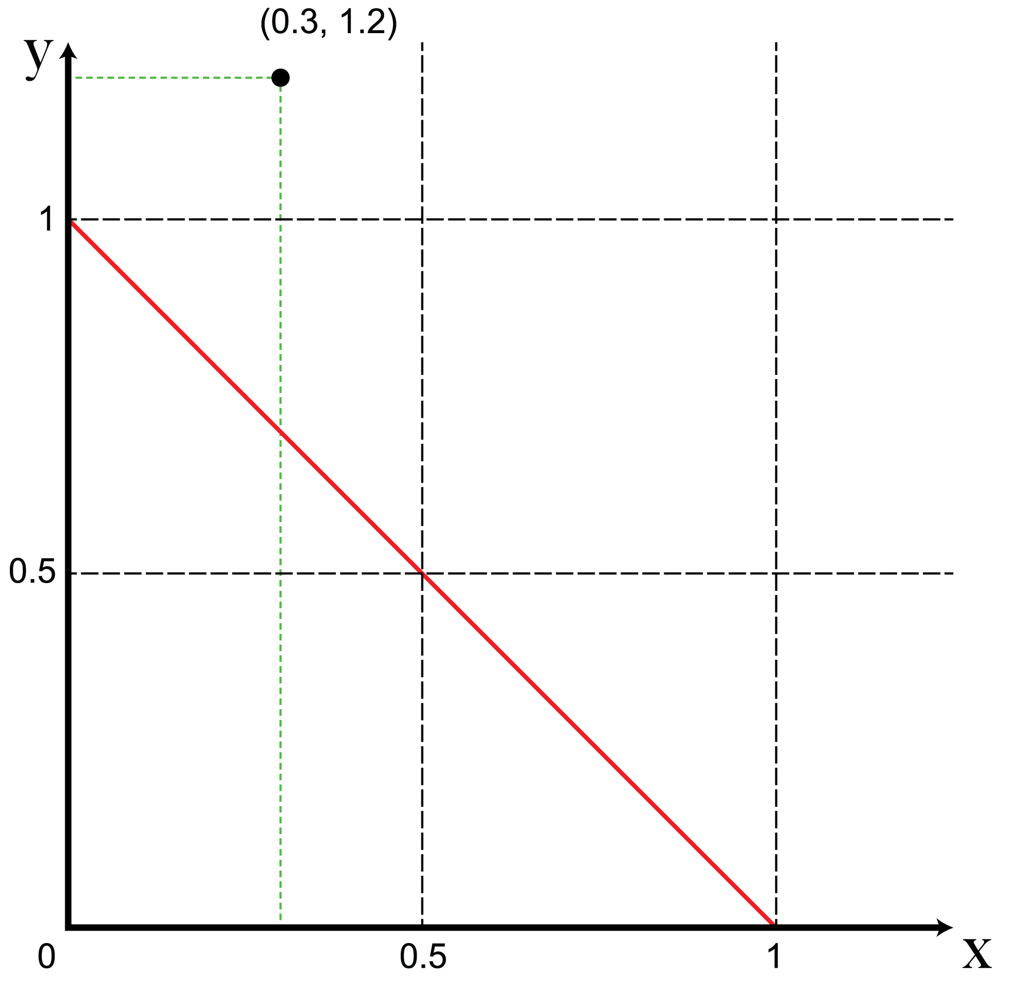
The simplex
However, we usually measure each of our variables in R₊.
Examples include point-counts of minerals, ion beam currents, etc.

Slide 23
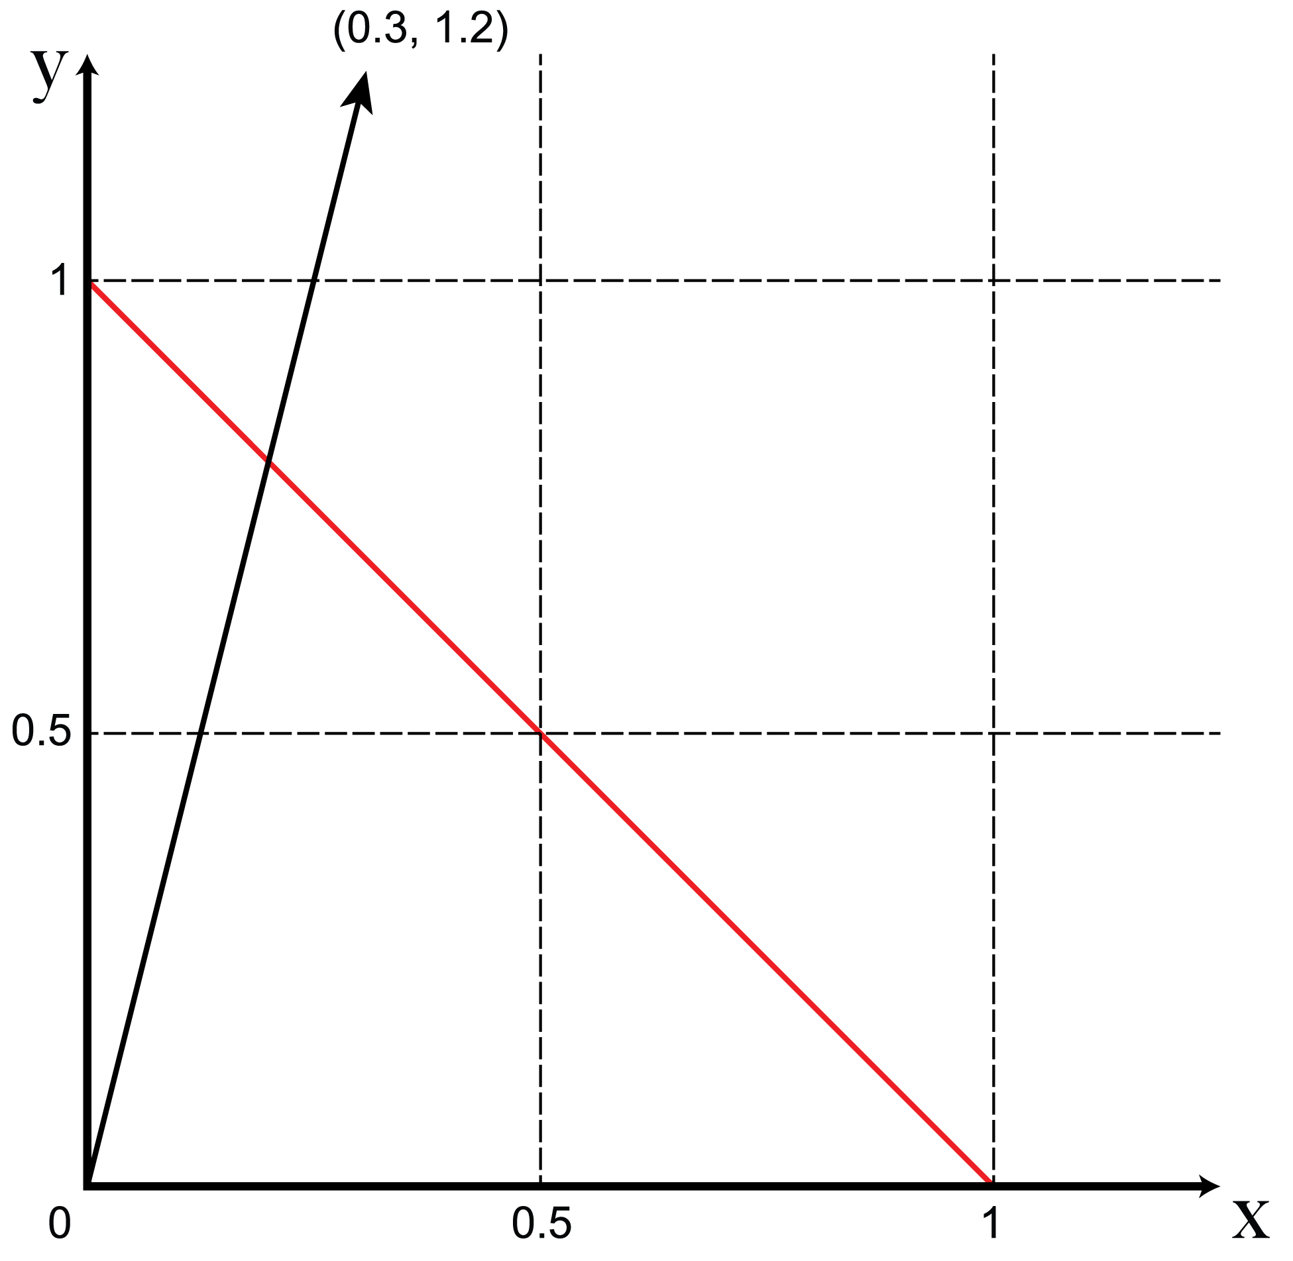
The simplex
The measured variables can also be represented by a vector from the origin to the coordinates of the measurement.
This vector is called a basis.

Slide 24

The simplex
Where the measurement vector intersects the simplex (its projection onto the simplex) is the composition, with the unit sum constraint enforced.

Slide 25
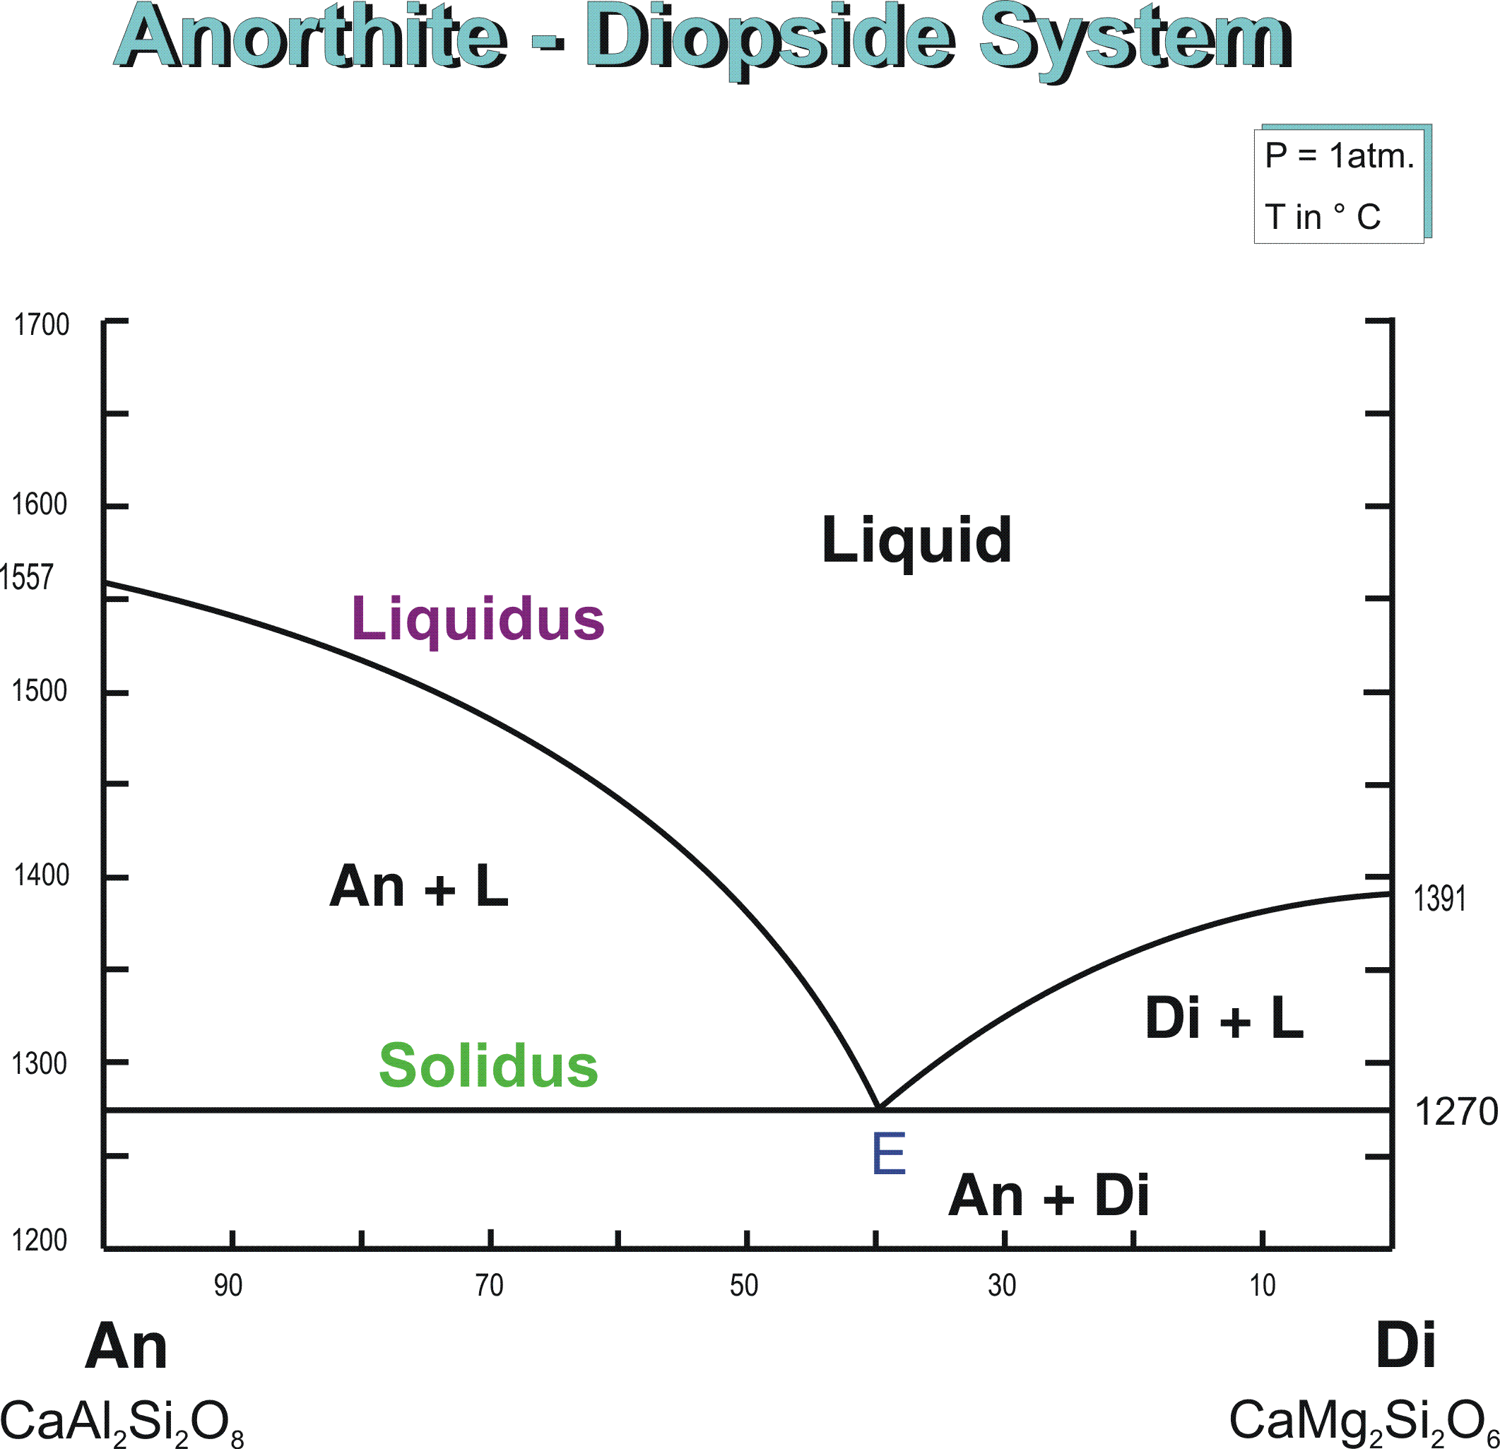
The (1D) simplex:

Slide 26
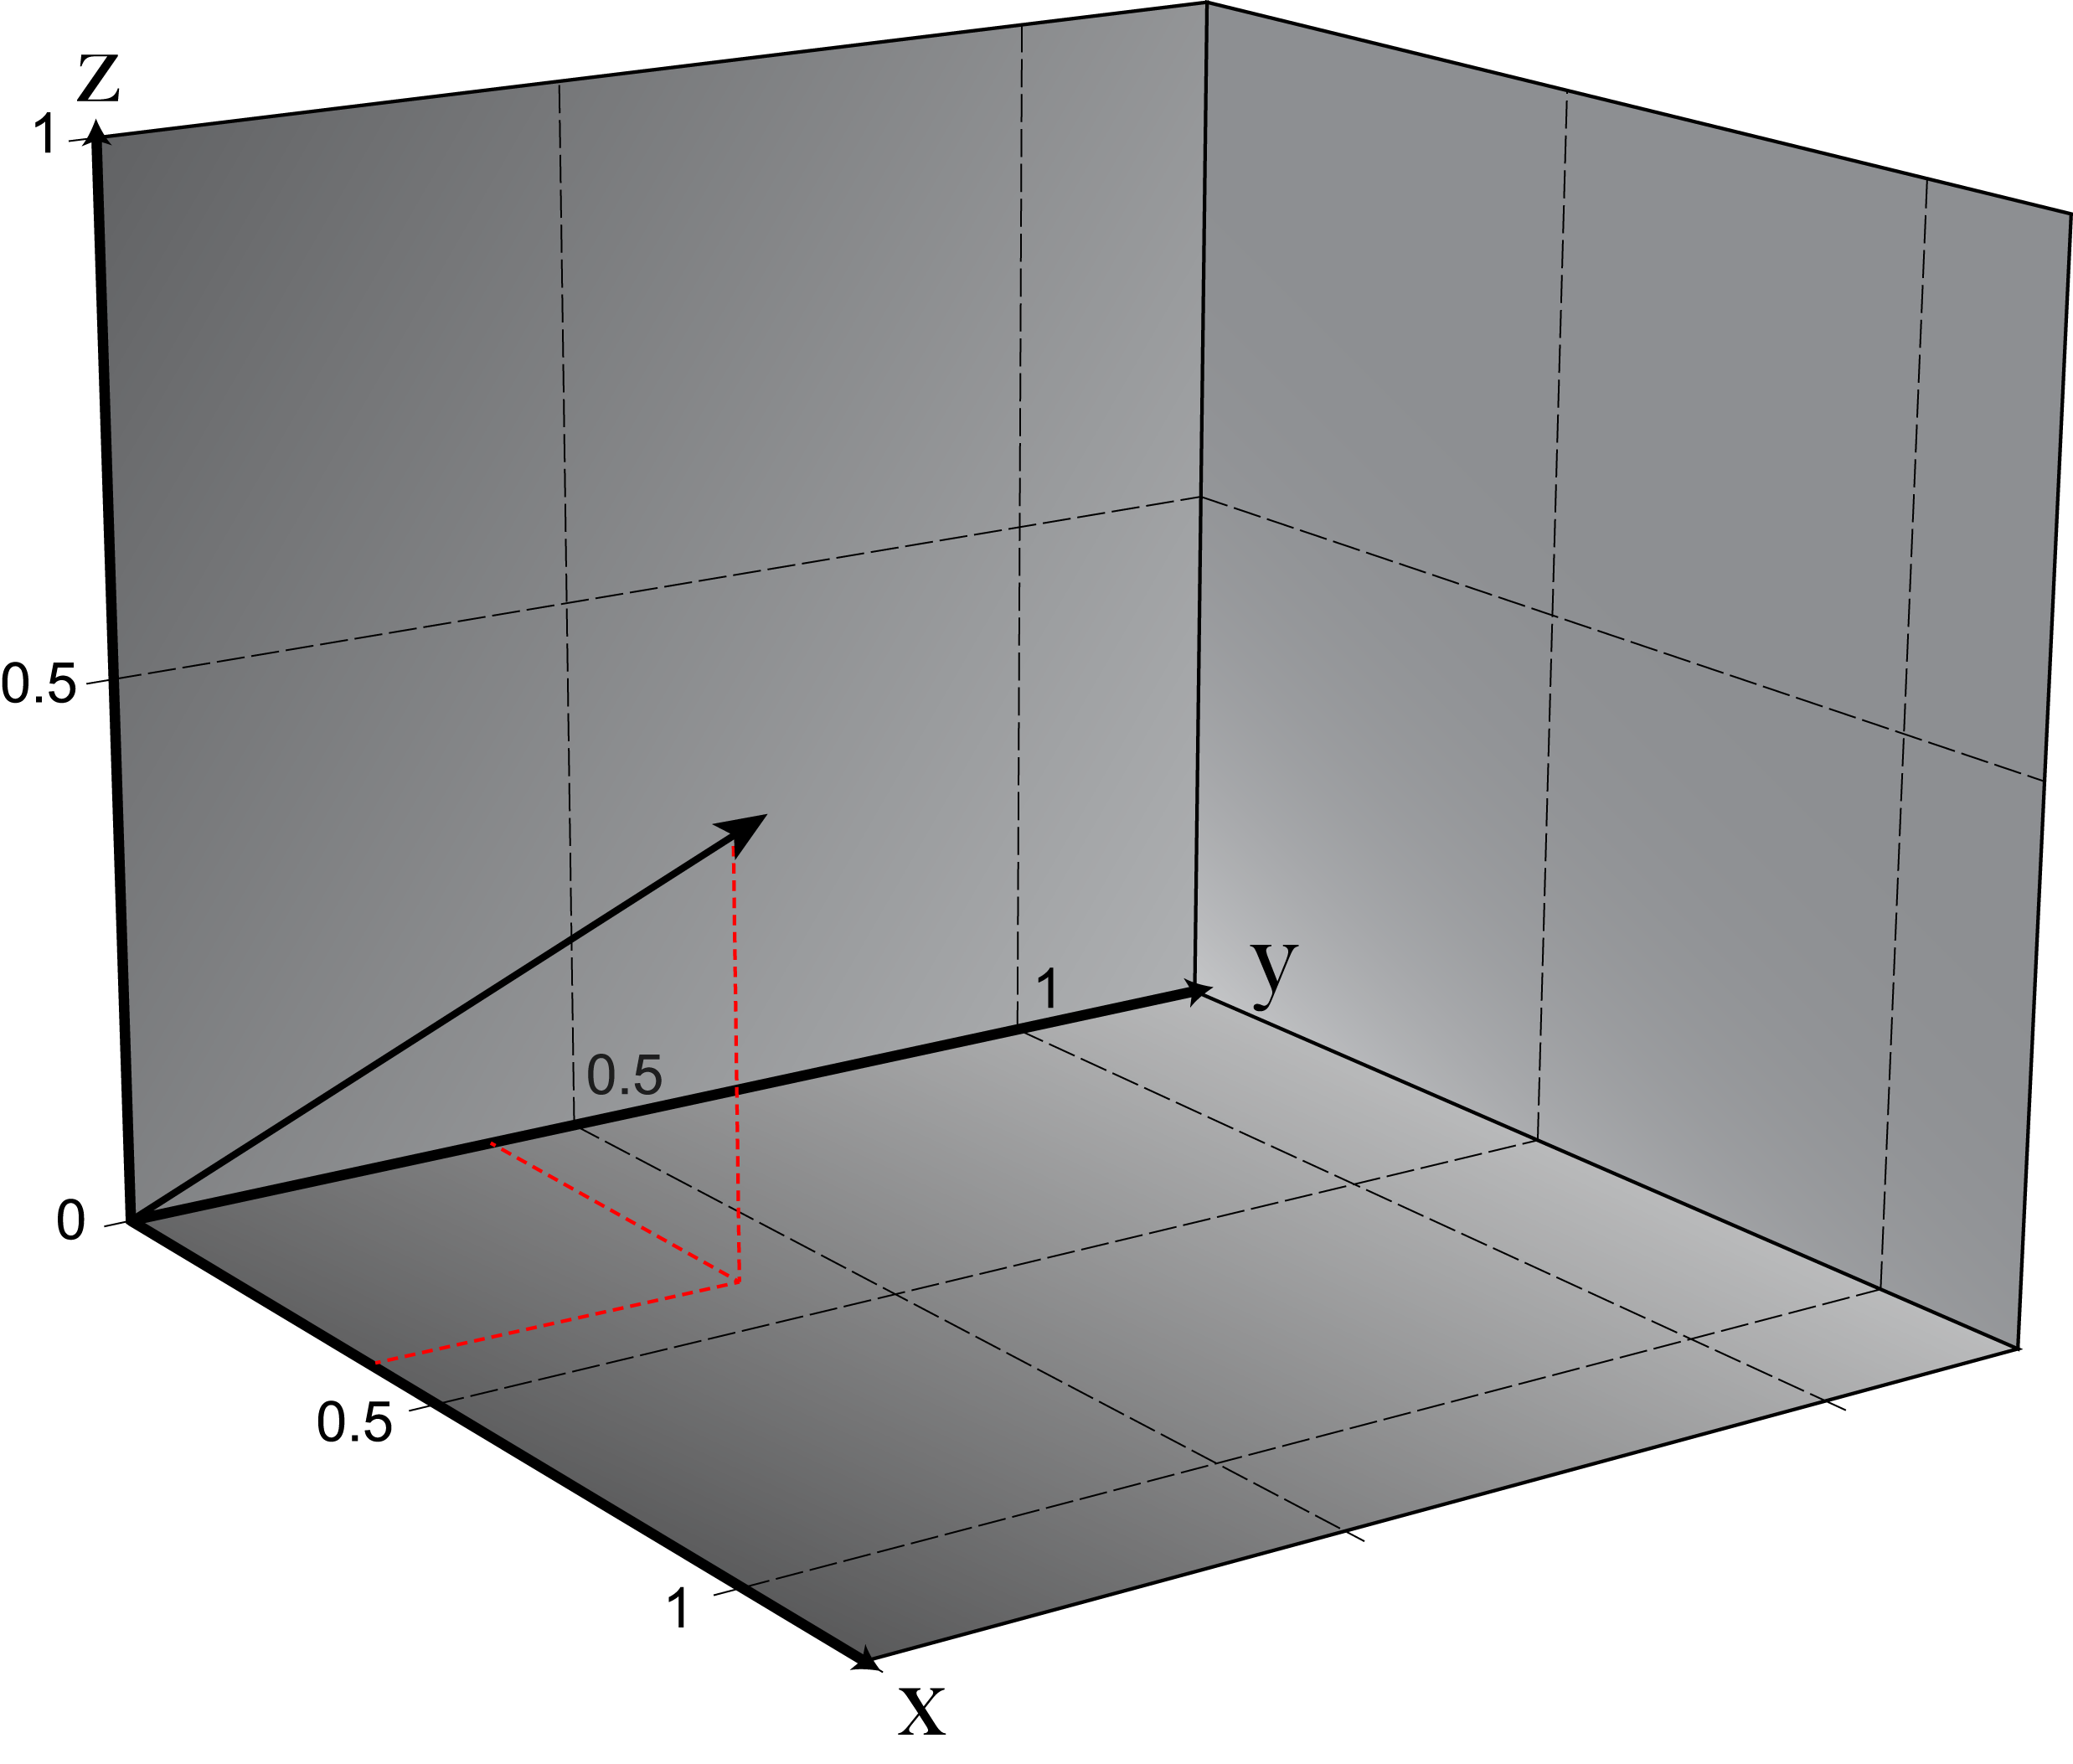

Slide 27
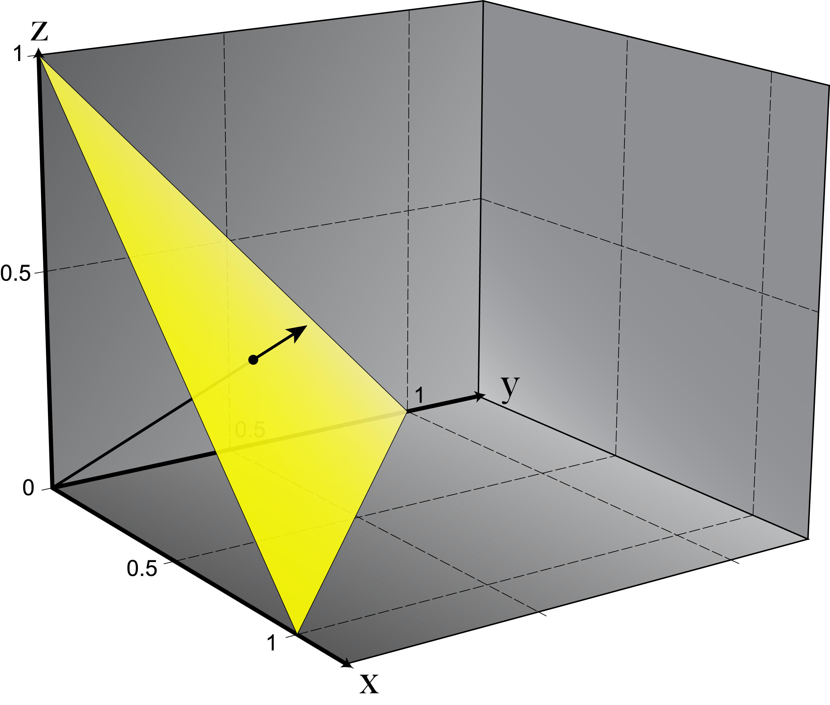

Slide 29
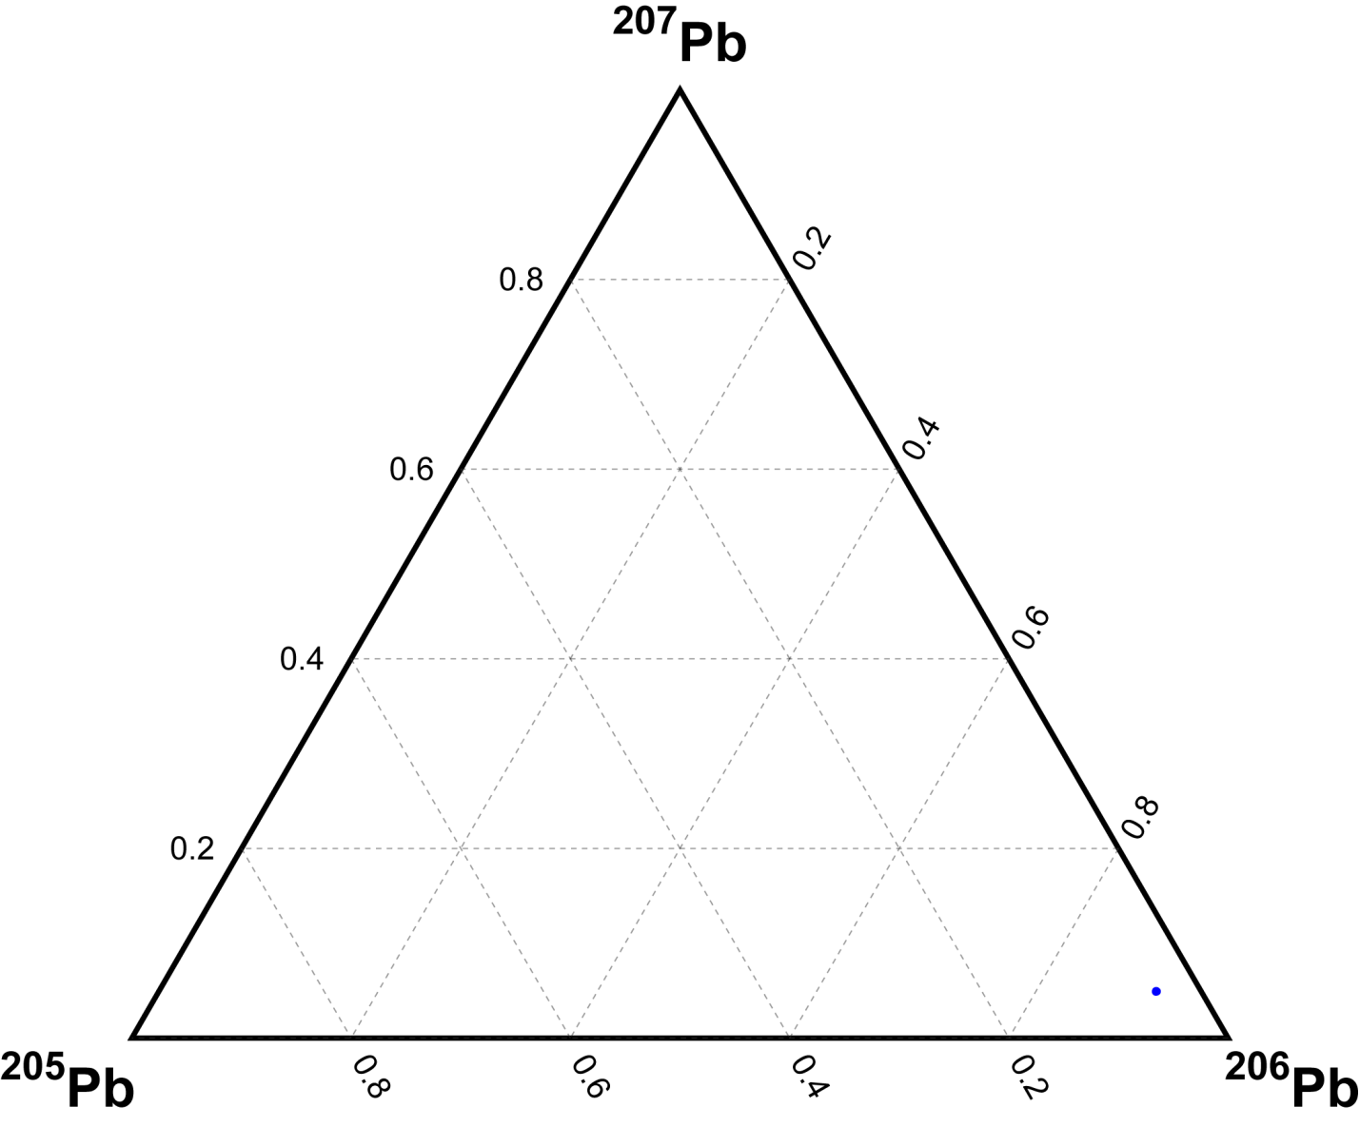
Ternary
plots
Express relative proportions of three components in a 2D space—they are a simplex.
Each vertex corresponds to a ‘pure’ end-member composition.
In the middle of the plot, the closer you are to a vertex, the greater the relative proportion of that component.

Slide 30
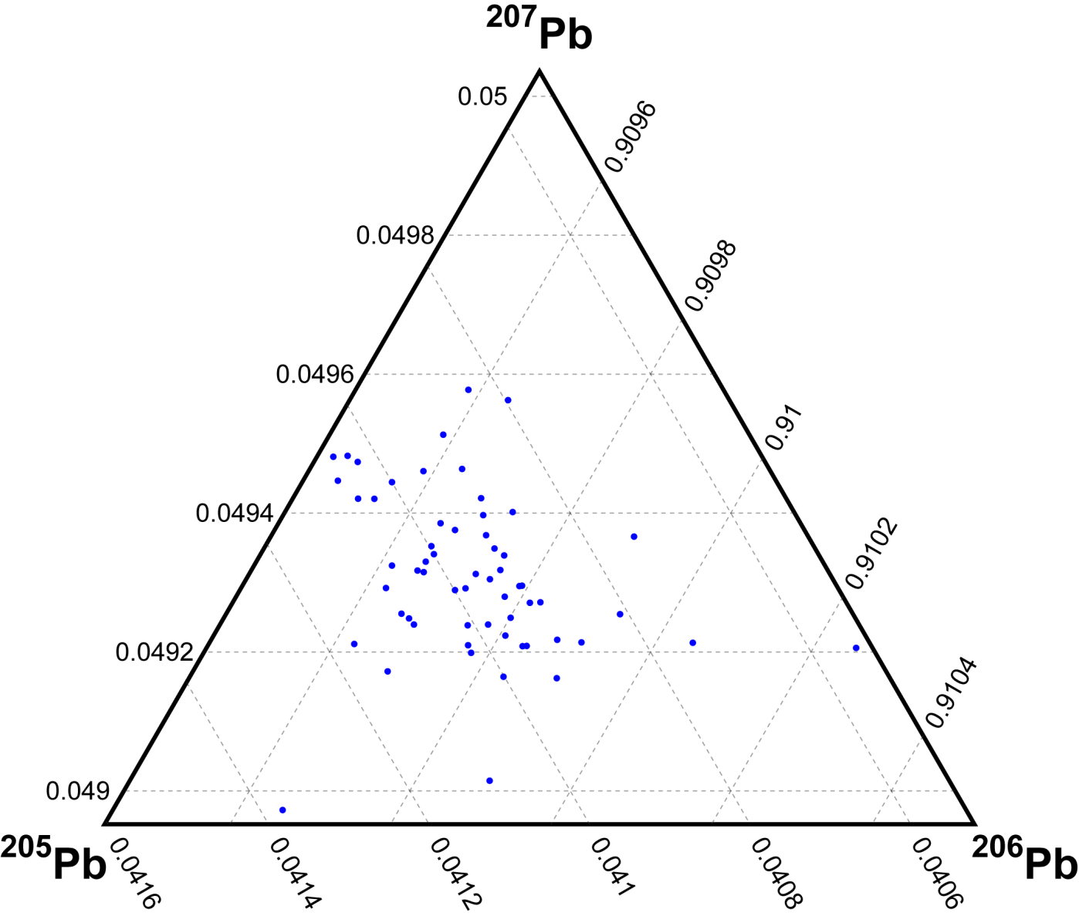
Ternary
plots
Ternary plots do not need to plot the whole of compositional data space—you can zoom in to better display data.

Slide 31
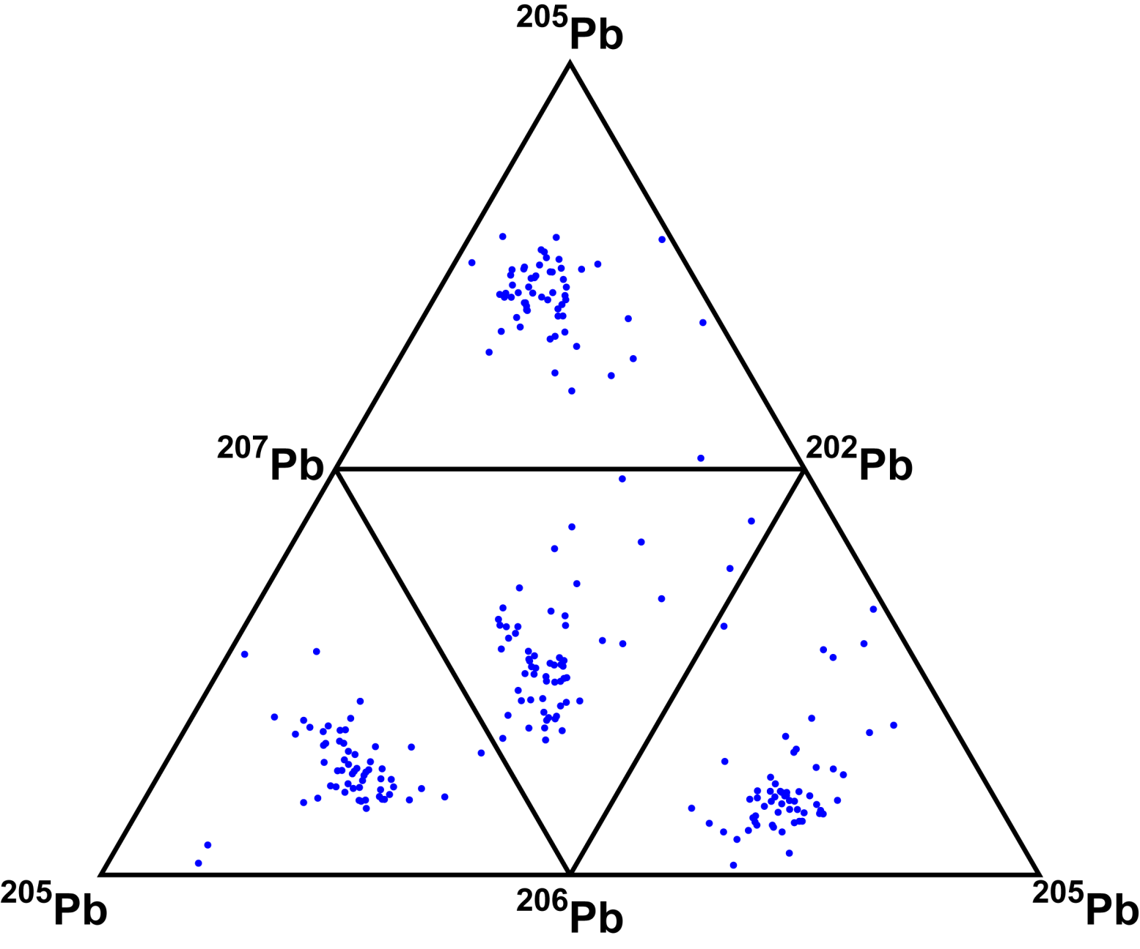
(Quad-) Ternary
Plots(?)
To visualize more than three components and stay on a (2D) page or screen, you can link multiple ternary plots together along their edges.

Slide 32
Compositional data presents unique problems.
Because we recognize the compositional nature of our geochemical and geological datasets, we usually perform some kind of normalization when reporting data and performing statistical analysis.
Weight % oxides, isotope ratios, deviations from a standard expressed in δ or ε notation

Slide 33
Compositional data presents unique problems.
Because we recognize the compositional nature of our geochemical and geological datasets, we usually perform some kind of normalization when reporting data and performing statistical analysis.
Weight % oxides, isotope ratios, deviations from a standard expressed in δ or ε notation

Slide 34
Compositional data presents unique problems.
However, all of these approaches have drawbacks when you go to evaluate a mean and standard deviation/error/covariance matrix.

Slide 35
Simple test data: isotope ratios
A | B | C |  | B/A | C/A | A/B | B/C
3.8816 | 2.2237 | 3.5034 |  | 0.5729 | 0.9026 | 1.7456 | 0.6347
3.4189 | 3.6334 | 4.4136 |  | 1.0627 | 1.2909 | 0.9410 | 0.8232
1.8736 | 3.4878 | 6.2357 |  | 1.8615 | 3.3282 | 0.5372 | 0.5593
2.7661 | 8.5963 | 4.0573 |  | 3.1077 | 1.4668 | 0.3218 | 2.1187
2.7887 | 3.5317 | 7.1290 |  | 1.2664 | 2.5564 | 0.7896 | 0.4954
2.2993 | 2.3495 | 6.8411 |  | 1.0218 | 2.9753 | 0.9786 | 0.3434
6.9564 | 8.9176 | 1.8384 |  | 1.2819 | 0.2643 | 0.7801 | 4.8507
1.9362 | 7.4160 | 2.3421 |  | 3.8302 | 1.2096 | 0.2611 | 3.1664
2.3554 | 3.5661 | 2.7637 |  | 1.5140 | 1.1733 | 0.6605 | 1.2903
2.1014 | 1.8837 | 3.3307 |  | 0.8964 | 1.5850 | 1.1156 | 0.5656

Slide 36
Simple test data: isotope ratios
A | B | C |  | B/A | C/A | A/B | B/C
3.8816 | 2.2237 | 3.5034 |  | 0.5729 | 0.9026 | 1.7456 | 0.6347
3.4189 | 3.6334 | 4.4136 |  | 1.0627 | 1.2909 | 0.9410 | 0.8232
1.8736 | 3.4878 | 6.2357 |  | 1.8615 | 3.3282 | 0.5372 | 0.5593
2.7661 | 8.5963 | 4.0573 |  | 3.1077 | 1.4668 | 0.3218 | 2.1187
2.7887 | 3.5317 | 7.1290 |  | 1.2664 | 2.5564 | 0.7896 | 0.4954
2.2993 | 2.3495 | 6.8411 |  | 1.0218 | 2.9753 | 0.9786 | 0.3434
6.9564 | 8.9176 | 1.8384 |  | 1.2819 | 0.2643 | 0.7801 | 4.8507
1.9362 | 7.4160 | 2.3421 |  | 3.8302 | 1.2096 | 0.2611 | 3.1664
2.3554 | 3.5661 | 2.7637 |  | 1.5140 | 1.1733 | 0.6605 | 1.2903
2.1014 | 1.8837 | 3.3307 |  | 0.8964 | 1.5850 | 1.1156 | 0.5656
 |  |  | mean: | 1.6416 | 1.6752 | 0.8131 | 1.4848

Slide 37
Simple test data: isotope ratios
A | B | C |  | B/A | C/A | A/B | B/C
3.8816 | 2.2237 | 3.5034 |  | 0.5729 | 0.9026 | 1.7456 | 0.6347
3.4189 | 3.6334 | 4.4136 |  | 1.0627 | 1.2909 | 0.9410 | 0.8232
1.8736 | 3.4878 | 6.2357 |  | 1.8615 | 3.3282 | 0.5372 | 0.5593
2.7661 | 8.5963 | 4.0573 |  | 3.1077 | 1.4668 | 0.3218 | 2.1187
2.7887 | 3.5317 | 7.1290 |  | 1.2664 | 2.5564 | 0.7896 | 0.4954
2.2993 | 2.3495 | 6.8411 |  | 1.0218 | 2.9753 | 0.9786 | 0.3434
6.9564 | 8.9176 | 1.8384 |  | 1.2819 | 0.2643 | 0.7801 | 4.8507
1.9362 | 7.4160 | 2.3421 |  | 3.8302 | 1.2096 | 0.2611 | 3.1664
2.3554 | 3.5661 | 2.7637 |  | 1.5140 | 1.1733 | 0.6605 | 1.2903
2.1014 | 1.8837 | 3.3307 |  | 0.8964 | 1.5850 | 1.1156 | 0.5656
 |  |  | mean: | 1.6416 | 1.6752 | 0.8131 | 1.4848
 |  |  | 1/(B/A): |  |  | 1.2299

Slide 38
Simple test data: isotope ratios
A | B | C |  | B/A | C/A | A/B | B/C
3.8816 | 2.2237 | 3.5034 |  | 0.5729 | 0.9026 | 1.7456 | 0.6347
3.4189 | 3.6334 | 4.4136 |  | 1.0627 | 1.2909 | 0.9410 | 0.8232
1.8736 | 3.4878 | 6.2357 |  | 1.8615 | 3.3282 | 0.5372 | 0.5593
2.7661 | 8.5963 | 4.0573 |  | 3.1077 | 1.4668 | 0.3218 | 2.1187
2.7887 | 3.5317 | 7.1290 |  | 1.2664 | 2.5564 | 0.7896 | 0.4954
2.2993 | 2.3495 | 6.8411 |  | 1.0218 | 2.9753 | 0.9786 | 0.3434
6.9564 | 8.9176 | 1.8384 |  | 1.2819 | 0.2643 | 0.7801 | 4.8507
1.9362 | 7.4160 | 2.3421 |  | 3.8302 | 1.2096 | 0.2611 | 3.1664
2.3554 | 3.5661 | 2.7637 |  | 1.5140 | 1.1733 | 0.6605 | 1.2903
2.1014 | 1.8837 | 3.3307 |  | 0.8964 | 1.5850 | 1.1156 | 0.5656
 |  |  | mean: | 1.6416 | 1.6752 | 0.8131 | 1.4848
 |  |  | 1/(B/A): |  |  | 1.2299
 |  |  | (B/A)/(C/A) | 0.9799

Slide 39
Simple test data: log-ratios:
A | B | C |  | log(B/A) | log(C/A) | log(A/B) | log(B/C)
3.8816 | 2.2237 | 3.5034 |  | -0.5571 | -0.1025 | 0.5571 | -0.4546
3.4189 | 3.6334 | 4.4136 |  | 0.0608 | 0.2554 | -0.0608 | -0.1945
1.8736 | 3.4878 | 6.2357 |  | 0.6214 | 1.2024 | -0.6214 | -0.5810
2.7661 | 8.5963 | 4.0573 |  | 1.1339 | 0.3831 | -1.1339 | 0.7508
2.7887 | 3.5317 | 7.1290 |  | 0.2362 | 0.9386 | -0.2362 | -0.7024
2.2993 | 2.3495 | 6.8411 |  | 0.0216 | 1.0903 | -0.0216 | -1.0687
6.9564 | 8.9176 | 1.8384 |  | 0.2484 | -1.3308 | -0.2484 | 1.5791
1.9362 | 7.4160 | 2.3421 |  | 1.3429 | 0.1903 | -1.3429 | 1.1526
2.3554 | 3.5661 | 2.7637 |  | 0.4148 | 0.1599 | -0.4148 | 0.2549
2.1014 | 1.8837 | 3.3307 |  | -0.1094 | 0.4606 | 0.1094 | -0.5699

Slide 40
Simple test data: log-ratios:
A | B | C |  | log(B/A) | log(C/A) | log(A/B) | log(B/C)
3.8816 | 2.2237 | 3.5034 |  | -0.5571 | -0.1025 | 0.5571 | -0.4546
3.4189 | 3.6334 | 4.4136 |  | 0.0608 | 0.2554 | -0.0608 | -0.1945
1.8736 | 3.4878 | 6.2357 |  | 0.6214 | 1.2024 | -0.6214 | -0.5810
2.7661 | 8.5963 | 4.0573 |  | 1.1339 | 0.3831 | -1.1339 | 0.7508
2.7887 | 3.5317 | 7.1290 |  | 0.2362 | 0.9386 | -0.2362 | -0.7024
2.2993 | 2.3495 | 6.8411 |  | 0.0216 | 1.0903 | -0.0216 | -1.0687
6.9564 | 8.9176 | 1.8384 |  | 0.2484 | -1.3308 | -0.2484 | 1.5791
1.9362 | 7.4160 | 2.3421 |  | 1.3429 | 0.1903 | -1.3429 | 1.1526
2.3554 | 3.5661 | 2.7637 |  | 0.4148 | 0.1599 | -0.4148 | 0.2549
2.1014 | 1.8837 | 3.3307 |  | -0.1094 | 0.4606 | 0.1094 | -0.5699
 |  |  | mean log-ratio | 0.3414 | 0.3247 | -0.3414 | 0.0166

Slide 41
Simple test data: log-ratios:
A | B | C |  | log(B/A) | log(C/A) | log(A/B) | log(B/C)
3.8816 | 2.2237 | 3.5034 |  | -0.5571 | -0.1025 | 0.5571 | -0.4546
3.4189 | 3.6334 | 4.4136 |  | 0.0608 | 0.2554 | -0.0608 | -0.1945
1.8736 | 3.4878 | 6.2357 |  | 0.6214 | 1.2024 | -0.6214 | -0.5810
2.7661 | 8.5963 | 4.0573 |  | 1.1339 | 0.3831 | -1.1339 | 0.7508
2.7887 | 3.5317 | 7.1290 |  | 0.2362 | 0.9386 | -0.2362 | -0.7024
2.2993 | 2.3495 | 6.8411 |  | 0.0216 | 1.0903 | -0.0216 | -1.0687
6.9564 | 8.9176 | 1.8384 |  | 0.2484 | -1.3308 | -0.2484 | 1.5791
1.9362 | 7.4160 | 2.3421 |  | 1.3429 | 0.1903 | -1.3429 | 1.1526
2.3554 | 3.5661 | 2.7637 |  | 0.4148 | 0.1599 | -0.4148 | 0.2549
2.1014 | 1.8837 | 3.3307 |  | -0.1094 | 0.4606 | 0.1094 | -0.5699
 |  |  | mean log-ratio | 0.3414 | 0.3247 | -0.3414 | 0.0166
 |  |  | mean(B/A)⁻¹ | -0.3414
 |  |  | (B/A)/(C/A) | 0.0166

Slide 42
Simple test data: log-ratios:
A | B | C |  | log(B/A) | log(C/A) | log(A/B) | log(B/C)
3.8816 | 2.2237 | 3.5034 |  | -0.5571 | -0.1025 | 0.5571 | -0.4546
3.4189 | 3.6334 | 4.4136 |  | 0.0608 | 0.2554 | -0.0608 | -0.1945
1.8736 | 3.4878 | 6.2357 |  | 0.6214 | 1.2024 | -0.6214 | -0.5810
2.7661 | 8.5963 | 4.0573 |  | 1.1339 | 0.3831 | -1.1339 | 0.7508
2.7887 | 3.5317 | 7.1290 |  | 0.2362 | 0.9386 | -0.2362 | -0.7024
2.2993 | 2.3495 | 6.8411 |  | 0.0216 | 1.0903 | -0.0216 | -1.0687
6.9564 | 8.9176 | 1.8384 |  | 0.2484 | -1.3308 | -0.2484 | 1.5791
1.9362 | 7.4160 | 2.3421 |  | 1.3429 | 0.1903 | -1.3429 | 1.1526
2.3554 | 3.5661 | 2.7637 |  | 0.4148 | 0.1599 | -0.4148 | 0.2549
2.1014 | 1.8837 | 3.3307 |  | -0.1094 | 0.4606 | 0.1094 | -0.5699
 |  |  | mean log-ratio | 0.3414 | 0.3247 | -0.3414 | 0.0166
 |  |  | mean(B/A)⁻¹ | -0.3414
 |  |  | (B/A)/(C/A) | 0.0166
 |  |  | mean ratio: | 1.4069 | 1.3837 | 0.7108 | 1.0168

Slide 43
Simple test data: log-ratios:
A | B | C |  | log(B/A) | log(C/A) | log(A/B) | log(B/C)
3.8816 | 2.2237 | 3.5034 |  | -0.5571 | -0.1025 | 0.5571 | -0.4546
3.4189 | 3.6334 | 4.4136 |  | 0.0608 | 0.2554 | -0.0608 | -0.1945
1.8736 | 3.4878 | 6.2357 |  | 0.6214 | 1.2024 | -0.6214 | -0.5810
2.7661 | 8.5963 | 4.0573 |  | 1.1339 | 0.3831 | -1.1339 | 0.7508
2.7887 | 3.5317 | 7.1290 |  | 0.2362 | 0.9386 | -0.2362 | -0.7024
2.2993 | 2.3495 | 6.8411 |  | 0.0216 | 1.0903 | -0.0216 | -1.0687
6.9564 | 8.9176 | 1.8384 |  | 0.2484 | -1.3308 | -0.2484 | 1.5791
1.9362 | 7.4160 | 2.3421 |  | 1.3429 | 0.1903 | -1.3429 | 1.1526
2.3554 | 3.5661 | 2.7637 |  | 0.4148 | 0.1599 | -0.4148 | 0.2549
2.1014 | 1.8837 | 3.3307 |  | -0.1094 | 0.4606 | 0.1094 | -0.5699
 |  |  | mean log-ratio | 0.3414 | 0.3247 | -0.3414 | 0.0166
 |  |  | mean(B/A)⁻¹ | -0.3414
 |  |  | (B/A)/(C/A) | 0.0166
 |  |  | mean ratio: | 1.4069 | 1.3837 | 0.7108 | 1.0168
 |  |  | 1/(B/A): | 0.7108
 |  |  | (B/A)/(C/A): | 1.0168

Slide 44
Another problem:
The normal distribution calculated by taking the mean and standard deviation of compositional data will not stay on the simplex: the domain of a normal distribution is

Slide 45
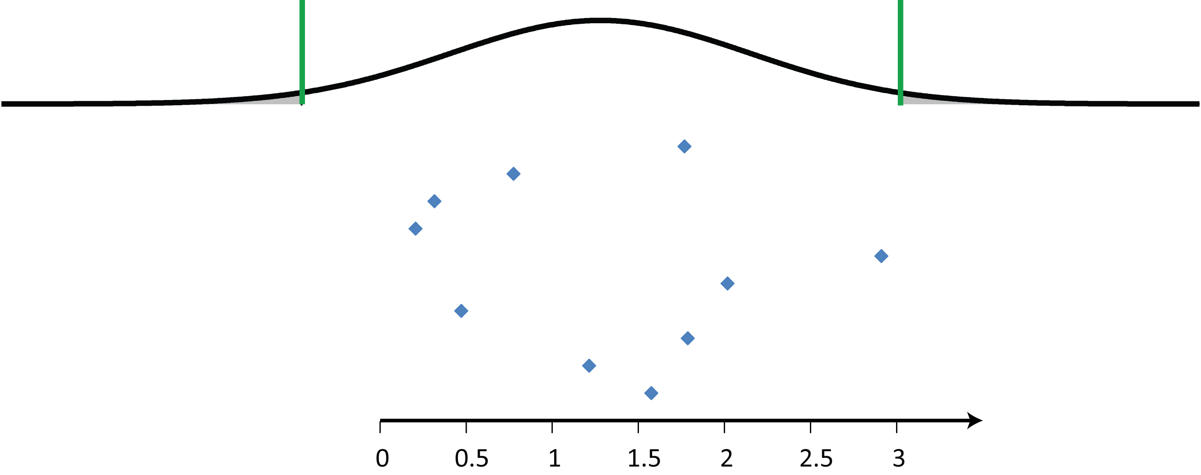
Another problem:
The normal distribution calculated by taking the mean and standard deviation of compositional data will not stay on the simplex: the domain of a normal distribution is
C/B

Slide 46
A better statement of the problem:
Measures of difference are measures of distance.
All of our statistics so far have boiled down to “all you need is S”

Slide 47
A better statement of the problem:
Distances—d(x,X)—should have six properties (Aitchison, 1992):
Positivity d(x,X) > 0 if X is not the same as x
Zero difference between equivalent compositions, d(x,X) = 0 if x=X
Interchangeability f(x,X) = f(X,x)
Scale invariance f(ax,aX) = f(x,X)
Perturbation invariance
Permutation invariance

Slide 48
The (easiest) solution
If we want to keep using the normal distribution, and the well-developed statistical framework that goes along with it, we need to transform our data out of the simplex and into the real numbers

Slide 49

The solution
If we want to keep using the normal distribution, and the well-developed statistical framework that goes along with it, we need to transform our data out of the simplex and into the real numbers

Slide 50
Additive log-ratio transform:
Evaluate ratios of components with a common component in the denominator
²⁰⁶Pb/²⁰⁴Pb, ²⁰⁷Pb/²⁰⁴Pb, ²⁰⁸Pb/²⁰⁴Pb
Take the logarithm of each
log(²⁰⁶Pb/²⁰⁴Pb), log(²⁰⁷Pb/²⁰⁴Pb), log(²⁰⁸Pb/²⁰⁴Pb)

Slide 51
Additive log-ratio transform:
Evaluate ratios of components with a common component in the denominator
²⁰⁶Pb/²⁰⁴Pb, ²⁰⁷Pb/²⁰⁴Pb, ²⁰⁸Pb/²⁰⁴Pb
Take the logarithm of each
log(²⁰⁶Pb/²⁰⁴Pb), log(²⁰⁷Pb/²⁰⁴Pb), log(²⁰⁸Pb/²⁰⁴Pb)

Slide 52
Additive log-ratio transform:
Evaluate ratios of components with a common component in the denominator
²⁰⁶Pb/²⁰⁴Pb, ²⁰⁷Pb/²⁰⁴Pb, ²⁰⁸Pb/²⁰⁴Pb
Take the logarithm of each
log(²⁰⁶Pb/²⁰⁴Pb), log(²⁰⁷Pb/²⁰⁴Pb), log(²⁰⁸Pb/²⁰⁴Pb)
Assume (or test that) the resulting log-ratios are normally distributed

Slide 53
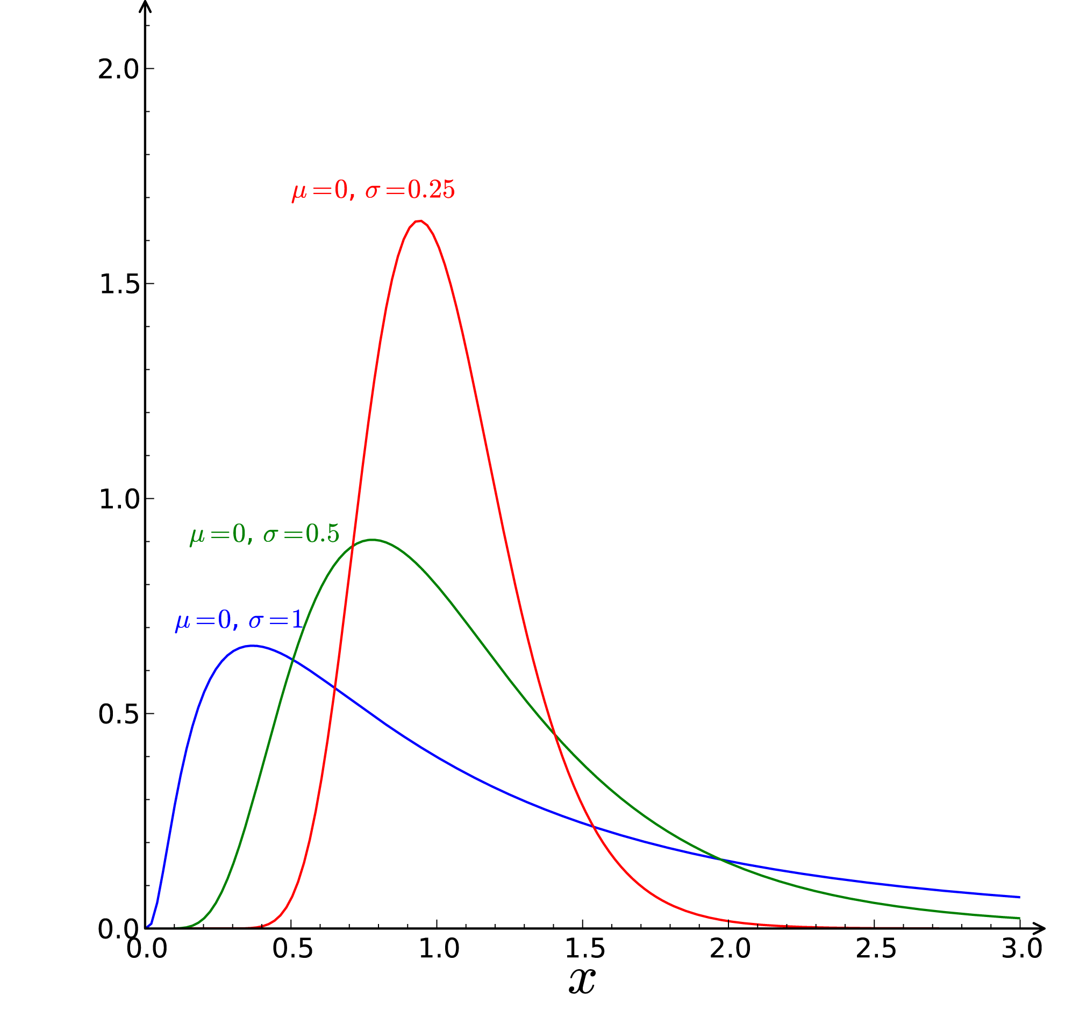
The lognormal distribution

Slide 54
Consequences
Since the additive log-ratio transformed data is normally distributed, proceed with your calculations as before, just evaluate statistics (mean, standard deviation, etc) on log-ratio data.
When you’re done, ‘undo’ the transform by evaluating an exponential:
exp( log(x/y) ) = x/y

Slide 55
Consequences
Log-normal distributions that are precise and far from zero look much like normal distributions, and can be assigned symmetric ±2σ confidence intervals.
Those that are close to zero and less precise have asymmetric probability distribution functions.

Slide 56
More consequences
The linear regression technique that we used before does not work for data plotted as isotope ratios. This goes for linear arrays in isotope ratio space, like isochrons and mixing lines.
The answer is to transform the data into log-ratio space, where x- and y-variables can be given multivariate normal distributions, then perform non-linear regression.

Slide 57
More consequences
The linear regression technique that we used before does not work for data plotted as isotope ratios. This goes for linear arrays in isotope ratio space, like isochrons and mixing lines.
The answer is to transform the data into log-ratio space, where x- and y-variables can be given multivariate normal distributions, then perform non-linear regression.

