Slide 1
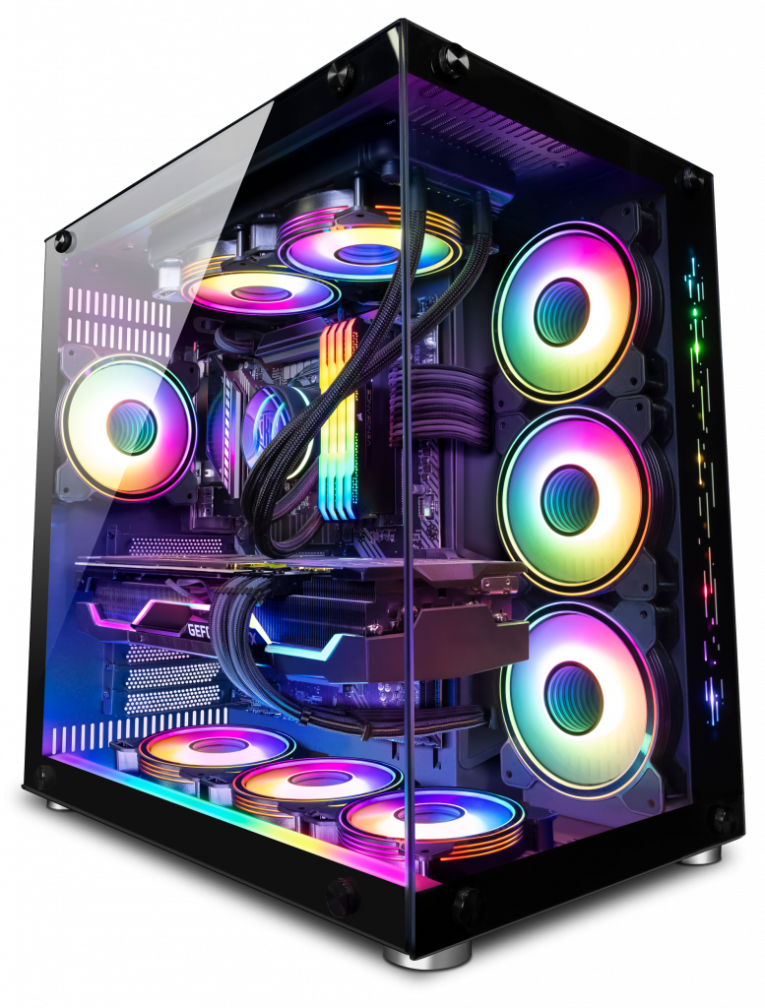


Ciri2 (Can I run it too)
Manage pc
Functionalities
Users can manage and share their pc
Admin can import games from steam
User can submit FPS for their pc in a game
Users can see an overview of other peoples FPS
Pc-gamer
Submit fps
Game
Jordy Walraven

Slide 2




Ciri2 (Can I run it too)
Challenges
Steam integration
Data integrity
Non-functional requirements
Security
Performance
Scalability
Maintainability
Technology selection
Angular?
Nestjs?
Kafka?
Jordy Walraven

