Slide 1
Sprint 1
Jordy Walraven

Slide 2
Sprint goals
Analysis Document
Requirements Document
Research plan
Project management environment
Portfolio reading guide
Create C4 diagram (Level 1 and 2)

Slide 3
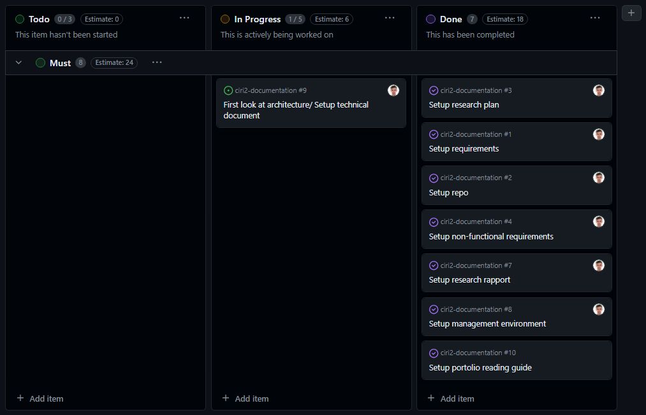
Sprint achievements

Slide 4
Relevant updated documentation
Analysis Document
Research plan
Requirements

Slide 5
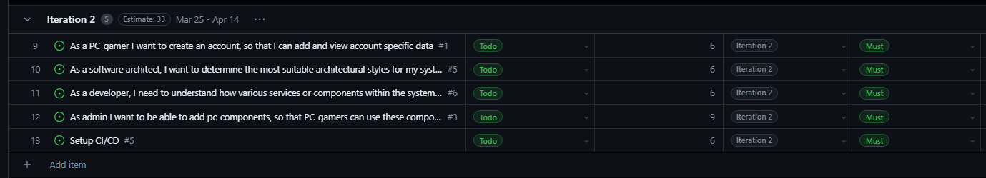
Sprint planning
https://github.com/orgs/CIRI2-s6/projects/2/views/2

