Slide 1
Demonstration of methods to estimate effects in target populations
SER Generalizability Workshop
January 8th, 2020

Slide 2
Variable selection figures

Slide 3
Variable selection and external validity
Remember that whichever method we use, we need to select variables for an adjustment set
There is ongoing work on using directed acyclic graphs and selection diagrams for this purpose
Due to their non-parametric nature, these tools say very little about the relative importance of each variable

Slide 4
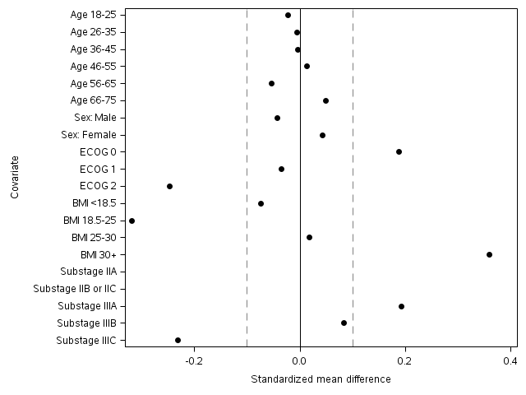
Love plots of standardized mean differences
Code to reference: Love_plot_code
Notes:
These plots illustrate on a per-variable basis the standardized mean difference (SMD) between two groups
SMD for binary variables = (P1 – P2) / ( ( P1*(1-P1) + P2*(1-P2) ) / 2 / ) ^ 0.5 )
The farther the SMD is from 0, the more the marginal distribution of that variable differs

Slide 5
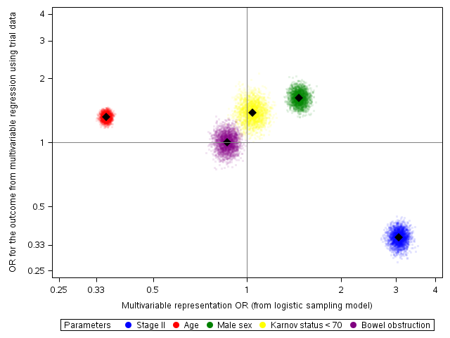
VITT plots of “sampling” and outcome ORs
Code to reference: VITT_plot_code
Notes:
VITT: variable importance for treatment transport
To create this plot, you fit multivariable models (in this case, logistic models) for “sampling” into the trial data set, as well as the outcome
The coefficients for each covariate are then used as the X and Y coordinate in the figure
Bootstrapping can be used to generate “clouds” of uncertainty around the X and Y coordinate

Slide 6
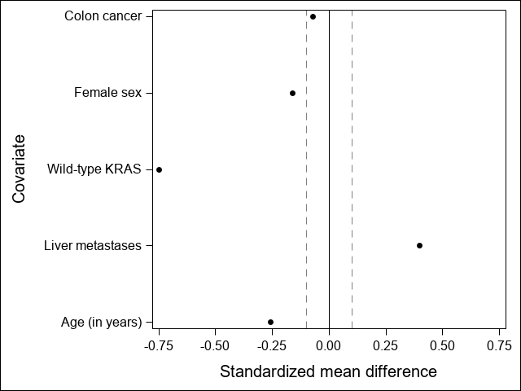
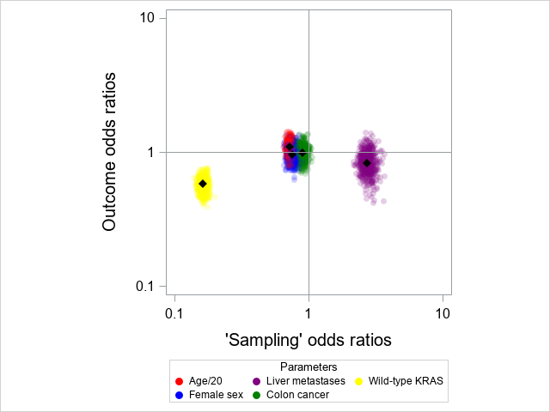
Discussion time: LOVE and VITT plots
Code to create this plot: Love_plot_code
Code to create this plot: VITT_plot_code
Questions:
What variables seem most important for inclusion in the adjustment set?
What variables seem the least important?
Are there any variables you would consider dropping completely?

Slide 7
Diagnosing potential problems

Slide 8
Solving the external validity problem with weights
Once you have identified the key variables, it is necessary to choose an analytic method
As discussed previously, here we’ll be focusing on weights and potential issues that can arise (especially the lack of overlap or positivity)
When using these weights, some preliminary visualizations can help diagnose potential problems

Slide 9
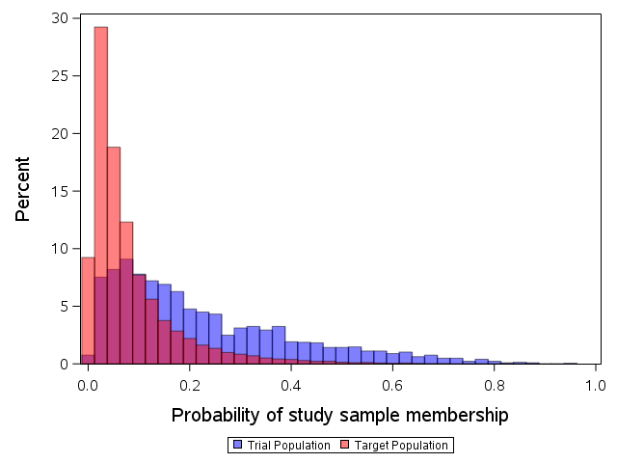
Histograms of “sampling” probabilities
Code to reference: Density_plot_code
Notes:
Plot the predicted probability of membership in the trial for each observation from the multivariable model
Check for overlap in the probabilities-specifically, overlap of the trial with the target

Slide 10
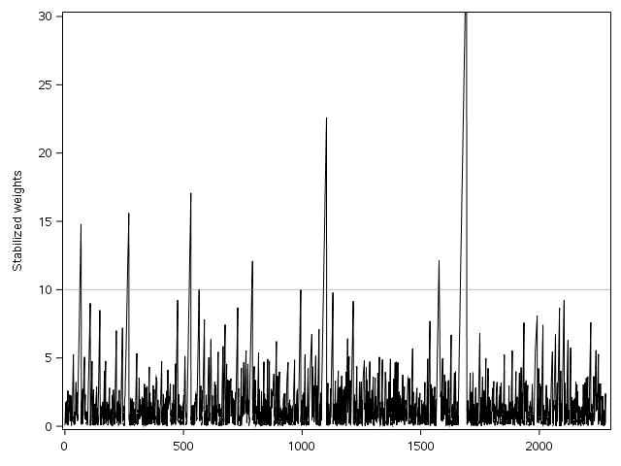
“Skyscraper” plots to identify high weights
Code to reference: Skyscraper_plot_code
Notes:
This plot allows a quick and dirty visualization of the overall weight distribution in the trial
If desired, you can sort the trial participants by key characteristics to identify which lead to the greatest weights
Can also “flag” observations with outcomes to identify the most influential ones

Slide 11
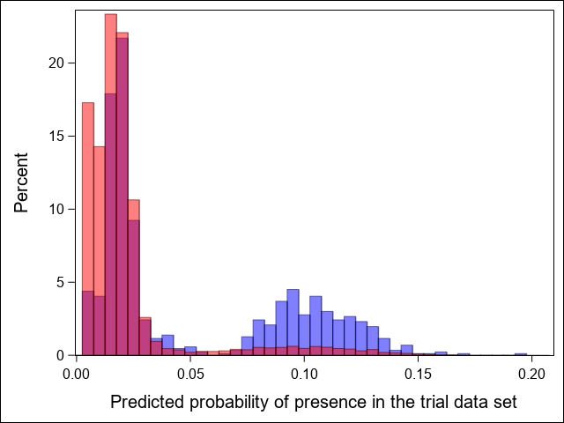
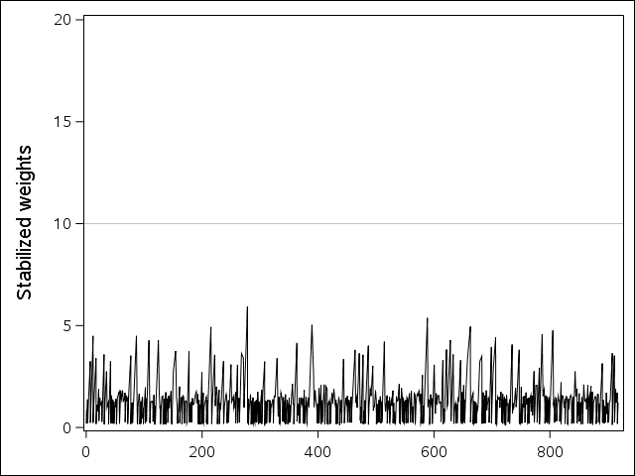
Discussion time: probability and skyscraper plots
Code to create this plot: Density_plot_code
Code to create this plot: Skyscraper_plot_code
Questions:
Do you see any potential problems with using this model based on the density plot?
What about the skyscraper plot? Do you see any potentially problematic weights?
Purely based on these plots, would you be comfortable proceeding with the analysis?

Slide 12
Analyzing data

Slide 13
Weighted analytics
Having completed our diagnostics, how do we actually estimate a treatment effect?
PROC PHREG conveniently allows use of a “WEIGHT” statement, as does many R packages for estimating hazard ratios
Notably, traditional tools for estimating variance can ignore variability from sampling your target population
Instead, we have bootstrapped, re-drawing from both the trial and target each iteration
Code to reference: 02_transport_analyses

Slide 14
Final results
Target population | Progression-free survival hazard ratio | 95% confidence limits | Confidence limit ratio
PRIME trial | 0.97 | 0.84, 1.11 | 1.33
SEER population | 0.88 | 0.74, 1.06 | 1.43
Notes:
<hold on this slide for discussion>

Slide 15
Questions?

