Slide 1
Demonstration of methods to estimate effects in target populations
SER Generalizability Workshop
January 8th, 2020

Slide 2
Data sets and code
As mentioned previously we will use two sets of real randomized trial and target population data for this workshop
Project Datasphere (specifically, the PRIME trial)
The Surveillance and End Results (SEER) cancer registry
We have provided commented code to:
Prepare and harmonize the data sets
01_trial_and_target_creation.sas/.R
Create some visualizations that can help identify specific important variables or diagnose problems
Love_plot_code.sas/.R
VITT_plot_code.sas/.R
Density_plot_code.sas/.R
Skyscraper_plot_code.sas/.R
Analytic code
02_transport_analyses.sas/.R

Slide 3
Estimating effects in target populations
Confounding and generalizability/transport problems often share a common causal structure
There are multiple ways to estimate effects in target populations from a study sample just as there are multiple ways to reduce confounding bias
Broadly speaking, you can model treatment (confounding) or trial participation (transport) or you can model the health outcome
Confounding
Confounders (Z)
Treatment
taken
Health
outcome
Generalizability/transport
Covariates (Z)
Trial
participation
Health
outcome

Slide 4
Available methods
Type of method | Brief description
Matching or restriction | Matches or restricts the trial population resemble to target participants in specific characteristics
Outcome modeling | Uses model(s) built in the trial population to estimate effects in the target based on covariate information
Doubly-robust approaches | Combine models for sample membership and the outcome so that if either model is correct you will have an unbiased estimate
Weight-based standardization | -Reweights the study sample to resemble the target population based the conditional probability of sample membership based on some set of covariates -May use inverse probability weights or inverse odds weights

Slide 5
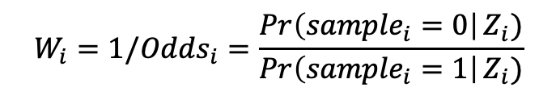
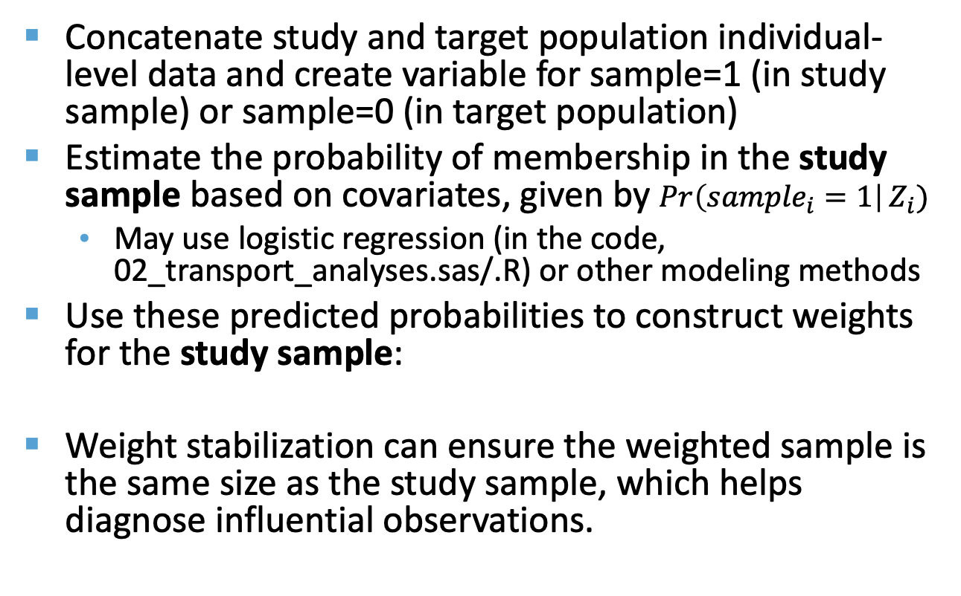
Weighting using inverse odds weights
Concatenate study and target population individual-level data and create variable for sample=1 (in study sample) or sample=0 (in target population)
Estimate the probability of membership in the study sample based on covariates, given by $\operatorname{Pr}\left({sample}_{i}=1\right|Z_{i})$
May use logistic regression (in the code, 02_transport_analyses.sas/.R) or other modeling methods
Use these predicted probabilities to construct weights for the study sample:
Weight stabilization can ensure the weighted sample is the same size as the study sample, which helps diagnose influential observations.
$$W_{i}=1/Odds_{i}=\frac{\operatorname{Pr}\left({sample}_{i}=0\right|Z_{i})}{\operatorname{Pr}\left({sample}_{i}=1\right|Z_{i})}$$

Slide 6
Weighting using inverse odds weights
The weighted trial data share the same covariate distribution as the target population but have the same covariate-specific effects of assignment-to-treatment as the trial.
Crude analysis of the weighted data estimates an effect of treatment, had we been able to run the trial directly in the target population

Slide 7
Questions? akeil@unc.edu

