Slide 1
Tools for geneRalizability
A Brief Introduction to some things and also stuff
Daniel Westreich

Slide 2
Motivating example
PrEP for HIV prevention: how well does it work?
How do we address this question? In general, how do we learn?

Slide 3
How do we learn?
Often: we do a trial.
This trial might look like the following: take N people, randomize them 1:1 to active PrEP and placebo PrEP, with blinding of both participants and researchers. Follow-up both groups for T months, and count the number of cases of incident HIV.

Slide 4

For example,

Slide 5
Baeten, Donnell, Ndase et al. Partners PrEP Study
This trial randomized 4747 serodiscordant couples 1:1:1, to TDF, TDF-FTC, or placebo; followed for 36 months. Outcome: HIV-1 incidence.
Modified intention to treat analysis:
TDF vs. placebo HR 0.33 (95% CI 0.19, 0.56)
TDF-FTC vs. placebo HR 0.25 (95% CI 0.13, 0.45)

Slide 6
Murnane, Brown, Donnell et al. Re-analysis (AJE 2015)
Reanalysis asking broadly, what if everyone had been perfectly adherent to PrEP?
Inverse probability weights & principal stratification approaches found results further from the null; e.g. from IPW:
TDF vs. placebo HR=0.18 (95% CI 0.06, 0.53)
TDF/FTC vs. placebo HR=0.15 (95% CI 0.04, 0.52)

Slide 7
So, we’re done?
This is where our research usually stops – including mine!
I report a result I believe to be internally valid – often on the ratio scale – dust my hands, and walk away.
In this PrEP example, reported on effectiveness (ITT analysis) and also efficacy (as-treated/100% adherent).

Slide 8
But how do we make policy?
…
Okay, how SHOULD we make policy?
One (I think reasonable) answer: on the basis of public health impact with some attention to cost.

Slide 9
Public health impact
Sometimes the ITT/effectiveness is referred to (informally) as a “public health effect” – is it?
How do the results of the ITT (or as-treated) analysis relate to public health impact?

Slide 10
Two issues in interpreting ITT as a public health effect
(There are more than two issues.)
1. Internal v. external validity
2. Exposures v. population interventions
Today we’ll focus only on the first!

Slide 11
Internal v. external validity
A trial (or well-conducted observational study) will usually identify an internally valid sample average causal effect (ACE) – sample as in the study sample.
But what is the target population? We are rarely interested in the study sample for its own sake, yet it is rare that we formally identify the target population. We almost never describe the target population in detail.
If the target population differs systematically from the study sample, the average causal effect estimated from the study sample may not generalize (or “transport”) unconditionally. Example:
Intervention is more effective in women than men.
Our study oversampled men compared to a target.
ACE from study ≠ ACE in the target.

Slide 12
External validity
Very little formal, quantitative attention was paid to external validity in the modern causal inference literature until late 2000s. Hernán et al. Epidemiology 2008; Weisberg et al. and Frangakis Clinical Trials 2009. Frangakis said,
“Standard practice teaches that randomized clinical trials should be preferred to observational studies if the aim is to obtain unbiased estimates of efficacy…differences between the results seen in an RCT and in an observational study can be larger than expected not because of confounding, but because of differences between their respective patient populations. These efficacy estimates can differ enough to change treatment recommendations…RCT results are useful only if we can calibrate their results to predict treatment efficacy in the target population of interest.”

Slide 13
Recent attention
Cole & Stuart Am J Epid 2010 presented a method using inverse probability weights to standardize clinical trial results to an external target population. Pearl and Bareinboim (and others) have presented several papers presenting causal diagram-based methods for identification of externally valid causal effects. Keiding and Louis JRSSA 2016
“…The central issue is whether conditional effects in the sample (the study population) may be transported to desired target populations.…Statisticians, epidemiologists and survey researchers should work together to increase understanding of these challenges and to develop improved tools to handle them.”

Slide 14
Example
Suppose (in a randomized trial with full compliance and no missing data/LTFU) that the causal effect of treatment on the outcome is a risk difference of 10% in HIV-negative women, and 20% in HIV-positive women.
Our study is 50% HIV-positive (because we oversampled HIV-positive women). What if…
…our target population is only 10% HIV-positive women?
…our target population is 50% HIV-positive women?
…our target population is 100% HIV-positive women?

Slide 15
The larger problem: target populations
Per Maldonado & Greenland, Int J Epidemiology 2002, no causal effect is defined without a specified target population.
Usually, in a trial or observational study, the target population is not explicitly identified as such…and is therefore what?
Open question: what are your thoughts?

Slide 16
Target population (2)
The study sample itself?
The superpopulation implied by Table 1 – e.g., the population for which Table 1 represents a simple random sample?
Defined by inclusion/exclusion criteria?

Slide 17
Target population (3)
Caveat: one of these may be true in a large-scale community randomized trial, or pragmatic trials generally.
In a traditional, individually randomized clinical trial? None seem likely.

Slide 18
Defined by inclusion/exclusion criteria?
Inclusion and exclusion criteria for a trial often reflect risk enrichment (we deliberately oversample high-risk people to increase power) or comorbidity anti-enrichment.

Slide 19
The super population for Table 1?
We rarely want to generalize only to those people who, had we approached them, would have consented to be in our trial. But that’s Table 1. Trials sometimes wind up recruiting people with greater health-seeking behaviors, who are more adherent than the typical member of the true target population.

Slide 20
The study sample itself?
Time.

Slide 21
The study sample itself?
Also, trials generally involve risks to the participants. What justified those risks? Usually, “generalized knowledge” is involved. E.g.
…Generalizable Knowledge means that the purpose or intent of the project is to test or to develop scientific theories or hypotheses, or to draw conclusions that are intended to be applicable and/or shared beyond the populations or situations being studied. http://www.bu.edu/irb/guidance-and-faqs/submission-guidance/is-irb-review-required/
Latter emphasis added. That is, you have an ethical obligation to generalize your work – you (usually, in broad terms) have promised the IRB that the study sample is not the target population.

Slide 22
Two kinds of external validity
Sometimes the implicit target population is “individuals in the community from which we selected study participants in a non-random way” so that the study sample is a proper subset of the target population. But often not.
When study sample is a subset of the target population – we call this generalizability. When study sample is (at least partially) external to target population - call it transportability.
Sidebar: currently these are treated as different problems in the literature (e.g., in work by Pearl; and in work by me!), but I’m not sure they have to be.

Slide 23
External validity of PrEP results
Why might the internally valid estimate of the effect of PrEP differ from the effect in a target population (that is, fail to be externally valid in a particular case)?
Let’s take a what-if: what if the study sample includes more people who are highly adherent to their treatment?
We’ll explore this using causal directed acyclic graphs (DAGs).

Slide 24
Adherence in a drug trial

Slide 25
Adherence in a drug trial
PrEP
HIV

Slide 26
Adherence in a drug trial
Active drug concentration
PrEP
HIV

Slide 27
Adherence in a drug trial
Adherence
Active drug concentration
PrEP
HIV
There is a structural interaction here: if adherence is 0, then there should be no causal effect of PrEP on HIV. If PrEP = placebo, then there should be no causal effect of Adherence on HIV.

Slide 28
Adherence in a drug trial
Adherence
Active drug concentration
PrEP
HIV
Koop’s Axiom (drugs don’t work in patients who don’t take them) provides leverage on modeling assumptions, because if our model predicts off-zero in either case then there’s a problem (measurement error? Something else?)
NB: Koop’s Axiom is often false for infectious diseases.

Slide 29
Adherence in a drug trial
Adherence
Active drug concentration
PrEP
HIV

Slide 30
Adherence in a drug trial
Health-seeking
Adherence
Active drug concentration
PrEP
HIV

Slide 31
Adherence in a drug trial
Health-seeking
S=1
Adherence
Active drug concentration
PrEP
HIV

Slide 32
Adherence in a drug trial
Health-seeking
S=1
Adherence
Active drug concentration
PrEP
HIV

Slide 33
Adherence in a drug trial
Health-seeking
S=1
Adherence
with blinding
Active drug concentration
PrEP
HIV

Slide 34
This is a missing data problem
We have data when S=1 (you are in my study sample) and we want inference unconditional on S (or possibly only in S=0).
Daniel et al. SMMR 2011 shows that we can estimate certain kinds of unbiased causal effects unconditional on missingness when we have conditional independence of (i) missingness (or in this case, sampling), and (ii) the outcome.
New work (in review) by R. Ross, Breskin, and Westreich is clarifying Daniel et al. – marginal causal effects are harder to obtain than suggested in this paper.
Additional work by Pearl, Bareinboim and others (various publications) also takes this approach. Hernán addresses similar issues in a recent commentary in AJE (2018).

Slide 35
Adherence in a drug trial
Health-seeking
S=1
Adherence
with blinding
Active drug concentration
PrEP
HIV

Slide 36
Identification conditions for generalizability
Parallel to those for internal validity:
Instead of exchangeability (no uncontrolled confounding or selection bias) we have external-exchangeability (no uncontrolled effect measure modification).
Instead of positivity (nonzero probability that every subject under study could have any treatment – that is, no empty table cells) we have transport-positivity (no empty table cells in the target population vis a vis the study sample)
e.g., if you have a bunch of 70 year old women in the target population, and no women over age 50 in your study sample, then you can’t estimate effects in the 70 year-olds. That is, unless you extrapolate your models, which is exactly how you can overcome non-positivity for internal validity.
Lesko et al. Epidemiology 2017

Slide 37
Identification (2)
Per Hernán & VanderWeele (Epidemiology, 2011) we also need similar versions of treatment in the study sample and target population aka transport-consistency.
Likewise, need similar patterns of interference between study sample and target population.

Slide 38
Super-randomization
In the case in which the study sample is a random sample of the target population, we get these in expectation:
exchangeability, because the distribution of effect measure modifiers is the same in the two populations in expectation.
positivity, because (on average) all patterns of data will be represented.
And so on. Thus, random sampling from the target population actually addresses external validity. The problem is that we rarely if ever can do such random sampling. But it is a useful thought experiment.

Slide 39
How strong are these conditions?
Work by Breskin et al. in press looks at bounds on the risk difference. Separately at bounds attributable to questions of internal exchangeability, and external exchangeability. (Except in rare circumstances) the bounds attributable to external exchangeability are wider than those attributable to internal exchangeability. Which means that assuming you have external exchangeability is (at least in one sense) a formally stronger assumption than assuming you have internal exchangeability. Why is this? Think about the potential outcomes: in internal validity – for people in your study! - you observe (or assume you observe!) one potential outcome for each subject. In external validity – for people you did not study at all – you observe ZERO potential outcomes for each subject, and thus have more things to assume.

Slide 40
How common is lack of external validity?
Answer 1: we don’t know, because few people are looking at it in depth.
Answer 2: probably reasonably common.

Slide 41
Why reasonably common?
Well, we know that when baseline risks change, we can expect EMM on at least one scale. This is just math.
What does this look like?

Slide 42
Example: changing baseline risks
1. We know that for a non-null effect, a change in the baseline risk of outcome necessitates effect measure modification on at least one scale (difference or ratio). Example:
Baseline risk Exposed risk RD RR
5% 10% (10-5=) 5% (10/5 =) 2.0
Suppose baseline risk shifts to 10%: what is exposed risk?
10% 20% 10% 2.0
10% 15% 5% 1.5
RD and RR can’t both stay constant here.

Slide 43
Example: changing baseline risks
2. Nearly all randomized trials misrepresent the baseline risk in the target population.
Typically, they will oversample individuals at high risk of the outcome to increase power.
In HIV contexts, for example: serodiscordant couples studies for HIV transmission outcomes; people with high-risk behaviors for HIV vaccine trials.
In CVD contexts: people with high risk of MI or stroke.

Slide 44
Example: changing baseline risks
Therefore:
Most randomized trials will not be generalizable to the intended target population (from which the study population was sampled) on at least one scale (ratio or difference).
Specifically, this will apply to any trial with a non-null result (and I think it applies everywhere except for a sharp causal null) in which the baseline risk in the target population of interest differs from the baseline risk in the study sample.
Of course, if the target population IS the study sample, there is no issue; but this is rarely the case (indeed, we argue never).

Slide 45
Why reasonably common (3)?
Any exposure/intervention which is adherence-mediated may lack external validity if adherence is different between study and target. I believe* this is quite common. ~ *By which I mean, I think adherence differences between study and target will change estimated causal effect by at least 20%, in at least 40% of published randomized trials involving a significant adherence component. I make this statement with confidence 75%, suggesting that I will bet $3 against your $1 that this is true.

Slide 46
Why reasonably common (4)?
Because non-representative trial populations is a long-standing issue.

Slide 47
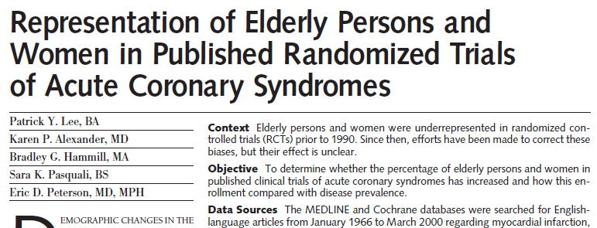
“Trial enrollment of patients aged 75 years or older increased from 2% for studies published during 1966-1990 to 9% during 1991-2000, but remains well below their representation among all patients with myocardial infarction (37%) in the United States.”
“Enrollment of women has risen from 20% for studies published between 1966-1990 to 25% during 1991-2000, but remains well below their proportion of all patients with myocardial infarction (43%) in the United States.”

Slide 48
What about our example?
This trial was done in serodiscordant couples; the uninfected partner in a discordant couple is at very high risk of HIV acquisition because we have guaranteed ongoing exposure to HIV.
This makes sense from a power perspective.
But people who are not in a stable relationship with an HIV-positive individual are at lower baseline risk. Which means we will very likely see changes in effects on at least one scale if we transport to them.

Slide 49
How do we address this problem?
Doubly randomized trials: identify target population, randomly sample study sample, randomized treatment in study sample. This won’t work, because not everyone says yes. Pragmatic trials This may work but isn’t always possible Analytic approaches

Slide 50
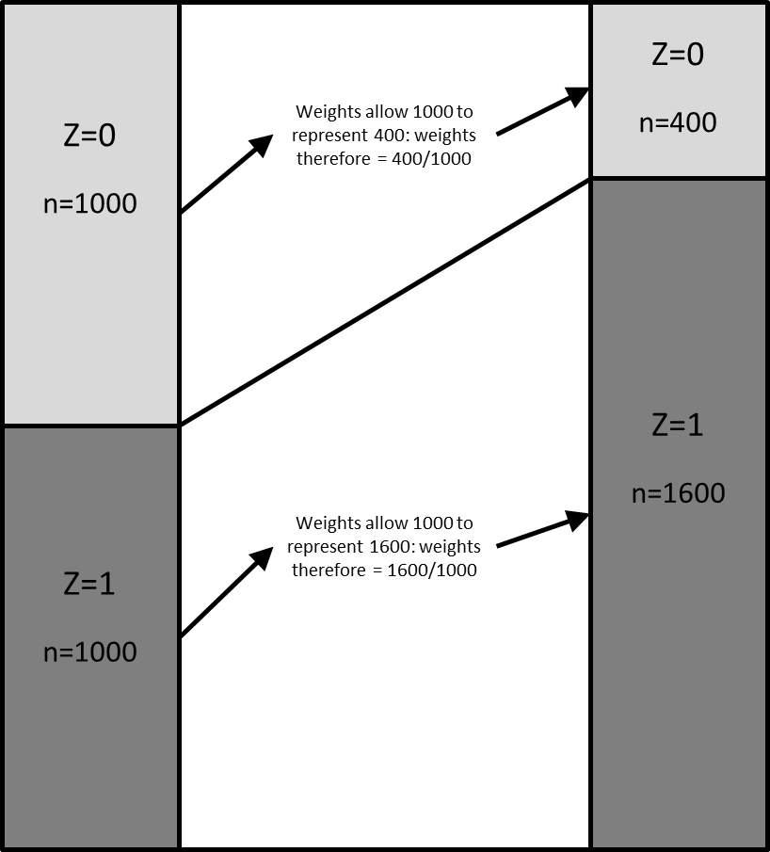
One analytic approach
Recall the problem is fundamentally one of effect measure modification, for which standardization approaches are key in the study sample.
Cole & Stuart described inverse probability of sampling weights for generalizing a trial to a target population. Extended to inverse odds weights by Westreich et al. AJE 2017. Predecessor methods in Sato Epidemiology 2003.

Slide 51
Algorithm
Take the study sample S, and the target population T.
Concatenate S (R=1) & T (R=0) into a single population.
Model Pr(R=1|Z)
where Z is the set of variables we believe will give us conditional independence of R and the outcome.
Use estimated probabilities to construct IPW
Weight R=1 so that these individuals stand in for R=0.
This is like “effect of the treatment in the untreated” except it is “effect of being in the study sample on those not in the study sample. There are predecessor methods in Sato Epidemiology 2003.

Slide 52
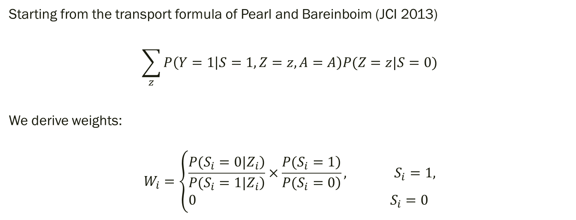
Method
Starting from the transport formula of Pearl and Bareinboim (JCI 2013)
$$\sum_{z}{P\left(Y=1 | S=1,Z=z,A=A\right)P(Z=z|S=0)}$$
We derive weights:
$$W_{i}=\left\{\begin{aligned}&\frac{\left.P(S_{i}=0|Z_{i}\right)}{\left.P(S_{i}=1|Z_{i}\right)}×\frac{\left.P(S_{i}=1\right)}{\left.P(S_{i}=0\right)}, S_{i}=1, \\ &0 { S}_{i}=0\end{aligned}\right.$$

Slide 53
Target validity (for generalizability) (see Westreich et al. in Am J Epidemiology)
What if instead of thinking of internal validity and external validity as separate things, we considered a joint measure of validity, target validity?

Slide 54


In populo veritas

