Slide 1
Introduction to High Performance Computing (HPC)
Cong Van (cvan@memphis.edu)
(adapted from Nurmohammed Patwary)
CIRL, EECE Department
University of Memphis

Slide 2
WHY High Performance Computing (HPC) facility?
Running Memory intensive simulations.
Repetitive simulations with different parameter sets.
Making computation faster using parallel computing or GPU.

Slide 3
Resources Available in HPC
https://www.memphis.edu/hpc/2018-hpc-upgrade.php

Slide 4
How to gain access to HPC?
Free to all UoM students.
Request your account @: https://memphis.topdesk.net/:
Self Service->Research and HPC Software->HPC Account

Slide 5
WHY HPC?
To get rid of out-of-memory Error!
Parallel/Distributed Computing
GPU Computing
Running multiple simulations simultaneously
Some Applications
Machine Learning/Deep Learning
Computationally intensive simulations
Multi-dimensional data processing

Slide 6
Running MATLAB in HPC is as simple as running in the Desktop
Required Software:
Putty: To open terminal @ https://www.putty.org/
WinSCP: To transfer data between local PC and HPC @ https://winscp.net
Xming: To open GUI @ https://sourceforge.net/projects/xming/
AnyConnect: To access the university network from home
https://www.memphis.edu/umtech/solutions/vpn.php

Slide 7
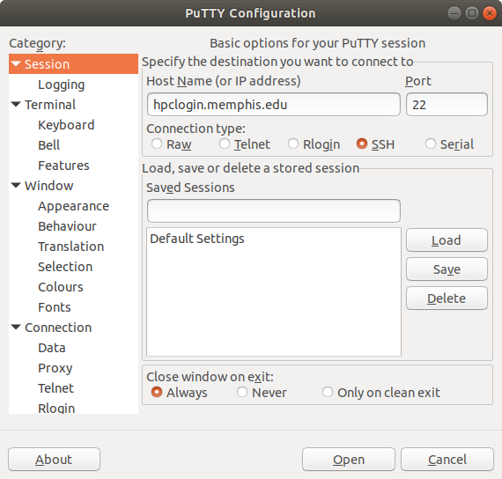
Login to HPC using Putty
Hostname: hpclogin.memphis.edu

Slide 8
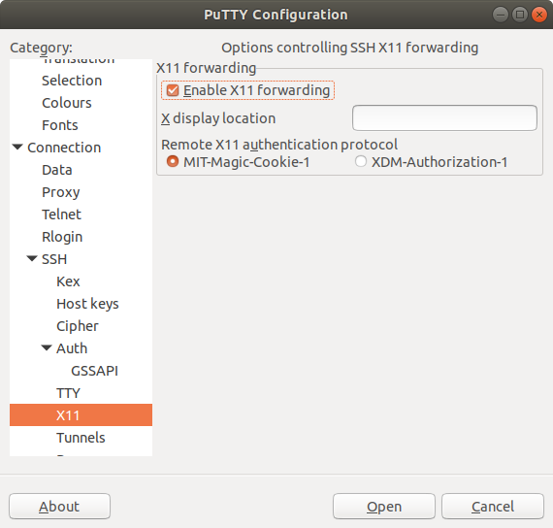
Enable Xming to run GUI

Slide 9
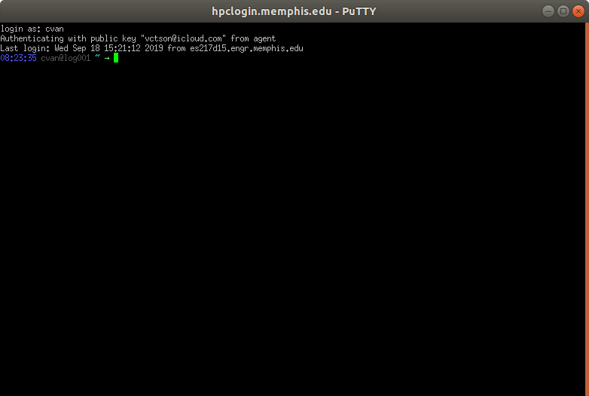
HPC Terminal

Slide 10
MATLAB can be run in three different ways in HPC
Using GUI
- Same as desktop computer
Opening only command window.
- Same as desktop, faster than opening GUI.
Using shell script.
- Best way to submit jobs.

Slide 11
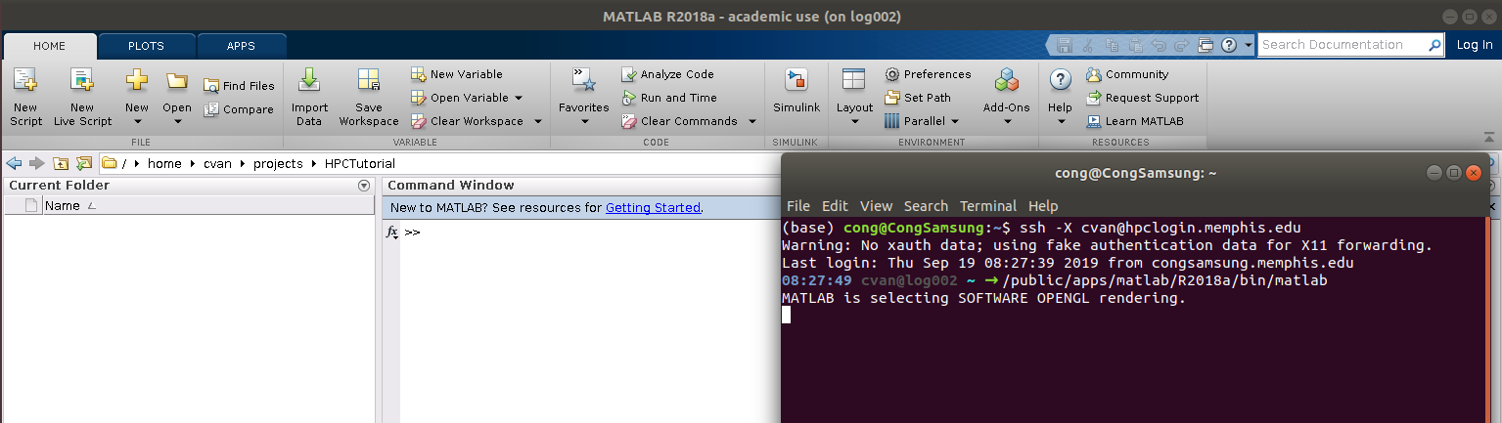
Opening MATLAB in HPC using GUI
matlab GUI will open by following command
/public/apps/matlab/R2018a/bin/matlab
(works in all nodes, login/compute)

Slide 12
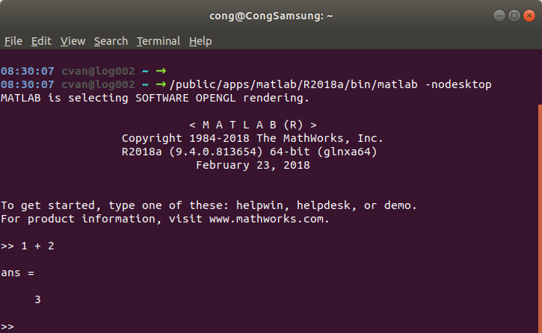
Opening MATLAB in command window HPC (DEMO)
Advantage of GUI: Simple, and works in any node.
Challenge with GUI: slow in compute nodes.
Opening only command window using
/public/apps/matlab/R2018a/bin/matlab –nodesktop

Slide 13
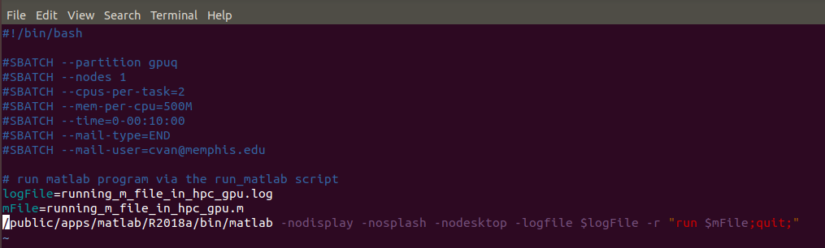
Submitting MATLAB jobs using shell scripts (DEMO)
Advantage
Works in all compute nodes
Does not require continuous supervision.
Hundreds of jobs can be submitted simultaneously.

Slide 14
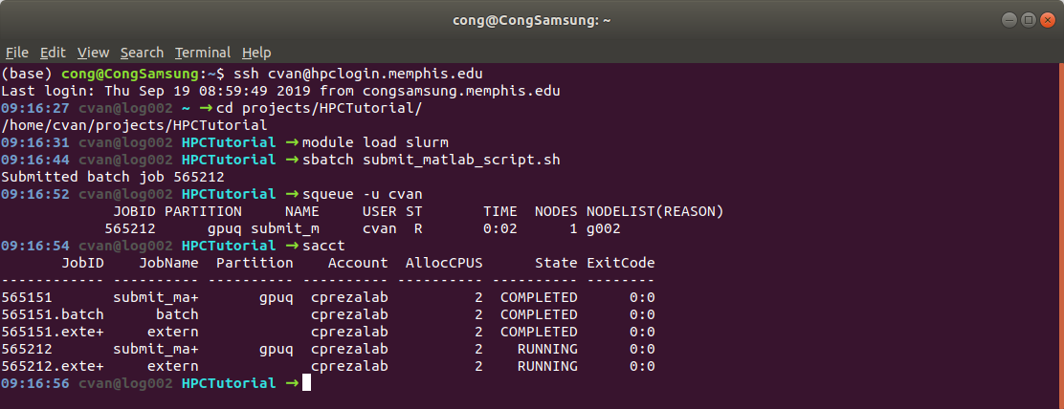
Submitting MATLAB jobs using shell scripts (DEMO)
module load slurm
sbatch submit_matlab_script.sh
sacct
squeue -u cvan

Slide 15
More on submitting shell scripts
https://www.memphis.edu/hpc/batchscripts.php
Useful commands:
squeue: see the status of your jobs.
sacct: see your jobs submitted over the past day.
scancel jobid: cancel the job with jobid.
Useful SLURM tags:
--partition computeq (or -p): gpuq, computeq, or bigmemq.
--nodes M (or -N): number of nodes to run task on.
--cpus-per-task N (or -c)
--mem-per-cpu 500M
--time: time limit of the task
--mail-type=END
--mail-user=cvan@memphis.edu

Slide 16
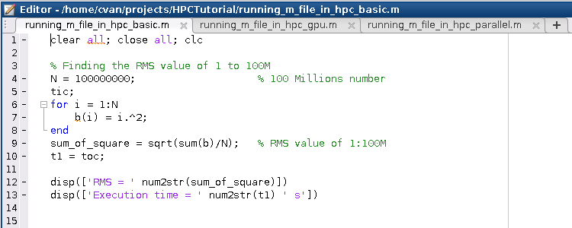
Simple Matlab script (DEMO 1)
srun --partition computeq --cpus-per-task 10 --mem-per-cpu 1000M --pty /public/apps/matlab/R2018a/bin/matlab -r "running_m_file_in_hpc_basic"
RMS = 57735027.352
Execution time = 6.2629 s

Slide 17
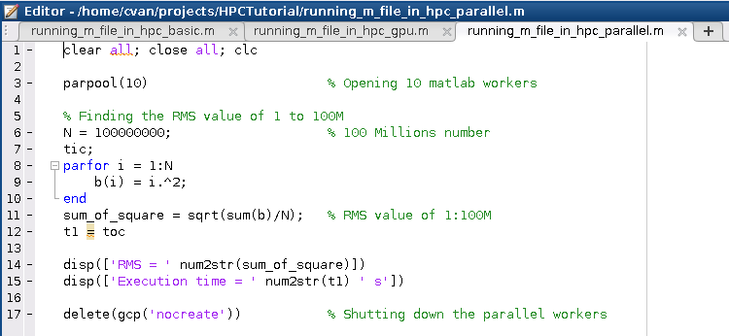
Parallel Computing using Matlab
(DEMO 2)
srun --partition computeq --cpus-per-task 10 --mem-per-cpu 1000M --pty /public/apps/matlab/R2018a/bin/matlab -r "running_m_file_in_hpc_parallel"
RMS = 57735027.352
Execution time = 2.7445 s

Slide 18
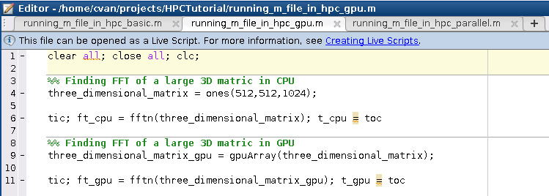
GPU Computing using Matlab
(DEMO 3)
srun --partition gpuq --cpus-per-task 10 --mem-per-cpu 1000M --pty --gres=gpu:1 /public/apps/matlab/R2018a/bin/matlab -r "running_m_file_in_hpc_gpu"
t_cpu = 6.1893
t_gpu = 0.3198

Slide 19
Slides and scripts on: https://github.com/congUoM/HPCTutorialUoM
Question?

