Slide 1

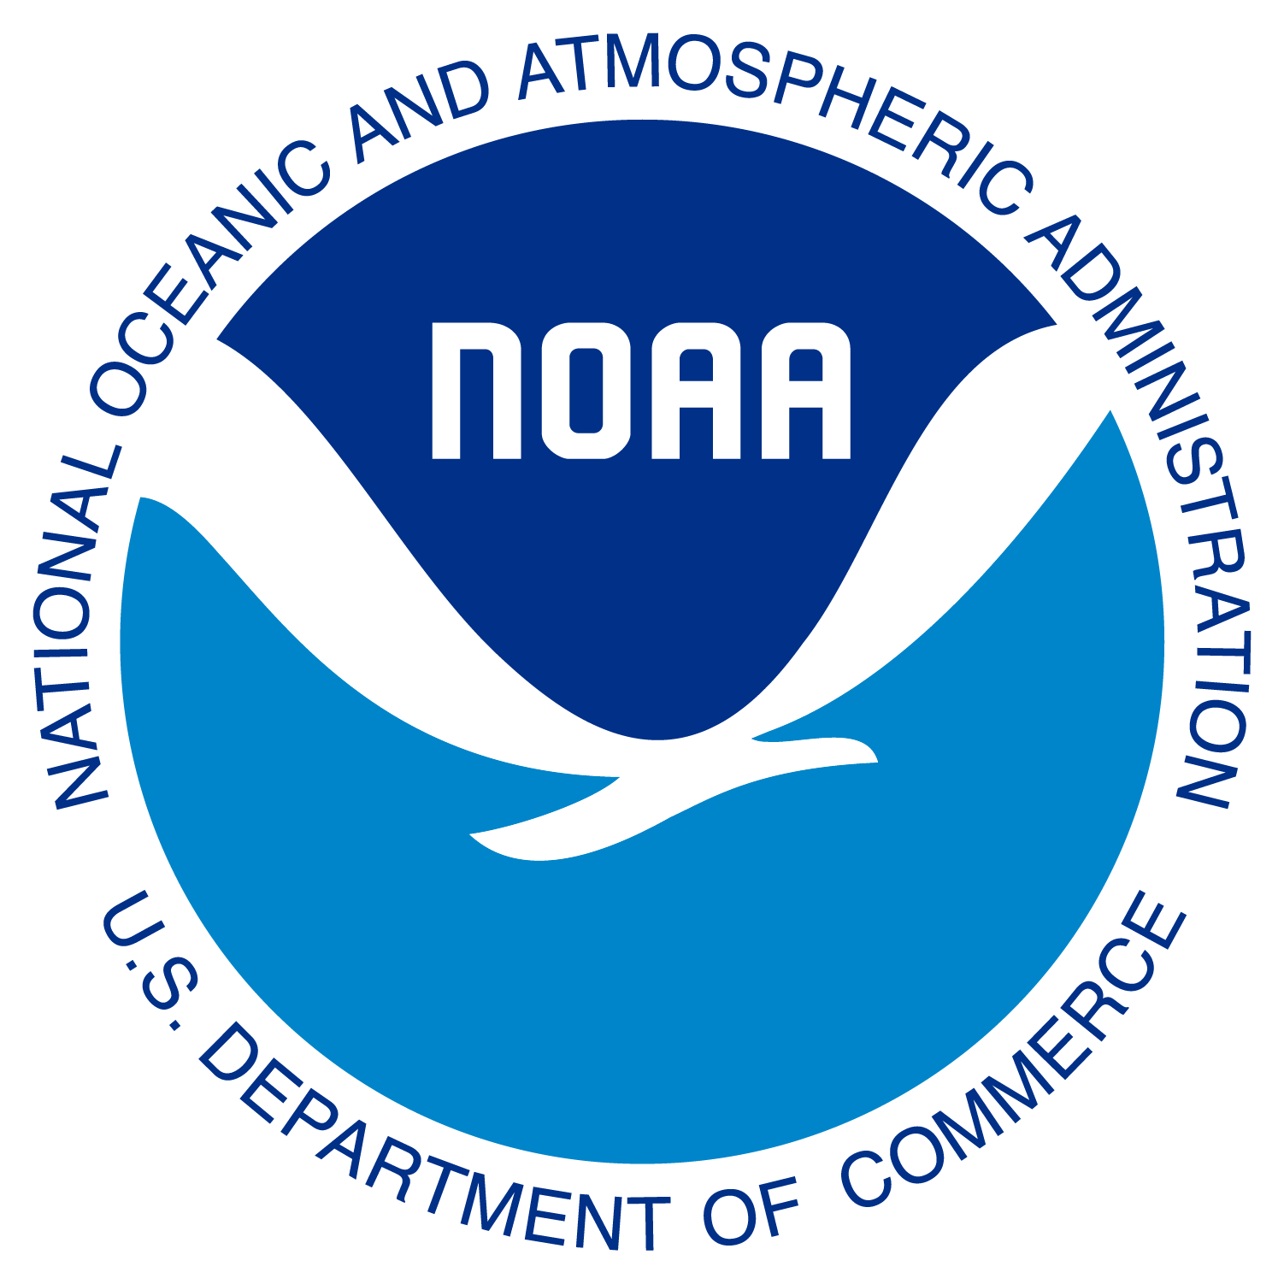
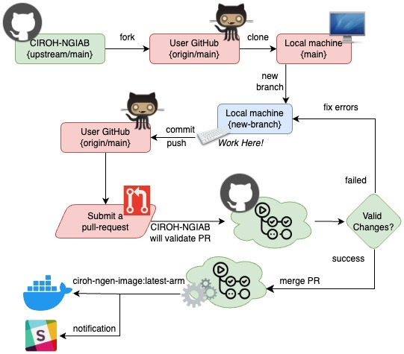
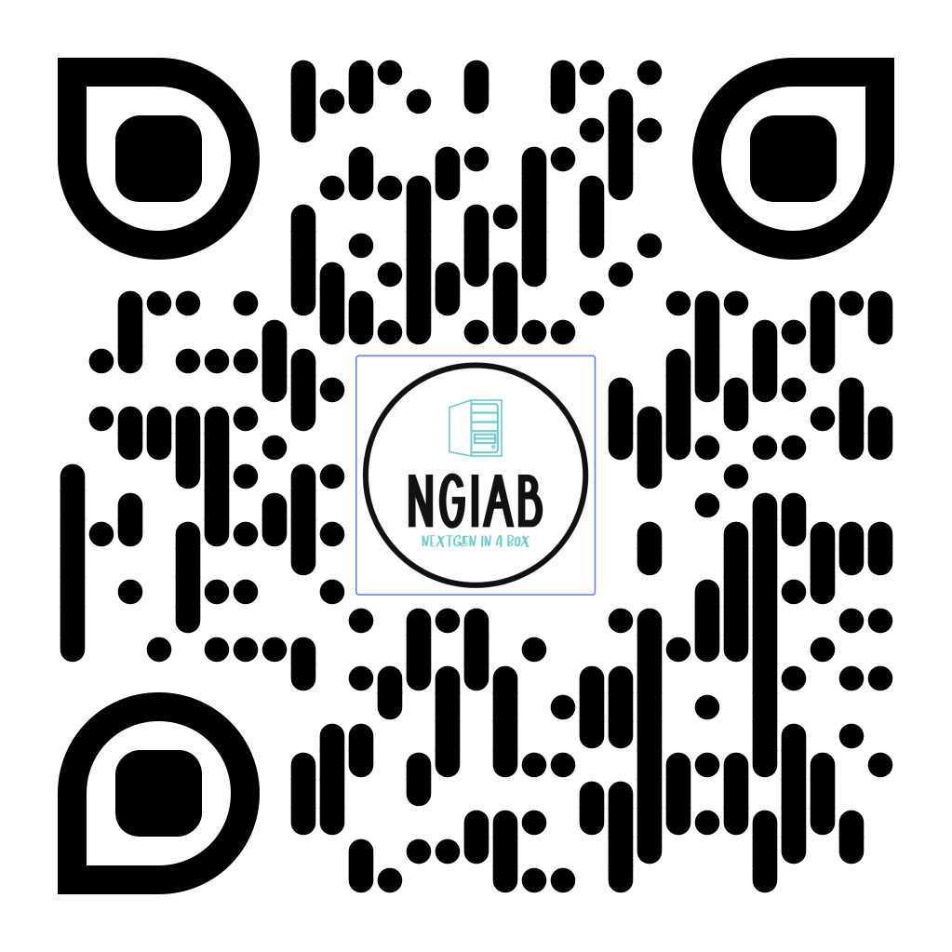

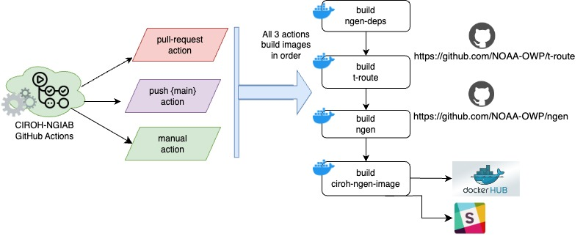


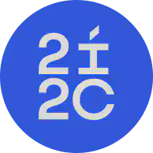





NextGen framework-based simulations are now easy with NextGen In A Box!
Arpita Patel, James Halgren, Sepehr Karimi, Benjamin Lee
Nels Frazier, Zach Wills, Jordan Laser, Purushotham Bangalore, Jeff Carver and Steve Burian.
Introduction
Continuous Integration (CI) pipeline for NGIAB
How to Run NGIAB? and what’s Next?
The key accomplishment of this research effort is the development and dissemination of NextGen In a Box (NGIAB), a community-accessible port of the NextGen framework. In addition to enhancing research infrastructure, this project places a strong emphasis on fostering and promoting the integration of NextGen Framework within the broader research community.
Containerized “NextGen In A Box” Code:
https://github.com/CIROH-UA/CIROH-NGIAB
Infrastructure Setup: Establish both on-premises and cloud-based infrastructure.
Community Engagement: Foster community development and research integration, emphasizing the use of the NextGen framework.
Enhance Accessibility: Improve the NGIAB engine to enhance usability and accessibility.
Integration with Data: Develop a continuous data stream of input and output results using NGIAB.
Technical Doc/How to Run NGIAB?
https://tinyurl.com/NGIAB-Docs
Goals
Integration​
Increase accessibility of the community accessible version of the National Water Center’s Next Generation Water Resource Modeling Framework.
Infrastructure​
Establish a versatile hybrid cloud and on-premise infrastructure capable of supporting continuous data stream development and high-performance compute. ​
Figure 1: Continuous Integration (CI) pipeline workflow
Ngen dependency and docker build flow diagram
Acknowledgment
Funding for this project was provided by the National Oceanic & Atmospheric Administration (NOAA), awarded to the Cooperative Institute for Research to Operations in Hydrology (CIROH) through the NOAA Cooperative Agreement with The University of Alabama (NA22NWS4320003)
Figure 2: Ngen dependency and docker build flow diagram

