Slide 1
Next generation water model DATAStream
Jordan laser
Zach wills
Nels frazier
SPRING 2024

Slide 2
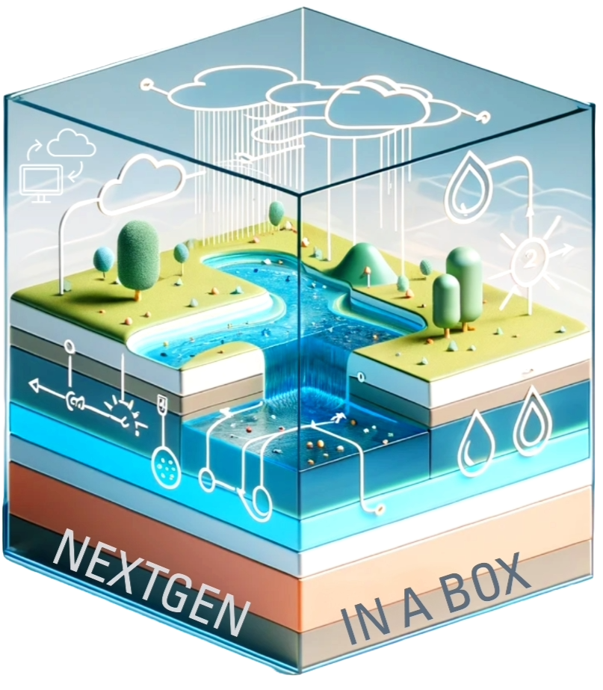
NEXTGEN Water Modeling Framework Datastream Conceptual Model
3
Prepare configuration and data inputs
Validation
Versioning
1
2
4
NGEN-DATASTREAM
https://github.com/CIROH-UA/ngen-datastream/tree/main
ngen-datastream refers to the software chain that builds valid ngen-run input packages, executes NEXTGEN with NGIAB, and versions the entire run. NEXTGEN is a framework that coordinates hydrologic model configuration, parameterization, and execution across spatial domains. NGIAB consists of the NEXTGEN docker container pre-built for the user’s architecture as well as software that aids users in properly running the container.

Slide 3

NEXTGEN Water Modeling Framework Datastream Conceptual Model Breakdown
Prepare configuration and data inputs
1
Hydrofabric
Weights
Forcings
NEXTGEN BMI model configuration
GET
CALC
CALC
CALC
Defining spatial domain and NEXTGEN BMI model configuration
To extract catchment averaged forcing values from grids, the weights (or grid indices) must be calculated
Extracts catchment averaged forcing values from grids
Executing the internal NEXTGEN bmi models.
Required for

Slide 4
NEXTGEN Water Modeling Framework Datastream Conceptual Model Breakdown
The calculations in the weights and BMI model configuration generation steps are identical for a given spatial domain and realization, meaning the files created in these steps can be reused. This can be thought of running ngen-datastream in “lite” mode.
Prepare configuration and data inputs
1
Hydrofabric
Weights
Forcings
NEXTGEN BMI model configuration
GET
CALC
CALC
CALC
Defining spatial domain and NEXTGEN BMI model configuration
To extract catchment averaged forcing values from grids, the weights (or grid indices) must be calculated
Extracts catchment averaged forcing values from grids
Executing the internal NEXTGEN bmi models.
Required for

Slide 5
NEXTGEN Water Modeling Framework Datastream Conceptual Model Breakdown
TLDR: The value of the validation step is to notify the user of any errors in the NEXTGEN run package before beginning the execution
ngen-run/
│
├── config/
│
├── forcings/
|
├── metadata/
│
├── outputs/
Validation
2
https://github.com/CIROH-UA/ngen-datastream?tab=readme-ov-file#ngen-run
https://github.com/CIROH-UA/ngen-datastream/tree/main/python#run_validatorpy
Realization
Forcings
BMI configuration
Ensures the user has supplied a valid realization file to configure NEXTGEN
Ensures a forcing file exists for each catchment in the hydrofabric and for each time step specified in the realization
Ensures all BMI model configuration files exist.
For example, t-route requires a single configuration YAMl, whereas PET and CFE require a configuration file for each catchment
Required for

Slide 6
Input explanations for NGIAB/NEXTGEN
 | Configuration | Hydrofabric | Forcings
Physical Explanation | Deciding how to model hydrologic data is not easy. There’s a ton of water models with different versions, configurations, and parameterizations that makes running and interoperation difficult. To add to the complexity, the performance of these models has been found to depend strongly on the environment, implying some models work better than others depending on the spatial domain. NextGen gives users control over modeling this complexity. | The hydrofabric is the spatial data that describes the physical location of things like the borders and topology of a catchment, nexus points, and flowpaths. | Forcings are the physical variables needed to “force” NextGen from one time step to the next. Forcings variables include temperature, precipitation, and solar longwave and shortwave intensities. These files are per catchment time series of these variables.
Computer Science Explanation | Here is where the user supplies NextGen with the information it needs to execute a “run”. This includes information like the time range, model selection, model configuration and parameterization. It is possible to specify the model selections on a per catchment basis. This allows the user to run different models over different areas and can dramatically increase the complexity of this file. The goal of NGIAB is to dynamically produce this file via a GUI. e.x. ngen-run/config/realization.json | This data is most readily available in .geopkg per VPU. Users often subset these .geopkg’s into smaller domains with tools like hfsubset. NextGen only accepts .geojson format, so users will then need to conver their .geopkg to .geojson with tools like og2og2 e.x. ngen-run/config/catchments.geojson | More on how to create these files later. e.x. data_dir/forcings/cat-12.csv
ngen-run/
│
├── config/
│
├── forcings/
|
├── metadata/
│
├── outputs/

Slide 7
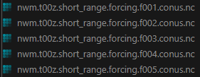
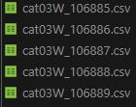
Why do we need a forcingprocessor?
NWM output forcing data
Gridded
CONUS wide
One file for each forecast time
NextGen input forcing data
Non-Gridded
Time Series within each file
One file for each catchment
U2D
V2D
U2D
V2D
T2D
t
t₁
y
y
x
x
forcingprocessor.py
T2D
y
x

Slide 8
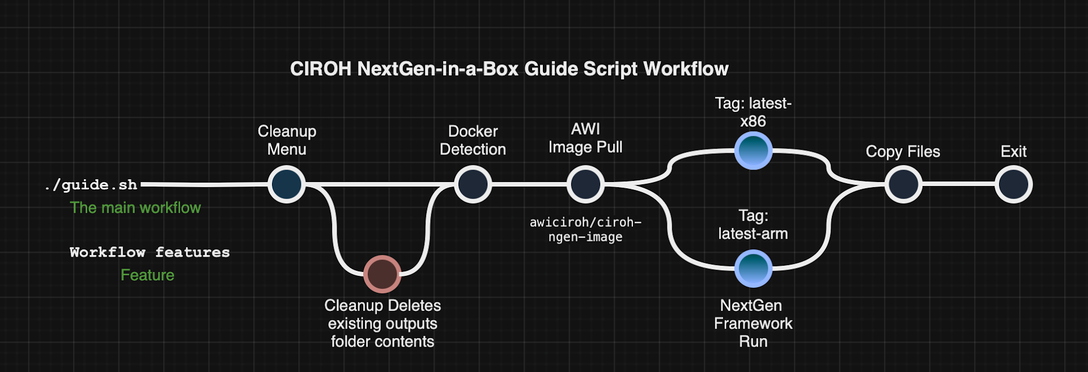

Slide 9
Terms
NGIAB – Next Generation National Water Model in a Box
NGEN - Next Generation National Water Model
Catchment – geographic area characterized by a single location, a nexus, where all precipitation in the area runs off through. A drainage basin.
Nexus – the singular point where water flows into or out of a catchment. Often a point along a river.
Subsetting – To reduce a large geopackage (many catchments) down to a smaller geopackage (fewer catchments) . In effect, this is choosing the domain over which ngen will run.
Hashing – SHA256 algorithm applied to files to generate a unique id for a file. Useful for preserving and distinguishing unique inputs.
Validation – Ensuring the ngen input directory data_dir has been constructed properly. Properly meaning that NextGen will not crash and will generate output data.

Slide 10
links
DATASTREAM https://github.com/CIROH-UA/ngen-datastream/tree/main
FORCINGPROCESSOR https://github.com/CIROH-UA/ngen-datastream/tree/main/forcingprocessor
REALIZATION GENERATION AND NGEN-RUN FOLDER VALIDATION https://github.com/NOAA-OWP/ngen-cal
HYDROFABRIC SUBSETTING https://github.com/LynkerIntel/hfsubset
HASHING/VERSIONING https://github.com/aaraney/ht
NGIAB https://github.com/CIROH-UA/NGIAB-CloudInfra
https://docs.ciroh.org/
https://docs.ciroh.org/docs/products/tools/nextgeninabox/ngiab-intro
https://github.com/NOAA-OWP/ngen/wiki
https://mikejohnson51.github.io/hyAggregate/
https://ciroh.ua.edu/

