Slide 1
Monopoly Clone
By Bryan H, John L, and Luke A

Slide 2
Who are we?
Bryan H: Back-end developer
John L: Front-end developer
Luke A: Misc. coder, Project Manager

Slide 3
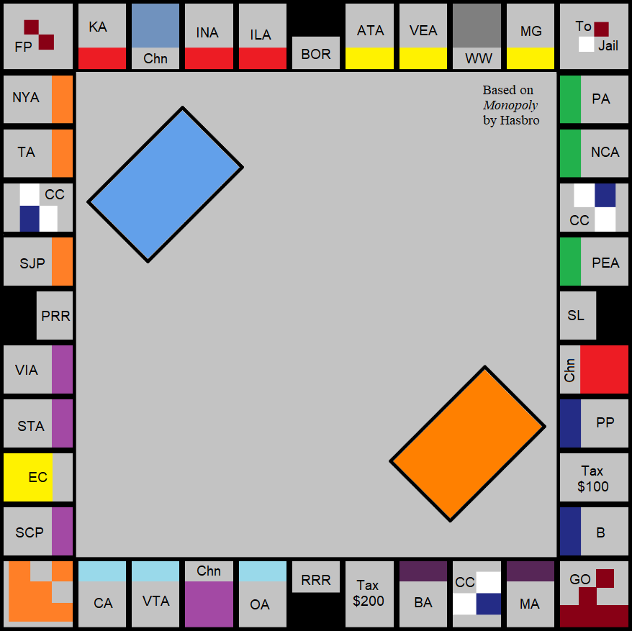
What have we done?
Recreated the board game Monopoly by Hasbro

Slide 4
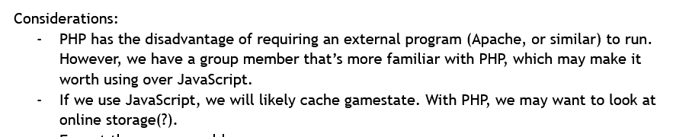

The start of our project
Considered languages: HTML/CSS and JavaScript/PHP
Settled on TypeScript, CSS, and HTML
Mulled over where to host the project, the steps going forward
Notes:
Week 2 document

Slide 5
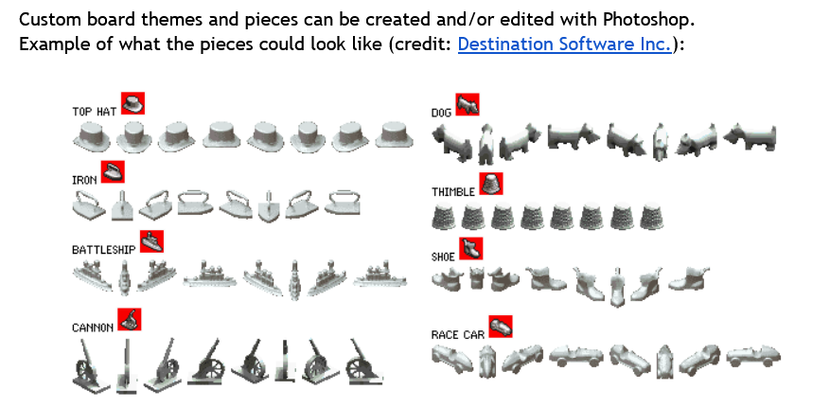
Discussions continued
Week 5, rules start coming together
Continued to ponder where to host, how to organize the parts (what was a property?), expanded player functions
GitHub Pages would be used to host
Worked on screen layout, base sprites
Talked about art style

Slide 6
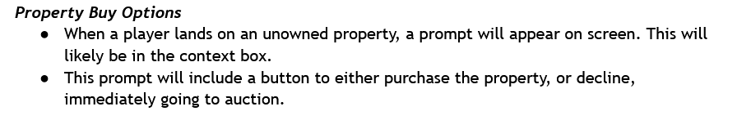
Discussions continued
Week 7, we continued to iron out the exact rules, needed functions.
GitHub Pages would be used to host

Slide 7
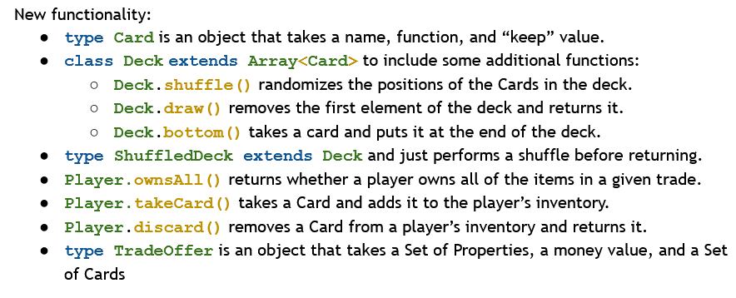
Proto functions
We designed the game outline week 9, began proto functions
Proto functions like deck shuffle were designed
More sprites were made(did not make the final cut)

Slide 8
Development
We began development by coding the library for the game, coding the HTML, CSS, TypeScript

Slide 9
Rules
Two players
Player actions:
You roll to move
If you land on a property, you can buy it (if you can pay) or ignore it
If you land on some else’s property, you pay them rent
If you land on a card tile, you draw a card (chance or community chest)
This can include moving to a tile, paying money
If you land on a miscellaneous tile, you do that action (pay taxes, go to jail)
While in jail, you can pay $50 to leave or roll doubles to leave

Slide 10
Rules Cont.
Property management:
Some work was made into being able to develop properties, button exists and rent values exist but did not make final cut
Auctioning was not implemented
The game is over when one player can’t afford to pay money they owe

Slide 11
HTML & Pictures
By John
https://github.com/CIS-4722-25/Monopoly-Clone/tree/main

Slide 12
Code & Demonstration:
By Bryan
https://github.com/CIS-4722-25/Monopoly-Clone/tree/main

Slide 13
Credits
Hasbro: for publishing Monopoly. & Sorry game pieces were used for inspiration
GitHub: for hosting the repository and game
Destination Software Inc.: Sprites were used for inspiration

