Slide 1


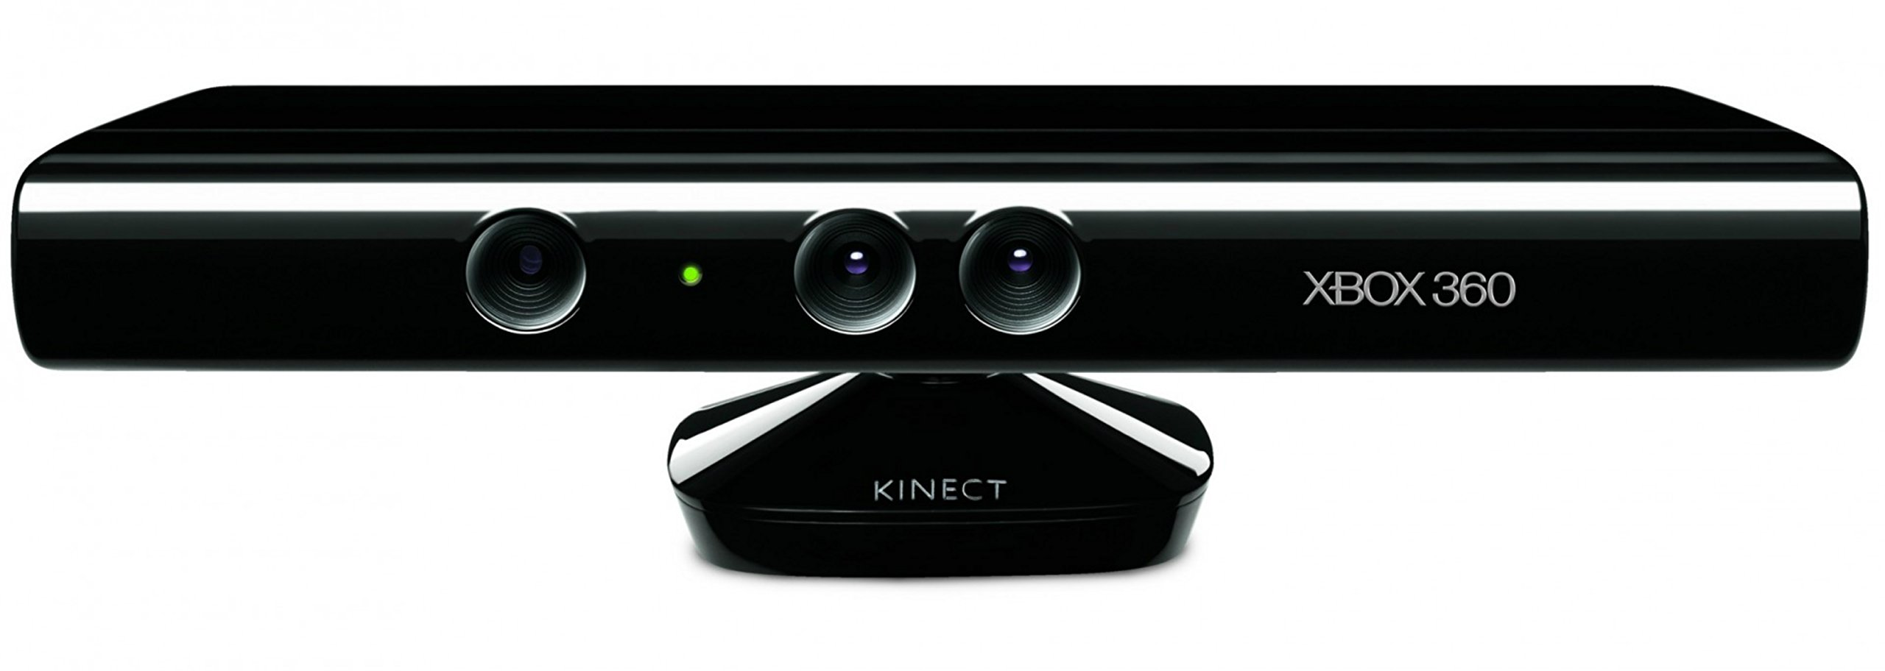

Audio Input
Beat Detection
Beats, kicks, snares, etc.
Sensor Input
Optical Flow-based Effects
Kinect Sensor
Render to Screen
User
GLSL Nodes
Background Visuals

