Slide 1
Python Arcade
Instructor: Rob Garner
Based on tutorial at: https://arcade.academy/examples/platform_tutorial/index.html

Slide 2
Overview
Step 1 - Install and Open a Window
Step 2 - Add Sprites
Step 3 - Add User Control
Step 4 - Add Gravity
Step 5 - Add Scrolling
Step 6 - Add Coins And Sound
Step 7 - Display The Score
Step 8 - Use a Map Editor
Step 9 - Multiple Levels and Other Layers
Step 10 - Add Ladders, Properties, and a Moving Platform
Step 11 - Add Character Animations, and Better Keyboard Control

Slide 3
Step 3
Add User Control

Slide 4
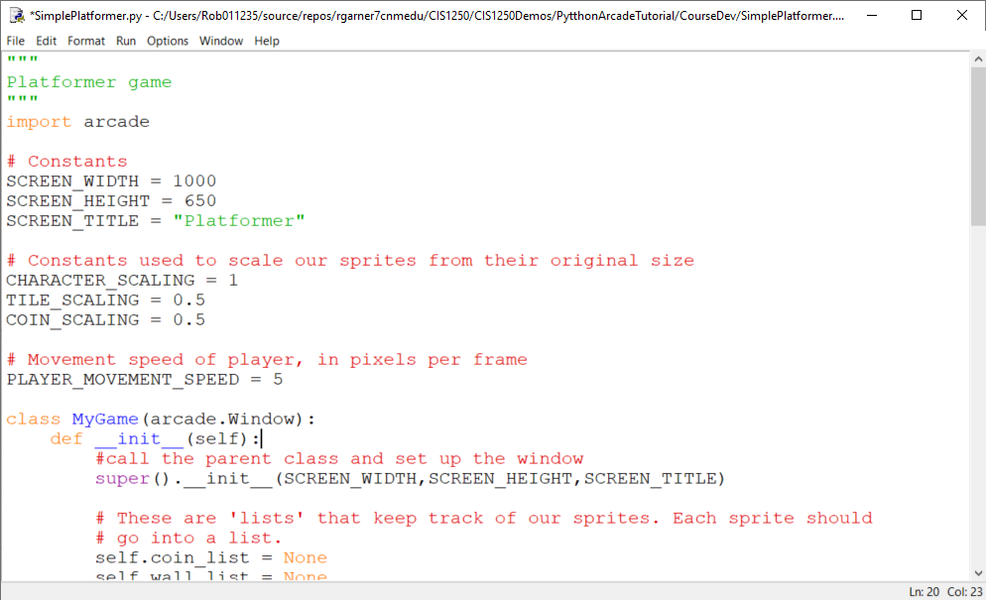
Add constants for player speed
Add constant for player movement speed

Slide 5
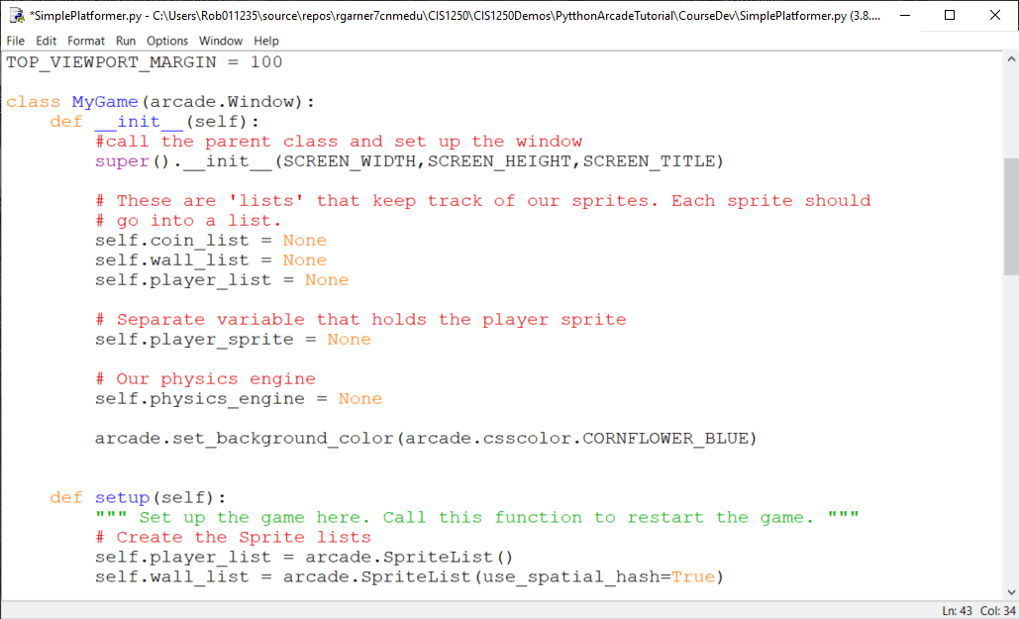
Add a physics engine in __init__
Add a physics engine in __init__

Slide 6
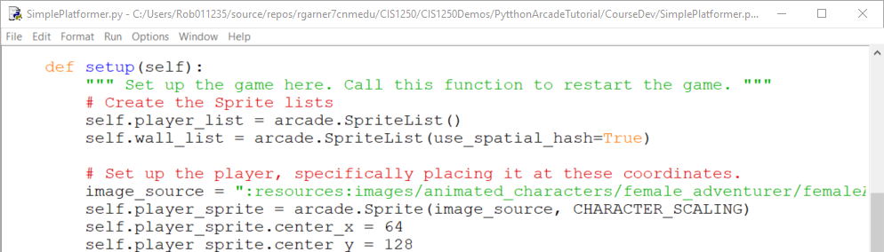
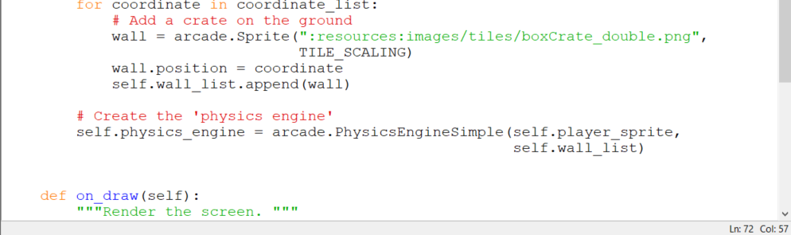
Add a physics engine to setup
Assign a physics engine in setup

Slide 7
Moving Sprites
Each sprite has center_x and center_y attributes.
Changing these will change the location of the sprite.
Each sprite has change_x and change_y variables.
These can be used to hold the velocity that the sprite is moving with.
We will adjust these based on what key the user hits.
If the user hits the right arrow key we want a positive value for change_x.
If the value is 5, it will move 5 pixels per frame.

Slide 8
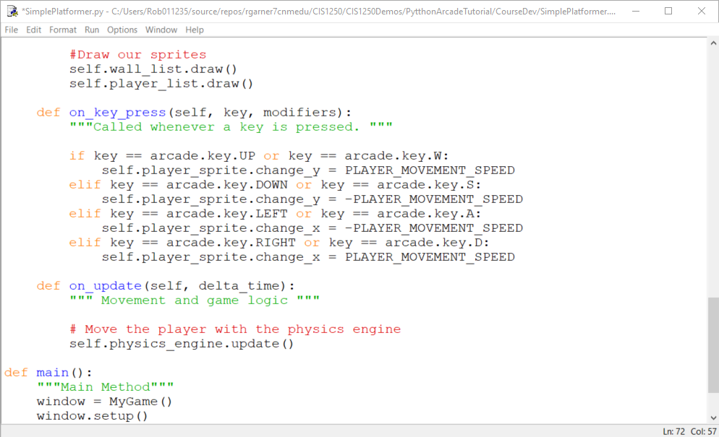
Add on_key_press and on_update
On_key_press responds to key presses.
On_update updates all moving objects each frame.

Slide 9
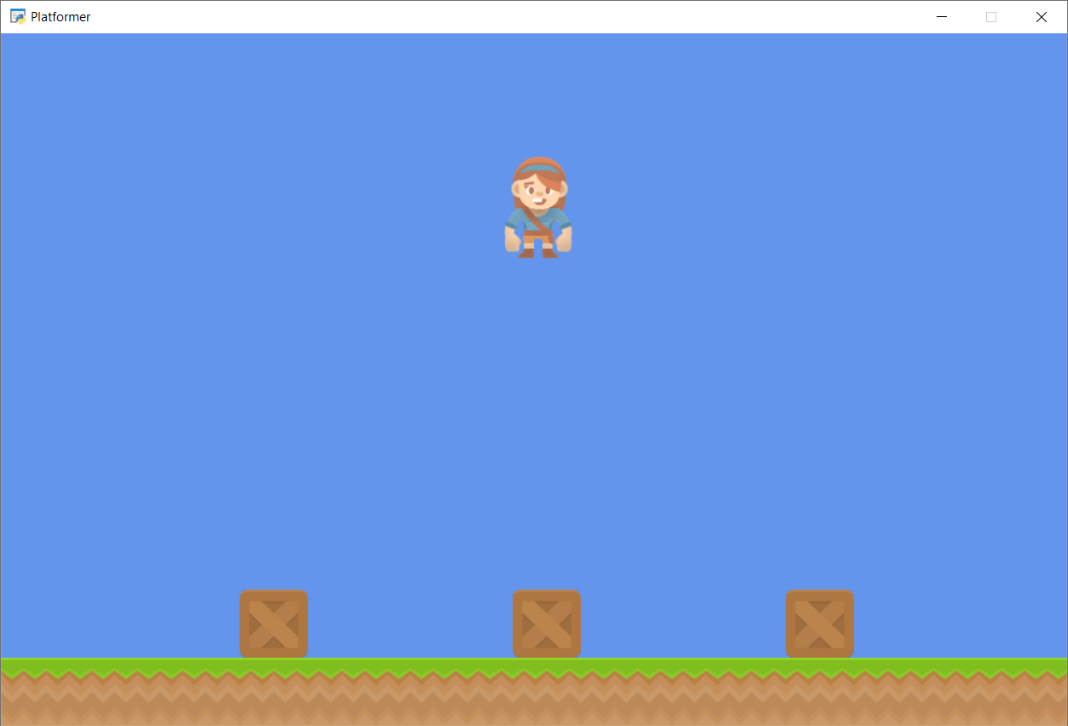
Run with F5
What went wrong?

Slide 10
Change_x and Change_y
Change_x and change_y will cause the player to keep moving every frame until we tell it to stop!
So the player moves continuously.
Also…
There is no gravity! So the player is flying!

Slide 11
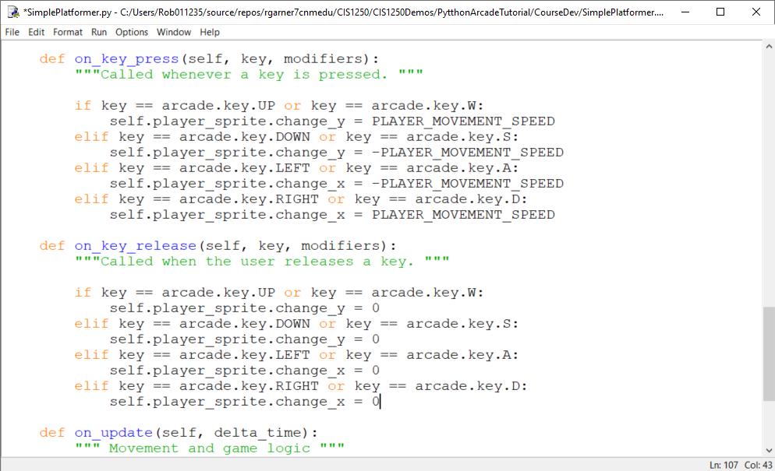
Add on_key_release
On_key_release responds when you let go of a key.

Slide 12
Run with F5
Character still flies but at least it stops when you let go of the key.

Slide 13
Why both a on_key_press as well as an on_key_release?
We often need to handle both on_key_press as well as on_key_release
It depends on how you want the game to behave.
It’s your game you can make it behave any way you want!
Next time you play a game ask yourself how the programmer may have set up the key presses.

Slide 14
Summary
Step 1 - Install and Open a Window
Step 2 - Add Sprites
Step 3 - Add User Control
Step 4 - Add Gravity
Step 5 - Add Scrolling
Step 6 - Add Coins And Sound
Step 7 - Display The Score
Step 8 - Use a Map Editor
Step 9 - Multiple Levels and Other Layers
Step 10 - Add Ladders, Properties, and a Moving Platform
Step 11 - Add Character Animations, and Better Keyboard Control

