Slide 1
Python Arcade
Instructor: Rob Garner
Based on tutorial at: https://arcade.academy/examples/platform_tutorial/index.html

Slide 2
Overview
Step 1 - Install and Open a Window
Step 2 - Add Sprites
Step 3 - Add User Control
Step 4 - Add Gravity
Step 5 - Add Scrolling
Step 6 - Add Coins And Sound
Step 7 - Display The Score
Step 8 - Use a Map Editor
Step 9 - Multiple Levels and Other Layers
Step 10 - Add Ladders, Properties, and a Moving Platform
Step 11 - Add Character Animations, and Better Keyboard Control

Slide 3
Step 5
Add Scrolling

Slide 4
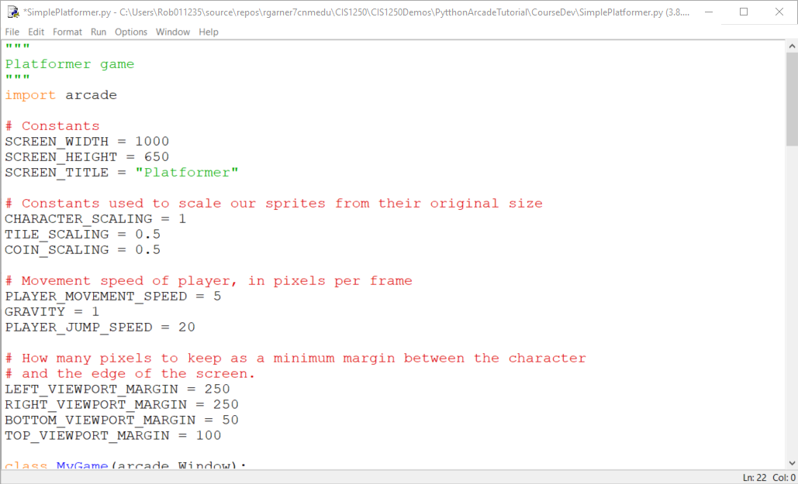
Add constants for viewport

Slide 5
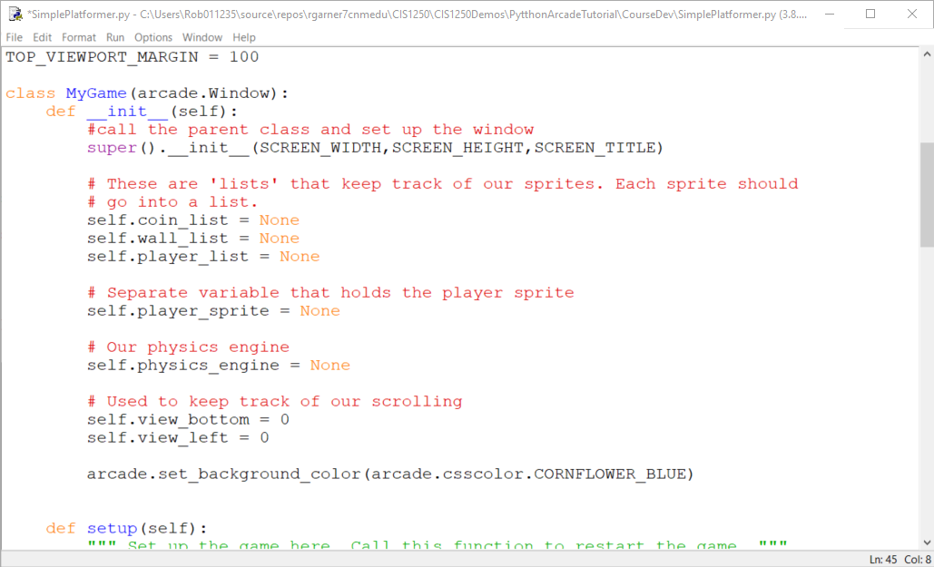
Add variables to keep track of scrolling

Slide 6
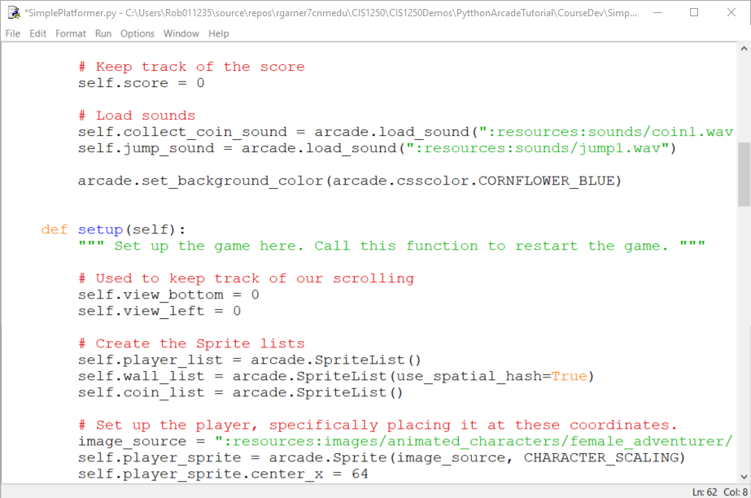
Add variables in setup as well to handle restarts

Slide 7
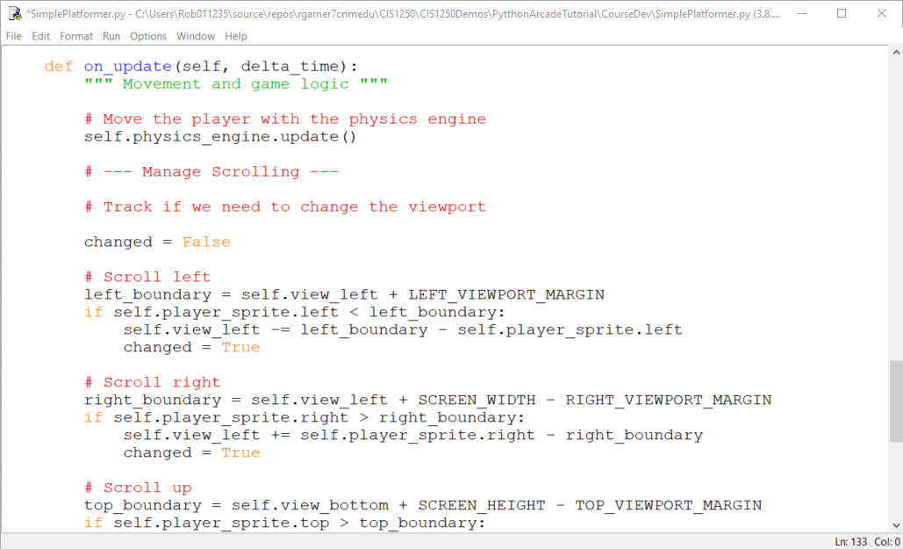
Add code to manage scrolling

Slide 8
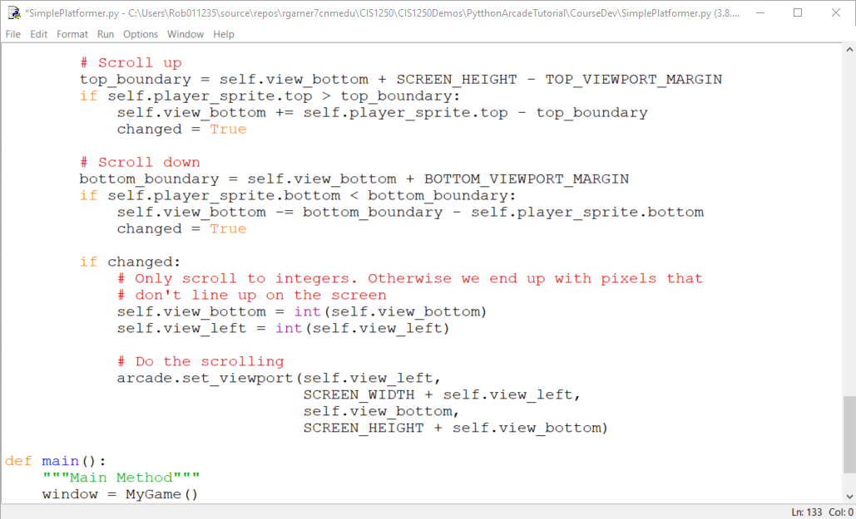
Remaining scrolling code

Slide 9
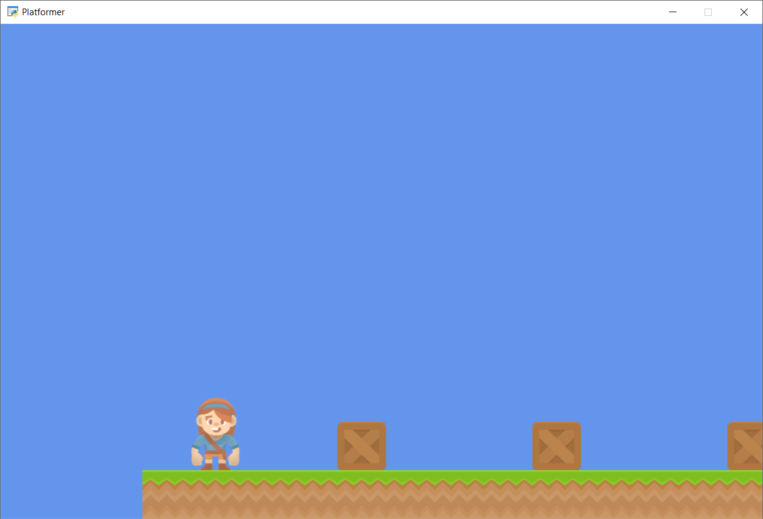
Run with F5
Navigate to the edge of the scene.

Slide 10
Summary
Step 1 - Install and Open a Window
Step 2 - Add Sprites
Step 3 - Add User Control
Step 4 - Add Gravity
Step 5 - Add Scrolling
Step 6 - Add Coins And Sound
Step 7 - Display The Score
Step 8 - Use a Map Editor
Step 9 - Multiple Levels and Other Layers
Step 10 - Add Ladders, Properties, and a Moving Platform
Step 11 - Add Character Animations, and Better Keyboard Control

