Slide 1
Python Arcade
Instructor: Rob Garner (rgarner7@cnm.edu)
Based on tutorial at: https://arcade.academy/examples/platform_tutorial/index.html

Slide 2
Overview
Step 1 - Install and Open a Window
Step 2 - Add Sprites
Step 3 - Add User Control
Step 4 - Add Gravity
Step 5 - Add Scrolling
Step 6 - Add Coins And Sound
Step 7 - Display The Score
Step 8 - Use a Map Editor
Step 9 - Multiple Levels and Other Layers
Step 10 - Add Ladders, Properties, and a Moving Platform
Step 11 - Add Character Animations, and Better Keyboard Control

Slide 3
Step 1
Install and Open a Window

Slide 4
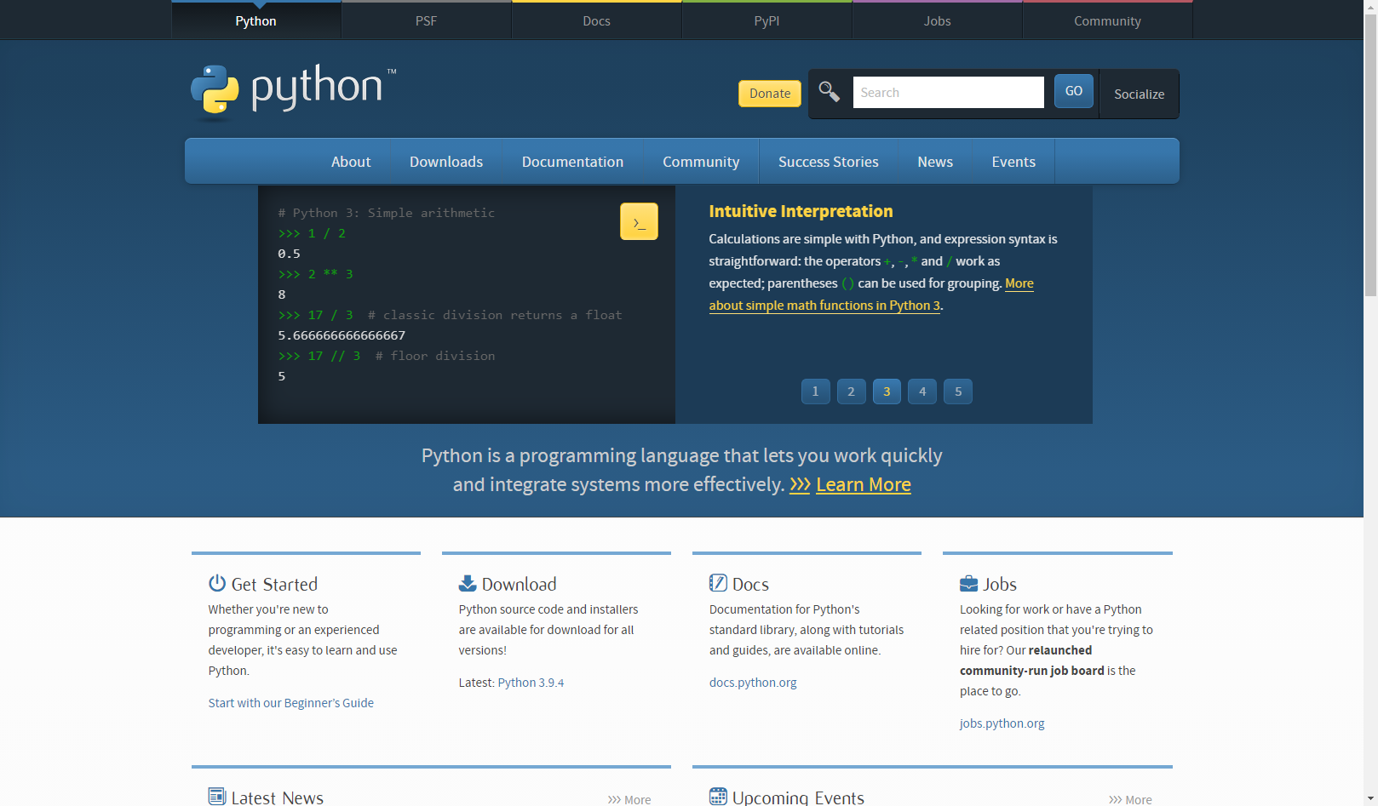
Installing Python
Workflow:
Go to www.python.org
Find the correct version for your machine (use Python 3.x).
Download
Install

Slide 5
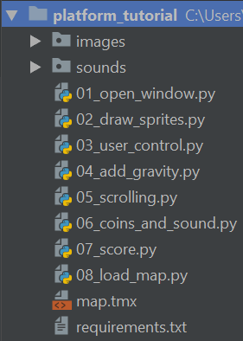
Download project bundls
Download and the zip file at: https://arcade.academy/_static/platform_tutorial.zip
Unzip it to a file on your drive.

Slide 6
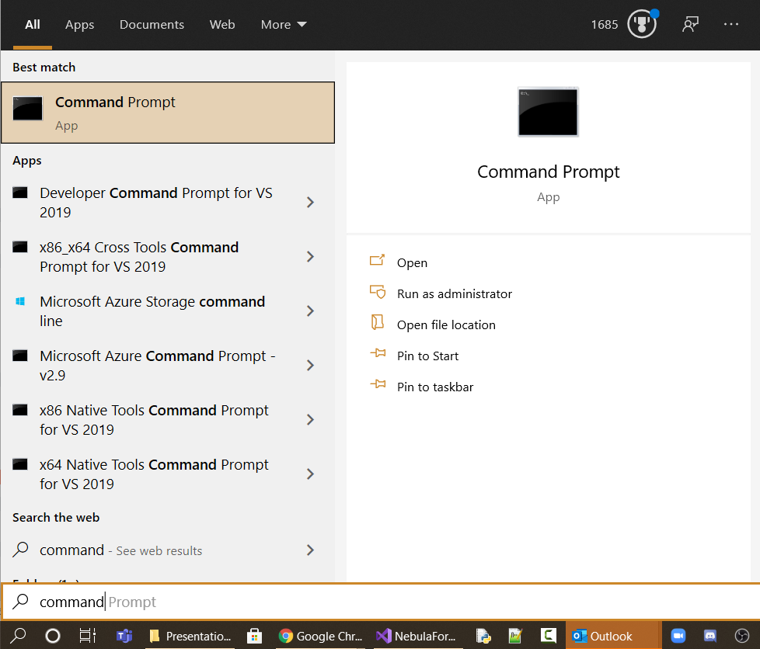
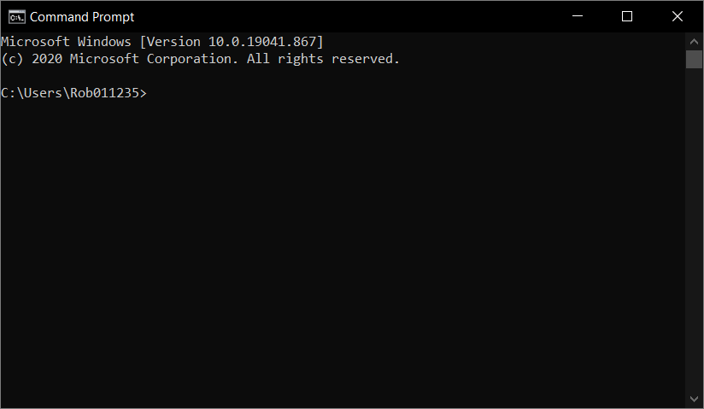
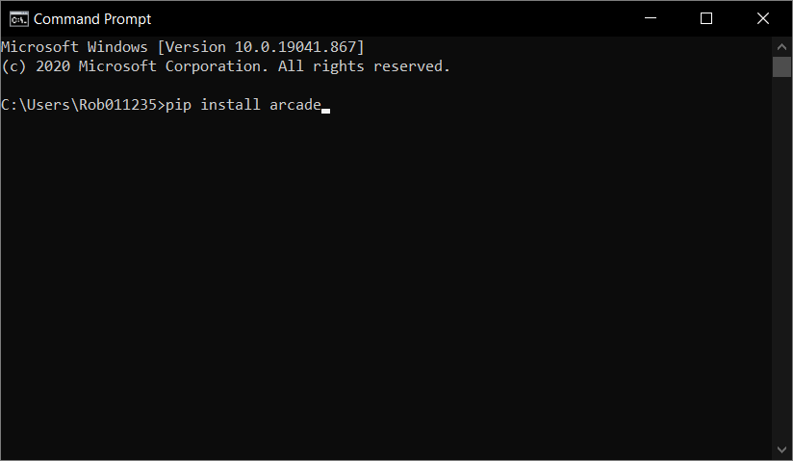
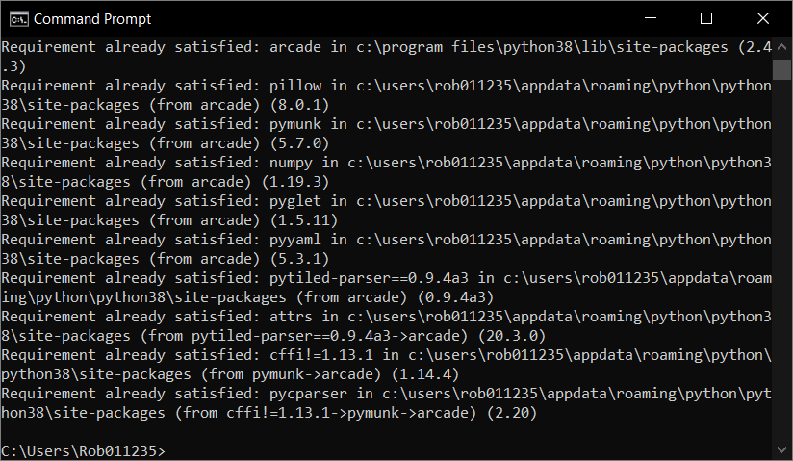
Install Arcade Library
Click Here
Search for command Prompt.
Search for “command prompt”
pip install arcade

Slide 7
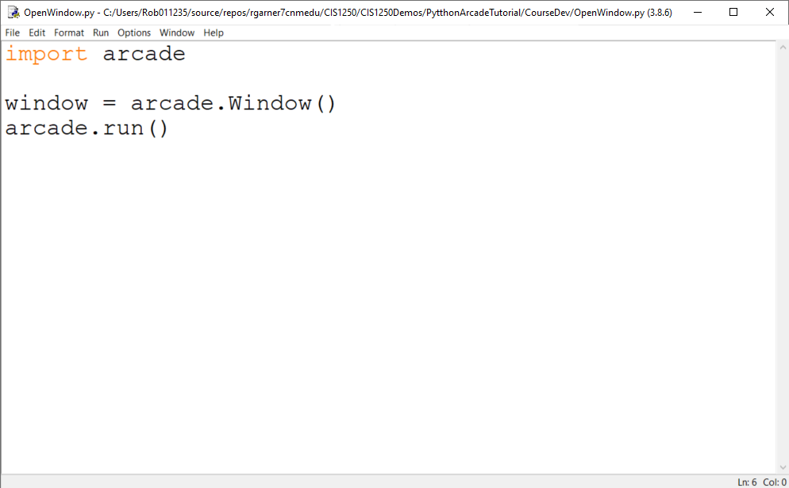
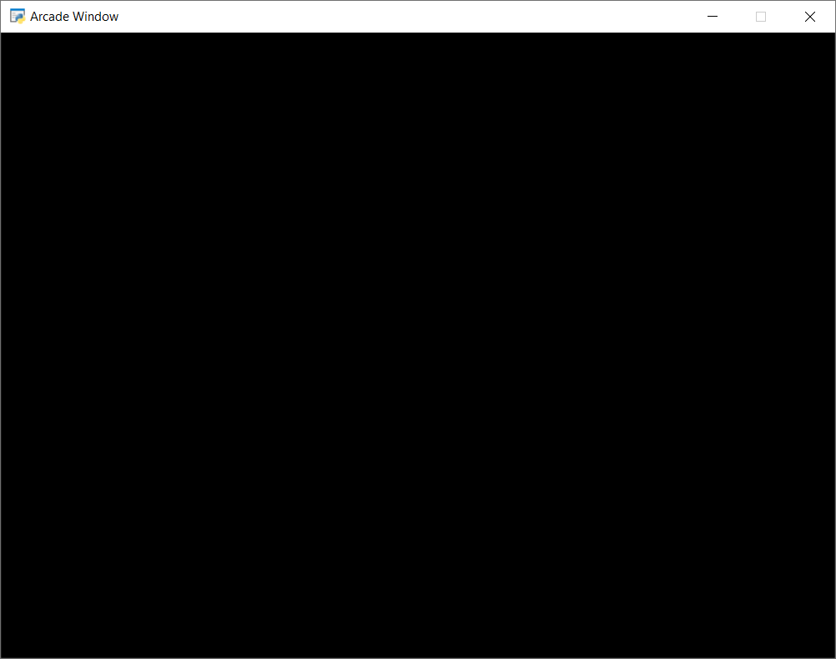
Open a Window
Type code and click F5 to run program.
Blank game window!

Slide 8
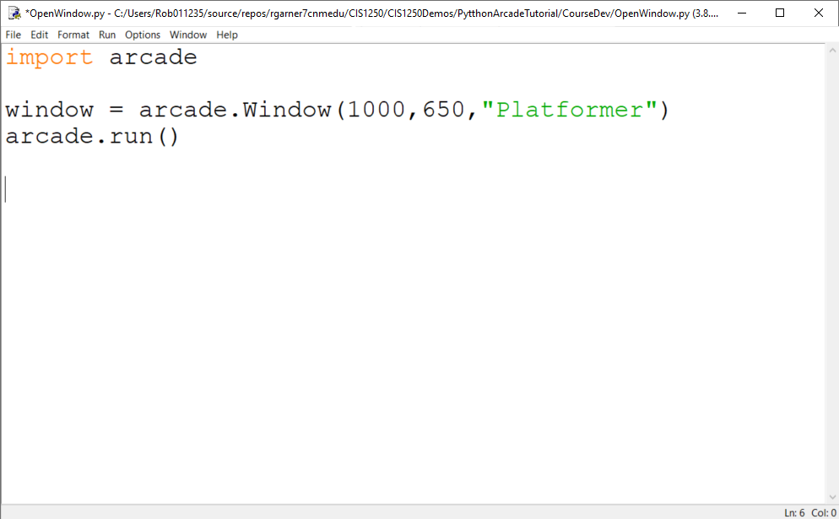
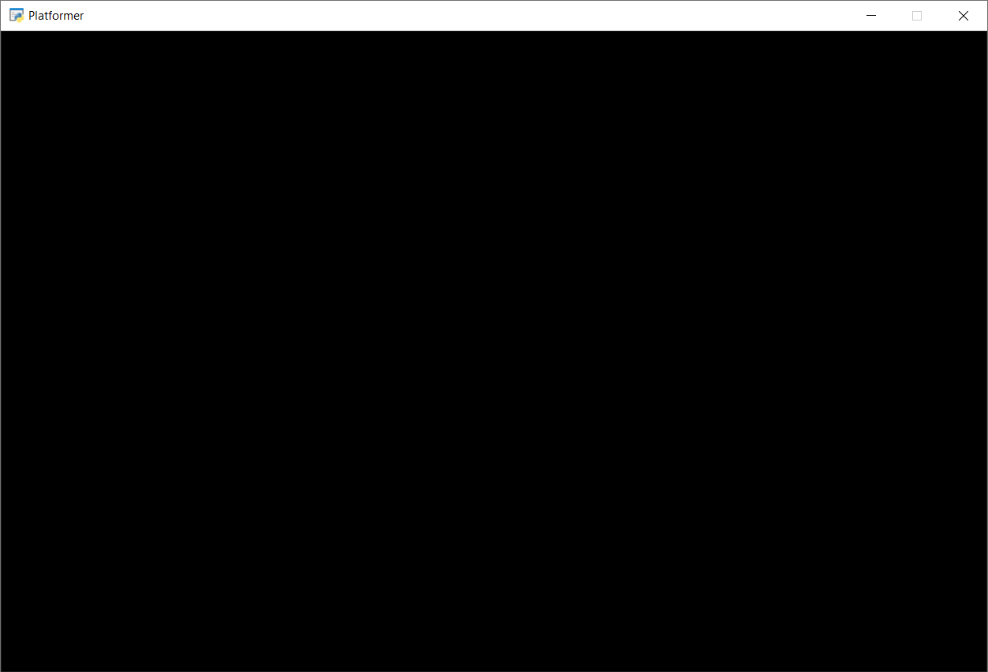
Set width, height and title
1000 pixels wide
Platformer
650 pixels

Slide 9
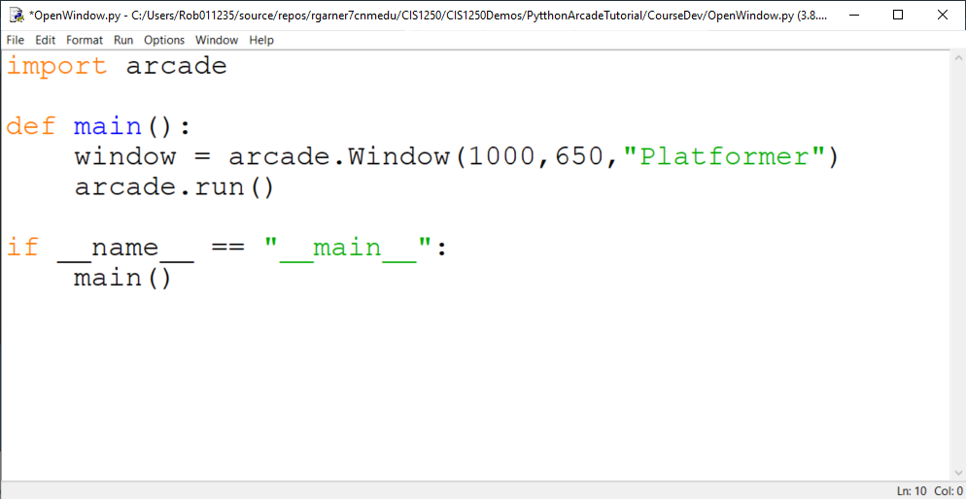
Put code in a main method
Still works!

Slide 10
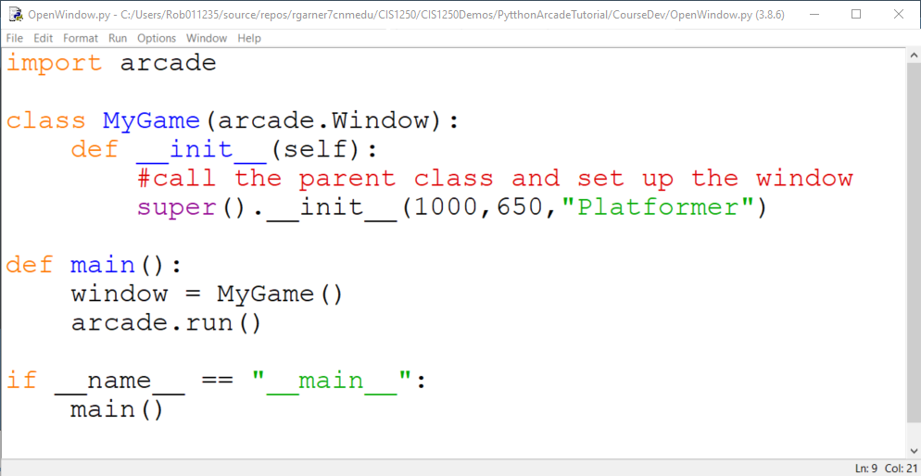
Put Code in a class
Window attributes are now here.
Still works!
“Instantiates” the MyGame class. Kind of like saying “Make MyGame please!”

Slide 11
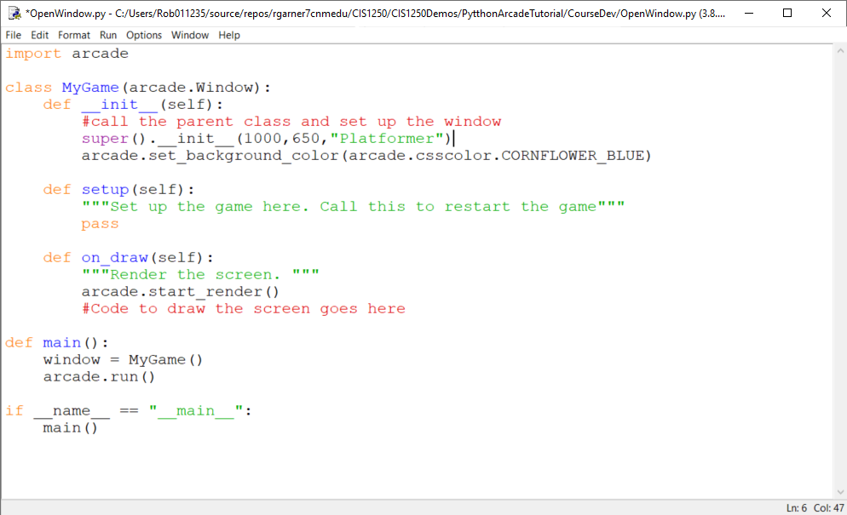
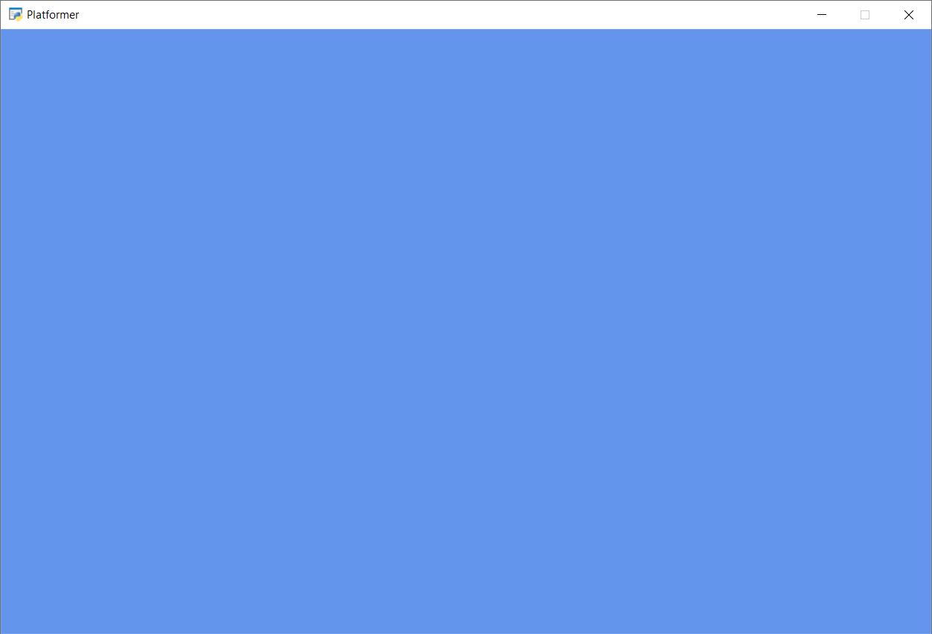
Add setup and on_draw
Blue Background!

Slide 12
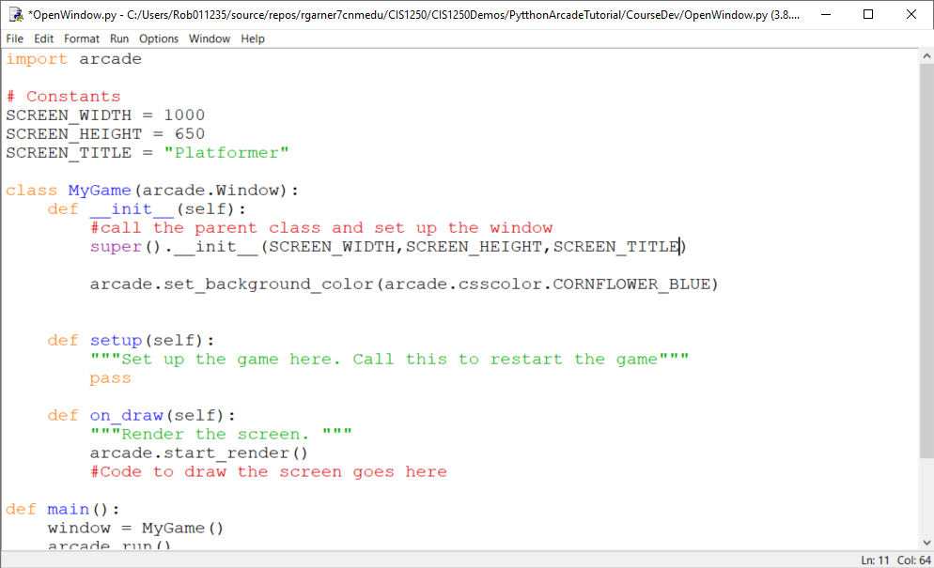
Move attributes to constants
Constants declared at top of program make it easier to change these things later if we want to.

Slide 13
Why both Setup and __init__?
__init__ is used to create and initialize variables
Setup is used to restart the game

Slide 14
Summary
Step 1 - Install and Open a Window
Step 2 - Add Sprites
Step 3 - Add User Control
Step 4 - Add Gravity
Step 5 - Add Scrolling
Step 6 - Add Coins And Sound
Step 7 - Display The Score
Step 8 - Use a Map Editor
Step 9 - Multiple Levels and Other Layers
Step 10 - Add Ladders, Properties, and a Moving Platform
Step 11 - Add Character Animations, and Better Keyboard Control

