Slide 1
Python Arcade
Instructor: Rob Garner (rgarner7@cnm.edu)
Based on tutorial at: https://arcade.academy/examples/platform_tutorial/index.html

Slide 2
Overview
Step 1 - Install and Open a Window
Step 2 - Add Sprites
Step 3 - Add User Control
Step 4 - Add Gravity
Step 5 - Add Scrolling
Step 6 - Add Coins And Sound
Step 7 - Display The Score
Step 8 - Use a Map Editor
Step 9 - Multiple Levels and Other Layers
Step 10 - Add Ladders, Properties, and a Moving Platform
Step 11 - Add Character Animations, and Better Keyboard Control

Slide 3
Step 4
Add Gravity

Slide 4
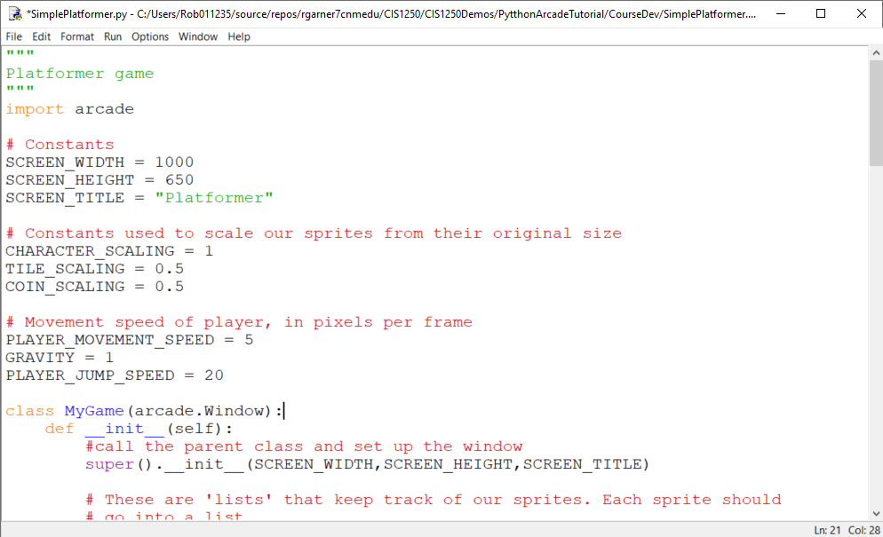
Add constants for gravity and jump speed.
Add constants for gravity and jump speed.

Slide 5
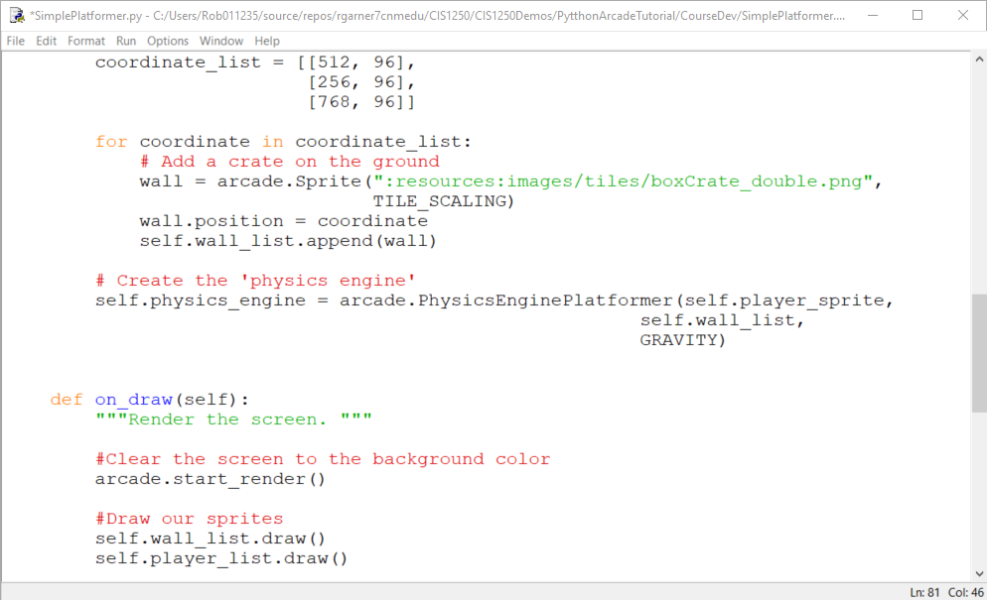
Change physics engine
Change to PhysicsEnginePlatformer
Add GRAVITY to physics engine.

Slide 6
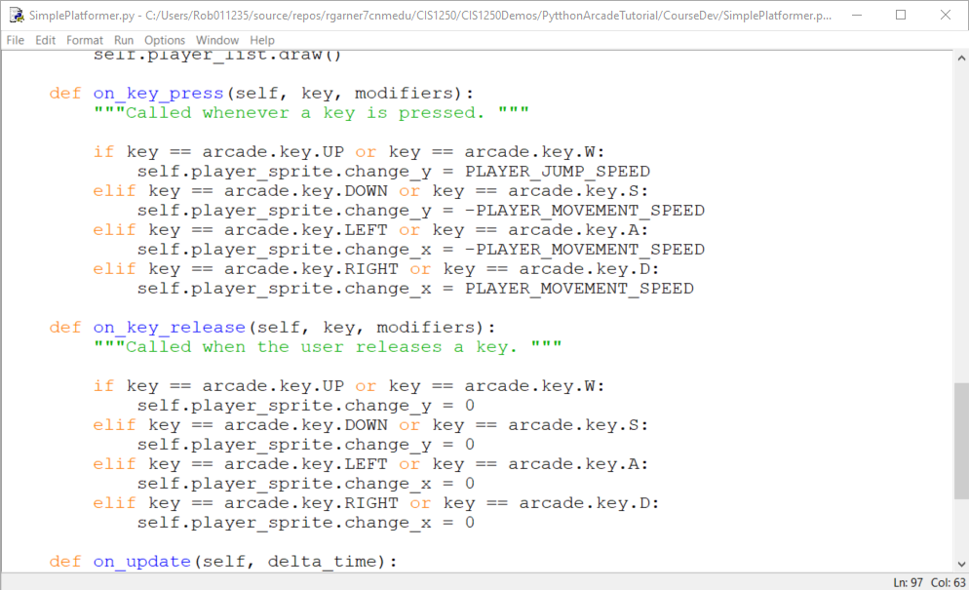
Change W to use jump speed
Change to PLAYER_JUMP_SPEED

Slide 7
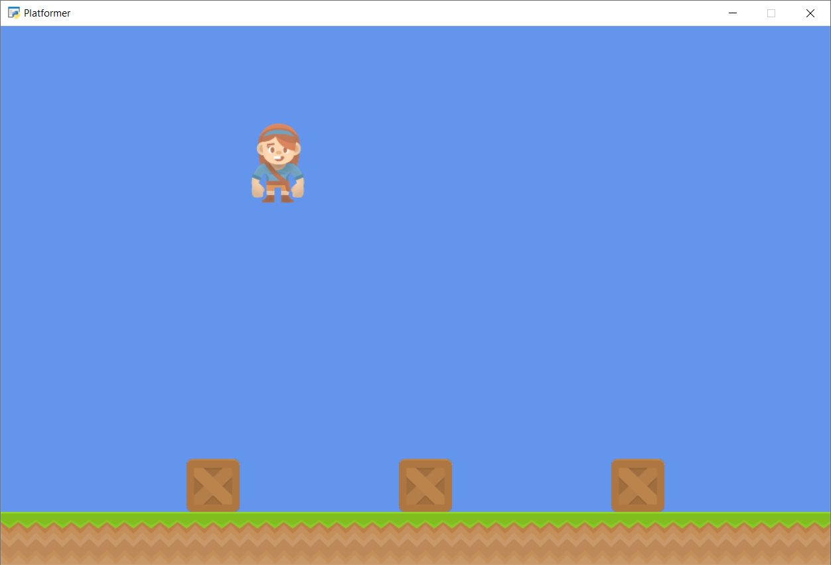
Run with F5
What game is that like?
Character now falls but what happens if we hit W multiple times?

Slide 8
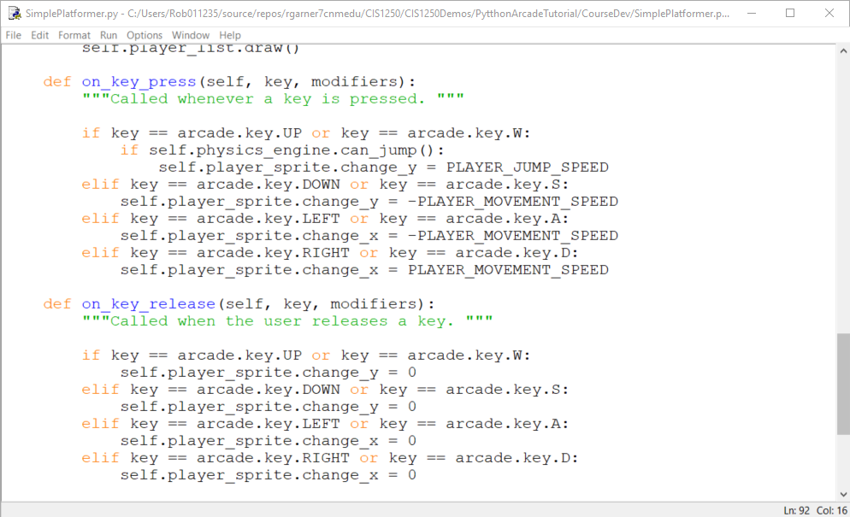
Add a check of can_jump()
Add an if statement to check if can_jump()

Slide 9
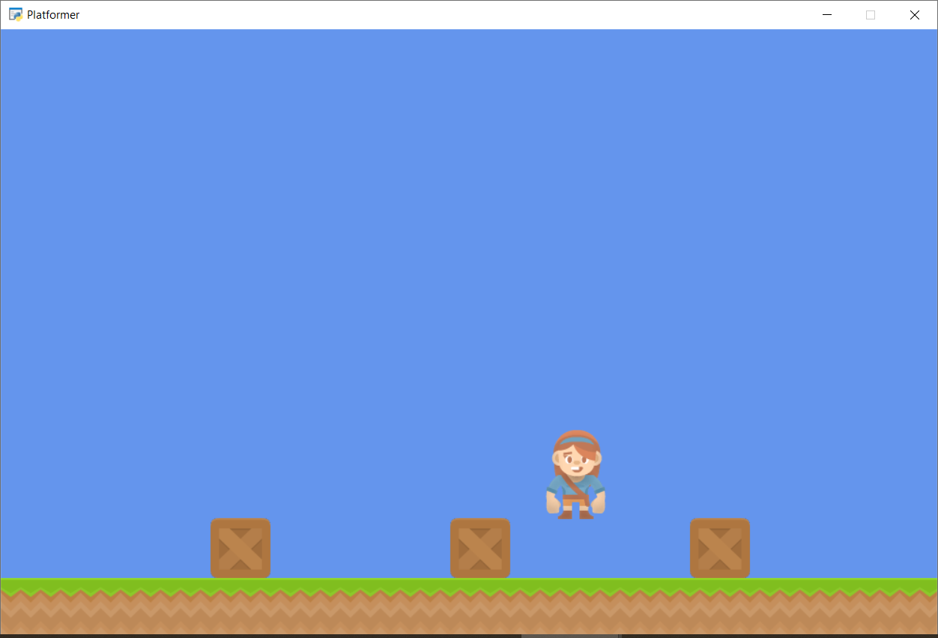
physics_engine.can_jump()
What does physics_engine.can_jump() mean?
What happens now if we hit W multiple times?

Slide 10
can_jump() is true if player is in contact with ground!
Checks to see if player is in contact with the ground!

Slide 11
Summary
Step 1 - Install and Open a Window
Step 2 - Add Sprites
Step 3 - Add User Control
Step 4 - Add Gravity
Step 5 - Add Scrolling
Step 6 - Add Coins And Sound
Step 7 - Display The Score
Step 8 - Use a Map Editor
Step 9 - Multiple Levels and Other Layers
Step 10 - Add Ladders, Properties, and a Moving Platform
Step 11 - Add Character Animations, and Better Keyboard Control

