Slide 1
Python Arcade
Instructor: Rob Garner (rgarner7@cnm.edu)
Based on tutorial at: https://arcade.academy/examples/platform_tutorial/index.html

Slide 2
Overview
Step 1 - Install and Open a Window
Step 2 - Add Sprites
Step 3 - Add User Control
Step 4 - Add Gravity
Step 5 - Add Scrolling
Step 6 - Add Coins And Sound
Step 7 - Display The Score
Step 8 - Use a Map Editor
Step 9 - Multiple Levels and Other Layers
Step 10 - Add Ladders, Properties, and a Moving Platform
Step 11 - Add Character Animations, and Better Keyboard Control

Slide 3
Step 6
Add Coins And Sound

Slide 4
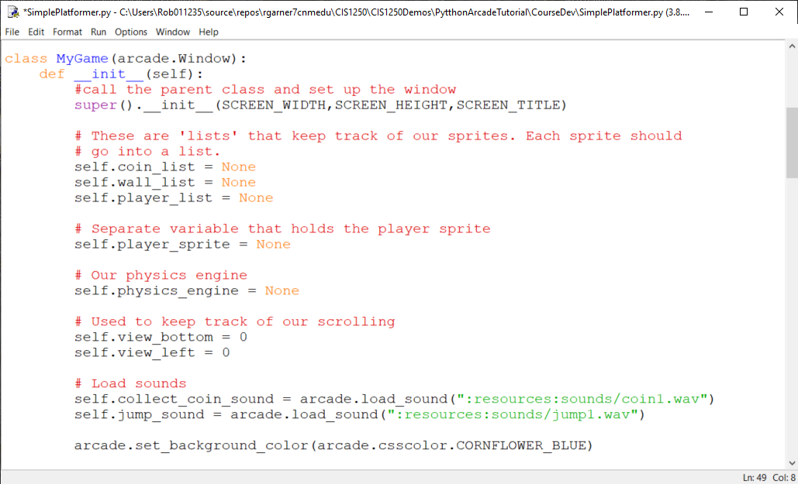
Add sounds to __init__ method
Use arcade.load_sound(…)

Slide 5
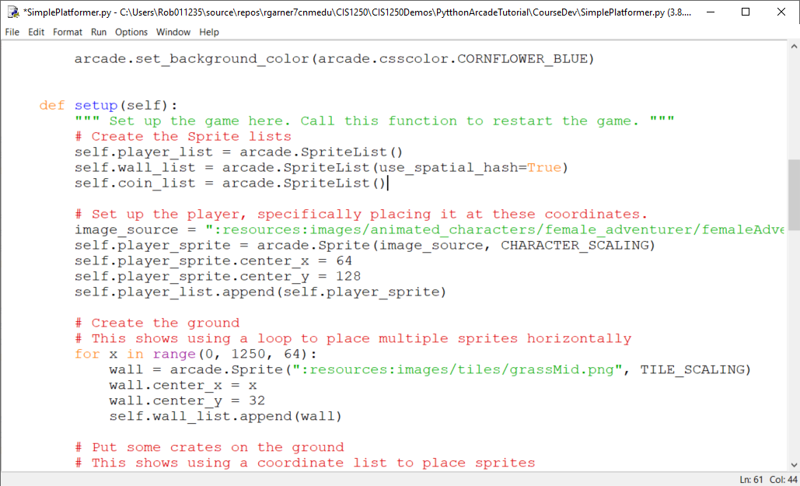
Add a SpriteList for coins in Setup
Add a SpriteList for coins.

Slide 6
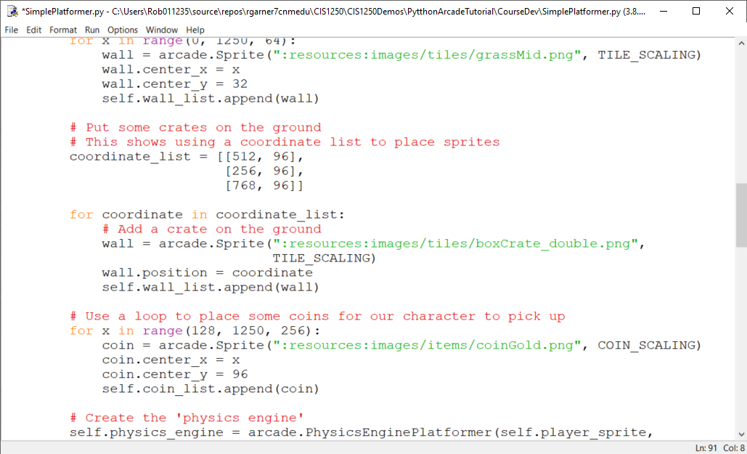
Place coins
Use a for loop to place coins.

Slide 7
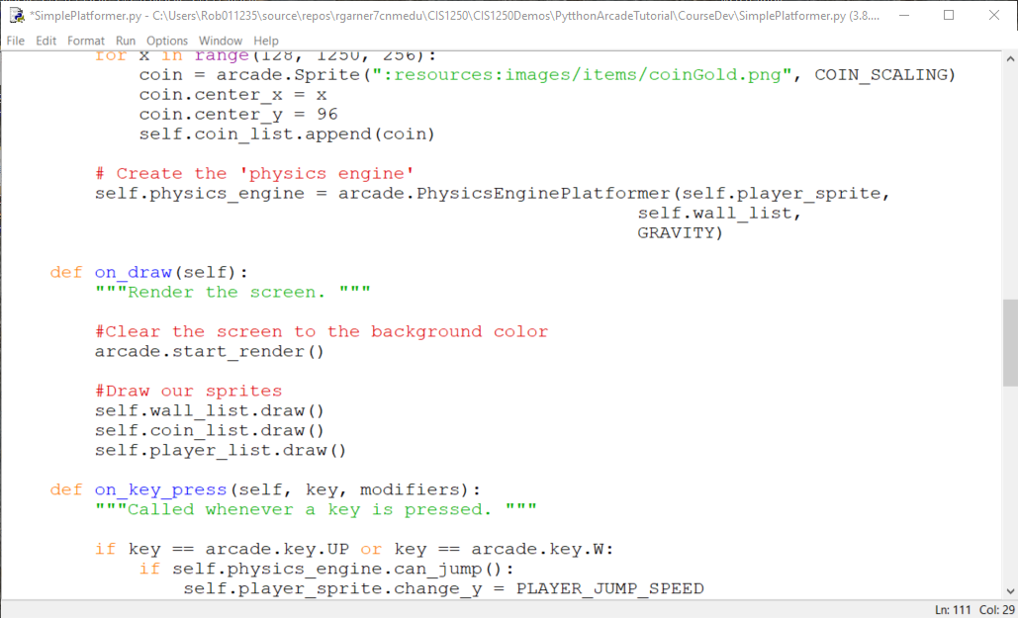
Draw coin list
Add a draw command.

Slide 8
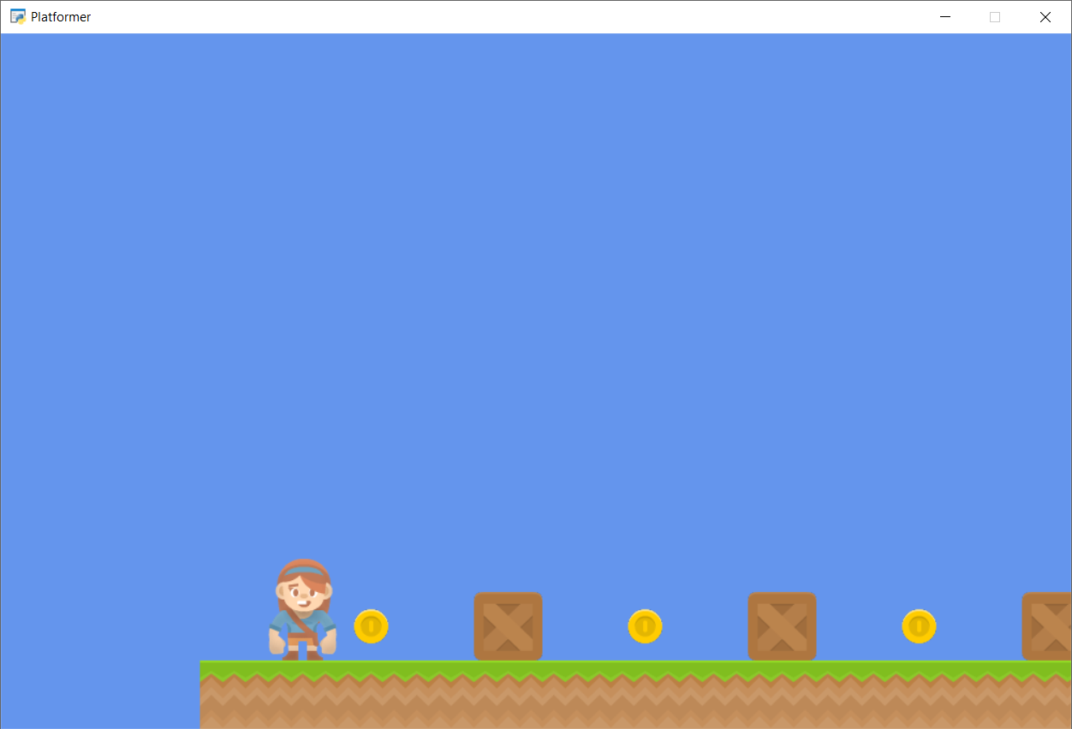
Run with F5
Coins!

Slide 9
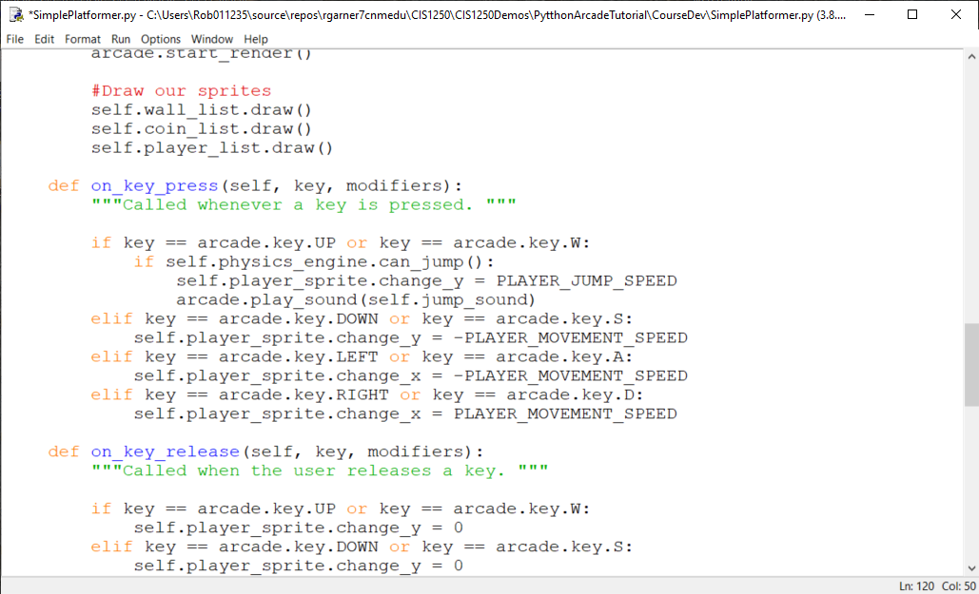
Add sound when player jumps
Add a call to play sound.

Slide 10
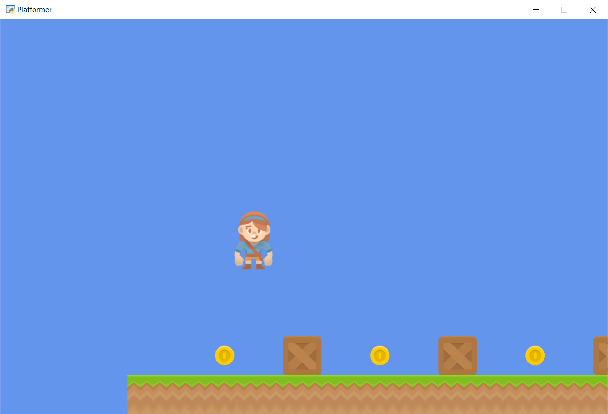

Run with F5
Jumping should make sound!

Slide 11
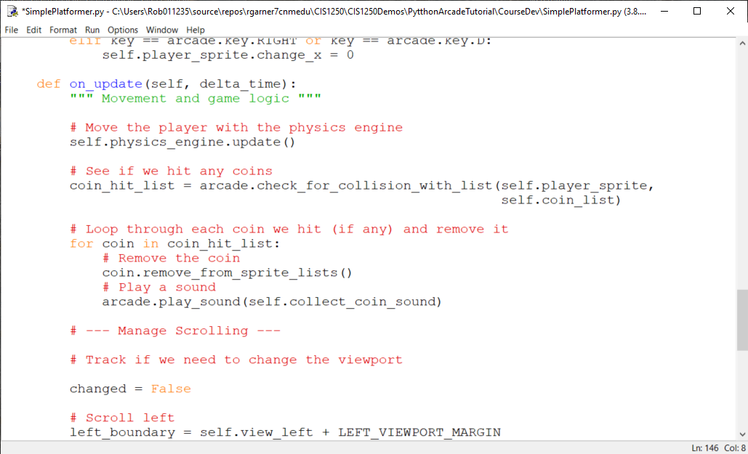
Check to see if we hit coins in update method.
Check to see if we hit coin by using check_for_collision_with_list method.
Play sound if hit coin.

Slide 12
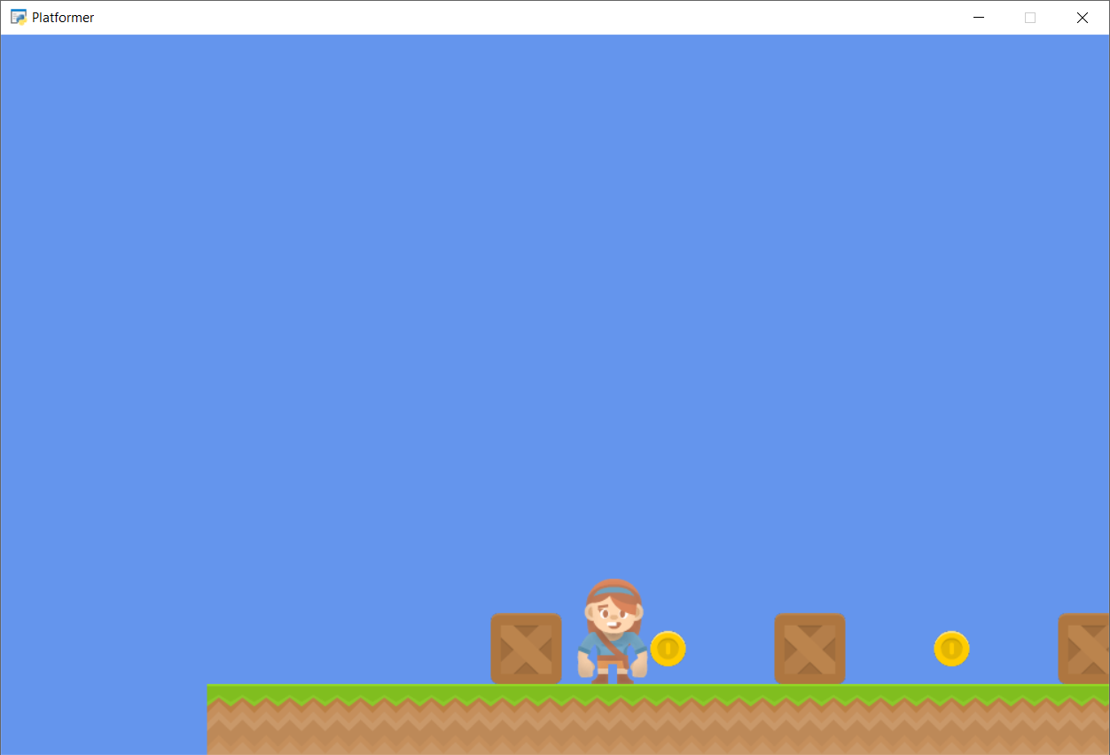
Run with F5
Going over coins makes sound.

Slide 13
Summary
Step 1 - Install and Open a Window
Step 2 - Add Sprites
Step 3 - Add User Control
Step 4 - Add Gravity
Step 5 - Add Scrolling
Step 6 - Add Coins And Sound
Step 7 - Display The Score
Step 8 - Use a Map Editor
Step 9 - Multiple Levels and Other Layers
Step 10 - Add Ladders, Properties, and a Moving Platform
Step 11 - Add Character Animations, and Better Keyboard Control

