Slide 1
Python Arcade
Instructor: Rob Garner (rgarner7@cnm.edu)
Based on tutorial at: https://arcade.academy/examples/platform_tutorial/index.html

Slide 2
Overview
Step 1 - Install and Open a Window
Step 2 - Add Sprites
Step 3 - Add User Control
Step 4 - Add Gravity
Step 5 - Add Scrolling
Step 6 - Add Coins And Sound
Step 7 - Display The Score
Step 8 - Use a Map Editor
Step 9 - Multiple Levels and Other Layers
Step 10 - Add Ladders, Properties, and a Moving Platform
Step 11 - Add Character Animations, and Better Keyboard Control

Slide 3
Step 7
Display The Score

Slide 4
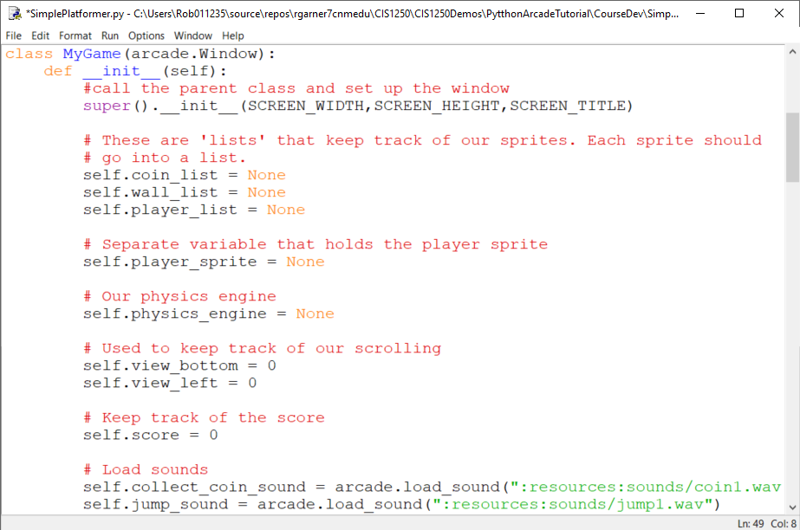
Add variable to keep score in __init__
Add self.score to keep track of score.

Slide 5
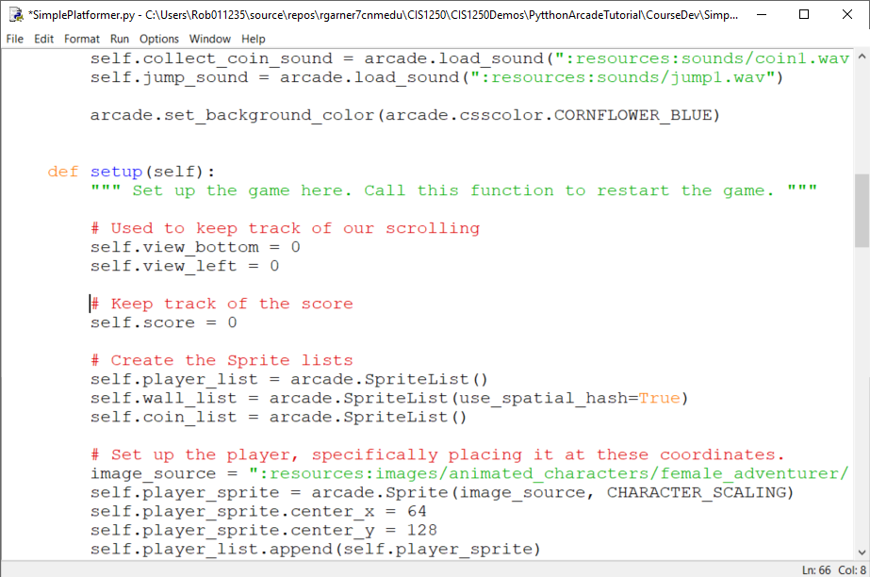
Add variable to keep score in setup as well
Add self.score to keep track of score.

Slide 6
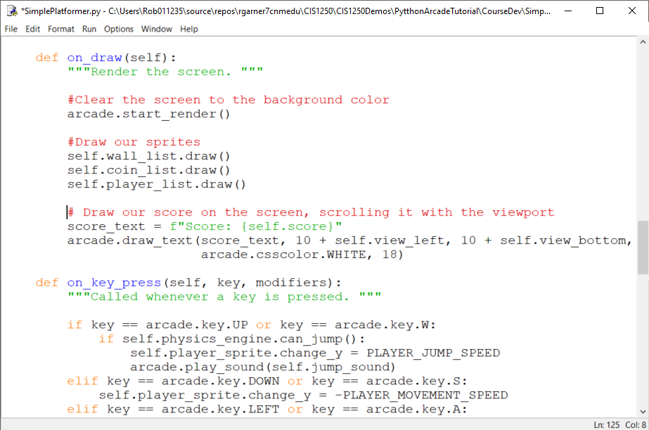
Draw the score on the screen
Use draw_text

Slide 7
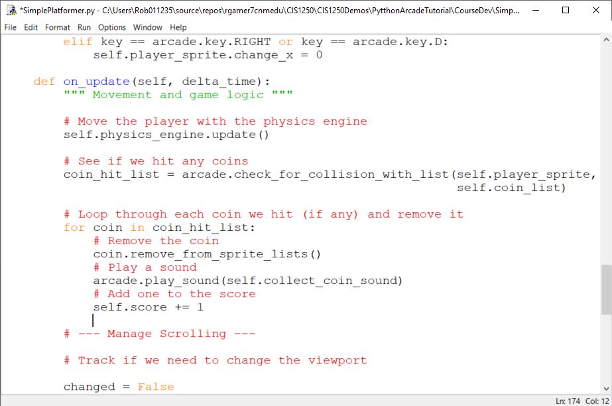
Increment score when player collides with coin.
Increment score

Slide 8
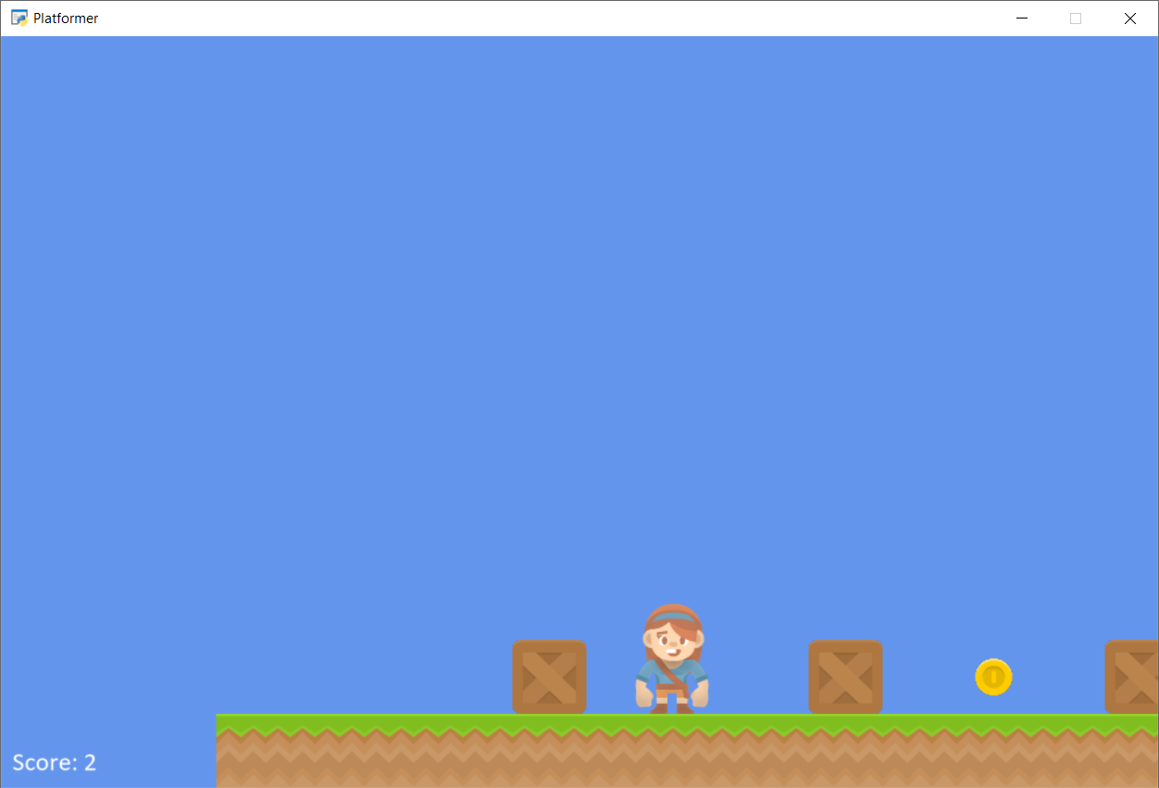
Score Displayed

Slide 9
Summary
Step 1 - Install and Open a Window
Step 2 - Add Sprites
Step 3 - Add User Control
Step 4 - Add Gravity
Step 5 - Add Scrolling
Step 6 - Add Coins And Sound
Step 7 - Display The Score
Step 8 - Use a Map Editor
Step 9 - Multiple Levels and Other Layers
Step 10 - Add Ladders, Properties, and a Moving Platform
Step 11 - Add Character Animations, and Better Keyboard Control

