Slide 1
Python Arcade
Instructor: Rob Garner (rgarner7@cnm.edu)
Based on tutorial at: https://arcade.academy/examples/platform_tutorial/index.html

Slide 2
Overview
Step 1 - Install and Open a Window
Step 2 - Add Sprites
Step 3 - Add User Control
Step 4 - Add Gravity
Step 5 - Add Scrolling
Step 6 - Add Coins And Sound
Step 7 - Display The Score
Step 8 - Use a Map Editor
Step 9 - Multiple Levels and Other Layers
Step 10 - Add Ladders, Properties, and a Moving Platform
Step 11 - Add Character Animations, and Better Keyboard Control

Slide 3
Step 8
Use a Map Editor

Slide 4
Create a Map File
For this part, we’ll restart with a new program.
Instead of placing our tiles by code, we’ll use a map editor.
Download and install the Tiled Map Editor.
https://www.mapeditor.org/

Slide 5
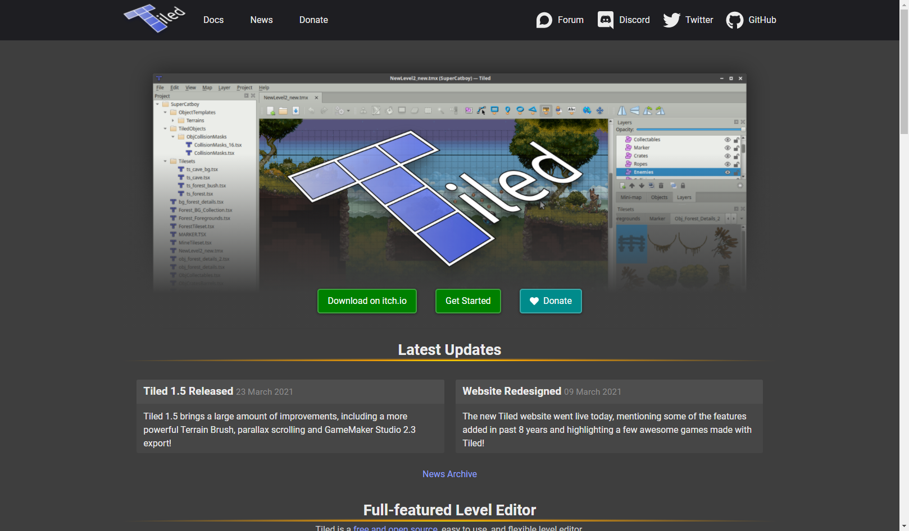
Click on Download link
Click Here

Slide 6
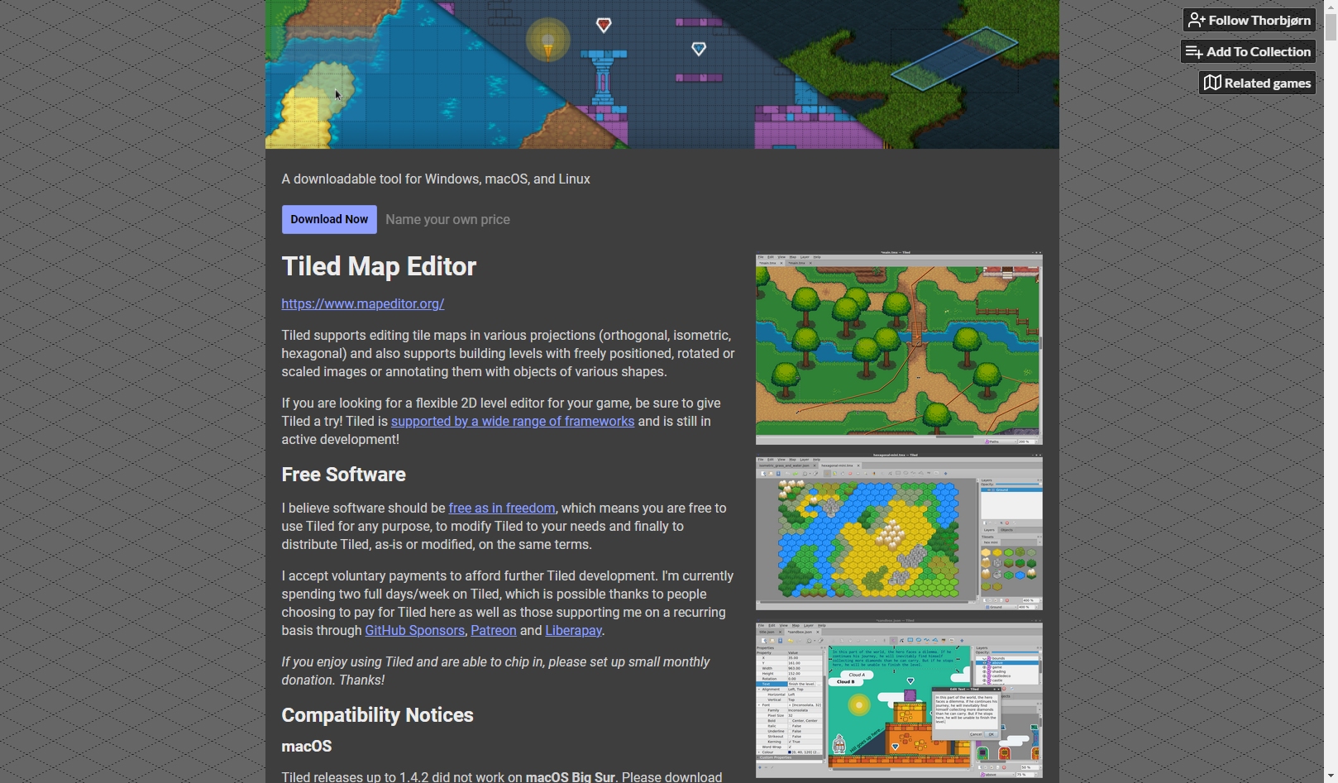
Click on Download link
Click Here

Slide 7
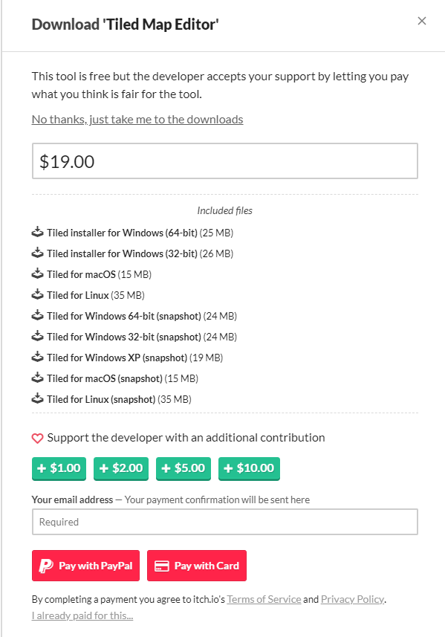
Donation is optional
Click here to try for free.

Slide 8
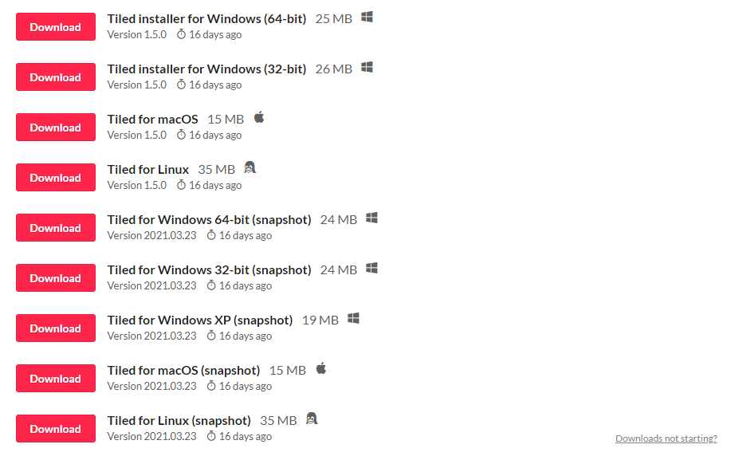
Select appropriate version for your machine.

Slide 9
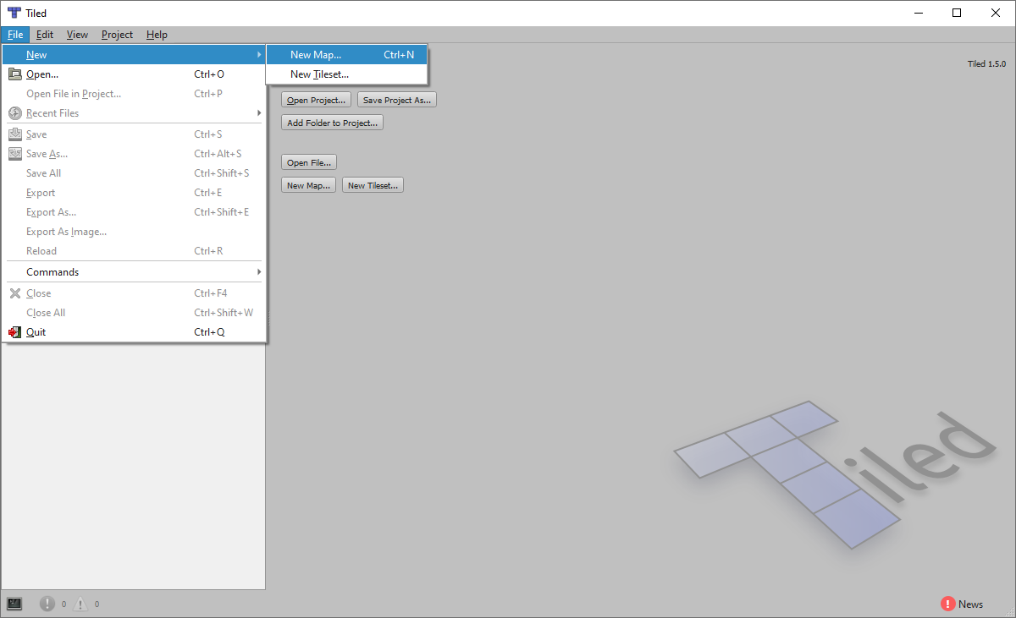
Click File -> New Map
Click here New Map

Slide 10
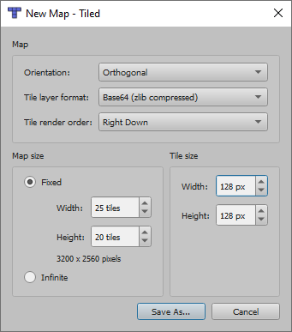
Enter configuration and click Save As
Click here

Slide 11
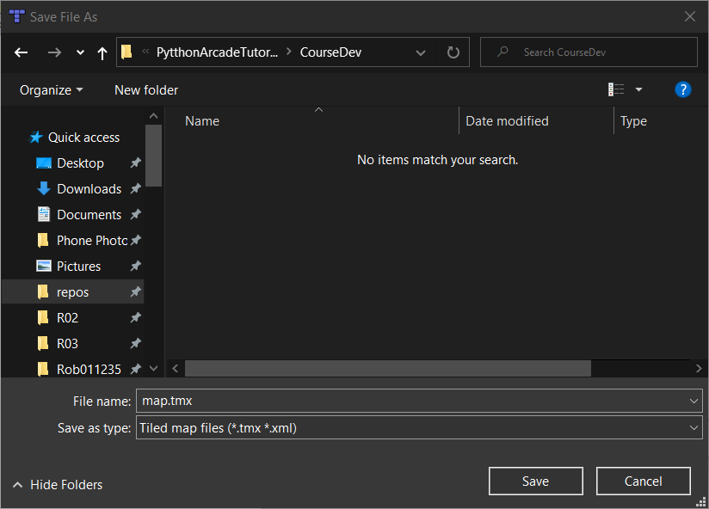
Save as map.tmx

Slide 12
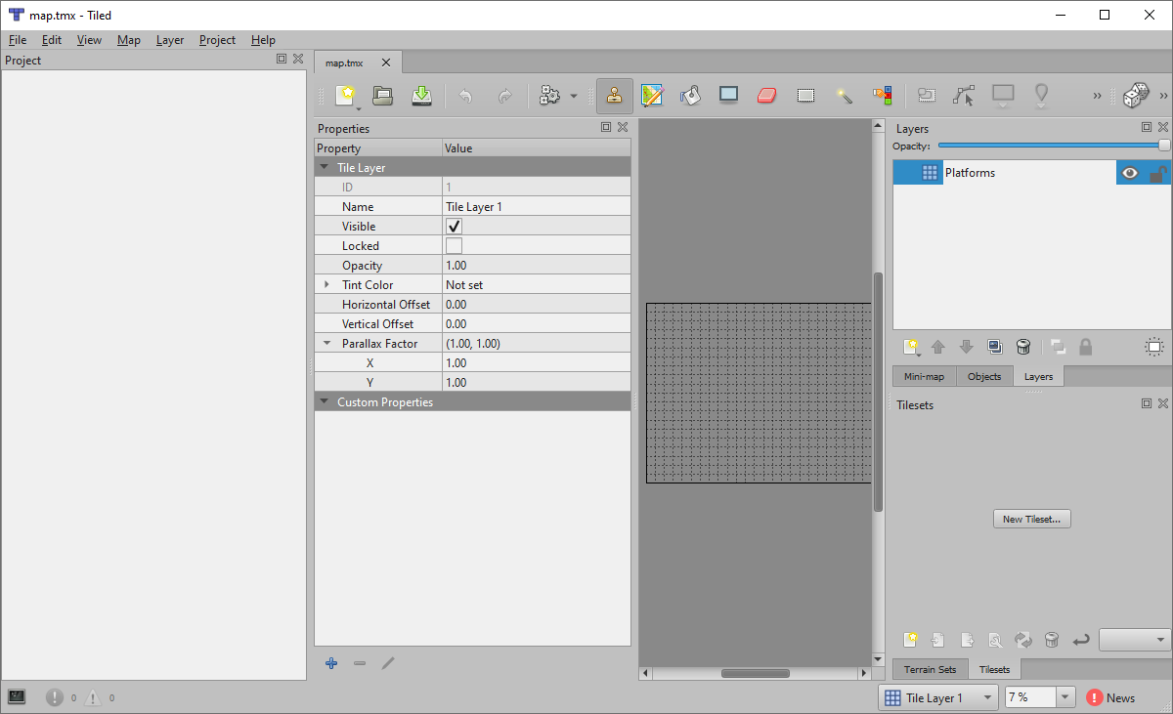
Change to Platforms
Click on New Tileset

Slide 13
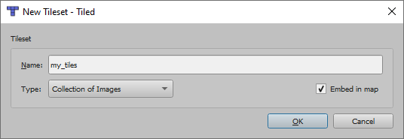
Set Name, Type and Embed in Map

Slide 14
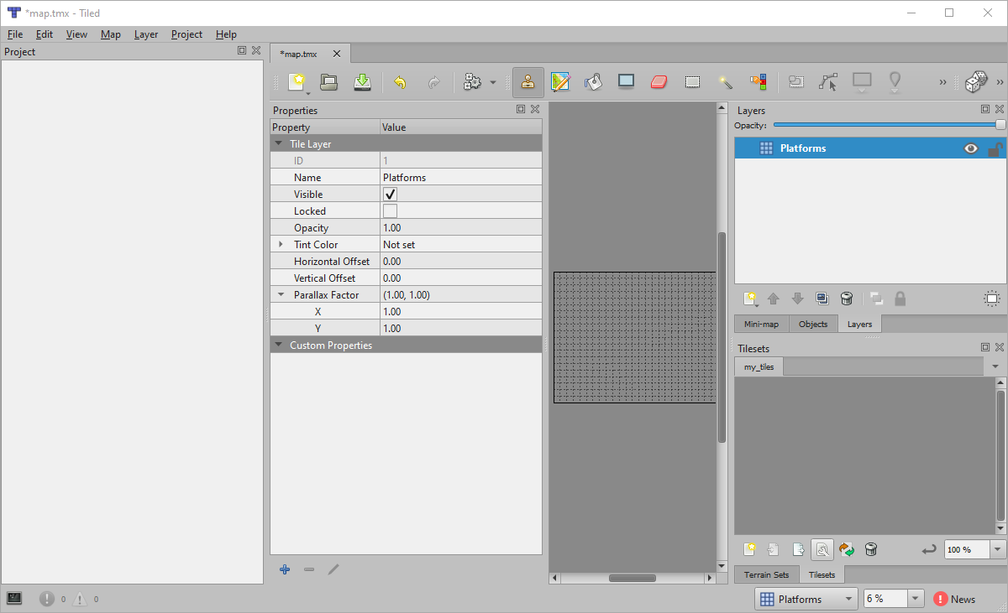
Click on the wrench icon
Click on wrench

Slide 15
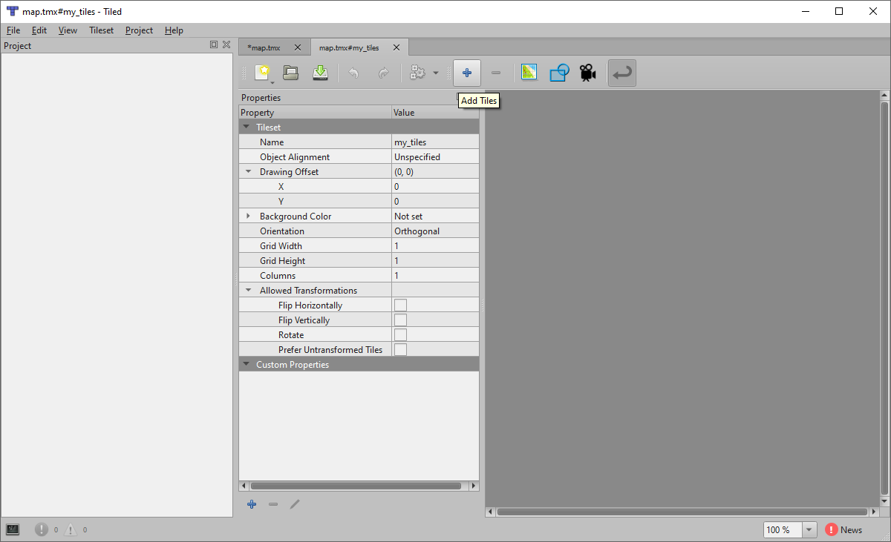
Add Tiles
Click on Add Tiles

Slide 16
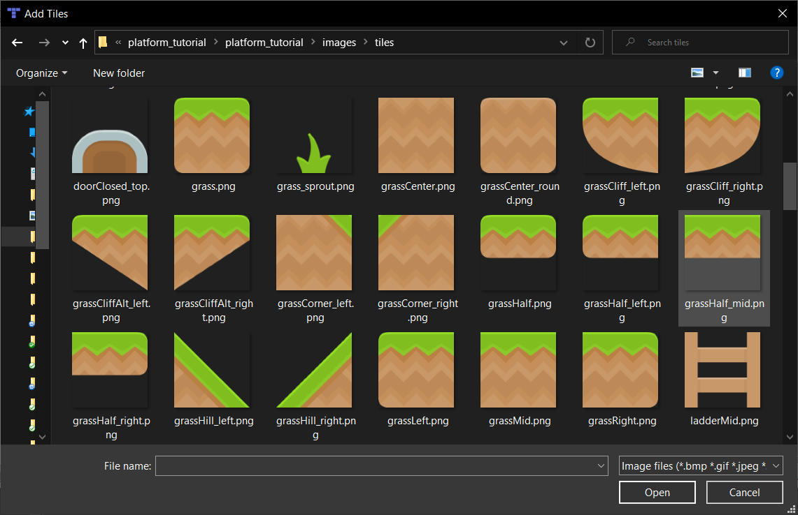
Navigate to downloaded image and pick images you want
Pick some tiles

Slide 17
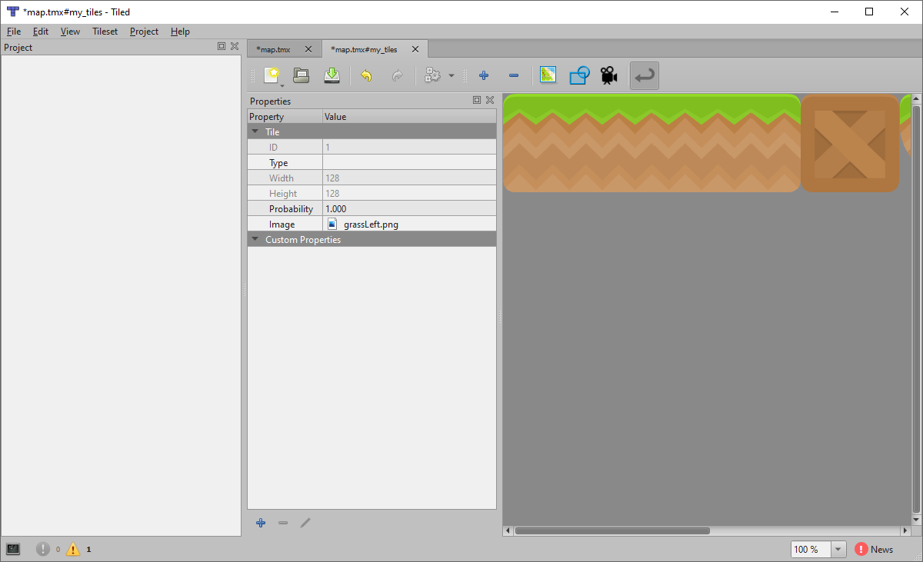
Add tiles you want to use
Tiles end up here

Slide 18
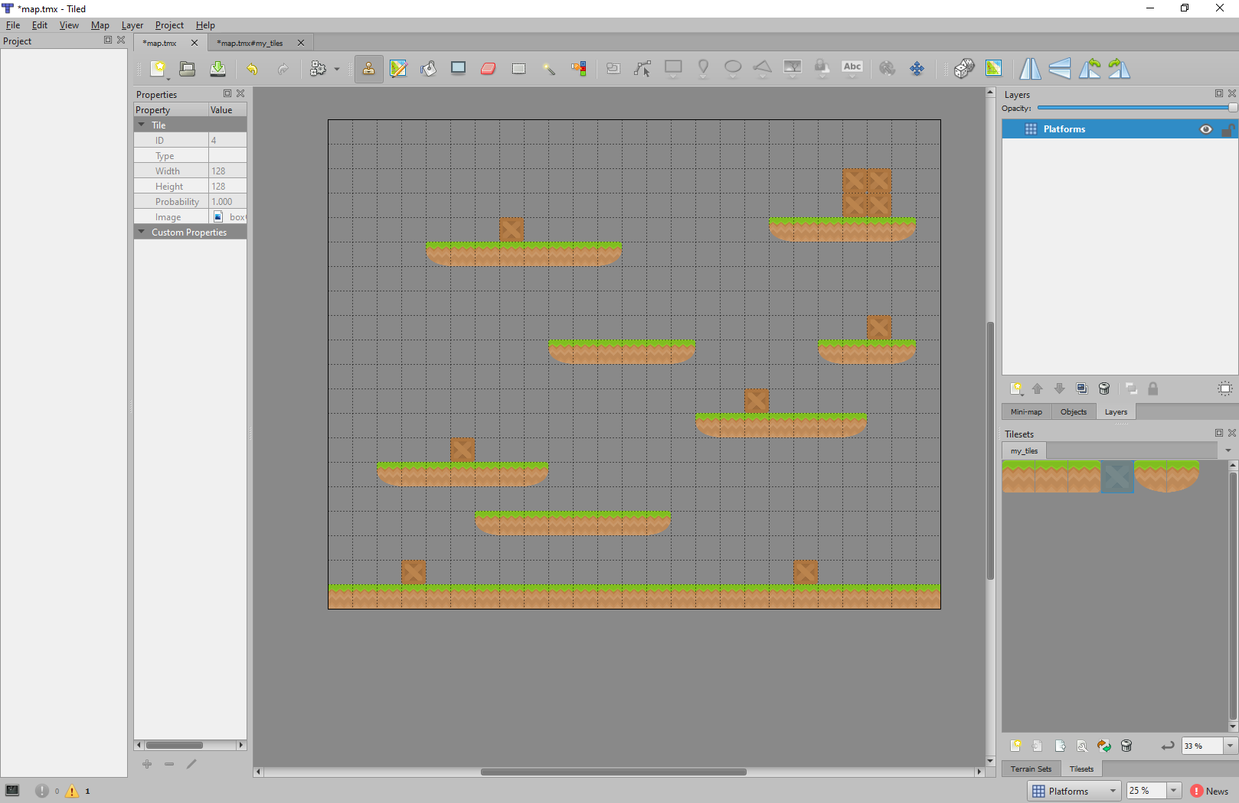
“Paint” your level
Eraser
Click in here to paint
Select tiles here

Slide 19
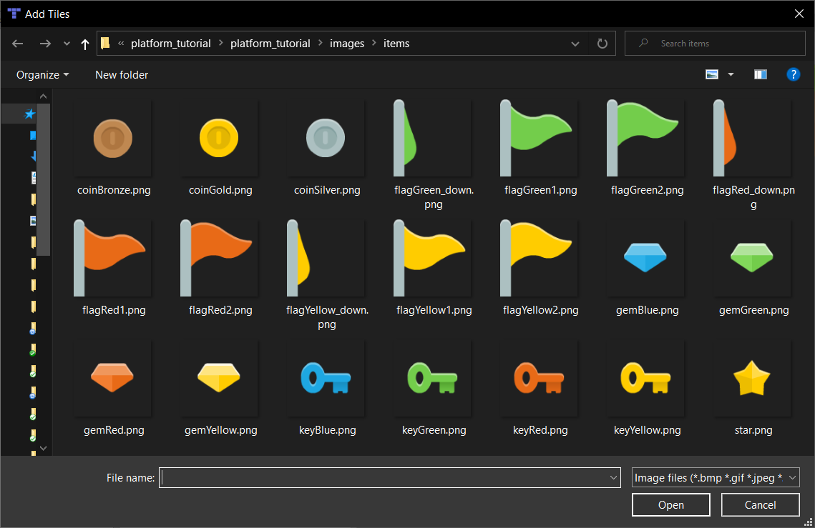
Add some items from the items folder

Slide 20
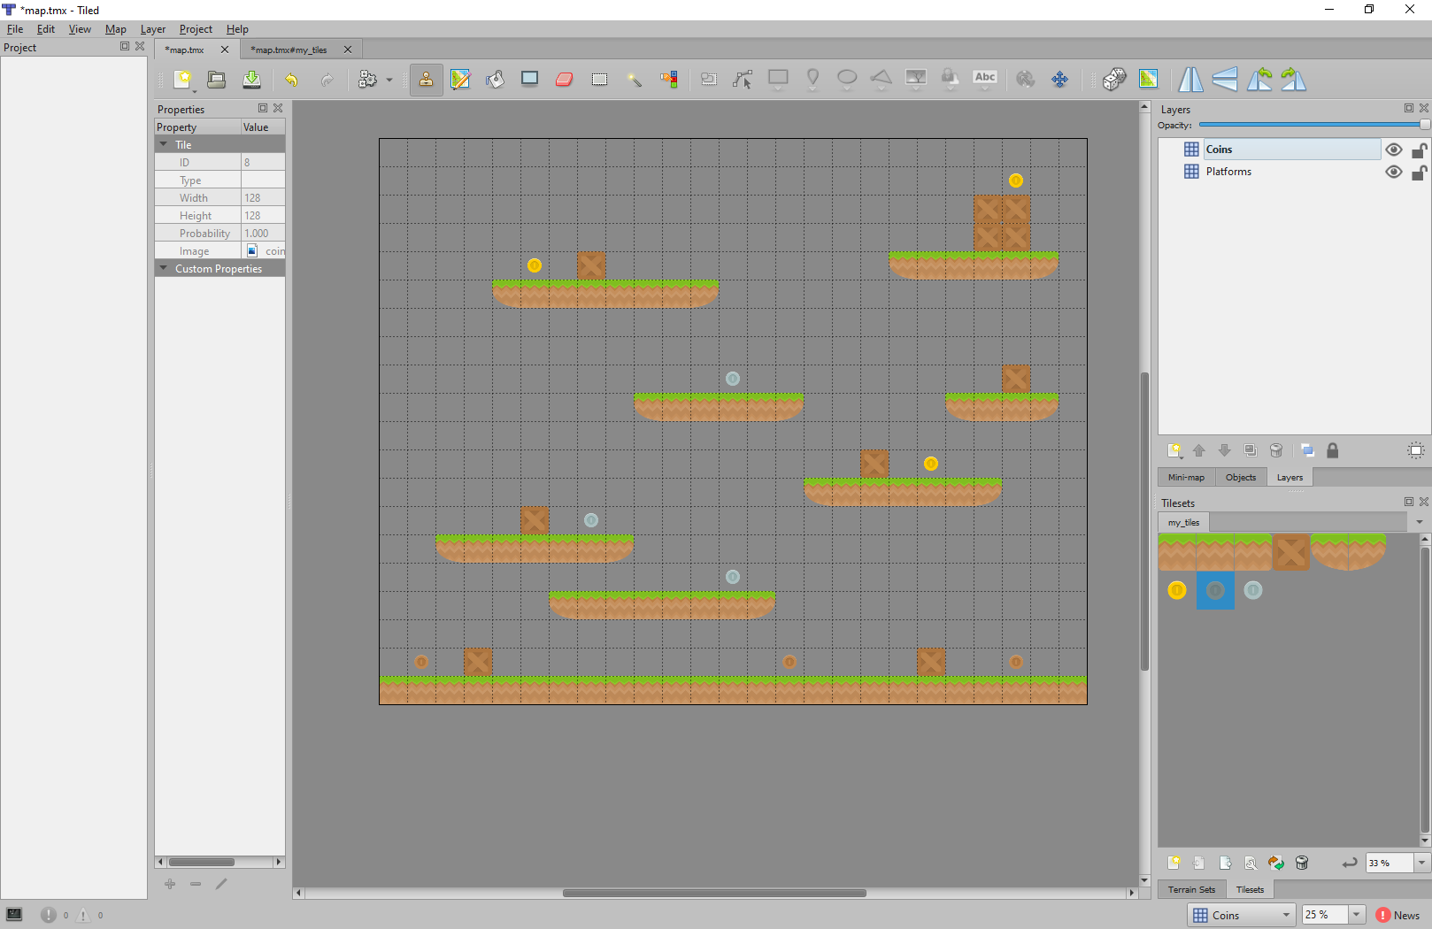
Add a coins layer
Add a coins layer
Add some coins on the coin layer.

Slide 21
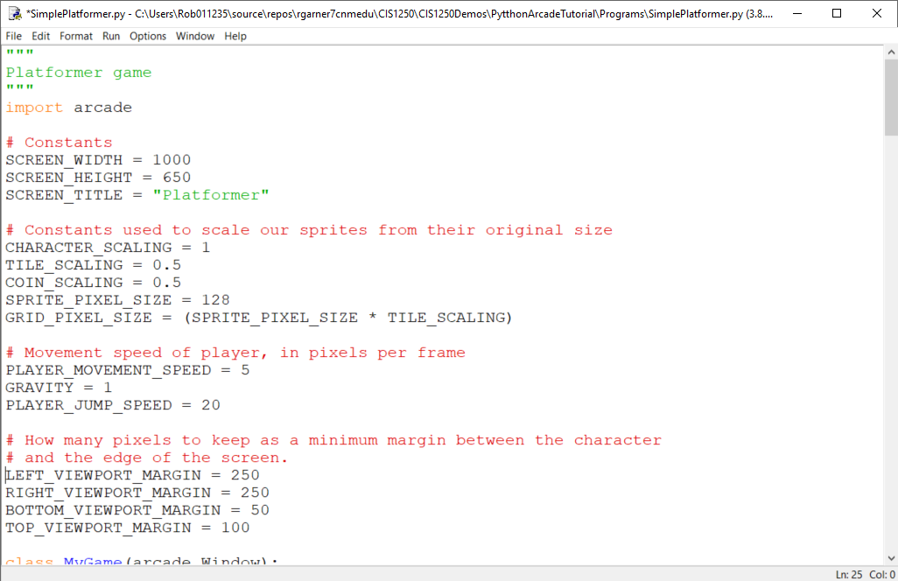
Add constants for map
Add constants.

Slide 22
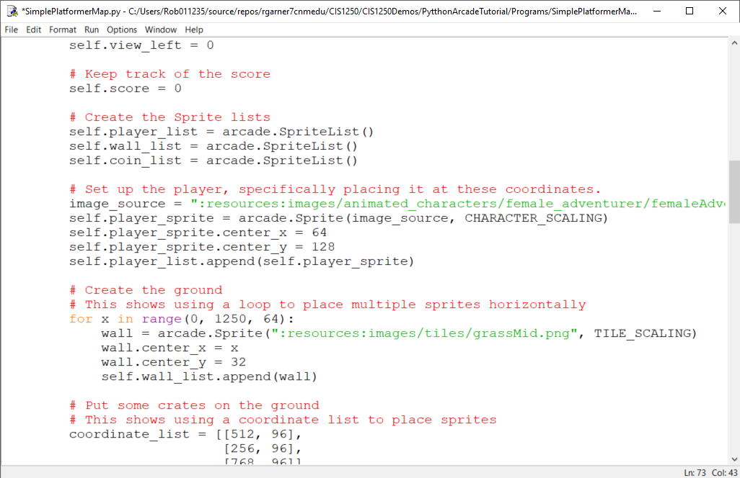
Remove spacial hash
Remove spatial hash.

Slide 23
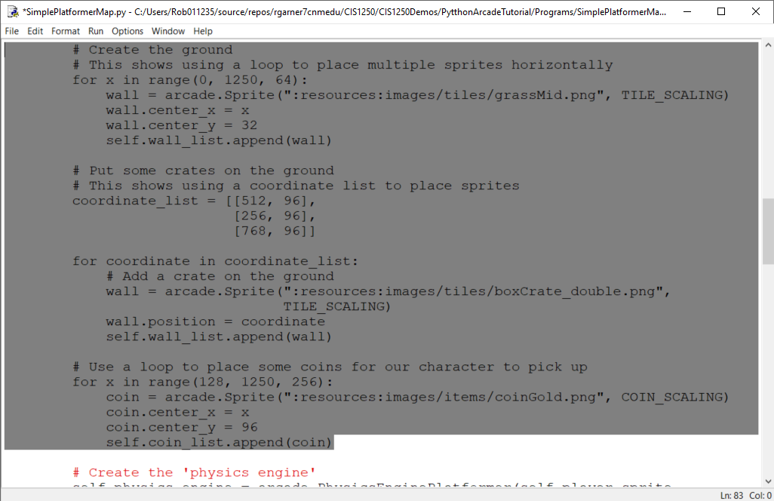
Remove existing code that creates the ground and coins from setup method
Delete all this from setup method.

Slide 24
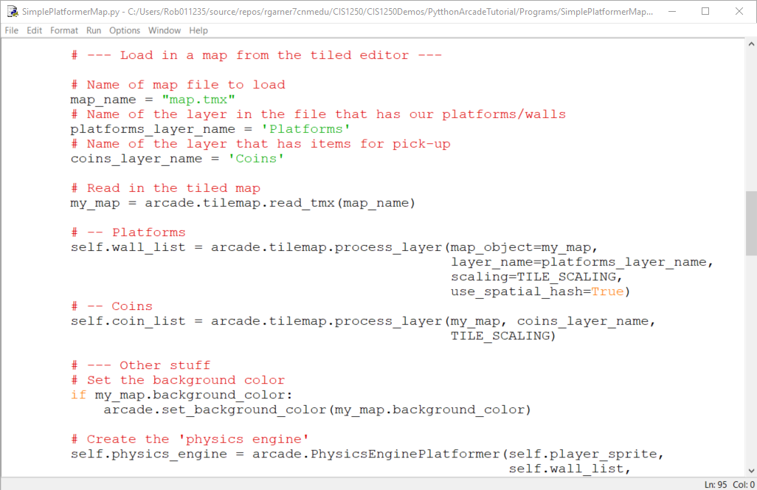
Add new code using map
Add new code

Slide 25
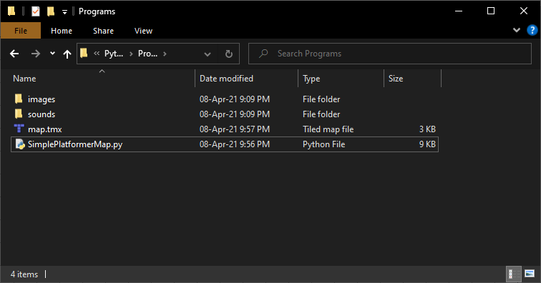
Make sure map.tmx is in same folder as .py program and spelling is correct

Slide 26
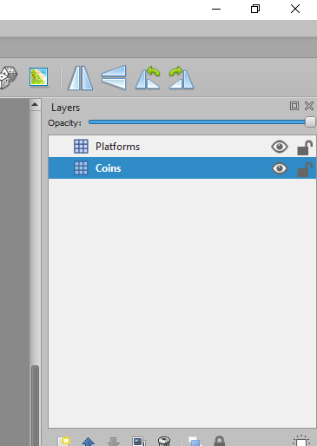
Make sure names match

Slide 27
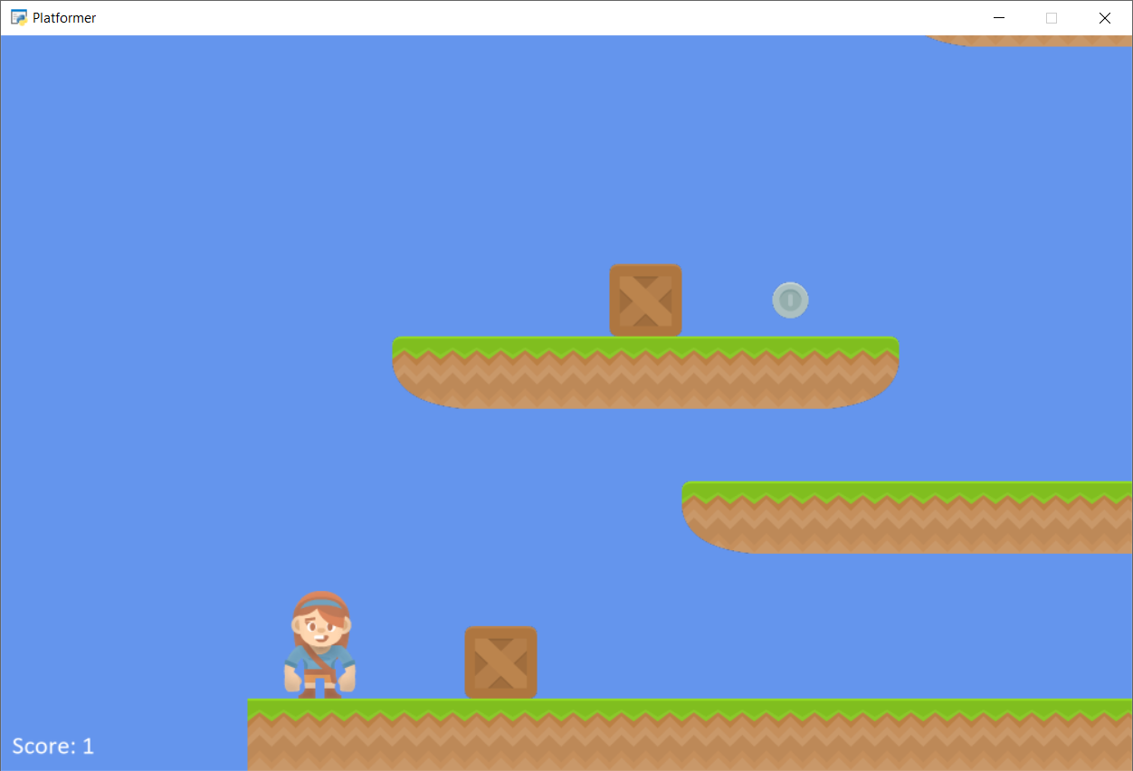
Test level with Ctrl-F5

Slide 28
Summary
Step 1 - Install and Open a Window
Step 2 - Add Sprites
Step 3 - Add User Control
Step 4 - Add Gravity
Step 5 - Add Scrolling
Step 6 - Add Coins And Sound
Step 7 - Display The Score
Step 8 - Use a Map Editor
Step 9 - Multiple Levels and Other Layers
Step 10 - Add Ladders, Properties, and a Moving Platform
Step 11 - Add Character Animations, and Better Keyboard Control

