Slide 1
Python Arcade
Instructor: Rob Garner (rgarner7@cnm.edu)
Based on tutorial at: https://arcade.academy/examples/platform_tutorial/index.html

Slide 2
Overview
Step 1 - Install and Open a Window
Step 2 - Add Sprites
Step 3 - Add User Control
Step 4 - Add Gravity
Step 5 - Add Scrolling
Step 6 - Add Coins And Sound
Step 7 - Display The Score
Step 8 - Use a Map Editor
Step 9 - Multiple Levels and Other Layers
Step 10 - Add Ladders, Properties, and a Moving Platform
Step 11 - Add Character Animations, and Better Keyboard Control

Slide 3
Step 9
Multiple Levels and Other Layers

Slide 4
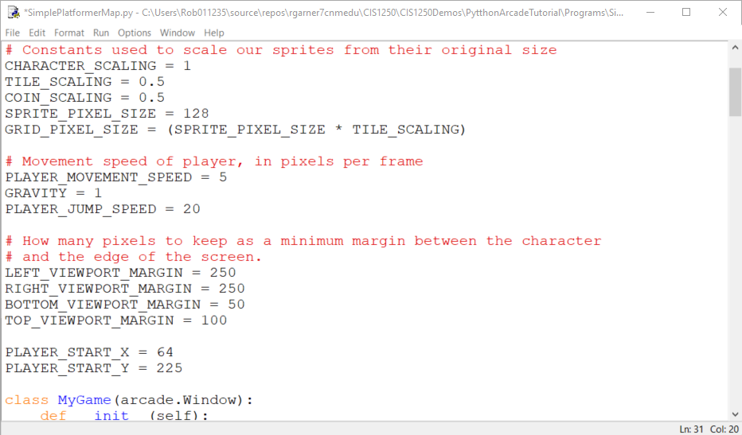
Add constants
Add these constants

Slide 5
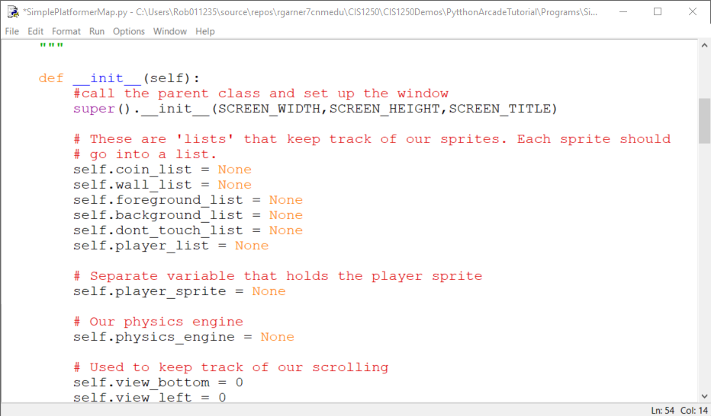
Update __init__ method
Add these variables

Slide 6
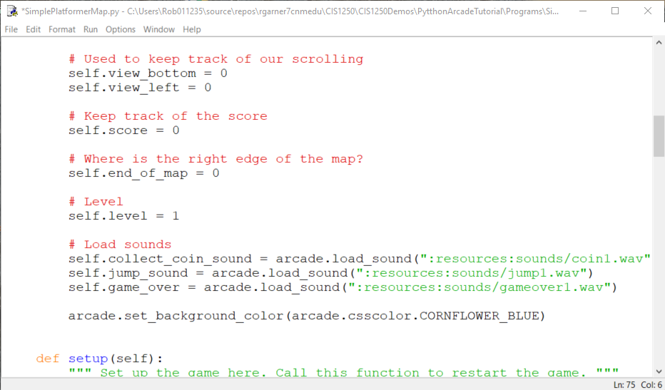
Update __init__ method
Add these variable initializations
Add this sound

Slide 7
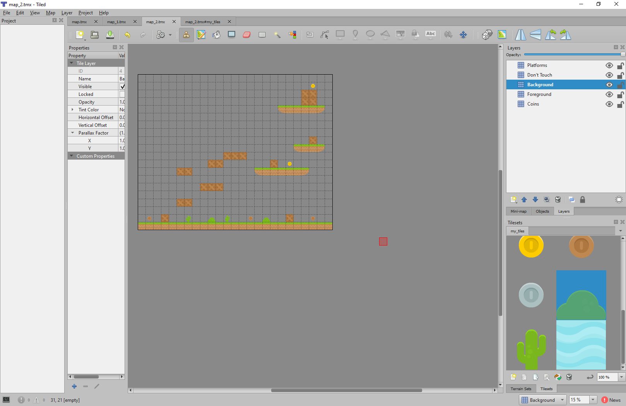
Make two new levels call them map_1.tmx and map_2.tmx
Put items you want behind player in Background layer.
Put items you want in front of player in Foreground layer.

Slide 8
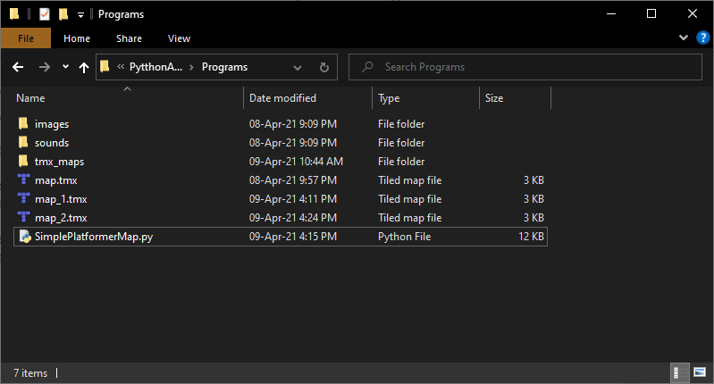
Put both maps in same folder as game py file.

Slide 9
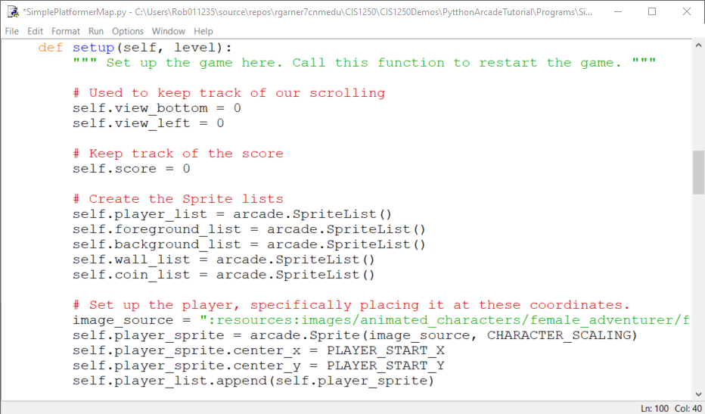
Update setup method
Add level parameter
Add foreground and background SpriteLists
Change to using constants

Slide 10
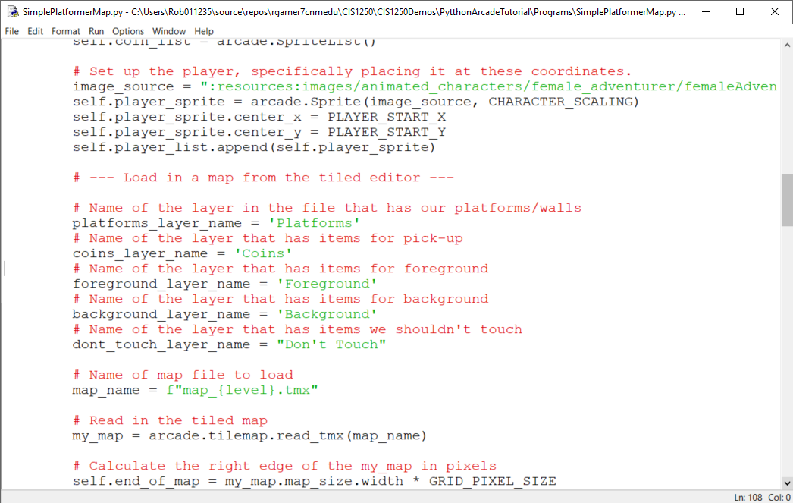
Update setup method
Set layer names
Set map name using f formating. See https://realpython.com/python-f-strings/
Calculate right edge of map
Notes:
See https://realpython.com/python-f-strings/ for f formating

Slide 11
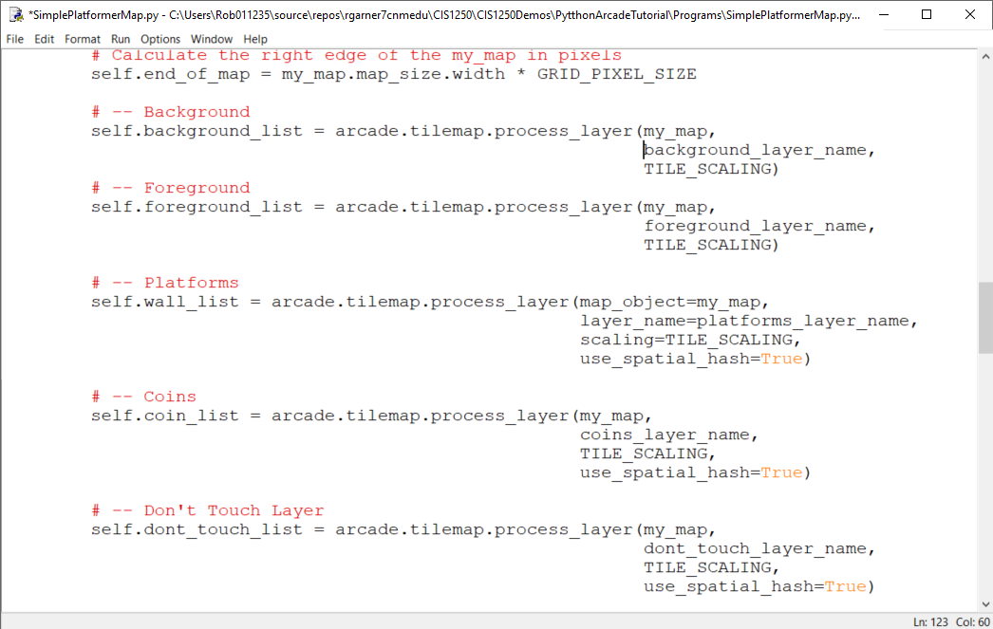
Update setup method
Edit and replace original code.

Slide 12
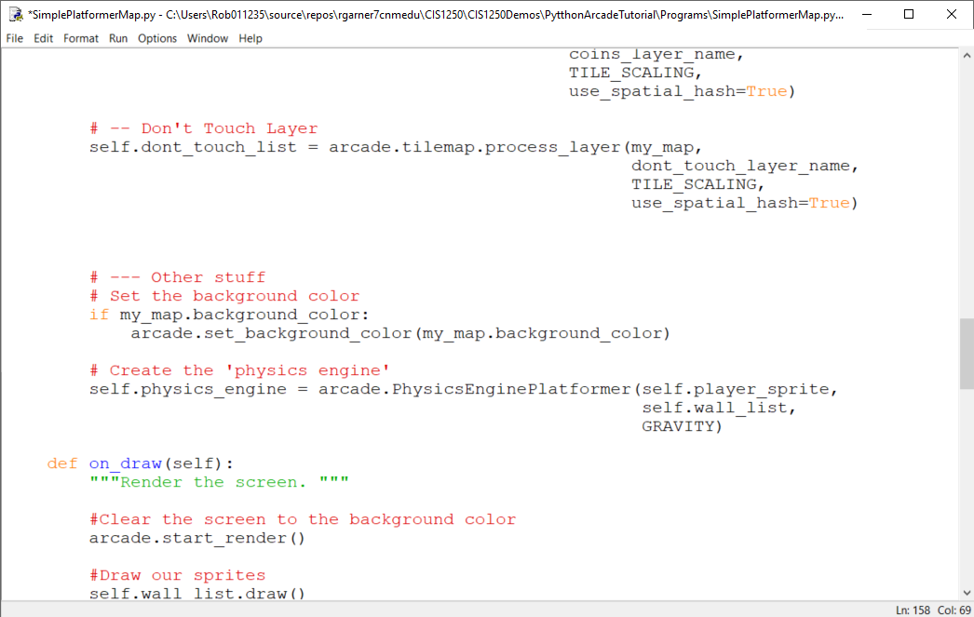
Update setup method
Edit and replace original code.

Slide 13
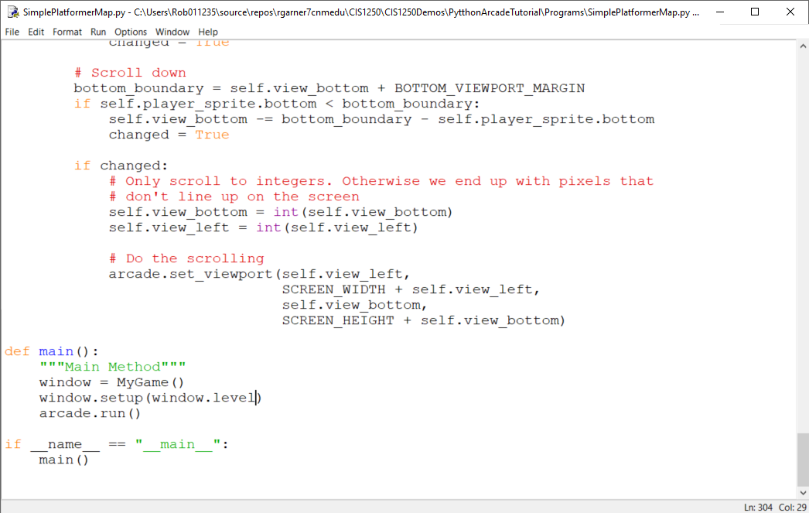
Update main()
Add window.level as argument to setup call

Slide 14
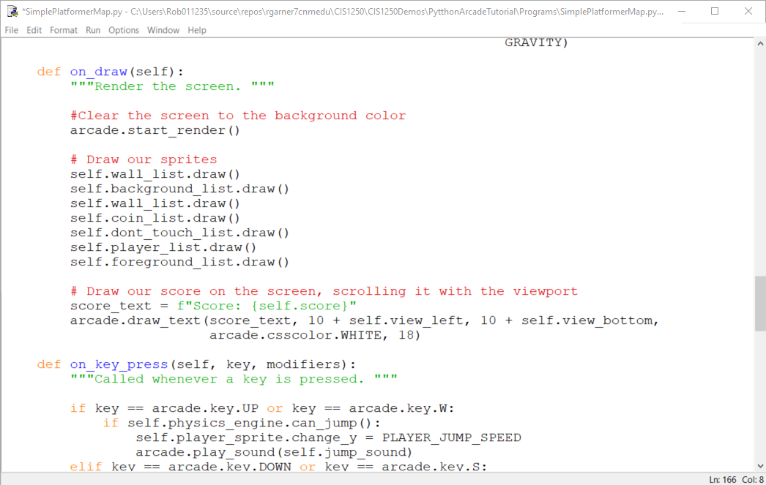
Update on_draw method
Edit and replace original code.

Slide 15
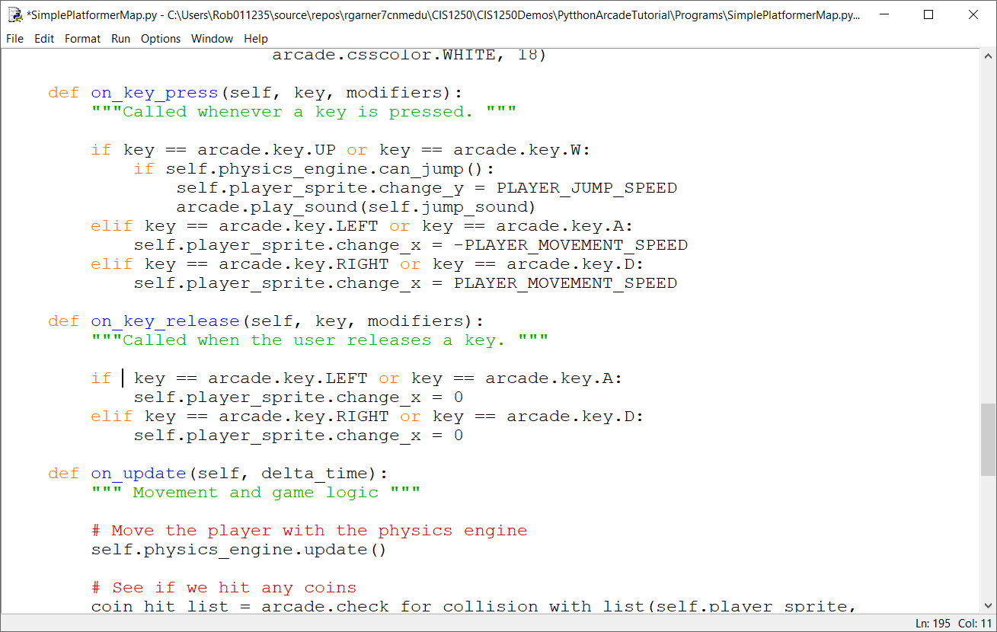
Update on_key_press and on_key_release methods
Edit and replace original code.

Slide 16
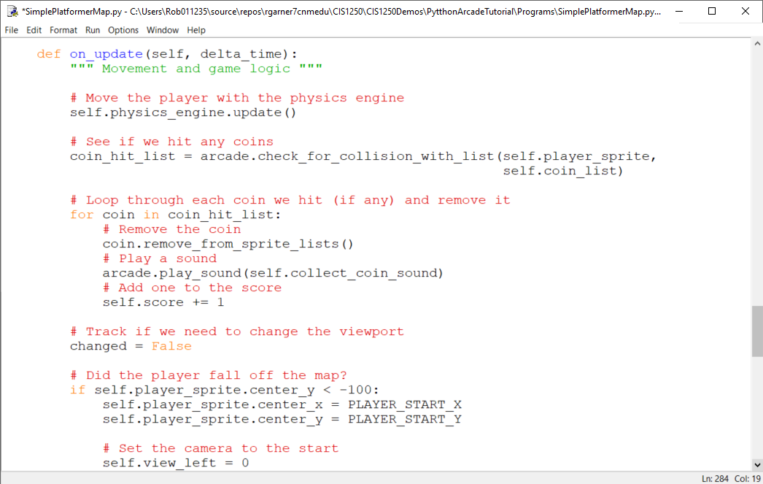
Change on_update method
Add code

Slide 17
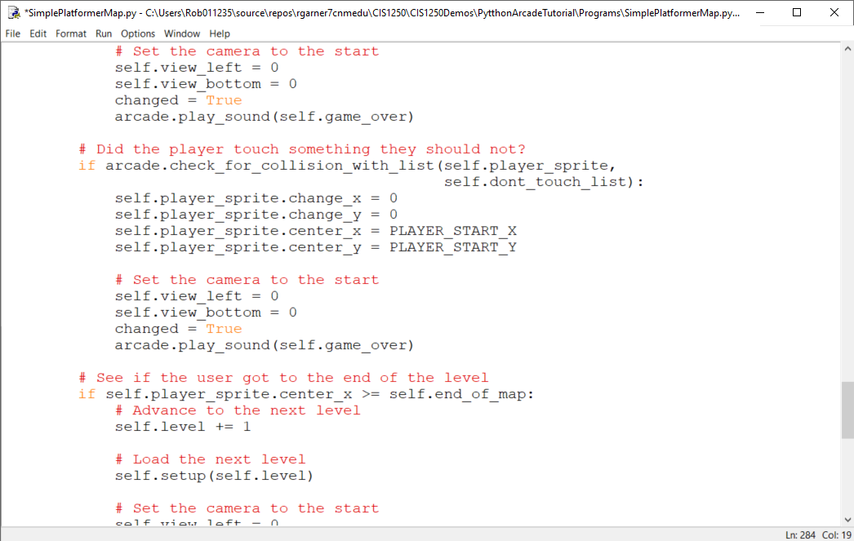
Change on_update method
Add code

Slide 18
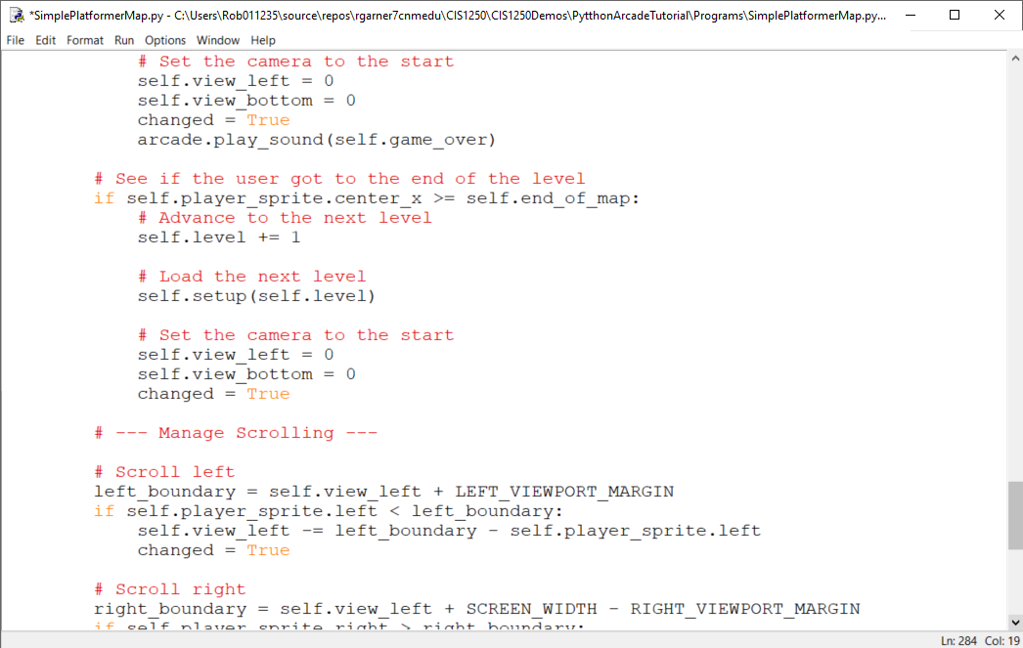
Change on_update method
Add code

Slide 19
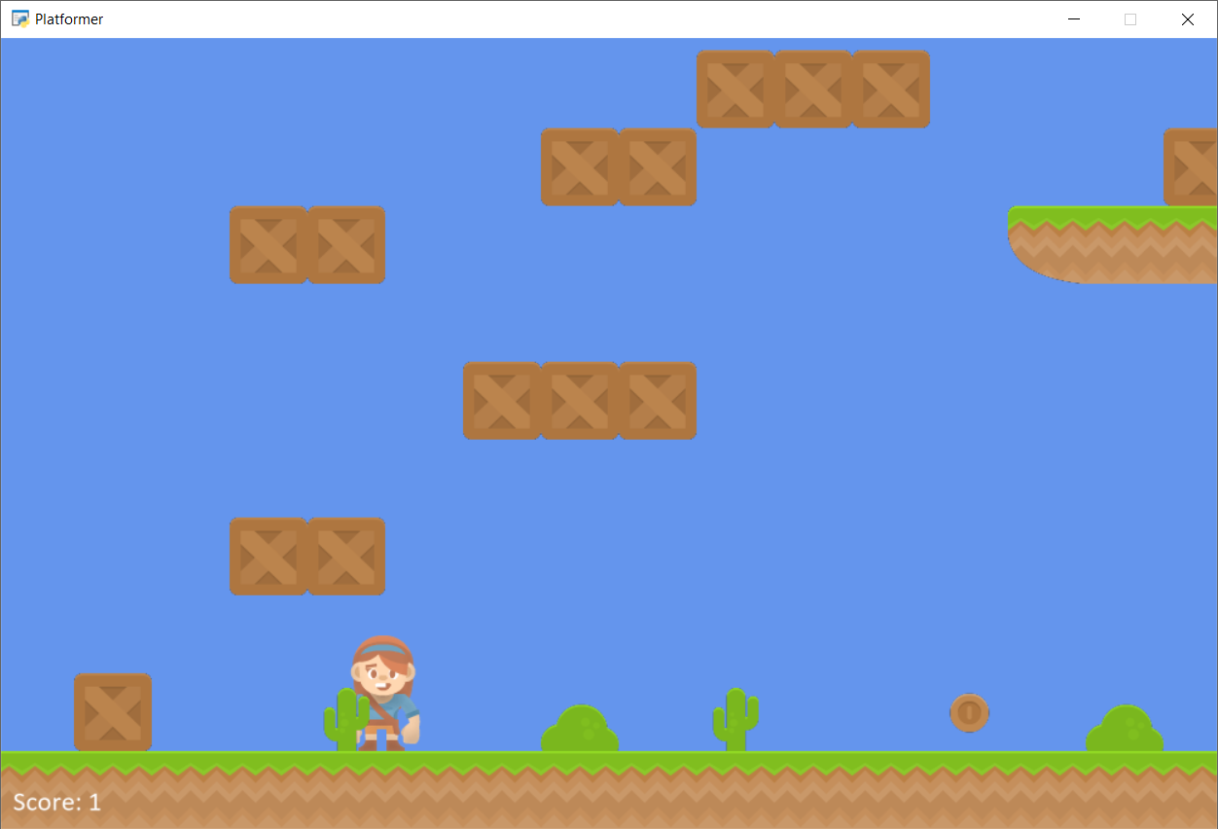
Try game with F5

Slide 20
Summary
Step 1 - Install and Open a Window
Step 2 - Add Sprites
Step 3 - Add User Control
Step 4 - Add Gravity
Step 5 - Add Scrolling
Step 6 - Add Coins And Sound
Step 7 - Display The Score
Step 8 - Use a Map Editor
Step 9 - Multiple Levels and Other Layers
Step 10 - Add Ladders, Properties, and a Moving Platform
Step 11 - Add Character Animations, and Better Keyboard Control

