Slide 1
Python Arcade
Instructor: Rob Garner (rgarner7@cnm.edu)
Based on tutorial at: https://arcade.academy/examples/platform_tutorial/index.html

Slide 2
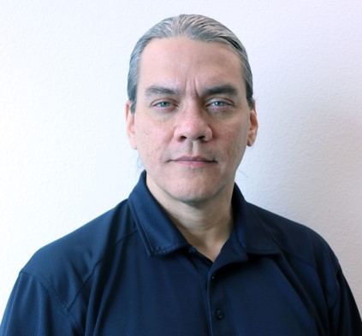
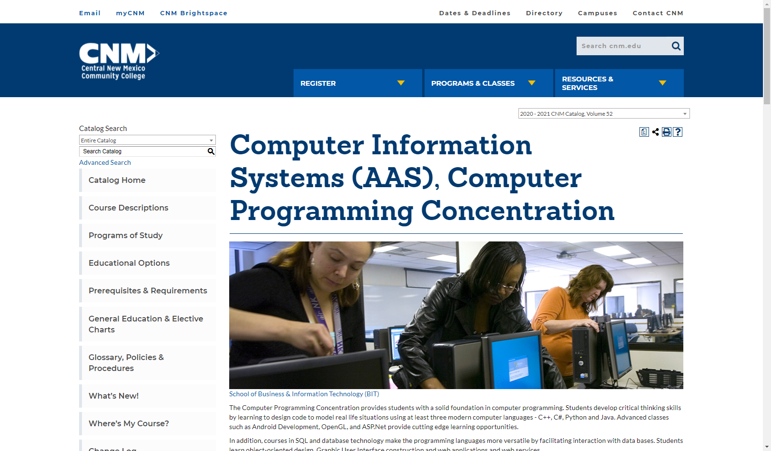
Instructor: Rob Garner
https://www.cnm.edu/programs-of-study/programs-a-z/computer-information-systems
https://catalog.cnm.edu/preview_program.php?catoid=46&poid=10542

Slide 3
About python arcade
A framework to learn python through games!

Slide 4
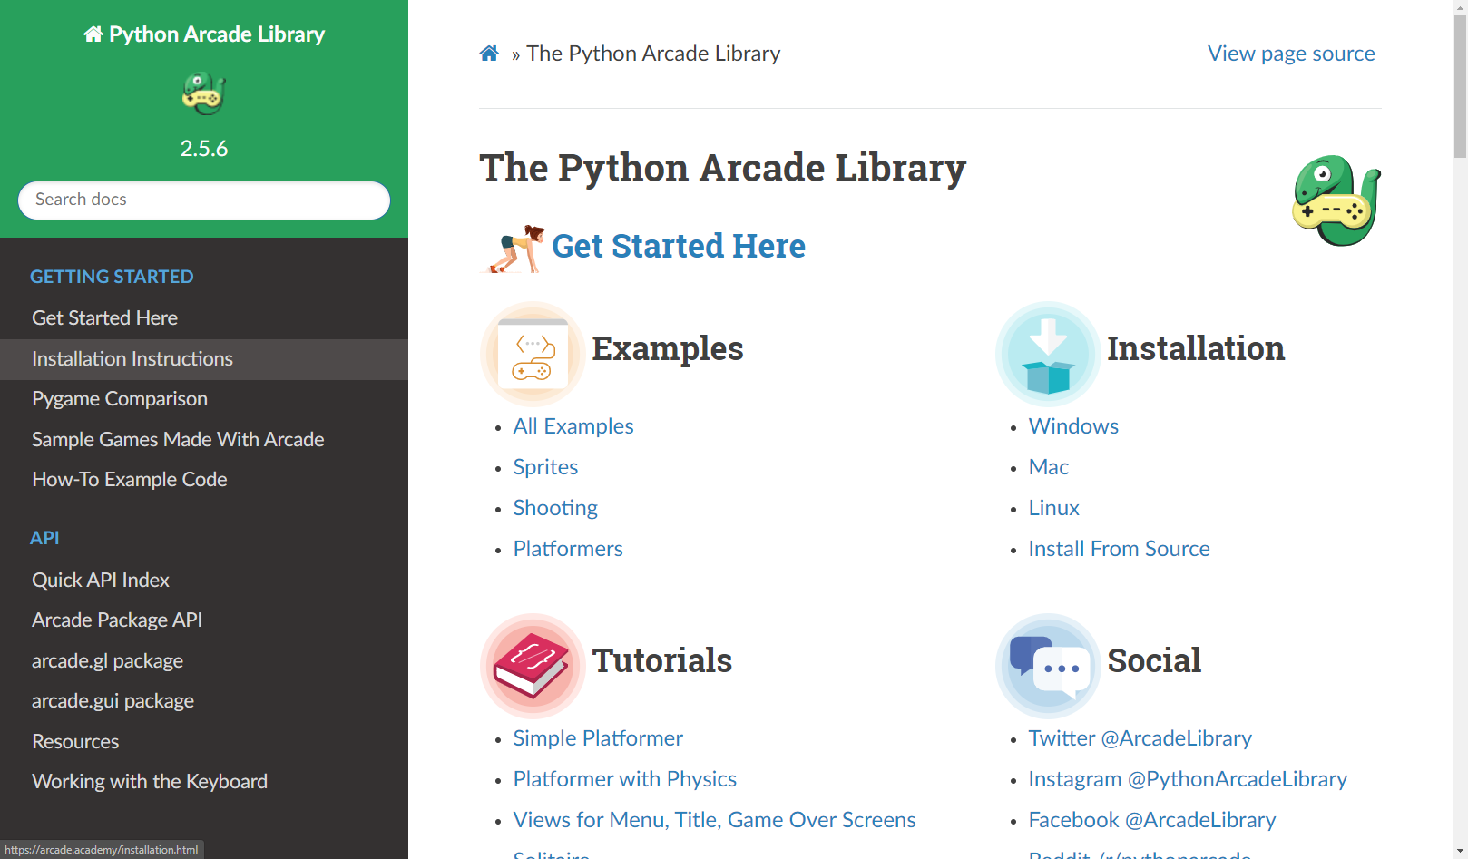
https://arcade.academy/index.html

Slide 5
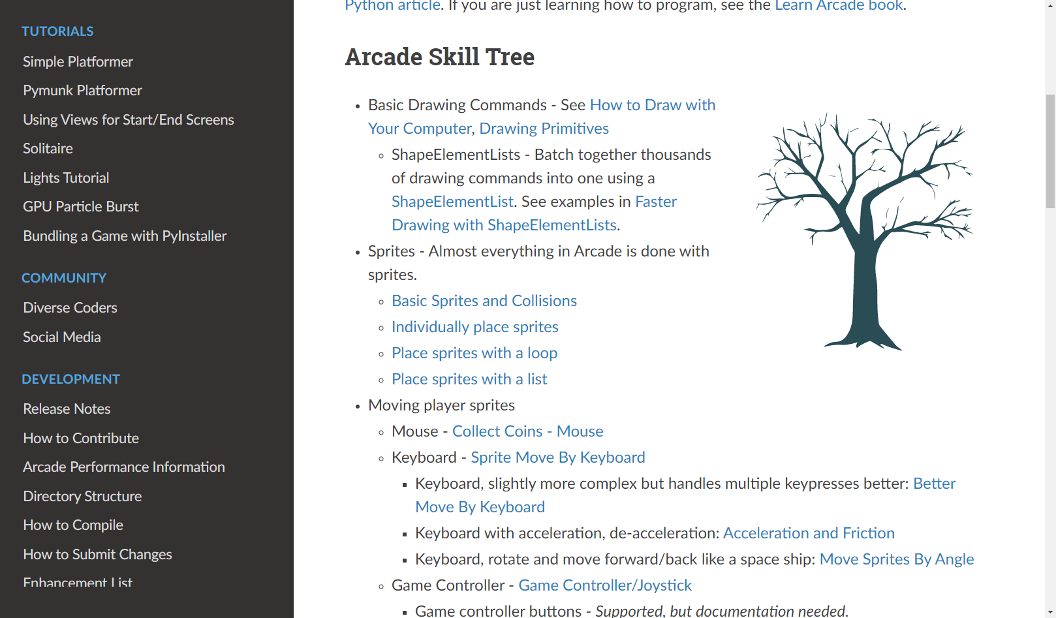
The Arcade Skill Tree: https://arcade.academy/get_started.html
Notes:
You can learn on your own.
Or get a group together and meet periodically to share what you have learned and created!
Great way to learn programming!

