Slide 1
Python Arcade
Instructor: Rob Garner (rgarner7@cnm.edu)
Based on tutorial at: https://arcade.academy/examples/platform_tutorial/index.html

Slide 2
Overview
Step 1 - Install and Open a Window
Step 2 - Add Sprites
Step 3 - Add User Control
Step 4 - Add Gravity
Step 5 - Add Scrolling
Step 6 - Add Coins And Sound
Step 7 - Display The Score
Step 8 - Use a Map Editor
Step 9 - Multiple Levels and Other Layers
Step 10 - Add Ladders, Properties, and a Moving Platform
Step 11 - Add Character Animations, and Better Keyboard Control

Slide 3
Step 2
Add Sprites

Slide 4
Sprite Lists
Sprites are managed in lists. The SpriteList class optimizes drawing, movement, and collision detection.
We are using three logical groups in our game.
A player_list for the player.
A wall_list for walls we can’t move through.
A coin_list for coins we can pick up.

Slide 5
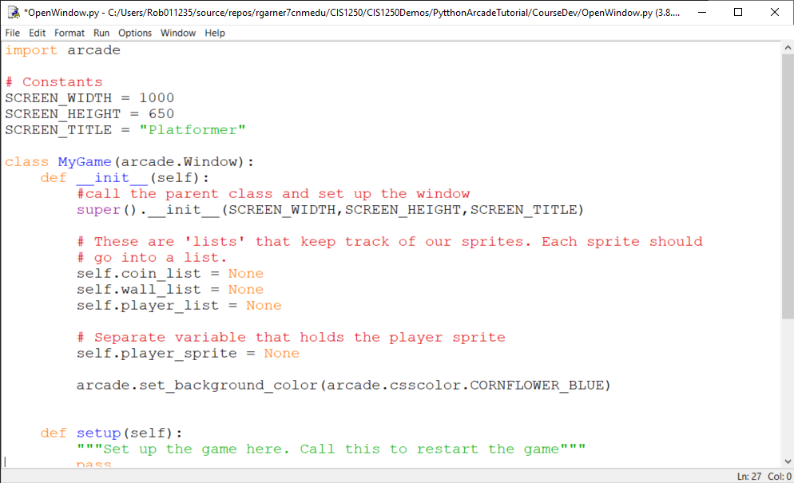
Add sprite lists

Slide 6
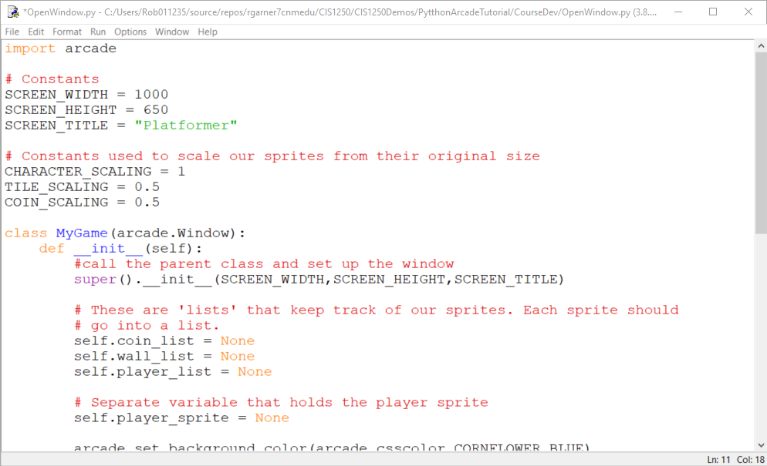
Add some constants for sprites

Slide 7
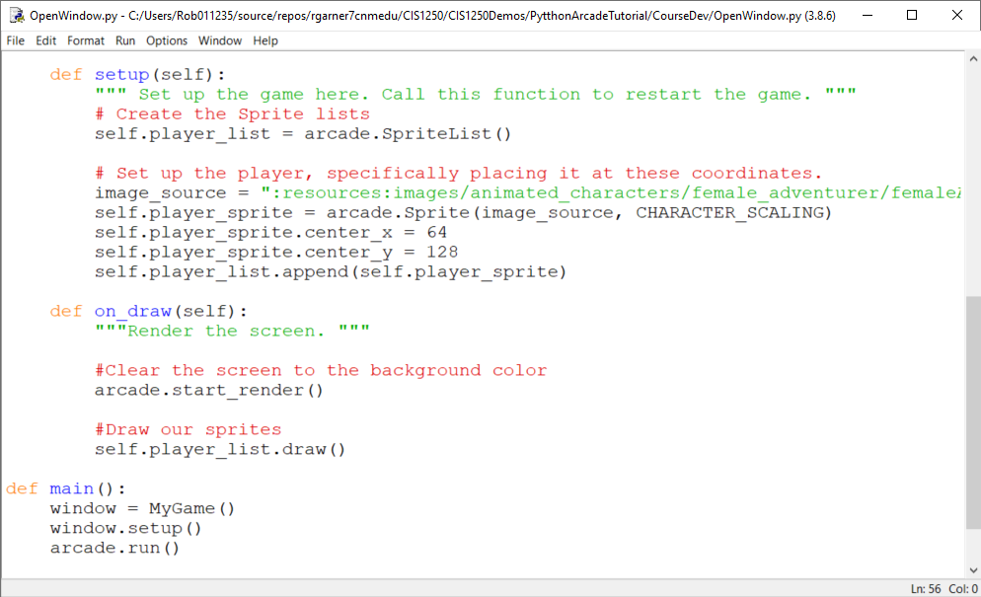
Add player sprite
":resources:images/animated_characters/female_adventurer/femaleAdventurer_idle.png"

Slide 8
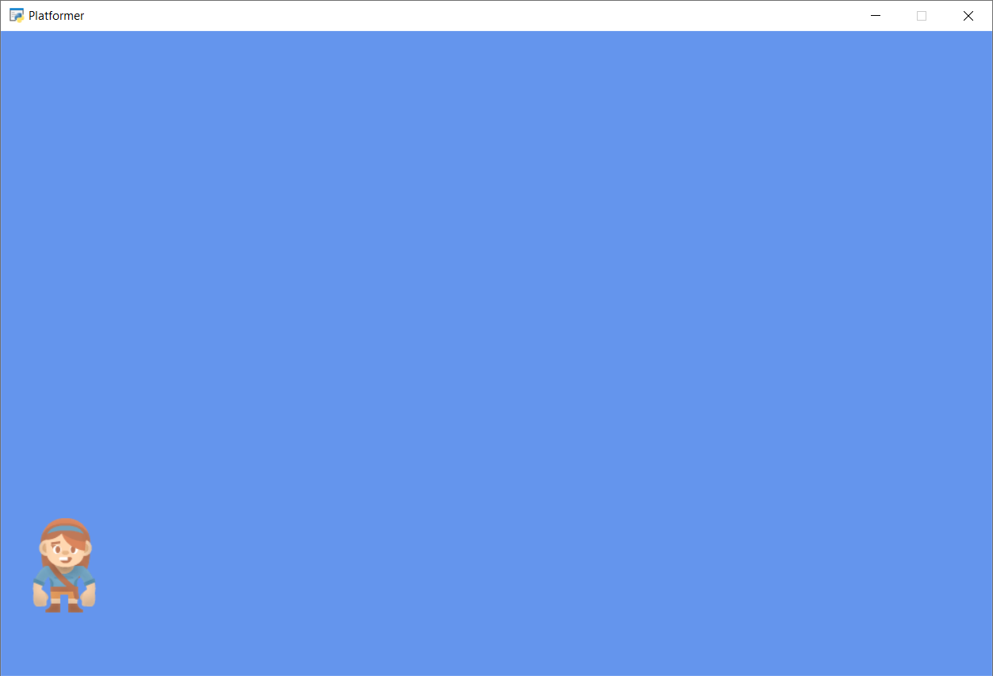
Run with F5
Character Sprite!

Slide 9
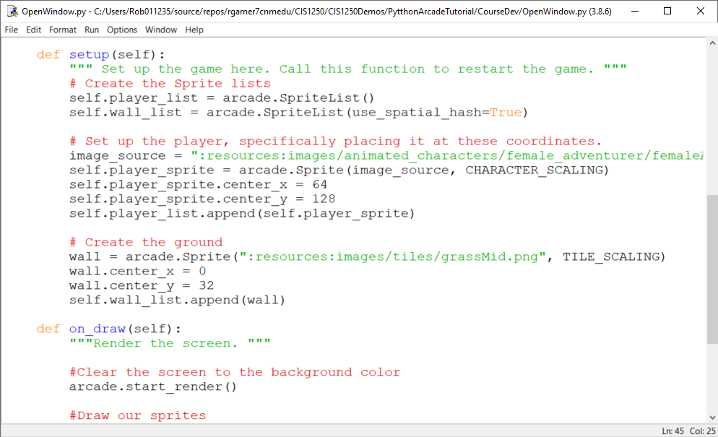
Add the wall list and create ground

Slide 10
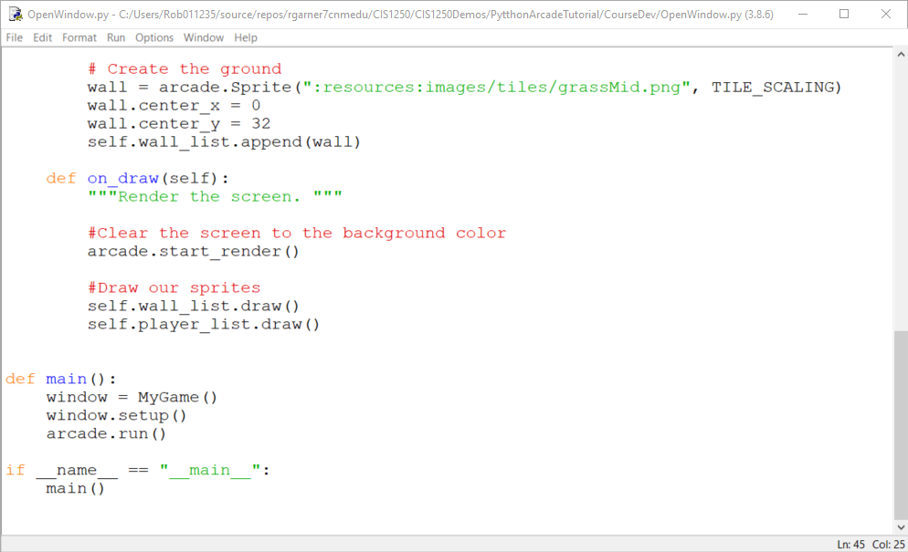
.draw() the wall_list

Slide 11
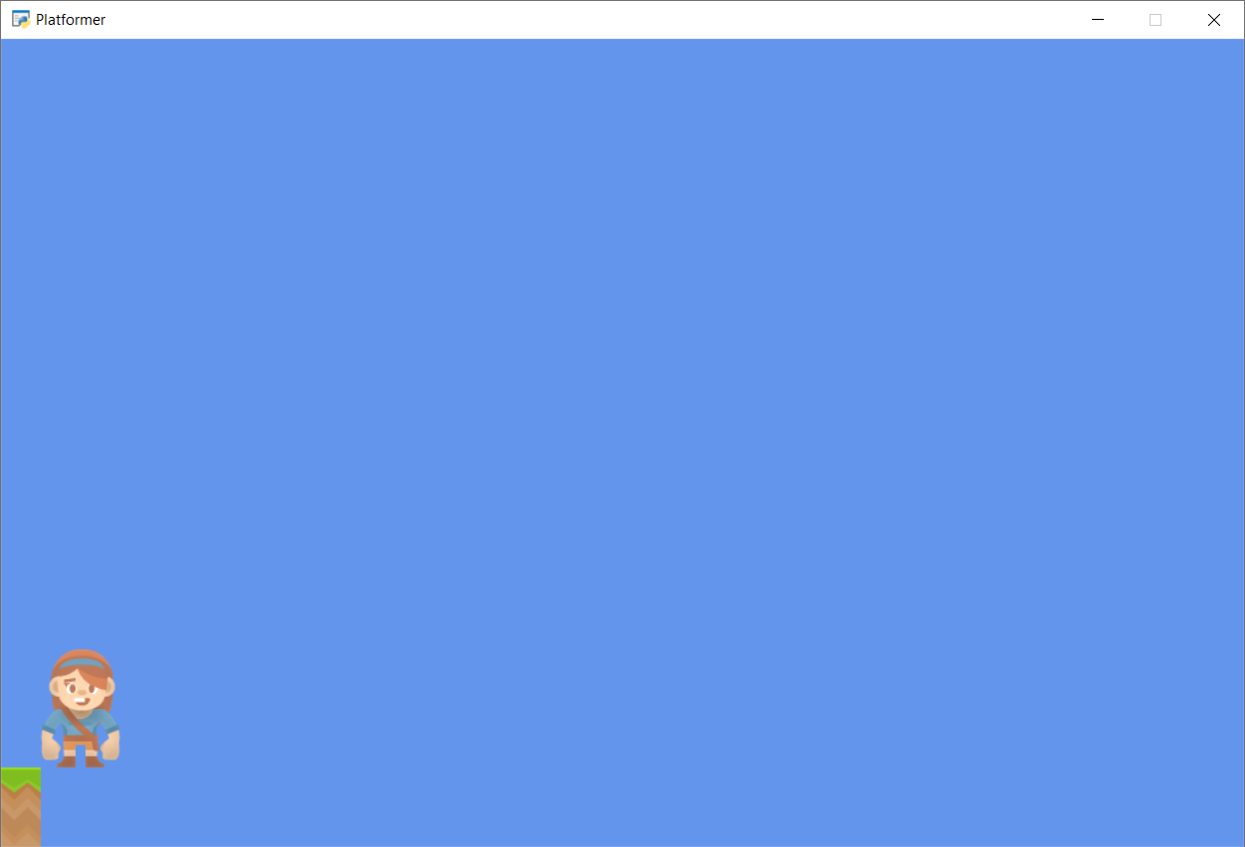
Run with F5
One piece of ground but we need more!

Slide 12
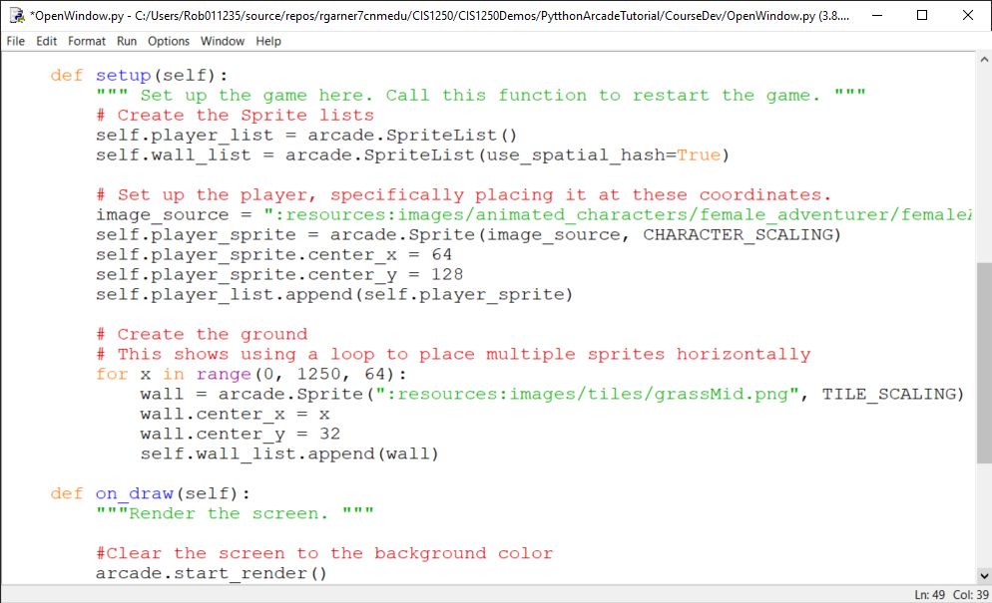
For loop iterates from 0 to 1250 in 64 step increments:
0 then 64 then 128 then 192 etc…
Use x to position each sprite one after the other.
Very important! Indent to identify all the statements that belong to the for loop.

Slide 13
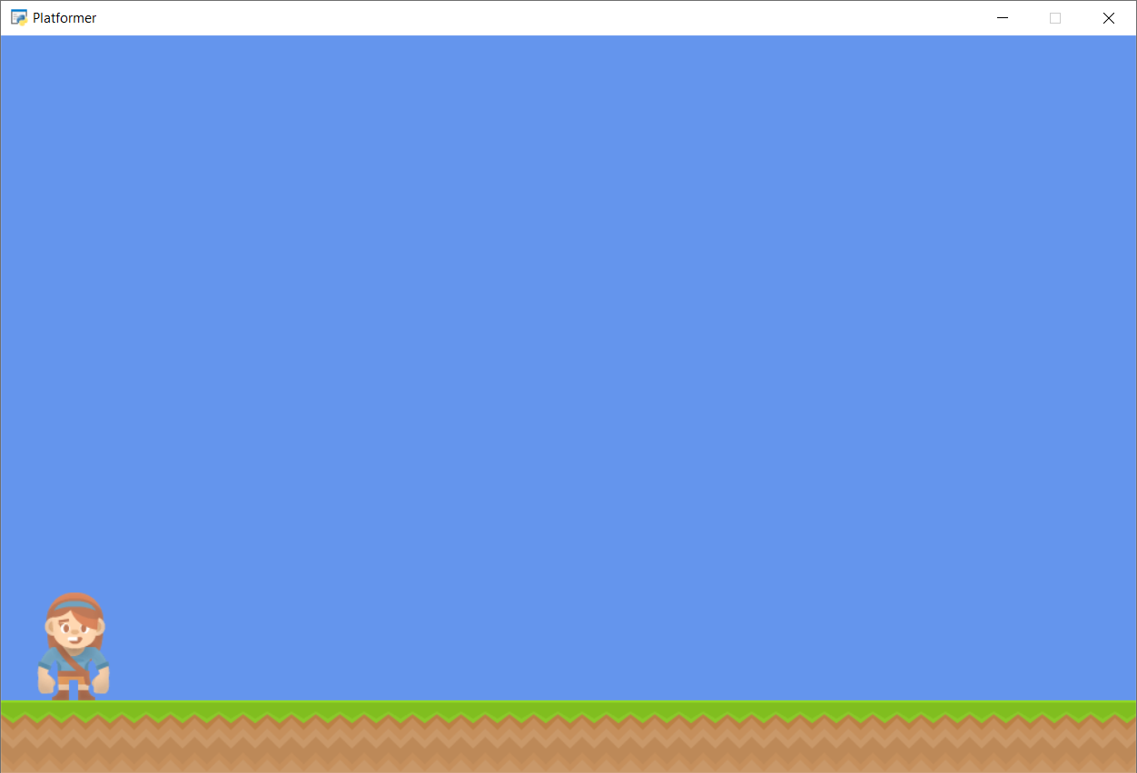
Run with F5
Multiple ground pieces!

Slide 14
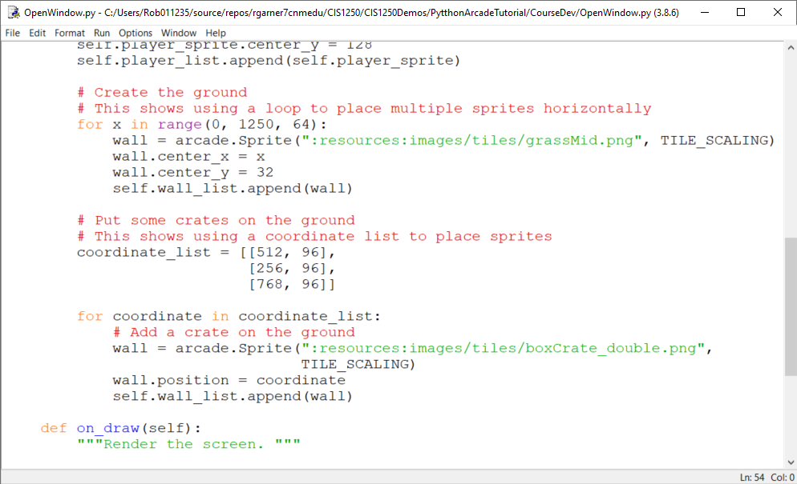
Put some crates on the ground
Create a list of lists with x and y position for three crates.
Loop through all coordinates and put a box there.

Slide 15
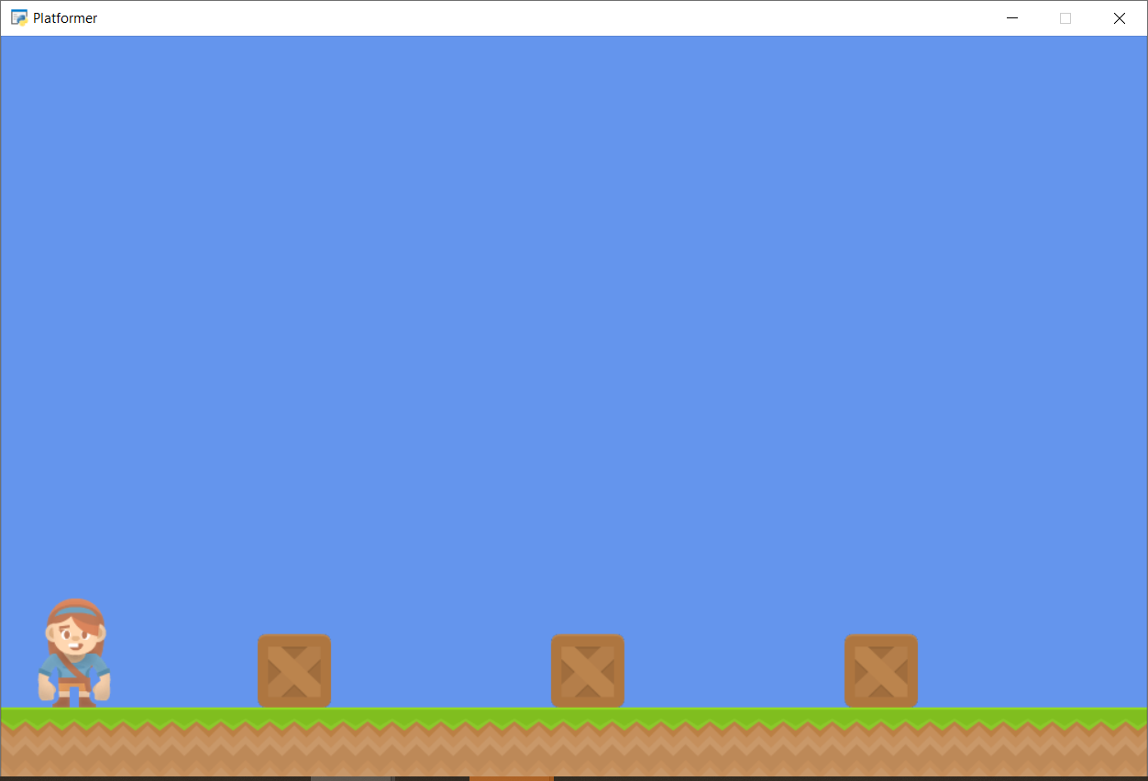
Run with F5
Boxes now show up!
Notes:
"""
Platformer game
"""
import arcade
# Constants
SCREEN_WIDTH = 1000
SCREEN_HEIGHT = 650
SCREEN_TITLE = "Platformer"
# Constants used to scale our sprites from their original size
CHARACTER_SCALING = 1
TILE_SCALING = 0.5
COIN_SCALING = 0.5
class MyGame(arcade.Window):
def __init__(self):
#call the parent class and set up the window
super().__init__(SCREEN_WIDTH,SCREEN_HEIGHT,SCREEN_TITLE)
# These are 'lists' that keep track of our sprites. Each sprite should
# go into a list.
self.coin_list = None
self.wall_list = None
self.player_list = None
# Separate variable that holds the player sprite
self.player_sprite = None
arcade.set_background_color(arcade.csscolor.CORNFLOWER_BLUE)
def setup(self):
""" Set up the game here. Call this function to restart the game. """
# Create the Sprite lists
self.player_list = arcade.SpriteList()
self.wall_list = arcade.SpriteList(use_spatial_hash=True)
# Set up the player, specifically placing it at these coordinates.
image_source = ":resources:images/animated_characters/female_adventurer/femaleAdventurer_idle.png"
self.player_sprite = arcade.Sprite(image_source, CHARACTER_SCALING)
self.player_sprite.center_x = 64
self.player_sprite.center_y = 128
self.player_list.append(self.player_sprite)
# Create the ground
# This shows using a loop to place multiple sprites horizontally
for x in range(0, 1250, 64):
wall = arcade.Sprite(":resources:images/tiles/grassMid.png", TILE_SCALING)
wall.center_x = x
wall.center_y = 32
self.wall_list.append(wall)
# Put some crates on the ground
# This shows using a coordinate list to place sprites
coordinate_list = [[512, 96],
[256, 96],
[768, 96]]
for coordinate in coordinate_list:
# Add a crate on the ground
wall = arcade.Sprite(":resources:images/tiles/boxCrate_double.png",
TILE_SCALING)
wall.position = coordinate
self.wall_list.append(wall)
def on_draw(self):
"""Render the screen. """
#Clear the screen to the background color
arcade.start_render()
#Draw our sprites
self.wall_list.draw()
self.player_list.draw()
def main():
"""Main Method"""
window = MyGame()
window.setup()
arcade.run()
if __name__ == "__main__":
main()

Slide 16
Summary
Step 1 - Install and Open a Window
Step 2 - Add Sprites
Step 3 - Add User Control
Step 4 - Add Gravity
Step 5 - Add Scrolling
Step 6 - Add Coins And Sound
Step 7 - Display The Score
Step 8 - Use a Map Editor
Step 9 - Multiple Levels and Other Layers
Step 10 - Add Ladders, Properties, and a Moving Platform
Step 11 - Add Character Animations, and Better Keyboard Control

