Slide 1

Chicago Crime Data 2015 – 2017

Slide 2
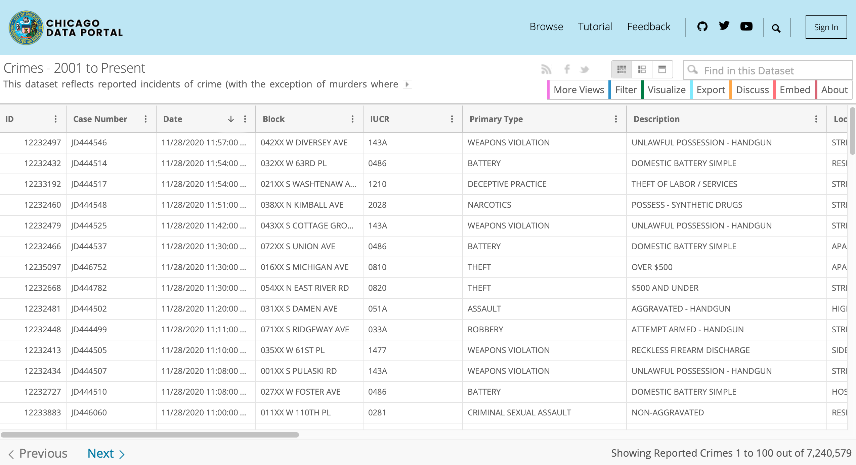
https://data.cityofchicago.org/Public-Safety/Crimes-2001-to-Present/ijzp-q8t2/data

Slide 3
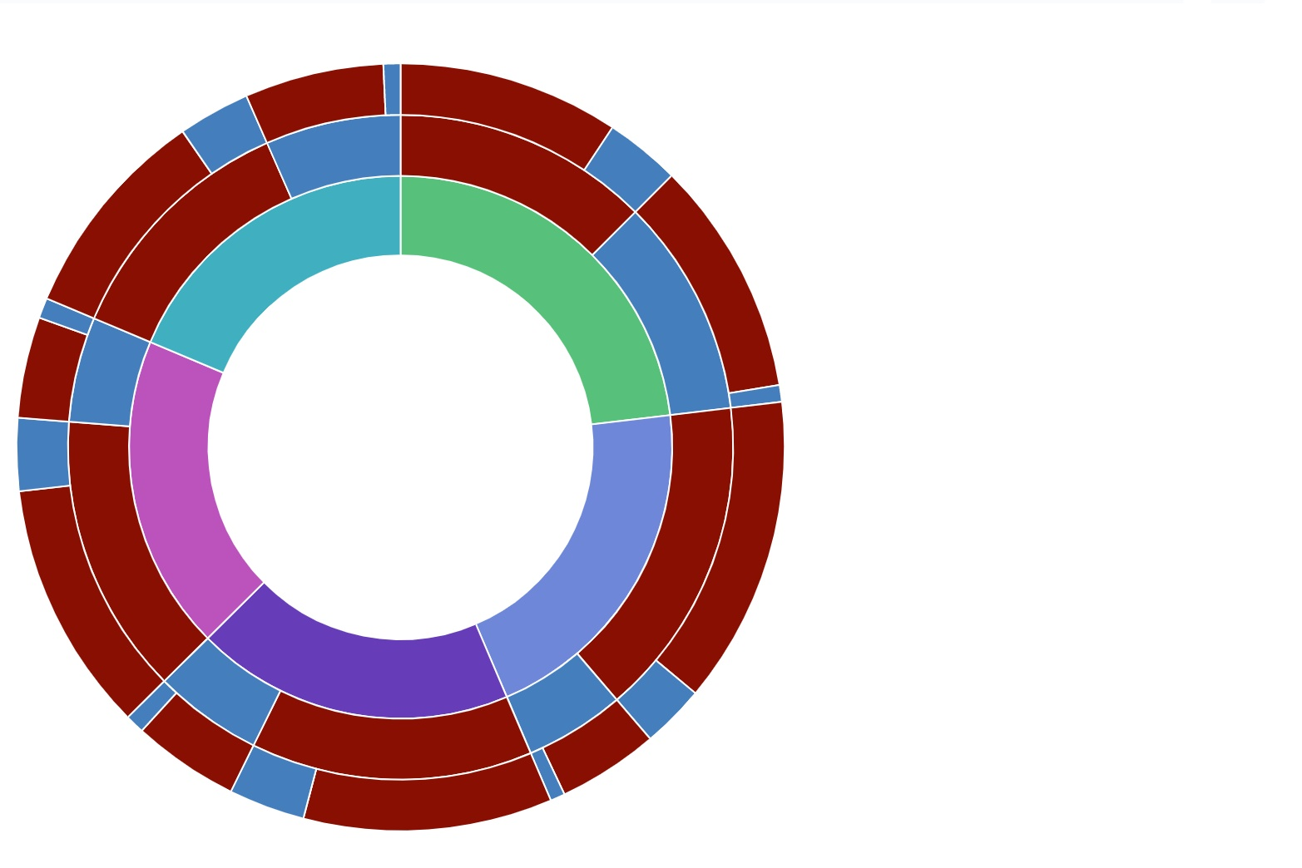
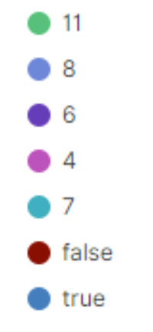
Crime Data For 2015
District 11: 23.11%
District 8: 20.49%
District 6: 18.98%
District 4: 18.76%
District 7: 18.68%
Total Case: 84,340
Arrests: 27,384 (32%)
Domestic Cases: 15,896 (19%)
Domestic\Arrests: 3,123 (11%)

Slide 4
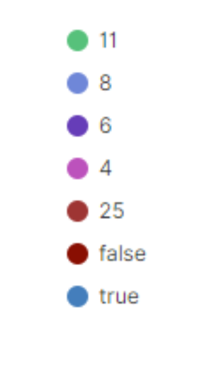
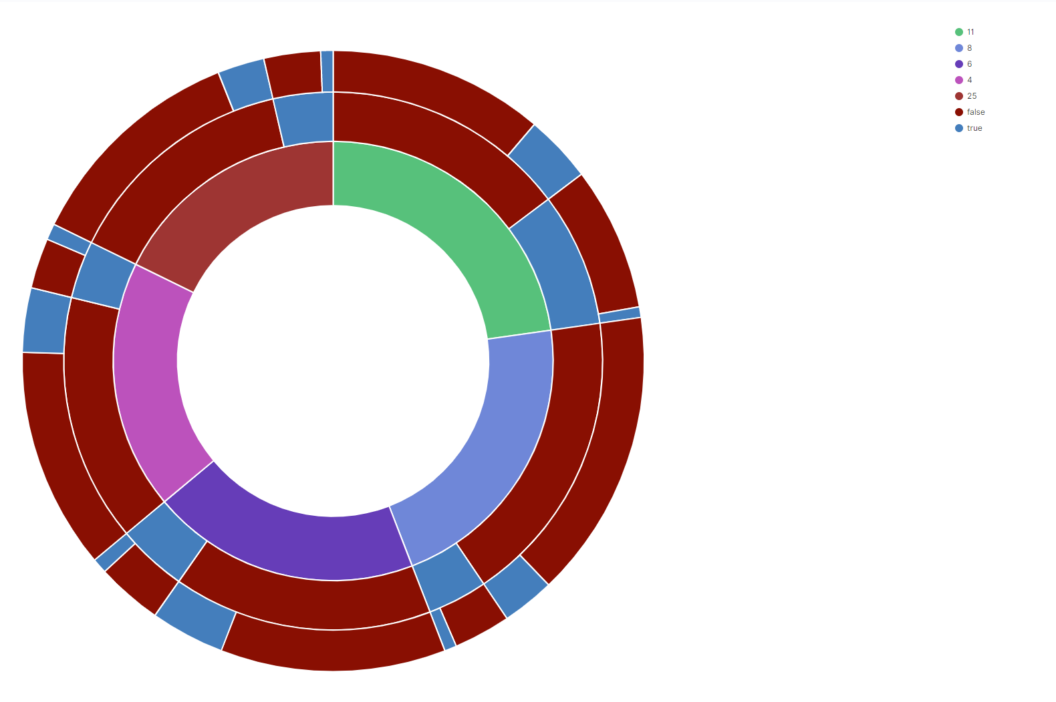
Crime Data for 2016
District 11: 22.76%
District 8: 21.39%
District 6: 19.77%
District 4: 18.34%
District 25: 17.74%
Total Cases: 81,716
Arrests: 18,694 (23%)
Domestic Cases: 15,816 (19%)
Domestic\Arrests: 2,823 (15%)

Slide 5
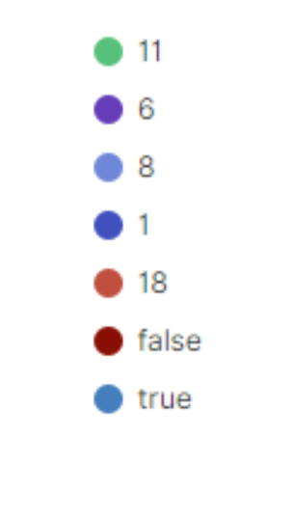
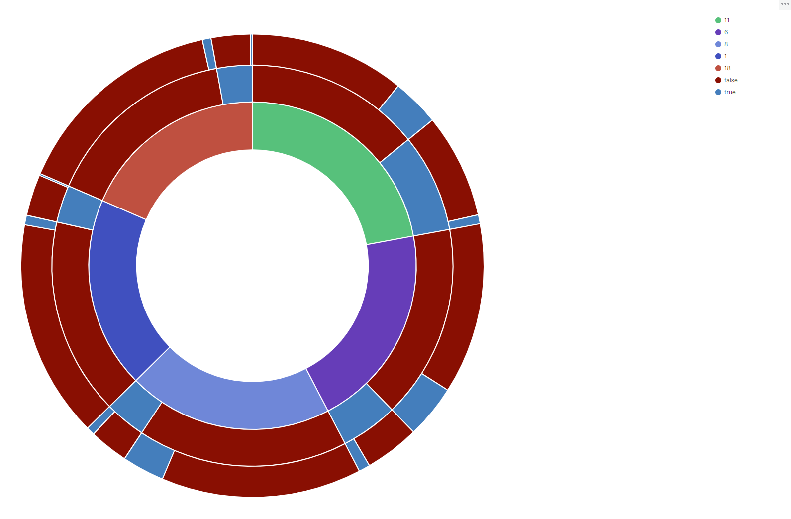
Crime Data for 2017
District 11: 22.10%
District 8: 20.26%
District 6: 20.27%
District 1: 18.89%
District 18: 18.48%
Total Cases: 81,472
Arrests: 17,700 (22%)
Domestic Cases: 11,040 (14%)
Domestic\Arrests: 1,840 (10%)

Slide 6
