Slide 1
Lichess Multi-Board Analysis Tool a project by
Andy Phillips, Hao Long Li,
Brian Durkin, and Jason Fleshel

Slide 2
The Main Idea
Goal: Introduce a new analysis tool for Chess players based on data from Lichess API

Slide 3
The Main Idea
Goal: Introduce a new analysis tool for Chess players based on data from Lichess API
  Enable self-analysis of multiple games at once, side-by-side

Slide 4
The Main Idea
Goal: Introduce a new web-based analysis tool for Chess players based on data from Lichess API
  Enable self-analysis of multiple games at once, side-by-side
  Search the games database from Lichess to capture up to 500 games at once

Slide 5
Project Breakdown
Two main parts:

Slide 6
Project Breakdown
Two main parts:
  Search functionality

Slide 7
Project Breakdown
Two main parts:
  Search functionality
  Board management

Slide 8
Project Breakdown
Two main parts:
  Search functionality
  Board management
Search involves:
  Querying the Lichess API for data
  Filtering data
  Presenting results
  Allow user to view the game on the page

Slide 9
Project Breakdown
Board management involves:
  Organizing the boards on the screen
  Enabling individual and simultaneous control of board state
  Add/Remove boards at will

Slide 10
Project Breakdown
Every component has multiple pieces:
  User interface/visual
  Interaction/event handling

Slide 11
Project Breakdown
Every component has multiple pieces:
  User interface/visual
  Interaction/event handling
Limited the scope of client/server interactivity
  No database, only interaction with one API
  Wanted to keep web development elements simple for newcomers to the discipline

Slide 12
Responsibility Breakdown
Andy, Product Owner
  Organized product development based on user personas (Product backlog, Sprint backlog)
  Built majority of backend infrastructure for search component
  Created simultaneous board controls
  Created and maintained:
    UML
    Project proposal
    Board creation and destruction sequence diagrams

Slide 13
Responsibility Breakdown
Li, Developer

Slide 14
Responsibility Breakdown
Brian, Developer

Slide 15
Responsibility Breakdown
Jason, Developer

Slide 16
Impact of Team Changes
Total of 3 teammate changes
  Felix left before we really started the project

Slide 17
Impact of Team Changes
Total of 3 teammate changes
  Felix left before we really started the project
  Jason joined us during week 2

Slide 18
Impact of Team Changes
Total of 3 teammate changes
  Felix left before we really started the project
  Jason joined us during week 2
  Keshav left us during week 3

Slide 19
Impact of Team Changes
Total of 3 teammate changes
  Felix left before we really started the project
  Jason joined us during week 2
  Keshav left us during week 3
Had moderate impact on progress

Slide 20
Impact of Team Changes
Total of 3 teammate changes
  Felix left before we really started the project
  Jason joined us during week 2
  Keshav left us during week 3
Had moderate impact on progress
  Some teammates had little prior web development exposure
  Kept technical complexity of project on the lower side to compensate for team changes and lack of experience

Slide 21
Team Meeting and Communication
No regular meetings

Slide 22
Team Meeting and Communication
No regular meetings
Constant communication via Discord

Slide 23
Now for a brief demo!

Slide 24
Skill Growth: Andy
Gained project management experience
  Have web development experience, but not much product ownership experience
  Working with people of various web dev skill levels was an interesting challenge
Gained more in-depth experience with tools like GitHub and Trello for project management
  Releases, general repo management
  Tagging/Task Organization in Trello

Slide 25
Skill Growth: Li

Slide 26
Skill Growth: Brian

Slide 27
Skill Growth: Jason

Slide 28
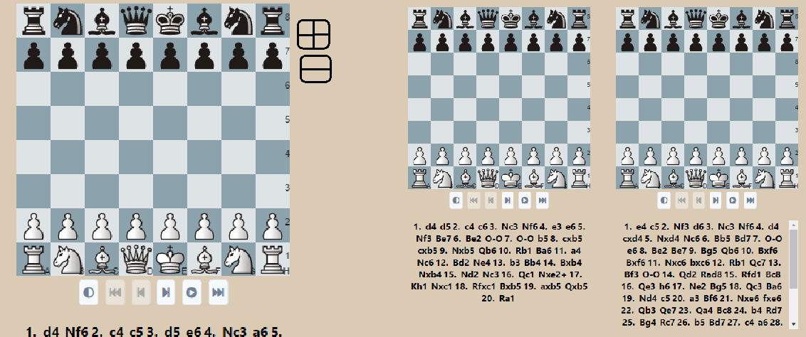
What wasn't implemented?
Scaling boards on page

Slide 29
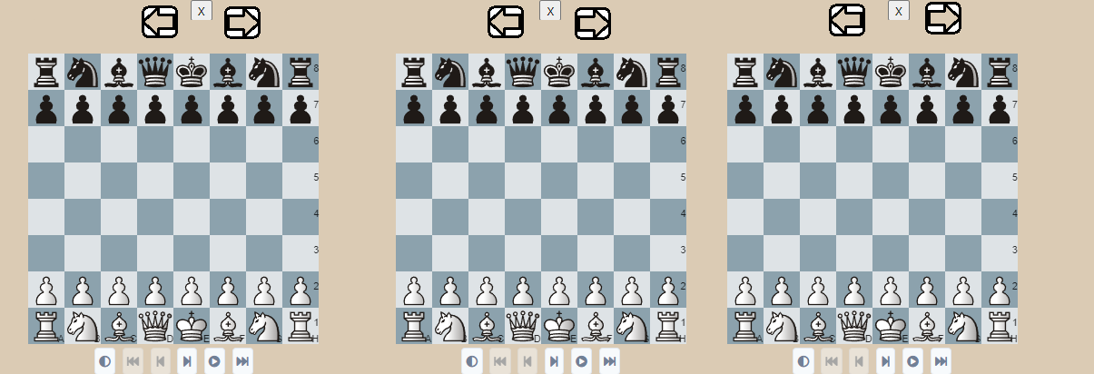
What wasn't implemented?
Functionality to allow shifting of boards on page

Slide 30
Any questions?

