Slide 1
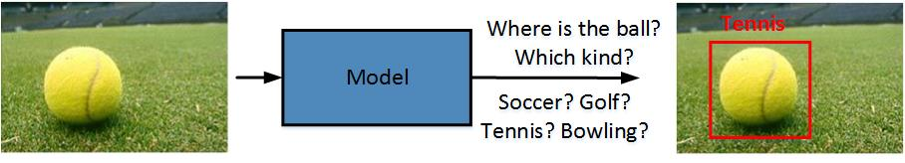
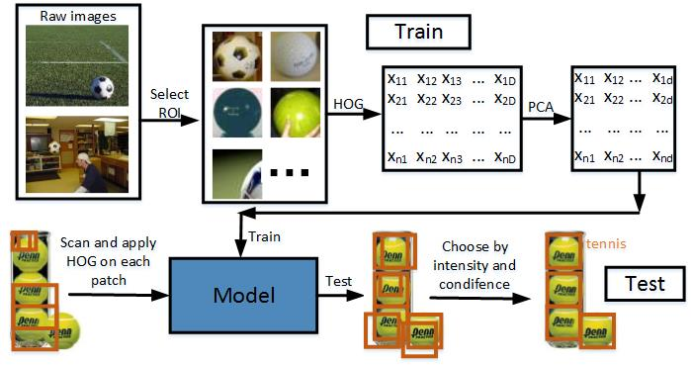
Task : Ball Reorganization
Methodology:
Train:
1. Select ROI manually
2. Resize and apply HOG to get features
3. Use PCA to decrease dimension
4. Train a SVM (Gaussian kernel)
Test:
1. Scan the image using different masks
2. Repeat Step 2-3 in Train on the test image and make a prediction
3. Choose those with high confidence and intensity

Slide 2
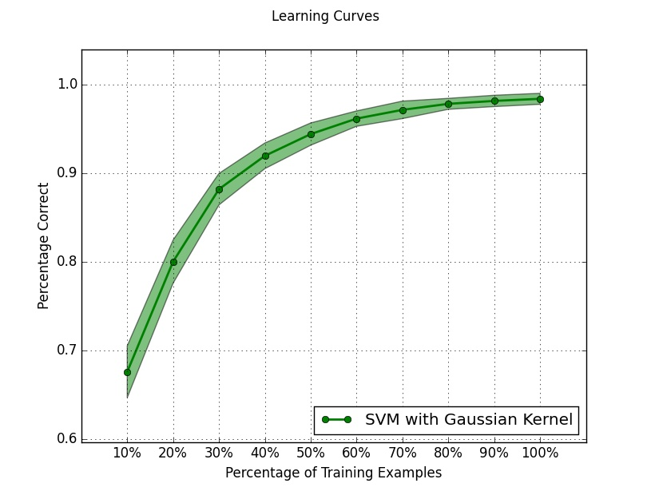
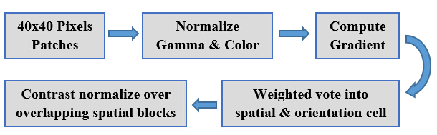
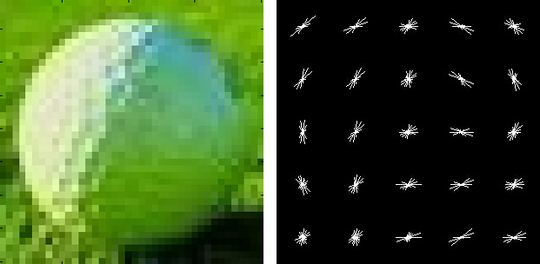
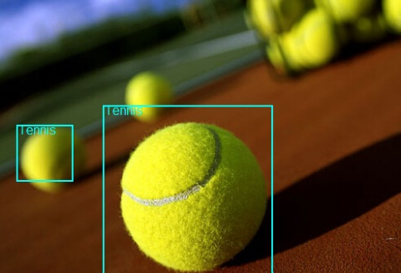
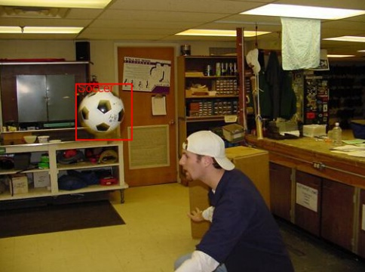
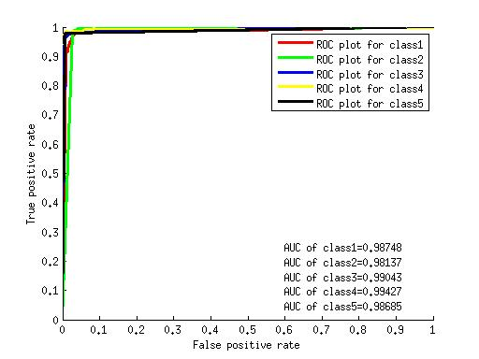
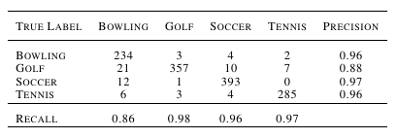
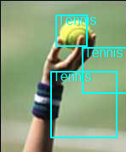
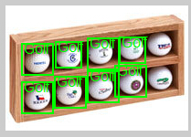
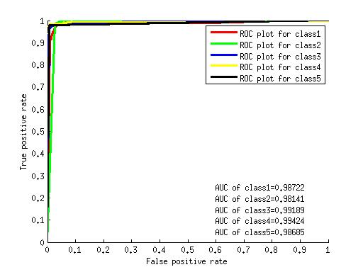
Learning Curve
HOG Feature Visualization
Ball Recognization
ROC Plots
Confusion Matrix
Successful Reorganization
Further Work
Larger Datasets
Cascade Training
False Positive and True Negative Results

